Slide 1

Chapter 11:
PWM and DC Motor Control
Raspberry Pi Pico
Interfacing and Programming
with MicroPython
www.MicroDigitalEd.com

Slide 2
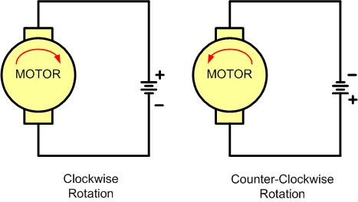
Figure 11-1: DC Motor Rotation (Permanent Magnet Field)

Slide 3
Table 11-1: Selected DC Motor Characteristics (http://www.Jameco.com)
Part No. | Nominal Volts | Volt Range | Current | RPM | Torque
154915CP | 3 V | 1.5–3 V | 0.070 A | 5,200 | 4.0 g-cm
154923CP | 3 V | 1.5–3 V | 0.240 A | 16,000 | 8.3 g-cm
177498CP | 4.5 V | 3–14 V | 0.150 A | 10,300 | 33.3 g-cm
181411CP | 5 V | 3–14 V | 0.470 A | 10,000 | 18.8 g-cm

Slide 4
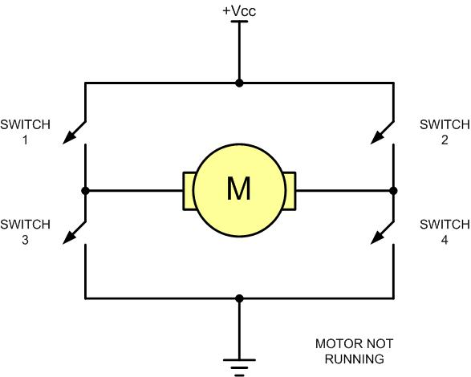
Figure 11-2: H-Bridge Motor Configuration

Slide 5
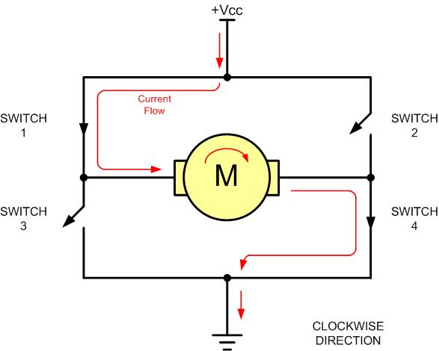
Figure 11-3: H-Bridge Motor Clockwise Configuration

Slide 6
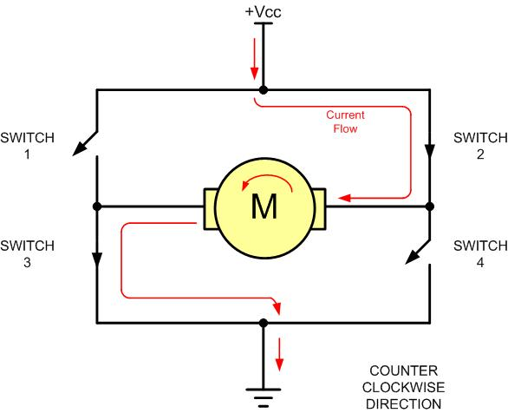
Figure 11-4: H-Bridge Motor Counterclockwise Configuration

Slide 7
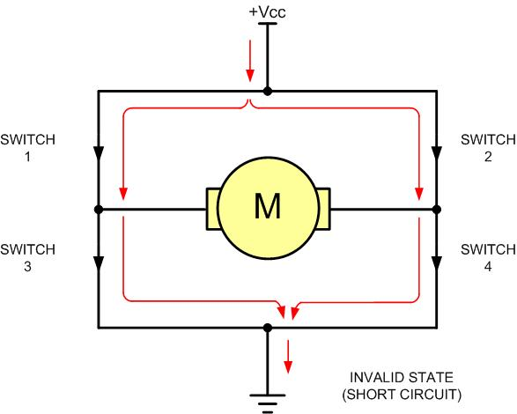
Figure 11-5: H-Bridge in an Invalid Configuration

Slide 8
Figure 11-5: H-Bridge in an Invalid Configuration
Motor Operation | SW1 | SW2 | SW3 | SW4
Off | Open | Open | Open | Open
Clockwise | Closed | Open | Open | Closed
Counterclockwise | Open | Closed | Closed | Open
Invalid | Closed | Closed | Closed | Closed

Slide 9
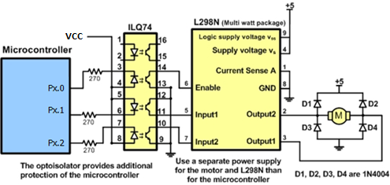
Figure 11-6: Bidirectional Motor Control Using an L298 Chip

Slide 10
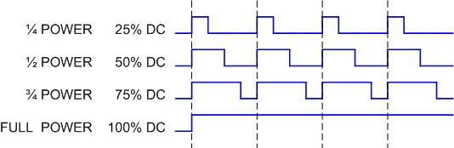
Figure 11-7: Pulse Width Modulation Comparison

Slide 11
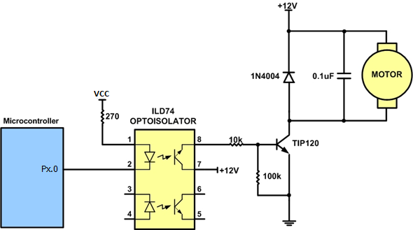
Figure 11-8: DC Motor Connection Using a Darlington Transistor

Slide 12
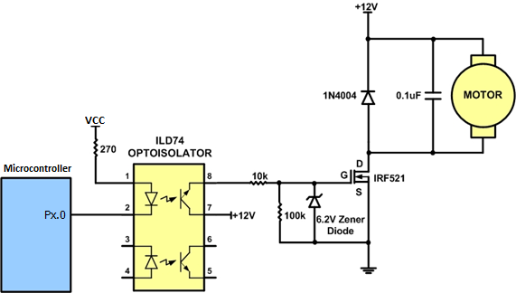
Figure 11-9: DC Motor Connection Using a MOSFET Transistor

Slide 13
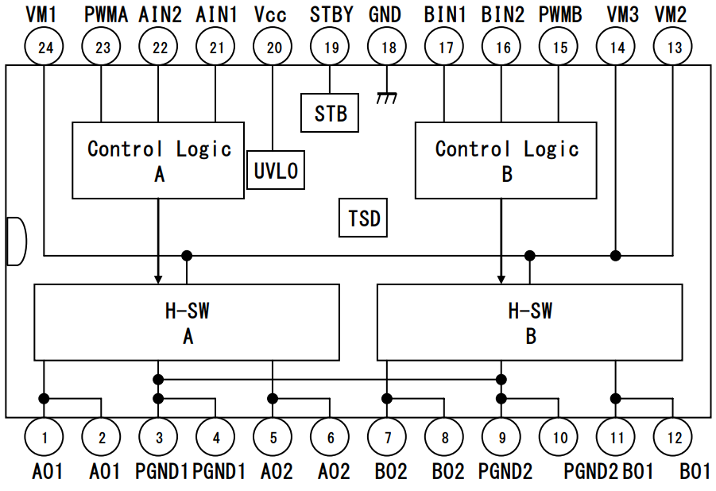
Figure 11-10: H-bridge Driver TB6612FNG Block Diagram

Slide 14
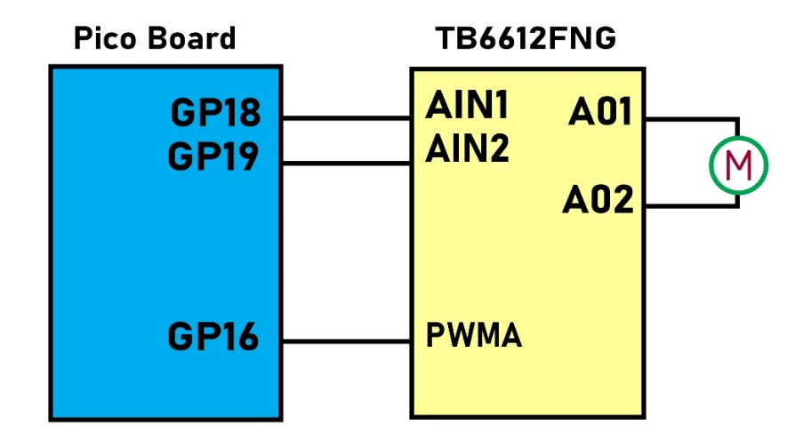
Figure 11-11: H-bridge Driver TB6612FNG Connection

Slide 15
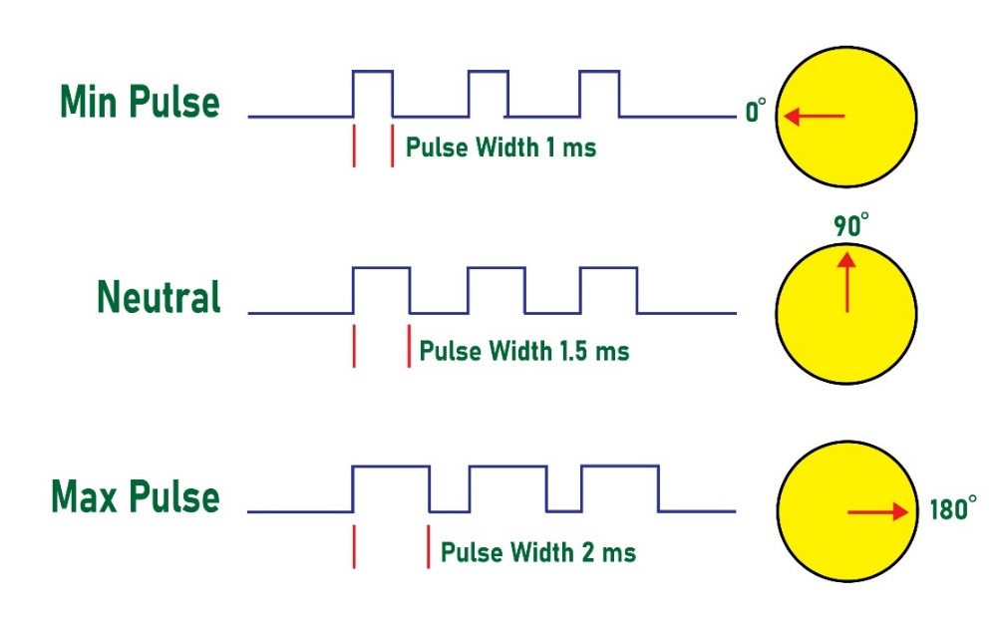
Figure 11-12: Servomotor Control

Slide 16
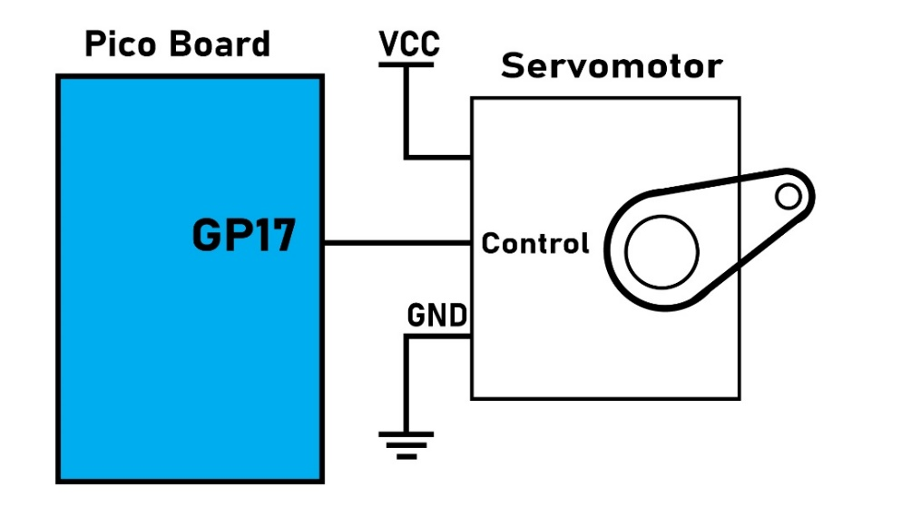
Figure 11-13: Pico Board to Servomotor Connection

