Slide 1
Chapter9
I2C Protocol and RTC Interfacing

Slide 2
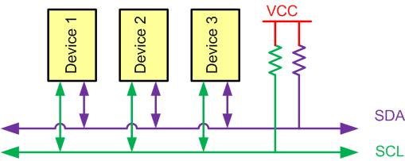
I2C Bus Characteristics

Slide 3
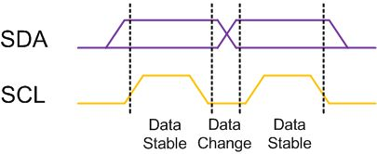
I2C Bit Format

Slide 4
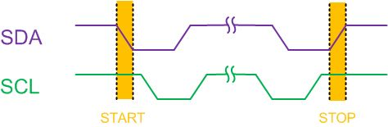
START and STOP Conditions

Slide 5
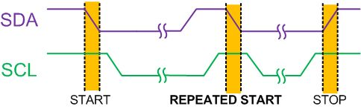
REPEATED START Condition

Slide 6
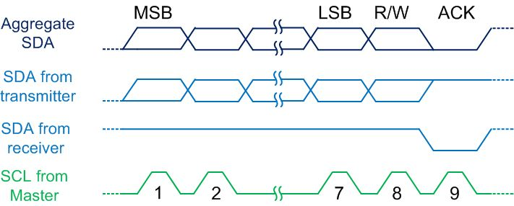
Byte Format in I2C

Slide 7
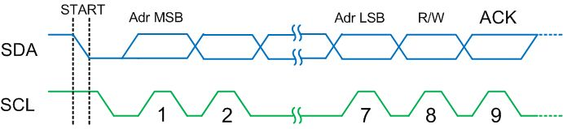
Address Byte Format in I2C

Slide 8
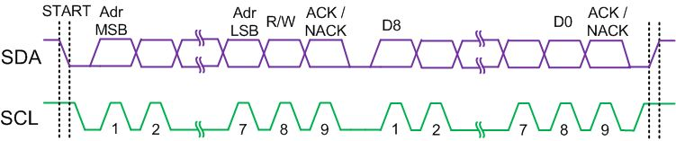
Typical Data Transmission

Slide 9
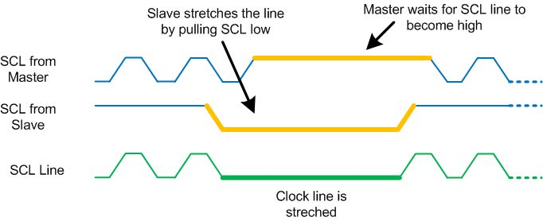
Clock Stretching

Slide 10
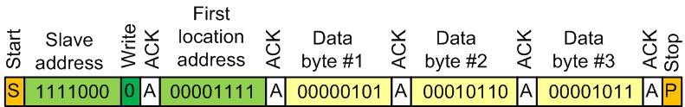
Multi-byte Burst Write

Slide 11
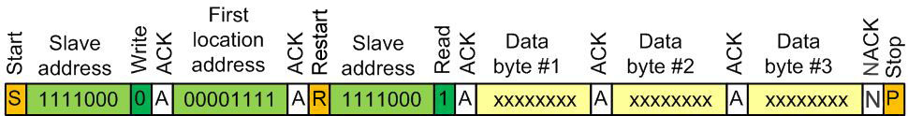
Multi-byte Burst Read

Slide 12
I2C Module Base Address for MSP432 (shared with SPI)
I2C Module(UCBx) | Base Address
UCB0(eUSCI0) | 0x4000_2000
UCB1(eUSCI1) | 0x4000_2400
UCB2(eUSCI2) | 0x4000_2800
UCB3(eUSCI3) | 0x4000_2C00

Slide 13
Some I2C Registers
Register Name | Register Function | Register Address
UCB0 Control Word 0 | Control 0 | 4000_1000
UCB0 Baud Rate Control Word | Baud Rate | 4000_1006
UCB0 Status | Status | 4000_1008
UCB0 RXBUF | Receive Buffer | 4000_100C
UCB0 TXBUF | Transmit Buffer | 4000_100E
UCB0 I2CSA | I2C Slave Address | 4000_1020
UCB0 IE | Interrupt Enable | 4000_102A
UCB0 IFG | Interrupt Flag | 4000_102C

Slide 14
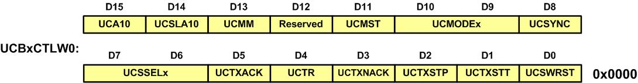
I2C Control Word 0 (UCBxCTLW0) Registers in MSP432

Slide 15
UCBxCTLW0 (UCBx Control Word 0) register bit description
Bits | Name | Function | Description
0 | UCSWRST | Software reset enable | 0b = Disabled. eUSCI_B released for operation. 1b = Enabled. eUSCI_B logic held in reset state.
1 | UCTXSTT | Transmit START condition | 0b = Do not generate START condition 1b = Generate START condition
2 | UCTXSTP | Transmit STOP condition | 0b = No STOP generated 1b = Generate STOP
3 | UCTXNACK | Transmit a NACK | 0b = Acknowledge normally 1b = Generate NACK
4 | UCTR | Transmitter/receiver | 0b = Receiver 1b = Transmitter
5 | UCTXACK | Transmit ACK condition | 0b = Do not acknowledge the slave address 1b = Acknowledge the slave address
7-6 | UCSSELx | eUSCI clock source select | 00b = Reserved 01b = ACLK 10b = SMCLK 11b = SMCLK

Slide 16
UCBxCTLW0 (UCBx Control Word 0) register bit description (Cont.)
Bits | Name | Function | Description
8 | UCSYNC | Synchronous mode enable | Always 1b 1b = Synchronous mode
10-9 | UCMODEx | eUSCI mode. | 00b = 3-pin SPI 01b = 4-pin SPI with UCxSTE active high: Slave enabled when UCxSTE = 1 10b = 4-pin SPI with UCxSTE active low: Slave enabled when UCxSTE = 0 11b = I2C mode
11 | UCMST | Master mode select | 0b = Slave mode 1b = Master mode
13 | UCMM | Multi-master environment select. | 0b = Single master environment. There is no other master in the system. The address compare unit is disabled. 1b = Multi-master environment
14 | UCSLA10 | Slave addressing mode select | 0b = Address slave with 7-bit address 1b = Address slave with 10-bit address
15 | UCA10 | Own addressing mode select. | 0b = Own address is a 7-bit address. 1b = Own address is a 10-bit address.

Slide 17
UCBxBRW Register to Set I2C Baud Rate

Slide 18
UCBxBRW Register
Bits | Description
15-0 | Bit clock prescaler. Modify only when UCSWRST = 1

Slide 19
UCBx I2C slave address registerData Register

Slide 20
UCBxTXBUF Transmit Buffer Register

Slide 21
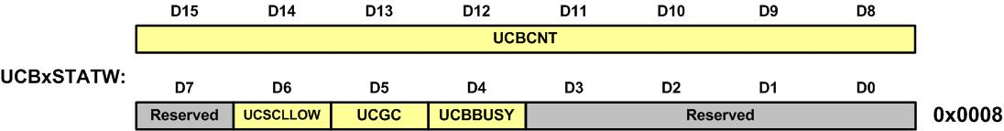
UCBxSTATW Status Word Register

Slide 22
UCBxSTATW Status Word Register bit description
Bit | Field | Description
15-8 | UCBCNTx | Returns the number of bytes received or transmitted on the I2C-Bus since the last START or RESTART.
7 | Reserved | Reserved
6 | UCSCLLOW | 0b = SCL is not held low 1b = SCL is held low
5 | UCGC | General call address received. UCGC is automatically cleared when a START condition is received. 0b = No general call address received 1b = General call address received
4 | UCBBUSY | 0b = Bus inactive 1b = Bus busy
3-0 | Reserved | Reserved

Slide 23
IO Pin Assignment for all 4 I2C UCBx Modules
I2C Module Pin | IO Pin | I2C Module Pin | IO Pin
SCL(UCB0) | P1.5 | SCL(UCB1) | P6.3
SDA(UCB0) | P1.6 | SDA(UCB1) | P6.4
SCL(UCB2) | P3.5 | SCL(UCB3) | P10.1
SDA(UCB2) | P3.6 | SDA(UCB3) | P10.2

Slide 24
Pins available for I2C
I/O pin | Function | PxSEL1=0 | PxSEL0=1
P1.5 | SCL(UCB0) | P1SEL1=00000000 | P1SEL0=00100000
P1.6 | SDA(UCB0) | P1SEL1=00000000 | P1SEL0=01000000
P6.3 | SCL(UCB1) | P6SEL1=00000000 | P6SEL0=00001000
P6.4 | SDA(UCB1) | P6SEL1=00000000 | P6SEL0=00010000
P3.5 | SCL(UCB2) | P3SEL1=00000000 | P3SEL0=00100000
P3.6 | SDA(UCB2) | P3SEL1=00000000 | P3SEL0=01000000
P10.1 | SCL(UCB3) | P10SEL1=00000000 | P10SEL0=00000010
P10.2 | SDA(UCB3) | P10SEL1=00000000 | P10SEL0=00000100

Slide 25
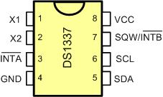
DS1337 Pins

Slide 26
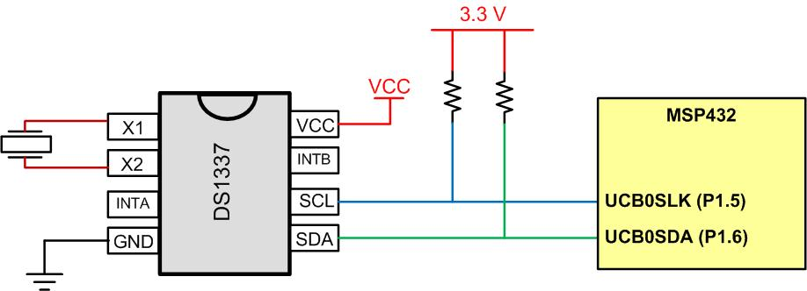
MSP432 Connections

Slide 27
DS1337 Address Map
Address | Bit7 | Bit6 | Bit5 | Bit4 | Bit3 | Bit2 | Bit1 | Bit0 | Function | Range
00H | 0 | 10 Seconds |  |  | Seconds |  |  |  | Seconds | 00-59
01H | 0 | 10 Minutes |  |  | Minutes |  |  |  | Minutes | 00-59
02H | 0 | 12/24 | 10 hour PM/AM | 10hour | Hours |  |  |  | Hours | 1-12 0-23
03H | 0 | 0 | 0 | 0 | 0 | Day |  |  | Day | 0-7
04H | 0 | 0 | 10 Date |  | Date |  |  |  | Date | 01-31
05H | Century | 0 | 0 | 10Mnt | Month |  |  |  | Month Century | 1-12+ Century
06H | 10 Year |  |  |  | Year |  |  |  | Year | 00-99
07H | A1M1 | 10 Seconds |  |  | Seconds |  |  |  | Alarm 1 Seconds | 00-59
08H | A1M2 | 10 Minutes |  |  | Minutes |  |  |  | Alarm 1 Minutes | 00-59

Slide 28
DS1337 Address Map (Cont.)
Address | Bit7 | Bit6 | Bit5 | Bit4 | Bit3 | Bit2 | Bit1 |  | Bit0 |  | Function | Range
09H | A1M3 | 12/24 | AM/PM | 10 Hour | Hour |  |  |  |  |  | Alarm 1 Hours | 1-12 00-23
 |  |  | 10 Hour
0AH | A1M4 | DY/DT | 10 Date |  | Day |  |  |  |  |  | Alarm 1 Day | 1-7
 |  |  |  |  | Date |  |  |  |  |  | Alarm 1 Date | 01-31
0BH | A2M2 | 10 Minutes |  |  | Minutes |  |  |  |  |  | Alarm 2 Minutes | 00-59
0CH | A2M3 | 12/24 | AM/PM | 10 Hour | Hour |  |  |  |  |  | Alarm 2 Hours | 1-12 00-23
 |  |  | 10 Hour
0DH | A2M4 | DY/DT | 10 Date |  | Day |  |  |  |  |  | Alarm 2 Day | 1-7
 |  |  |  |  | Date |  |  |  |  |  | Alarm 2 Date | 01-31
0EH | EOSC | 0 | 0 | RS2 | RS1 | INTCN |  | A2IE |  | A1IE | Control | -
0FH | OSF | 0 | 0 | 0 | 0 | 0 |  | A2F |  | A1F | Status | -

Slide 29
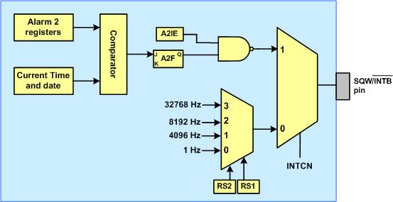
Simplified Structure of SQW/INTB Pin

Slide 30
RS bits
RS2 | RS1 | Output Frequency
0 | 0 | 1 Hz
0 | 1 | 4.096 kHz
1 | 0 | 8.192 kHz
1 | 1 | 32.768 kHz

Slide 31
Alarm 2 Register Mask Bits
DY/DT | A2M4 | A2M3 | A2M2 | Alarm Rate
X | 1 | 1 | 1 | Alarm once per minute
X | 1 | 1 | 0 | Alarm when minutes match
X | 1 | 0 | 0 | Alarm when hours and minutes match
0 | 0 | 0 | 0 | Alarm when date, hours, and minutes match
1 | 0 | 0 | 0 | Alarm when day, hours, and minutes match

