Slide 1
Chapter 8
SPI Protocol and DAC Interfacing

Slide 2
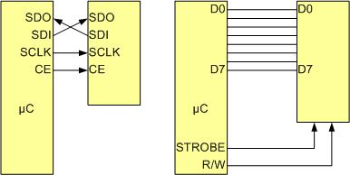
SPI Bus vs. Traditional Parallel Bus Connection to Microcontroller

Slide 3
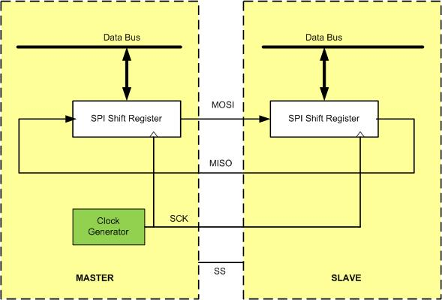
SPI Architecture

Slide 4
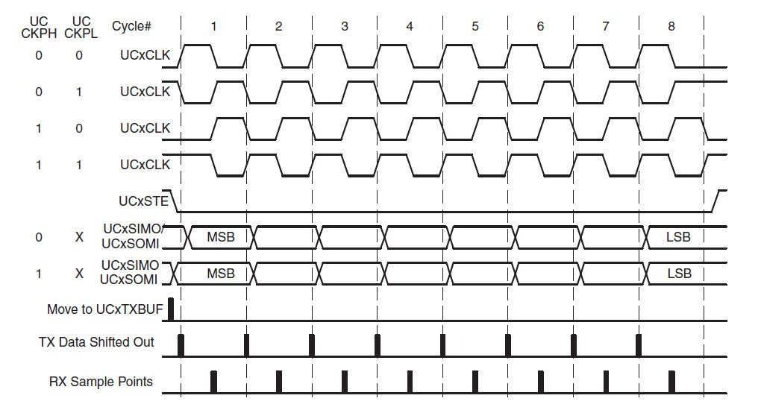
SPI Clock Polarity and phase

Slide 5
SPI Clock Polarity and phase
Clock Polarity | Clock Phase | Data read and change time | SPI Mode
0 | 0 | read on falling edge, changed on a rising edge | 0
0 | 1 | read on rising edge, changed on a falling edge | 1
1 | 0 | read on rising edge, changed on a falling edge | 2
1 | 1 | read on falling edge, changed on a rising edge | 3

Slide 6
eUSCI_A Module Base Address (Shared with UART)
USCI_Ax Module | Base Address
eUSCI_A0 | 0x4000_1000
eUSCI_A1 | 0x4000_1400
eUSCI_A2 | 0x4000_1800
eUSCI_A3 | 0x4000_1C00

Slide 7
eUSCI_B Module Base Address (Shared with I2C)
USCI_Bx Module | Base Address
eUSCI_B0 | 0x4000_2000
eUSCI_B1 | 0x4000_2400
eUSCI_B2 | 0x4000_2800
eUSCI_B3 | 0x4000_2C00

Slide 8
eUSCI Registers
Register Name | Register Function
UCAxCTLW0 (UCAx Control Word 0) | Control 0
UCAxBRW (UCAx Baud Rate Control Word) | Baud Rate
UCAxSTATW (UCAx Status) | Status
UCAxRXBUF (UCAx Receive Buffer) | Receive Register
UCAxTXBUF (UCAx Transmit Buffer) | Transmit Register
UCAxIE (UCAx Interrupt Enable) | Interrupt Enable
UCAxIFG (UCAx Interrupt Flag) | Interrupt Flags
UCAxIV (UCAx Interrupt Vector) | Interrupt Vector

Slide 9
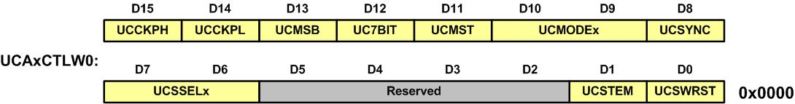
SPI Control Word 0 (UCAxCTLW0) Registers in MSP432

Slide 10
UCAxCTLW0 (UCAx Control Word 0) register
Bits | Name | Function | Description
0 | UCSWRST | Software reset enable | 0b = Disabled. eUSCI reset released for operation. 1b = Enabled. eUSCI logic held in reset state
1 | UCSTEM | STE mode select in master mode. | 0b = STE pin is used to prevent conflicts with other masters 1b = STE pin is used to generate the enable signal for a 4-wire slave
7-6 | UCSSELx | eUSCI clock source select | 00b = Reserved 01b = ACLK 10b = SMCLK 11b = SMCLK
8 | UCSYNC | Synchronous mode enable | 0b = Asynchronous mode (UART) 1b = Synchronous mode (SPI or I2C)
10-9 | UCMODEx | eUSCI mode. | 00b = 3-pin SPI 01b = 4-pin SPI with UCxSTE active high: Slave enabled when UCxSTE = 1 10b = 4-pin SPI with UCxSTE active low: Slave enabled when UCxSTE = 0 11b = I2C mode

Slide 11
UCAxCTLW0 (UCAx Control Word 0) register (Cont.)
Bits | Name | Function | Description
11 | UCMST | Master mode select | 0b = Slave mode 1b = Master mode
12 | UC7BIT | Character length | 0b = 8-bit data 1b = 7-bit data
13 | UCMSB | MSB first select. | 0b = LSB first 1b = MSB first
14 | UCCKPL | Clock polarity select | 0b = The inactive state is low. 1b = The inactive state is high.
15 | UCCKPH | Clock phase select | 0b = Data is changed on the first UCLK edge and captured on the following edge. 1b = Data is captured on the first UCLK edge and changed on the following edge.

Slide 12
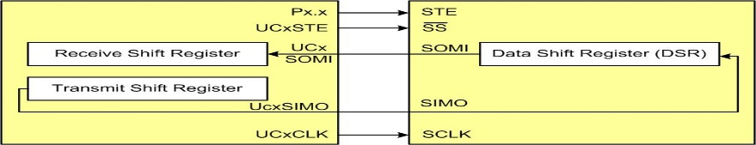
Using MSP432 SPI module as Master

Slide 13
UCAxBRW Register SPI Baud Rate

Slide 14
UCAxTXDBUF register

Slide 15
UCAxRXDBUF register

Slide 16
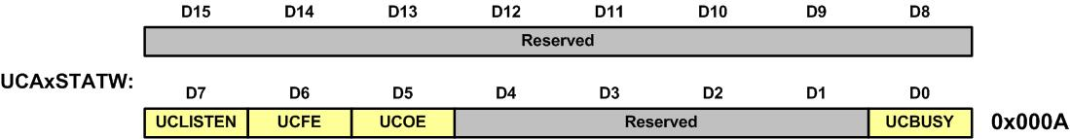
UCAx Status (UCAxSTATW) Register

Slide 17
UCAx Status (UCAxSTATW) Register
Bits | Name | Function | Description
0 | UCBUSY | SPI Busy Bit | The bit is 1 when the SPI is currently busy transmitting or receiving
5 | UCOE | Overrun error flag. | 0b = No error 1b = Overrun error occurred
6 | UCFE | Framing error flag. | 0b = No error 1b = Bus conflict occurred
7 | UCLISTEN | Listen enable. | 0b = Disabled 1b = Enabled. The transmitter output is internally fed back to the receiver.

Slide 18
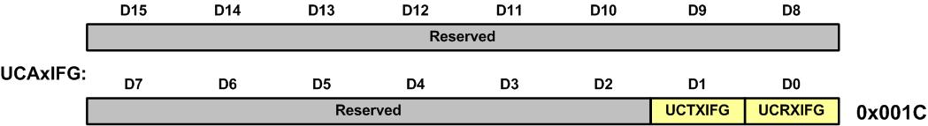
UCAx Interrupt Flag (UCAxIFG) Register

Slide 19
UCAx Interrupt Flag (UCAxIFG) Register
Bits | Name | Function | Description
0 | UCRXIFG | RX Receive Interrupt flag | The bit is 1 when the receive BUF is empty
1 | UCTXIFG | TX Transmit Interrupt flag | The bit is 1 when the transmit BUF is empty

Slide 20
IO Pin Assignment for all 4 UCAx Modules
SPI Module Pin | IO Pin | SPI Module Pin | IO Pin
STE(UCA0) | P1.0 | STE(UCA1) | P2.0
CLK(UCA0) | P1.1 | CLK(UCA1) | P2.1
SOMI(UCA0) | P1.2 | SOMI(UCA1) | P2.2
SIMO(UCA0) | P1.3 | SIMO(UCA1) | P2.3
STE(UCA2) | P3.0 | STE(UCA3) | P9.4
CLK(UCA2) | P3.1 | CLK(UCA3) | P9.5
SOMI(UCA2) | P3.2 | SOMI(UCA3) | P9.6
SIMO(UCA2) | P3.3 | SIMO(UCA3) | P9.7

Slide 21
IO Pin Assignment for all 4 UCBx Modules
SPI Module Pin | IO Pin | SPI Module Pin | IO Pin
STE(UCB0) | P1.4 | STE(UCB1) | P6.2
CLK(UCB0) | P1.5 | CLK(UCB1) | P6.3
SIMO(UCB0) | P1.6 | SIMO(UCB1) | P6.4
SOMI(UCB0) | P1.7 | SOMI(UCB1) | P6.5
STE(UCB2) | P3.4 | STE(UCB3) | P10.0
CLK(UCB2) | P3.5 | CLK(UCB3) | P10.1
SIMO(UCB2) | P3.6 | SIMO(UCB3) | P10.2
SOMI(UCB2) | P3.7 | SOMI(UCB3) | P10.3

Slide 22
Pins available for UCAs
I/O pin | Function | PxSEL1=0 | PxSEL0=1
P1.0 | STE(UCA0) | P1SEL1=00000000 | P1SEL0=00000001
P1.1 | CLK(UCA0) | P1SEL1=00000000 | P1SEL0=00000010
P1.2 | SOMI(UCA0) | P1SEL1=00000000 | P1SEL0=00000100
P1.3 | SIMO(UCA0) | P1SEL1=00000000 | P1SEL0=00001000
For SPI0: |  | P1SEL1=0x00 | P1SEL0=00001111=0x0F
P2.0 | STE(UCA1) | P2SEL1=00000000 | P2SEL0=00000001
P2.1 | CLK(UCA1) | P2SEL1=00000000 | P2SEL0=00000010
P2.2 | SOMI(UCA1) | P2SEL1=00000000 | P2SEL0=00000100
P2.3 | SIMO(UCA1) | P2SEL1=00000000 | P2SEL0=00001000
For SPI1: |  | P2SEL1=0x00 | P2SEL0=00001111=0x0F
P3.0 | STE(UCA2) | P3SEL1=00000000 | P3SEL0=00000001
P3.1 | CLK(UCA2) | P3SEL1=00000000 | P3SEL0=00000010
P3.2 | SOMI(UCA2) | P3SEL1=00000000 | P3SEL0=00000100
P3.3 | SIMO(UCA2) | P3SEL1=00000000 | P3SEL0=00001000
For SPI2: |  | P3SEL1=0x00 | P3SEL0=00001111=0x0F
P9.4 | STE(UCA3) | P9SEL1=00000000 | P9SEL0=00010000
P9.5 | CLK(UCA3) | P9SEL1=00000000 | P9SEL0=00100000
P9.6 | SOMI(UCA3) | P9SEL1=00000000 | P9SEL0=01000000
P9.7 | SIMO(UCA3) | P9SEL1=00000000 | P9SEL0=10000000
For SPI3: |  | P9SEL1=0x00 | P9SEL0=11110000=0xF0

Slide 23
Pins available for UCBs
I/O pin | Function | PxSEL1=0 | PxSEL0=1
P1.4 | STE(UCB0) | P1SEL1=00000000 | P1SEL0=00010000
P1.5 | CLK(UCB0) | P1SEL1=00000000 | P1SEL0=00100000
P1.6 | SIMO(UCB0) | P1SEL1=00000000 | P1SEL0=01000000
P1.7 | SOMI(UCB0) | P1SEL1=00000000 | P1SEL0=10000000
For SPI0: |  | P1SEL1=0x00 | P1SEL0=11110000=0XF0
P6.2 | STE(UCB1) | P2SEL1=00000000 | P2SEL0=00000100
P6.3 | CLK(UCB1) | P6SEL1=00000000 | P6SEL0=00001000
P6.4 | SIMO(UCB1) | P6SEL1=00000000 | P6SEL0=00010000
P6.5 | SOMI(UCB1) | P6SEL1=00000000 | P6SEL0=00100000
For SPI1: |  | P6SEL1=0x00 | P6SEL0=00111100=0x3C
P3.4 | STE(UCB2) | P3SEL1=00000000 | P3SEL0=00010000
P3.5 | CLK(UCB2) | P3SEL1=00000000 | P3SEL0=00100000
P3.6 | SIMO(UCB2) | P3SEL1=00000000 | P3SEL0=01000000
P3.7 | SOMI(UCB2) | P3SEL1=00000000 | P3SEL0=10000000
For SPI2: |  | P3SEL1=0x00 | P3SEL0=11110000=0xF0
P10.0 | STE(UCB3) | P10SEL1=00000000 | P10SEL0=00000001
P10.1 | CLK(UCB3) | P10SEL1=00000000 | P10SEL0=00000010
P10.2 | SIMO(UCB3) | P10SEL1=00000000 | P10SEL0=00000100
P10.3 | SOMI(UCB3) | P10SEL1=00000000 | P10SEL0=00001000
For SPI3: |  | P10SEL1=0x00 | P10SEL0=00001111=0x0F

Slide 24
eUSCI_B Module Base Address (Shared with I2C)
USCI_Bx Module | Base Address
eUSCI_B0 | 0x4000_2000
eUSCI_B1 | 0x4000_2400
eUSCI_B2 | 0x4000_2800
eUSCI_B3 | 0x4000_2C00

Slide 25
IO Pin Assignment for all 4 UCBx Modules
SPI Module Pin | IO Pin | SPI Module Pin | IO Pin
STE(UCB0) | P1.4 | STE(UCB1) | P6.2
CLK(UCB0) | P1.5 | CLK(UCB1) | P6.3
SIMO(UCB0) | P1.6 | SIMO(UCB1) | P6.4
SOMI(UCB0) | P1.7 | SOMI(UCB1) | P6.5
STE(UCB2) | P3.4 | STE(UCB3) | P10.0
CLK(UCB2) | P3.5 | CLK(UCB3) | P10.1
SIMO(UCB2) | P3.6 | SIMO(UCB3) | P10.2
SOMI(UCB2) | P3.7 | SOMI(UCB3) | P10.3

Slide 26
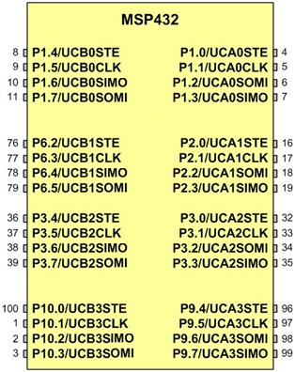
SPI pins for UCAx and UCBx

Slide 27
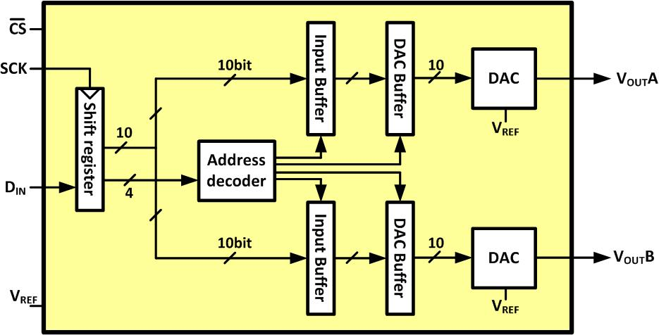
LTC1661 Internal Block Diagram

Slide 28
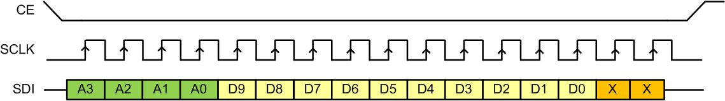
Sending a Packet of Data to LTC166x

Slide 29
LTC1661 DAC Control Functions
A3 A2 A1 A0 | Interrupt Register | DAC Register | Power Down Status | Comments
0 0 0 0 | No Change | No Update | No Change | No operation. power-down status unchanged
0 0 0 1 | Load DAC A | No Update | No Change | Load input register A with data. DAC outputs unchanged. power-down Status unchanged
0 0 1 0 | Load DAC B | No Update | No Change | Load input register B with data. DAC outputs unchanged. power-down status unchanged
0 0 1 1 | - | - | - | Reserved
0 1 0 0 | - | - | - | Reserved
0 1 0 1 | - | - | - | Reserved

Slide 30
LTC1661 DAC Control Functions (Cont.)
A3 A2 A1 A0 | Interrupt Register | DAC Register | Power Down Status | Comments
0 1 1 0 | - | - | - | Reserved
0 1 1 1 | - | - | - | Reserved
1 0 0 0 | No Change | Update Outputs | Wake | Load both DAC Regs with existing contents of input Regs. Outputs update. Part wakes up
1 0 0 1 | Load DAC A | Update Outputs | Wake | Load input Reg A. Load DAC Regs with new contents of input Reg A and existing contents of Reg B. Outputs update.
1 0 1 0 | Load DAC B | Update Outputs | Wake | Load input Reg B. Load DAC Regs with existing contentsof input Reg A and new contents of Reg B. Outputs update

Slide 31
LTC1661 DAC Control Functions (Cont.)
A3 A2 A1 A0 | Interrupt Register | DAC Register | Power Down Status | Comments
1 0 1 1 | - | - | - | Reserved
1 1 0 0 | - | - | - | Reserved
1 1 0 1 | No Change | No Update | Wake | Part wakes up. Input and DAC Regs unchanged. DAC outputs reflect existing contents of DAC Regs
1 1 1 0 | No Change | No Update | Sleep | Part goes to sleep. Input and DAC Regs unchanged. DAC outputs set to high impedance state
1 1 1 1 | Load ADCs A, B with same 10-bit code | Update Outputs | Wake | Load both input Regs. Load both DAC Regs with new contents of input Regs. Outputs update. Part wakes up

Slide 32
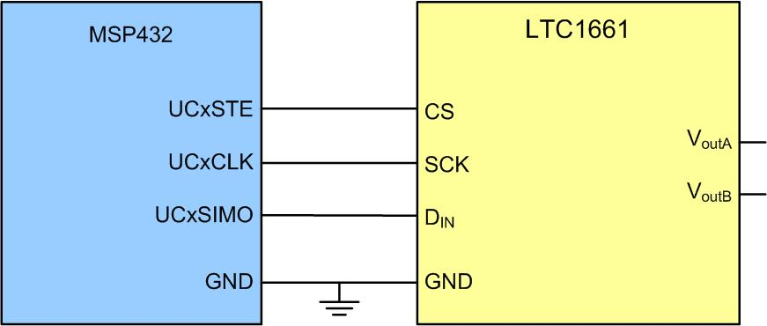
Connecting LTC1661 to the Microcontroller

Slide 33
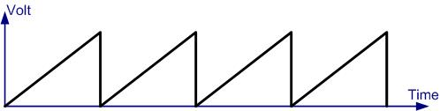
The Generated sawTooth waveform

