Slide 1
Chapter 7
ADC, DAC, and Sensor Interfacing

Slide 2
Microcontroller Connection to Sensor via ADC

Slide 3
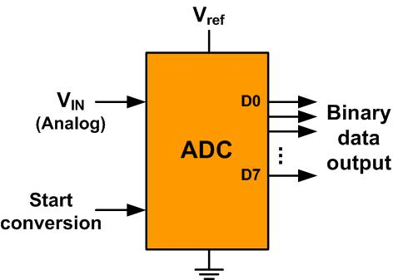
An 8-bit ADC Block Diagram

Slide 4
Resolution versus Step Size for ADC (Vref = 5V)
n-bit | Number of steps | Step size
8 | 256 | 5V /256 = 19.53 mV
10 | 1024 | 5V /1024 = 4.88 mV
12 | 4096 | 5V /4096 = 1.2 mV
16 | 65,536 | 5V /65,536 = 0.076 mV
Note: V_{ref} = 5V

Slide 5
Vref Relation to Vin Range for an 8-bit ADC
V_{ref} (V) | V_{in} in Range (V) | Step Size (mV)
5.00 | 0 to 5 | 5 / 256 = 19.53
4.00 | 0 to 4 | 4 / 256 = 15.62
3.00 | 0 to 3 | 3 / 256 = 11.71
2.56 | 0 to 2.56 | 2.56 / 256 = 10
2.00 | 0 to 2 | 2 / 256 = 7.81
1.28 | 0 to 1.28 | 1.28 / 256 = 5
1.00 | 0 to 1 | 1 / 256 = 3.90
Note: In an 8-bit ADC, step size is V_{ref}/256

Slide 6
Vref Relation to Vin Range for an 10-bit ADC
Vref (V) | V_{in}Range (V) | Step Size (mV)
5.00 | 0 to 5 | 5 / 1024 = 4.88
4.96 | 0 to 4.096 | 4.096 / 1024 = 4
3.00 | 0 to 3 | 3 / 1024 = 2.93
2.56 | 0 to 2.56 | 2.56 / 1024 = 2.5
2.00 | 0 to 2 | 2 / 1024 = 2
1.28 | 0 to 1.28 | 1.28 / 1024 = 1.25
1.024 | 0 to 1.024 | 1.024 / 1024 = 1
Note: In a 10-bit ADC, step size is V_{ref}/1024

Slide 7
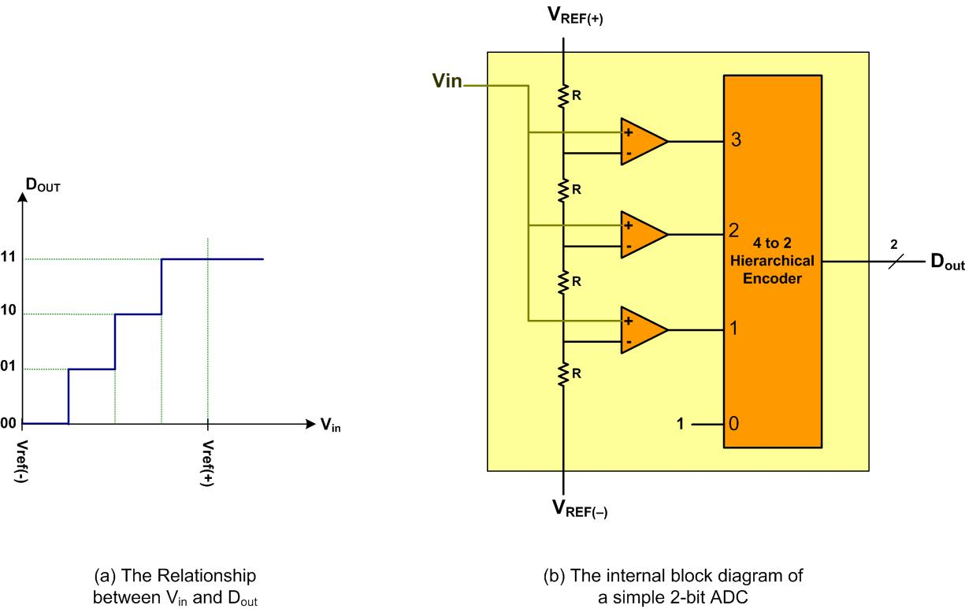
A Simultaneous 2-bit ADC

Slide 8
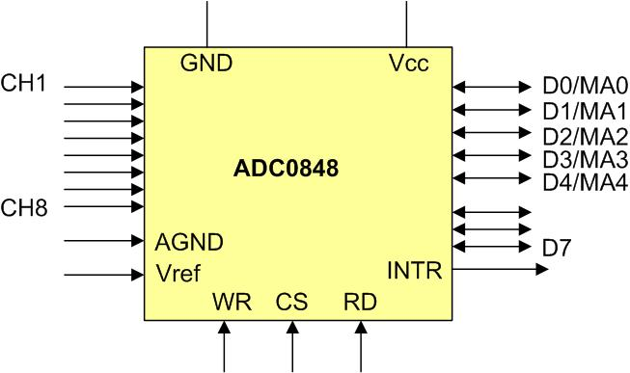
ADC0848 Parallel ADC Block Diagram

Slide 9
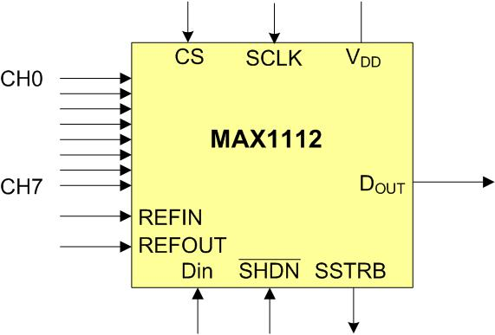
MAX1112 Serial ADC Block Diagram

Slide 10
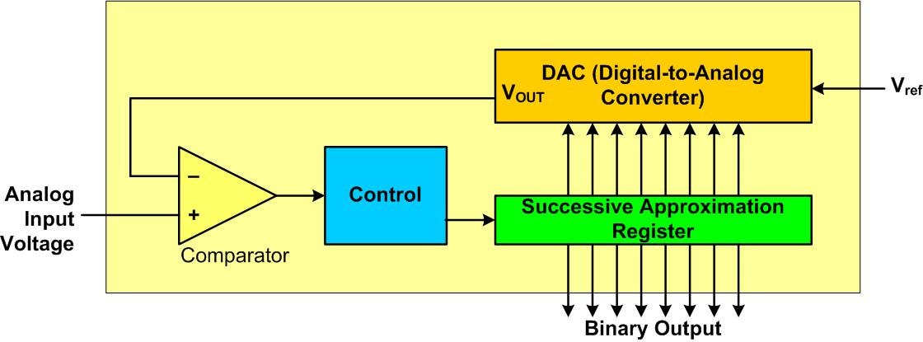
Successive Approximation ADC

Slide 11
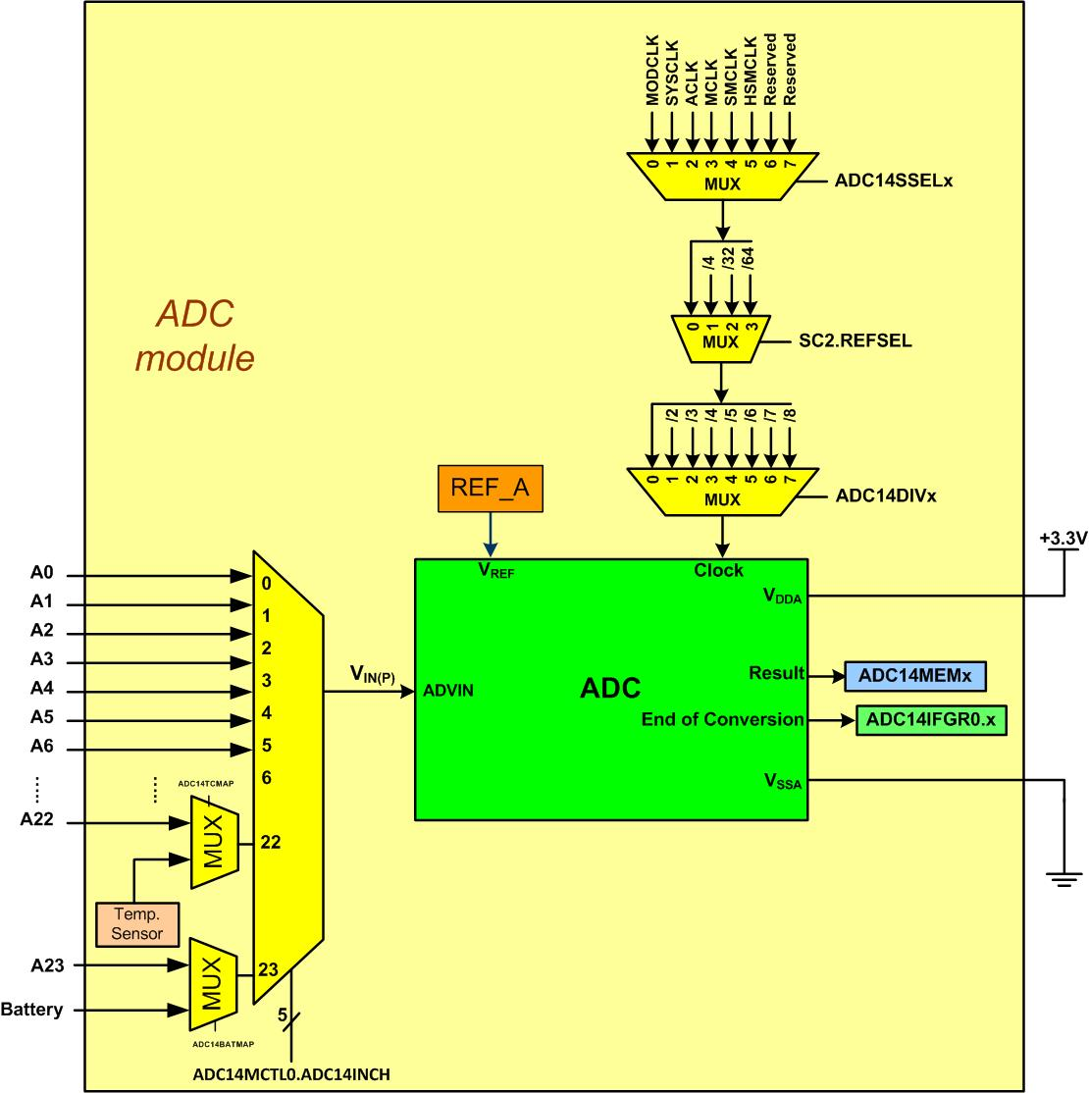
Simplified Block Diagram of MSP432P401R chip

Slide 12
Some of the MSP432P401R ADC Registers (See reference manual table 20-3)
Absolute Address | Register
4001 2000 | ADC Control Registers 0 (ADC14CTL0)
4001 2004 | ADC Control Registers 1 (ADC14CTL1)
4001 2018 | ADC Memory Control Register0 (ADC14MCTL0, there are 32 of them)
4001 2098 | ADC Memory Register0 (ADC14M0, there are 32 of them)
4001 213C | ADC IER0 Register (ADC14 Interrupt Enable 0)
4001 2144 | ADC IFGR0 (ADC14 Interrupt Flag 0)

Slide 13
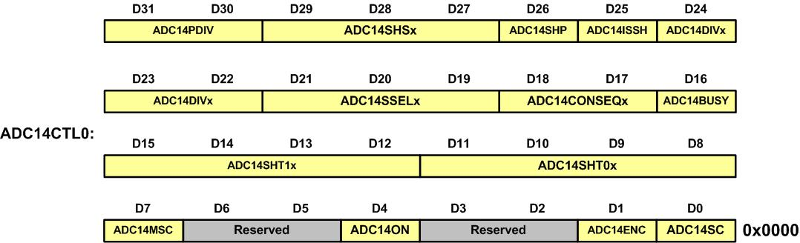
ADC14CTL0 (ADC14 Control 0) register

Slide 14
ADC14CTL0 (ADC14 Control 0) Register of MSP432P401R
Bit | Field | Descriptions
31-30 | ADC14PDIV | ADC14 predivider. These bits pre-divides the selected ADC14 clock source. Can be modified only when ADC14ENC = 0. 00b = Predivide by 1 01b = Predivide by 4 10b = Predivide by 32 11b = Predivide by 64
29-27 | ADC14SHSx | ADC14 sample-and-hold source select. Can be modified only when ADC14ENC = 0. 000b = ADC14SC bit 001b = TA0_C1 010b = TA0_C2 011b = TA1_C1 100b = TA1_C2 101b = TA2_C1 110b = TA2_C2 111b = TA3_C1

Slide 15
ADC14CTL0 (ADC14 Control 0) Register of MSP432P401R (Cont.)
Bit | Field | Descriptions
26 | ADC14SHP | ADC14 sample-and-hold pulse-mode select. This bit selects the source of the sampling signal (SAMPCON) to be either the output of the sampling timer or the sample-input signal directly. Can be modified only when ADC14ENC = 0. 0b = SAMPCON signal is sourced from the sample-input signal. 1b = SAMPCON signal is sourced from the sampling timer
25 | ADC14ISSH | ADC14 invert signal sample-and-hold. Can be modified only when ADC14ENC = 0. 0b = The sample-input signal is not inverted. 1b = The sample-input signal is inverted. Setting ADC14ISSH=1 and triggering a conversion using ADC14SC is not recommended. ADC14SC bit gets reset to 0 automatically at the end of conversion and if ADC14ISSH=1, the 1->0 transition on ADC14SC will trigger another conversion.

Slide 16
ADC14CTL0 (ADC14 Control 0) Register of MSP432P401R (Cont.)
Bit | Field | Descriptions
24-22 | ADC14DIVx | ADC14 clock divider. Can be modified only when ADC14ENC = 0. 000b = /1 001b = /2 010b = /3 011b = /4 100b = /5 101b = /6 110b = /7 111b = /8

Slide 17
ADC14CTL0 (ADC14 Control 0) Register of MSP432P401R (Cont.)
Bit | Field | Descriptions
21-19 | ADC14SSELx | ADC14 clock source select. Can be modified only when ADC14ENC = 0. 000b = MODCLK 001b = SYSCLK 010b = ACLK 011b = MCLK 100b = SMCLK 101b = HSMCLK 110b = Reserved 111b = Reserved
18-17 | ADC14CONSEQx | ADC14 conversion sequence mode select Can be modified only when ADC14ENC=0. 00b = Single-channel, single-conversion 01b = Sequence-of-channels 10b = Repeat-single-channel 11b = Repeat-sequence-of-channels

Slide 18
ADC14CTL0 (ADC14 Control 0) Register of MSP432P401R (Cont.)
Bit | Field | Descriptions
16 | ADC14BUSY | ADC14 busy. This bit indicates an active sample or conversion operation. 0b = No operation is active. 1b = A sequence, sample, or conversion is active
15-12 | ADC14SHT1x | ADC14 sample-and-hold time. These bits define the number of ADC14CLK cycles in the sampling period for registers ADC14MEM8 to ADC14MEM23. Can be modified only when ADC14ENC = 0. 0000b = 4 0001b = 8 0010b = 16 0011b = 32 0100b = 64 0101b = 96 0110b = 128 0111b = 192 1000b to 1111b = Reserved

Slide 19
ADC14CTL0 (ADC14 Control 0) Register of MSP432P401R (Cont.)
Bit | Field | Descriptions
11-8 | ADC14SHT0x | ADC14 sample-and-hold time. These bits define the number of ADC14CLK cycles in the sampling period for registers ADC14MEM0 to ADC14MEM7 and ADC14MEM24 to ADC14MEM31. Can be modified only when ADC14ENC = 0. 0000b = 4 0001b = 8 0010b = 16 0011b = 32 0100b = 64 0101b = 96 0110b = 128 0111b = 192 1000b to 1111b = Reserved

Slide 20
ADC14CTL0 (ADC14 Control 0) Register of MSP432P401R (Cont.)
Bit | Field | Descriptions
7 | ADC14MSC | ADC14 multiple sample and conversion. Valid only for sequence or repeated modes. 0b = The sampling timer requires a rising edge of the SHI signal to trigger each sample-and-convert. 1b = The first rising edge of the SHI signal triggers the sampling timer, but further sample-and-conversions are performed automatically as soon as the prior conversion is completed
6-5 | Reserved | Reserved. Always reads as 0.
4 | ADC14ON | ADC14 on 0b = ADC14 off 1b = ADC14 on. ADC core is ready to power up when a valid conversion is triggered.

Slide 21
ADC14CTL0 (ADC14 Control 0) Register of MSP432P401R (Cont.)
Bit | Field | Descriptions
3-2 | Reserved | Reserved. Always reads as 0.
1 | ADC14ENC | ADC14 enable conversion 0b = ADC14 disabled 1b = ADC14 enabled ADC14ENC low pulse width must be at-least 3 ADC14CLK cycles.
0 | ADC14SC | ADC14 start conversion. Software-controlled sample-and-conversion start. ADC14SC and ADC14ENC may be set together with one instruction. ADC14SC is reset automatically. 0b = No sample-and-conversion-start 1b = Start sample-and-conversion

Slide 22
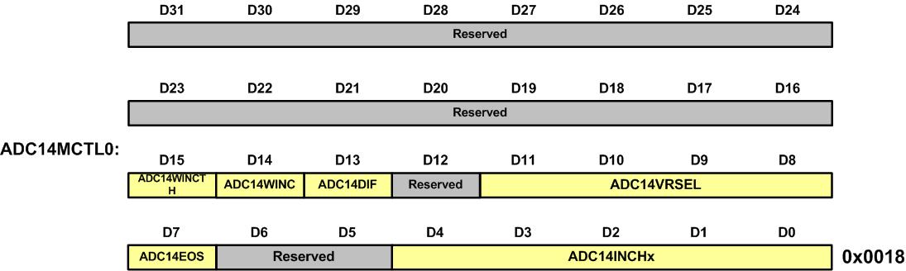
ADC14MCTL0 Register

Slide 23
ADC14MCTL0 Register
Bit | Field | Description
13 | ADC14DIF | Differential mode (0= single-ended, 1=Differential)
11-18 | ADCVRSEL | ADC14 Vref selection. 0000 = Vref+= AVCC (analog VCC) and Vref-=AVSS 1110 = Vref+= External Source connected to pin P5.6 Vref- =External Source connected to pin P5.7
4-0 | ADC14INCH | ADC14 input channel: The field selects the input channel. When DIFF = 0 (single-ended mode), values 0 to 23 choose between the 24 ADC input channels. When DIFF = 1 (Differential mode), values 0 to 15 select between the 12 differential channels. See the reference manual for more information. 00000 = A0 00001 = A1 … 10111 = A23

Slide 24
Analog input pin assignment in MSP432P401R chip for LaunchPad
Pin Function | ADC Channel Input | Pin Name | PxSEL1 : PxSEL0
A0 | ADC input 0 | P5.5 | P5SEL0=00100000=0x20 & P5SEL1=00100000=0x20
A1 | ADC input 1 | P5.4 | P5SEL0=00010000=0x10 & P5SEL1=00010000=0x10
A2 | ADC input 2 | P5.3 | P5SEL0=00001000=0x08 & P5SEL1=00001000=0x08
A3 | ADC input 3 | P5.2 | P5SEL0=00000100=0x04 & P5SEL1=00000100=0x04
A4 | ADC input 4 | P5.1 | P5SEL0=00000010=0x02 & P5SEL1=00000010=0x02
A5 | ADC input 5 | P5.0 | P5SEL0=00000001=0x01 & P5SEL1=00000001=0x01
A6 | ADC input6 | P4.7 | P4SEL0=10000000=0x80 & P4SEL1=10000000=0x80
A7 | ADC input 7 | P4.6 | P4SEL0=01000000=0x40 & P4SEL1=01000000=0x40
A8 | ADC input 8 | P4.5 | P4SEL0=00100000=0x20 & P4SEL1=00100000=0x20
A9 | ADC input 9 | P4.4 | P4SEL0=00010000=0x10 & P4SEL1=00010000=0x10
A10 | ADC input 10 | P4.3 | P4SEL0=00001000=0x08 & P4SEL1=00001000=0x08
A11 | ADC input 11 | P4.2 | P4SEL0=00000100=0x04 & P4SEL1=00000100=0x04
A12 | ADC input 12 | P4.1 | P4SEL0=00000010=0x02 & P4SEL1=00000010=0x02

Slide 25
Analog input pin assignment in MSP432P401R chip for LaunchPad (Cont.)
Pin Function | ADC Channel Input | Pin Name | PxSEL1 : PxSEL0
A13 | ADC input 13 | P4.0 | P4SEL0=00000001=0x01 & P4SEL1=00000001=0x01
A14 | ADC Input 14 | P6.1 | P6SEL0=00000010=0x02 & P6SEL1=00000010=0x02
A15 | ADC Input 15 | P6.0 | P6SEL0=00000001=0x01 & P6SEL1=00000001=0x01
A16 | ADC Input 16 | P9.1 | P9SEL0=00000010=0x02 & P9SEL1=00000010=0x02
A17 | ADC Input 17 | P9.0 | P9SEL0=00000001=0x01 & P9SEL1=00000001=0x01
A18 | ADC Input 18 | P8.7 | P8SEL0=10000000=0x80 & P8SEL1=10000000=0x80
A19 | ADC Input 19 | P8.6 | P8SEL0=01000000=0x40 & P8SEL1=01000000=0x40
A20 | ADC Input 20 | P8.5 | P8SEL0=00100000=0x20 & P8SEL1=00100000=0x20
A21 | ADC Input 21 | P8.4 | P8SEL0=00010000=0x10 & P8SEL1=00010000=0x10
A22 | ADC Input 22 | P8.3 | P8SEL0=00001000=0x08 & P8SEL1=00001000=0x08
A23 | ADC Input 23 | P8.2 | P8SEL0=00000100=0x04 & P8SEL1=00000100=0x04

Slide 26
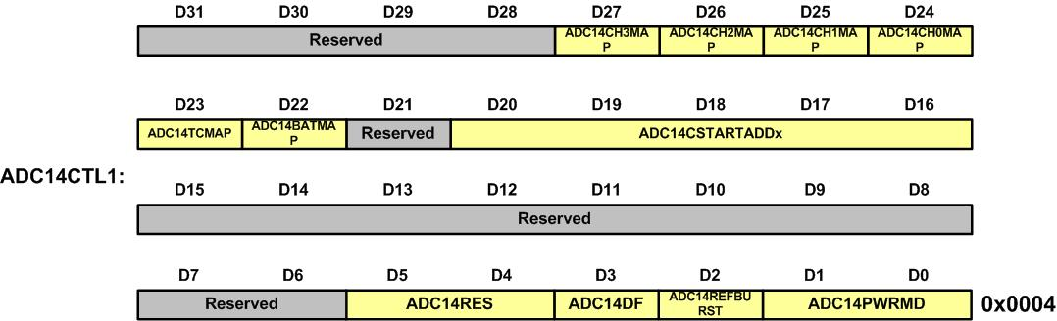
ADC14CTL1 (ADC14 Control 1) Register

Slide 27
ADC14CTL1 (ADC14 Control 1) Register
Bit | Name | Description
31-28 | Reserved | Reserved
27 | ADC14CH3MAP | 0b = ADC input channel internal 3 is not selected 1b = ADC input channel internal 3 is selected for ADC input channel MAX-5
26 | ADC14CH2MAP | 0b = ADC input channel internal 2 is not selected 1b = ADC input channel internal 2 is selected for ADC input channel MAX-4
25 | ADC14CH1MAP | 0b = ADC input channel internal 1 is not selected 1b = ADC input channel internal 1 is selected for ADC input channel MAX-3
24 | ADC14CH0MAP | 0b = ADC input channel internal 0 is not selected 1b = ADC input channel internal 0 is selected for ADC input channel MAX-2
23 | ADC14TCMAP | 0b = ADC internal temperature sensor channel is not selected for ADC 1b = ADC internal temperature sensor channel is selected for ADC input channel
22 | ADC14BATMAP | 0b = ADC internal 1/2 x AVCC channel is not selected for ADC 1b = ADC internal 1/2 x AVCC channel is selected for ADC input channel MAX

Slide 28
ADC14CTL1 (ADC14 Control 1) Register (Cont.)
Bit | Name | Description
21 | Reserved | Reserved
20-16 | ADC14CSTARTADDx | 0h to 1Fh, corresponding to ADC14MEM0 to ADC14MEM31
15-6 | Reserved | Reserved
5-4 | ADC14RES | 00b = 8 bit (9 clock cycle conversion time) 01b = 10 bit (11 clock cycle conversion time) 10b = 12 bit (14 clock cycle conversion time) 11b = 14 bit (16 clock cycle conversion time)

Slide 29
ADC14CTL1 (ADC14 Control 1) Register (Cont.)
Bit | Name | Description
3 | ADC14DF | 0b = Binary unsigned. Theoretically, for ADC14DIF = 0 and 14-bit mode, the analog input voltage - V(REF) results in 0000h, and the analog input voltage + V(REF) results in 3FFFh. 1b = Signed binary (2s complement), left aligned. Theoretically, for ADC14DIF = 0 and 14-bit mode, the analog input voltage - V(REF) results in 8000h, and the analog input voltage + V(REF) results in 7FFCh.
2 | ADC14REFBURST | 0b = ADC reference buffer on continuously 1b = ADC reference buffer on only during sample-and-conversion
1-0 | ADC14PWRMD | 00b = Regular power mode for use with any resolution setting. Sample rate can be up to 1 Msps. 01b = Reserved 10b = Low-power mode for 12-bit, 10-bit, and 8-bit resolution settings. Sample rate must not exceed 200 ksps. 11b = Reserved

Slide 30
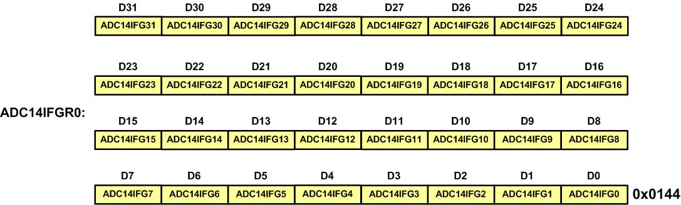
ADC14IFGR0 (ADC14 Interrupt Flag Register 0) Register for End-of-Conversion

Slide 31
ADC14IFGR0 Register
Bit | Field | Descriptions
x | ADC14IFGx | ADC14MEMx interrupt flag. This bit is set to 1 when ADC14MEMx is loaded with a conversion result. This bit is reset to 0 when the ADC14MEMx register is read, or when the ADC14IV register is read, or when the corresponding bit in the ADC14CLRIFGR0 register is set to 1. 0b = No interrupt pending 1b = Interrupt pending

Slide 32
ADC14MEMx (ADC14 memoryx) holding ADC14 conversion result (x=0- 31)

Slide 33
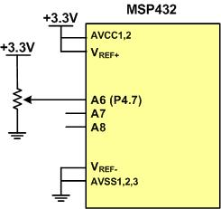
ADC Connection for Program 7-1

Slide 34
Thermistor Resistance vs. Temperature
Temperature ('C) | Tf (K ohms)
0 | 29.490
25 | 10.000
50 | 3.893
75 | 1.700
100 | 0.817

Slide 35
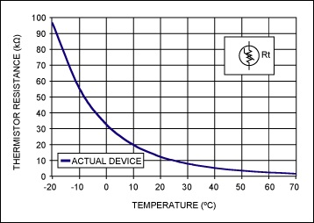
Thermistor
(Copied from http://www.maximintegrated.com)

Slide 36
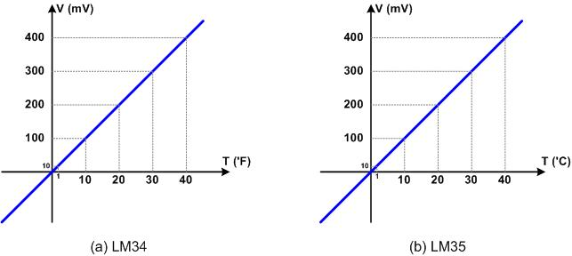
LM34 and LM35

Slide 37
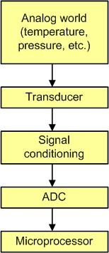
Getting analog data to the CPU

Slide 38
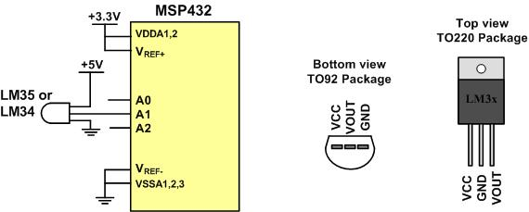
LM34/35 Connection to ARM and Its Pin Configuration

Slide 39
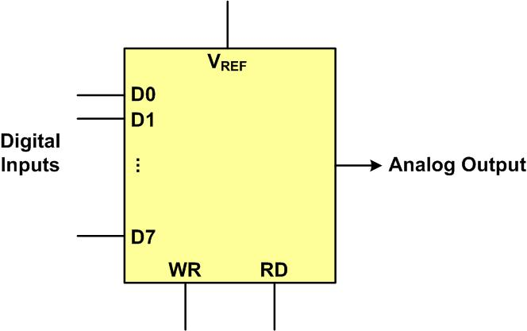
DAC Block Diagram

Slide 40
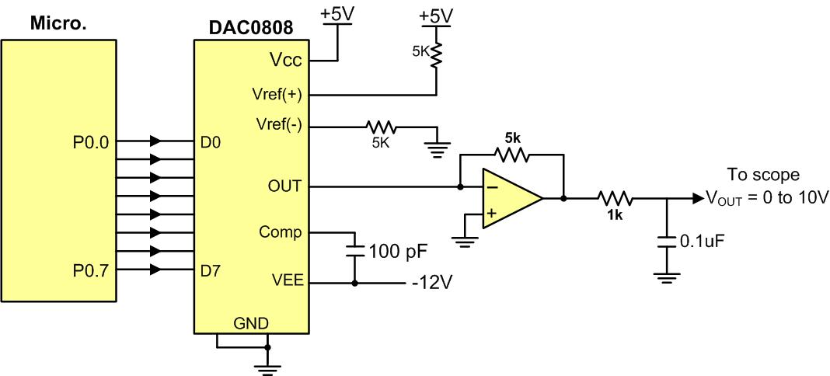
Microcontroller Connection to DAC0808

Slide 41
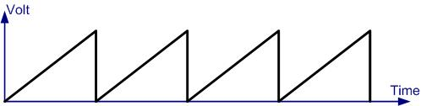
Saw Tooth Wave Form

Slide 42
Angle vs. Voltage Magnitude for Sine Wave
Angle Ɵ (degrees) | Sin Ɵ | V_{OUT} (Voltage Magnitude) 5V + (5V × sin Ɵ) | Values Sent to DAC (decimal) (Voltage Mag. × 25.6)
0 | 0 | 5 | 128
30 | 0.5 | 7.5 | 192
60 | 0.866 | 9.33 | 238
90 | 1.0 | 10 | 255
120 | 0.866 | 9.33 | 238
150 | 0.5 | 7.5 | 192
180 | 0 | 5 | 128
210 | -0.5 | 2.5 | 64
240 | -0.866 | 0.669 | 17
270 | -1.0 | 0 | 0
300 | -0.866 | 0.669 | 17
330 | -0.5 | 2.5 | 64
360 | 0 | 5 | 128

Slide 43
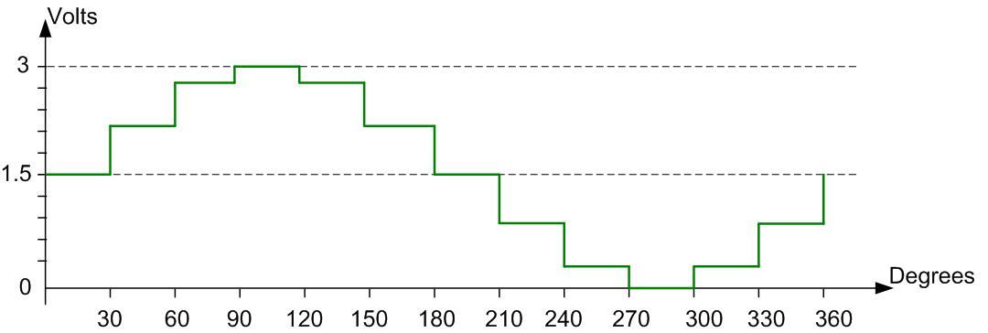
Angle vs. Voltage Magnitude for Sine Wave

