Slide 1
Chapter 6
Interrupt and Exception Programming

Slide 2
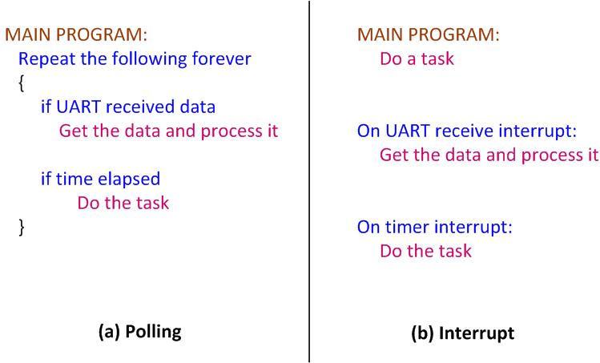
Polling vs. Interrupts

Slide 3
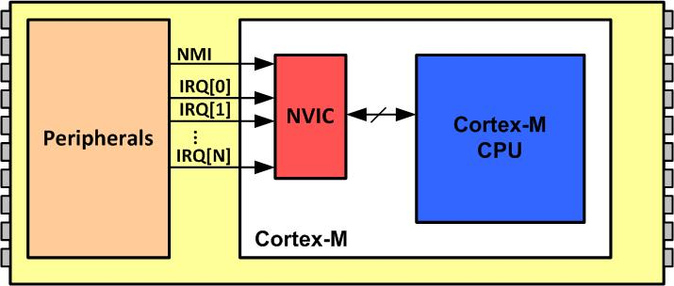
NVIC in ARM Cortex-M

Slide 4
Interrupt Vector Table for ARM Cortex-M
Interrupt # | Interrupt | Memory Location (Hex)
 | Stack Pointer initial value | 0x00000000
1 | Reset | 0x00000004
2 | NMI | 0x00000008
3 | Hard Fault | 0x0000000C
4 | Memory Management Fault | 0x00000010
5 | Bus Fault | 0x00000014
6 | Usage Fault (undefined instructions, divide by zero, unaligned memory access,...) | 0x00000018
7 | Reserved | 0x0000001C
8 | Reserved | 0x00000020
9 | Reserved | 0x00000024
10 | Reserved | 0x00000028
11 | SVCall | 0x0000002C
12 | Debug Monitor | 0x00000030
13 | Reserved | 0x00000034
14 | PendSV | 0x00000038
15 | SysTick | 0x0000003C
16 | IRQ 0 for peripherals | 0x00000040
17 | IRQ 1 for peripherals | 0x00000044
… | … | …
255 | IRQ 239 for peripherals | 0x000003FC

Slide 5
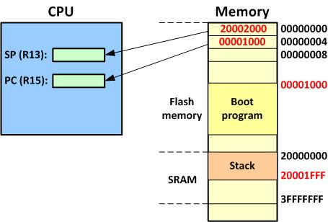
Going from Reset to Boot Program

Slide 6
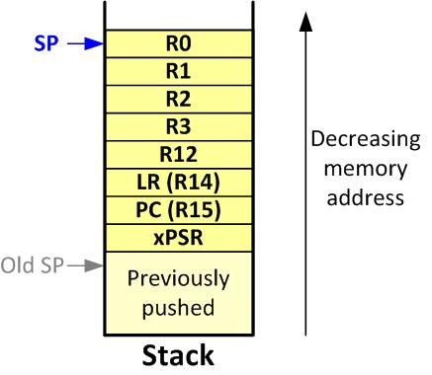
ARM Cortex-M Stack Frame upon Interrupt

Slide 7
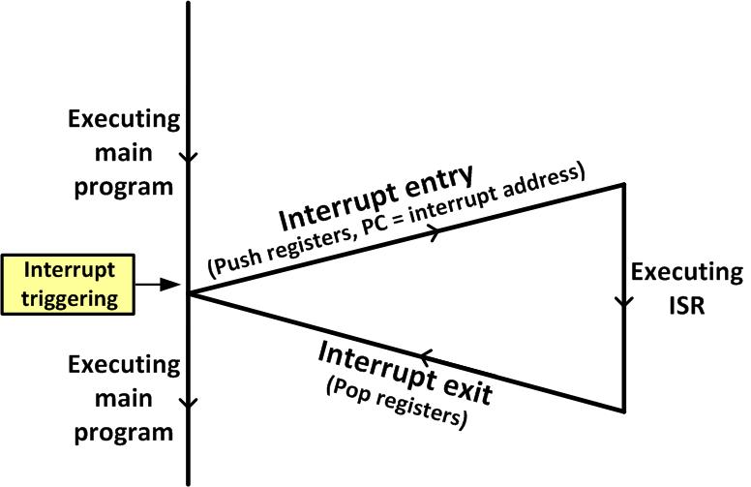
Main Program gets interrupted

Slide 8
Interrupt Priority for ARM Cortex-M
Interrupt # | Interrupt | Priority Level
0 | Stack Pointer initial value
1 | Reset | -3 Highest
2 | NMI | -2
3 | Hard Fault | -1
4 | Memory Management Fault | Programmable
5 | Bus Fault | Programmable
6 | Usage Fault (undefined instructions, divide by zero, unaligned memory access,....) | Programmable
7 | Reserved | Programmable
8 | Reserved | Programmable
9 | Reserved | Programmable
10 | Reserved | Programmable
11 | SVCall | Programmable
12 | Debug Monitor | Programmable
13 | Reserved | Programmable
14 | PendSV | Programmable
15 | SysTick | Programmable
16 | IRQ 0 for peripherals | Programmable
17 | IRQ 1 for peripherals | Programmable
… | … | Programmable
255 | IRQ 239 for peripherals | Programmable

Slide 9

CONTROL Register in ARM Cortex-M4
nPRIV (Privilege): Defines the Thread mode privilege level 0: Privileged 1: Unprivileged Active Stack Pointer (ASP): Defines the currently active stack pointer (ASP = SPSEL) 0: MSP is the current stack pointer. 1: PSP is the current stack pointer. Floating Point Context Active (FPCA) 0: No floating point context active. 1: Floating point context active.

Slide 10
Privileged level Execution and Processor Modes in ARM Cortex-M
Processor Mode | Software | Privilege level
Thread | Applications | Privileged and Unprivileged
Handler | ISR for Exceptions and IRQs | Always Privileged
In Thread mode, use bit 0 of the CONTROL register to select Privileged or Unprivileged

Slide 11
Processor Modes and Stack Usage in ARM Cortex-M
Processor Mode | Software | Stack Usage
Thread | Applications | MSP or PSP
Handler | ISR for Exceptions and IRQs | MSP
Note: In Thread mode, use bit 1 of the Control register to select MSP or PSP for stack pointer.

Slide 12
Processor Mode, Privilege, and Stack in ARM Cortex
Mode | Privilege | Stack Pointer | Typical Example usage
Handler | Privileged | Main | Exception Handling
Handler | Unprivileged | Any | Reserved since Handler is always Privileged
Thread | Privileged | Main | Operating system kernel
Thread | Privileged | Process
Thread | Unprivileged | Main
Thread | Unprivileged | Process | Application threads

Slide 13
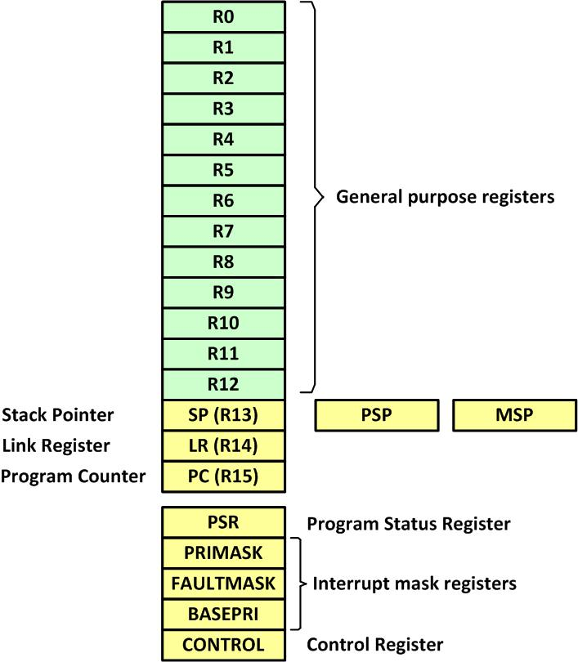
ARM Cortex-M Registers

Slide 14
Special function registers of ARM Cortex-M
Register name | Privilege Usage
MSP (main stack pointer) | Privileged
PSP (processor stack pointer) | Privileged or Unprivileged
PSR (Processor status register) | Privileged
APSR (application processor status register) | Privileged or Unprivileged
ISPR (interrupt processor status register) | Privileged
EPSR (execution processor status register) | Privileged
PRIMASK (Priority Mask register) | Privileged
FAULTMASK(fault mask register) | Privileged
BASEPRI (base priority register) | Privileged
CONTROL (control register) | Privileged
Note: We must use MSR and MRS instructions to access the above registers

Slide 15
IRQ assignment in MSP432P401R
INT# | IRQ# | Vector location | Device
1-15 | None | 0000 0000 to 0000 003C | CPU Exception(set by ARM)
16 | 0 | 0000 0040 | PSS
17 | 1 | 0000 0044 | CS
18 | 2 | 0000 0048 | PCM
19 | 3 | 0000 004C | WDT_A
20 | 4 | 0000 0050 | FPU_INT
21 | 5 | 0000 0054 | Flash Controller
22 | 6 | 0000 0058 | COMP_E1
23 | 7 | 0000 005C | COMP_E2
24 | 8 | 0000 0060 | TIMERA0
25 | 9 | 0000 0064 | TIMERA0
26 | 10 | 0000 0068 | TIMERA1
27 | 11 | 0000 006C | TIMERA1
28 | 12 | 0000 0070 | TIMERA2

Slide 16
IRQ assignment in MSP432P401R (Cont.)
INT# | IRQ# | Vector location | Device
29 | 13 | 0000 0074 | TIMERA2
30 | 14 | 0000 0078 | TIMERA3
31 | 15 | 0000 007C | TIMERA3
32 | 16 | 0000 0080 | eUSCI_A0
33 | 17 | 0000 0084 | eUSCI_A1
34 | 18 | 0000 0088 | eUSCI_A2
35 | 19 | 0000 008C | eUSCI_A3
36 | 20 | 0000 0090 | eUSCI_B0
37 | 21 | 0000 0094 | eUSCI_B1
38 | 22 | 0000 0098 | eUSCI_B3
39 | 23 | 0000 009C | eUSCI_B4
40 | 24 | 0000 00A0 | ADC14
41 | 25 | 0000 00A4 | TIMER32_INT1
42 | 26 | 0000 00A8 | TIMER32_INT2

Slide 17
IRQ assignment in MSP432P401R (Cont.)
INT# | IRQ# | Vector location | Device
43 | 27 | 0000 00AC | TIMER32_INTC
44 | 28 | 0000 00B0 | AES256
45 | 29 | 0000 00B4 | RTC_C
46 | 30 | 0000 00B8 | DMA_ERR
47 | 31 | 0000-00BC | DMA_INT3
48 | 32 | 0000 00C0 | DMA_INT2
49 | 33 | 0000 00C4 | DMA_INT1
50 | 34 | 0000 00C8 | DMA_INT0
51 | 35 | 0000-00CC | I/O Port P1
52 | 36 | 0000 00D0 | I/O Port P2
53 | 37 | 0000 00D4 | I/O Port P3
54 | 38 | 0000 00D8 | I/O Port P4
55 | 39 | 0000-00DC | I/O Port P5
56 | 40 | 0000 00E0 | I/O Port P6
57-79 | 41-63 | 0000 00E4 – 0000 013C | reserved

Slide 18
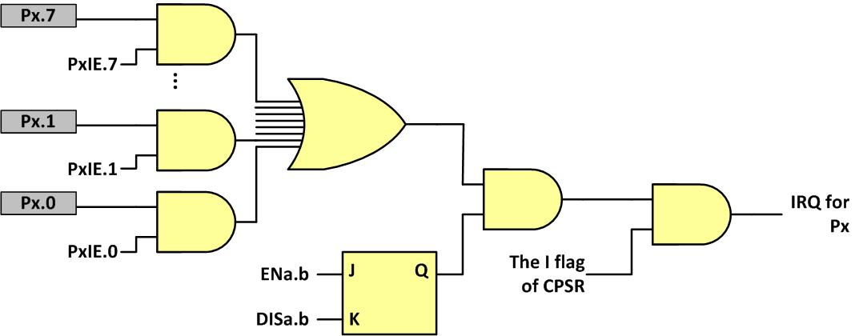
Interrupt enabling at all 3 levels

Slide 19
PxIE register

Slide 20
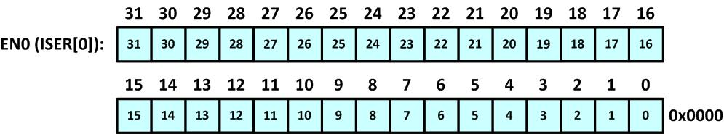
Interrupts 0–31 Set Enable (EN0)

Slide 21
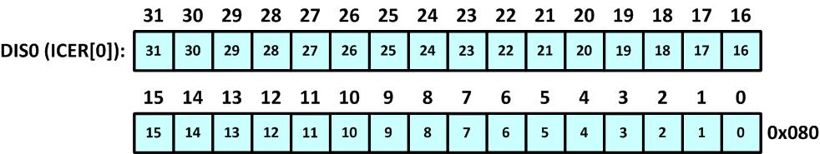
Interrupts 0–31 Clear Enable (DIS0)

Slide 22

Enabling and Disabling an Interrupt

Slide 23
PxIES Interrupt edge activation bits

Slide 24
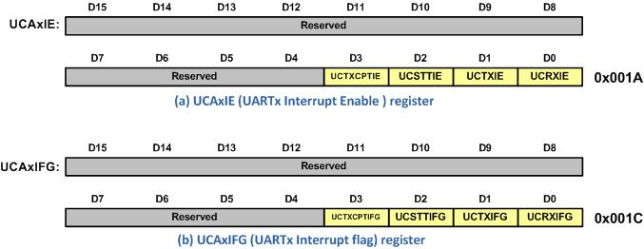
UART Interrupt Registers

Slide 25
UCAxIE (UARTx Interrupt Enable) register
Field | Bit | Description
UCTXCPTIE | D3 | Transmit complete interrupt enable 0 = Interrupt disabled 1 = Interrupt enabled
UCSTTIE | D2 | Start bit interrupt enable 0 = Interrupt disabled 1 = Interrupt
UCTXIE | D1 | Transmit interrupt enable 0 = Interrupt disabled 1 = Interrupt enabled
UCRXIE | D0 | Receive interrupt enable 0 = Interrupt disabled 1 = Interrupt enabled

Slide 26
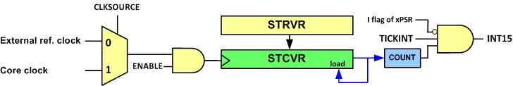
SysTick Internal Structure

Slide 27
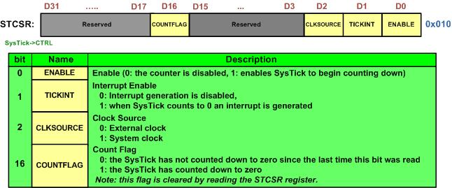
SysTick Control and Status Register (STCTRL)

Slide 28
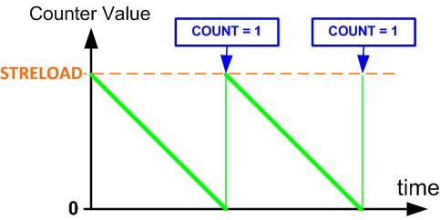
SysTick Counting

Slide 29
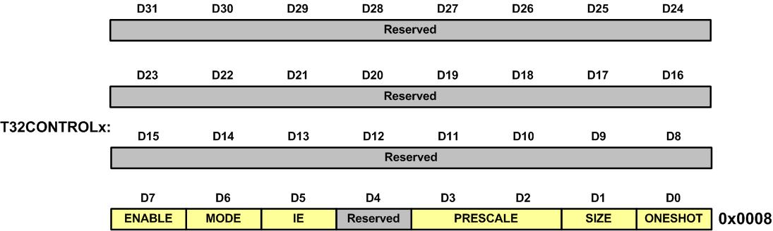
IE (Interrupt Enable) bit (d5) in T32CONTROLx (T32 Control) register

Slide 30
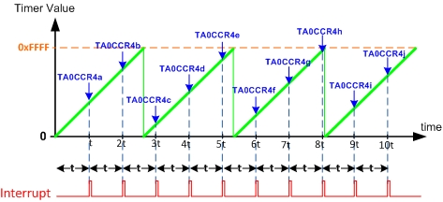
Making Periodic Interrupts using Timer_A

Slide 31
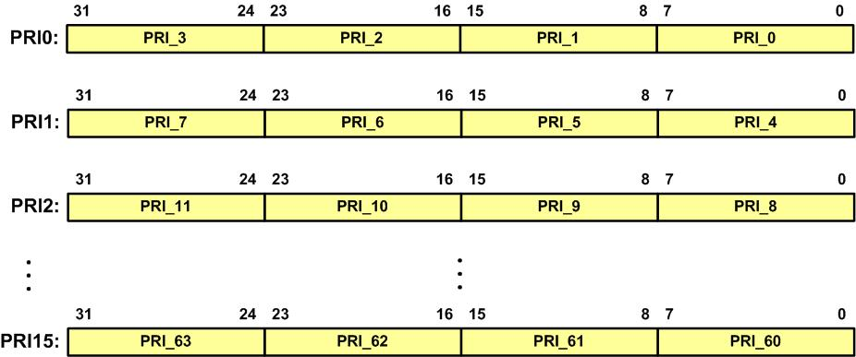
IPRn Registers

