Slide 1
Chapter 5
MSP432 ARM Timer Programming

Slide 2
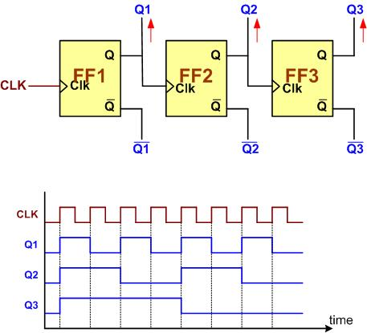
A 3-bit Counter

Slide 3

An 8-bit up-counter stages

Slide 4

An 8-bit down-counter stages

Slide 5

Counting Events Using a Counter

Slide 6
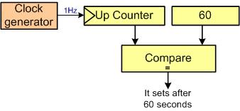
Using Counter as a Timer

Slide 7

Capturing

Slide 8
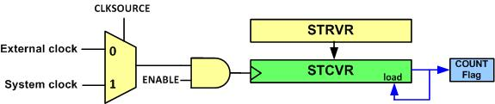
System Tick Timer Internal Structure

Slide 9
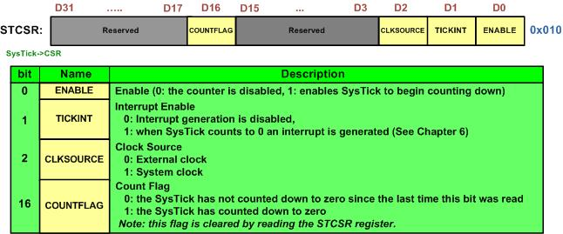
STCTRL (System Tick Control)

Slide 10
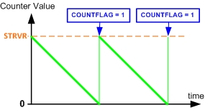
System Tick Counting

Slide 11
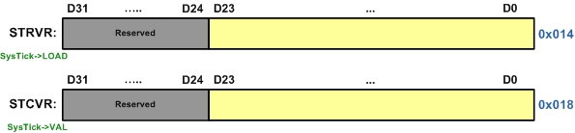
STRVR vs. STCVR

Slide 12
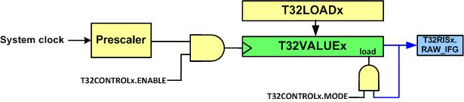
System Tick Timer Internal Structure

Slide 13
Timer32 Registers
Offset | Acronym | Register Name | Type | Reset Value
00H | T32LOAD1 | Timer 1 Load Register | RW | 0
04H | T32VALUE1 | Timer 1 Current Value Register | R | FFFFFFFFH
08H | T32CONTROL1 | Timer 1 Timer Control Register | RW | 20H
0CH | T32INTCLR1 | Timer 1 Interrupt Clear Register | W | -
10H | T32RIS1 | Timer 1 Raw Interrupt Status Register | R | 0
14H | T32MIS1 | Timer 1 Interrupt Status Register | R | 0
18H | T32BGLOAD1 | Timer 1 Background Load Register | RW | 0
20H | T32LOAD2 | Timer 2 Load Register | RW | 0
24H | T32VALUE2 | Timer 2 Current Value Register | R | FFFFFFFFH
28H | T32CONTROL2 | Timer 2 Timer Control Register | RW | 20H
2CH | T32INTCLR2 | Timer 2 Interrupt Clear Register | W | -
30H | T32RIS2 | Timer 2 Raw Interrupt Status Register | R | 0
34H | T32MIS2 | Timer 2 Interrupt Status Register | R | 0
38H | T32BGLOAD2 | Timer 2 Background Load Register | RW | 0H

Slide 14
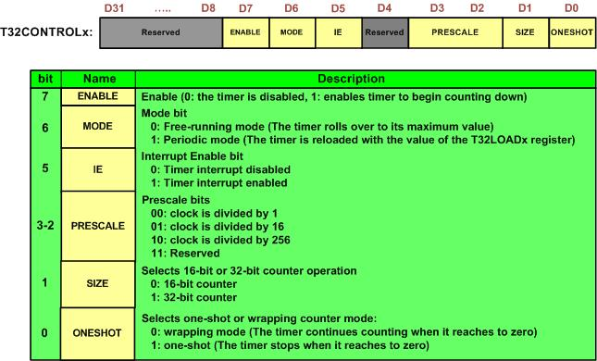
T32CONTROLxRegister

Slide 15
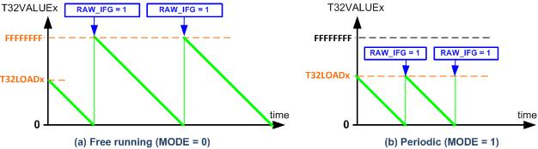
Counting in Free-Running Mode vs. Periodic Mode

Slide 16

T32RIS Register

Slide 17
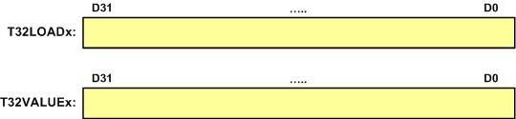
T32LOAD vs. T32VALUE

Slide 18
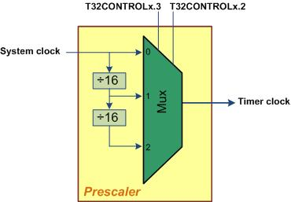
The Timer32 Prescaler

Slide 19
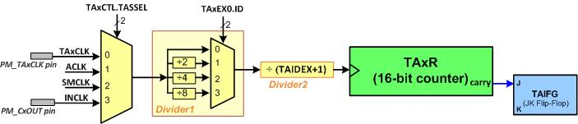
Timer_A Simplified Diagram

Slide 20
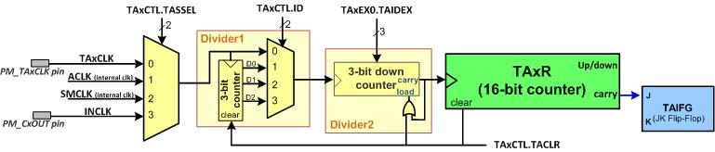
A more detailed diagram of Timer_A

Slide 21
TAxR register

Slide 22
TAxCTL register

Slide 23
TAxCTL register
bit | Name | Description
0 | TAIFG | Timer_A Interrupt Flag 0: Timer did not overflow 1: Timer overflowed
1 | TAIE | Timer_A Interrupt Enable (0: Disabled, 1: Enabled)
2 | TACLR | Timer_A Clear
4-5 | MC | Mode Control: 00: Stop mode: timer is halted 01: Up mode: Timer counts up to TAxCCR0 10: Continuous mode: Timer counts up to 0xFFFF 11: Up/down mode: Timer counts up to TAxCCR0 then down to 0.
6-7 | ID | Input divider: These bits select the divider for the input clock: 00: divide by 1 01: divide by 2 10: divide by 4 11: divide by 8
8-9 | TASSEL | Timer_A clock Source Select: These bits select the Timer_A clock source: 00: TAxCLK (external clock): The timer uses external clock which is fed to the PM_TAxCLK pin. 01: ACLK (internal clock) 10: SMCLK (internal clock) 11: INCLK

Slide 24
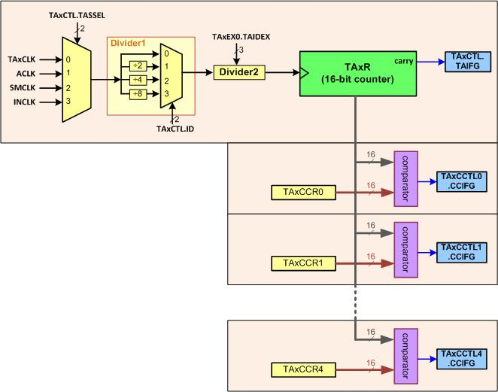
TAxCCRn Registers and TAxCCTLn Flags

Slide 25
TAxCCRn Register

Slide 26

TAxCCTLn Register

Slide 27
TAxCCTLn Register (Table 17-6 of the chip manual)
bit | Name | Description
15-14 | CM | Capture mode 00: No capture 01: Capture on rising edge 10: Capture on falling edge 11: Capture on both rising and falling edges
13-12 | CCIS | Capture/compare input select. These its select the TAxCCR0 input signal: 00: CCIxA 01: CCIxB 10: GND 11: VCC
11 | SCS | Synchronize capture source. This bit is used to synchronize the capture input signal with the timer clock. 0: Asynchronous capture 1: Synchronous capture

Slide 28
TAxCCTLn Register (Table 17-6 of the chip manual) (Cont.)
bit | Name | Description
10 | SCCI | Synchronized capture/compare input. The selected CCI input signal is latched with the EQUx signal and can be read via this bit.
8 | CAP | Capture mode 0: Compare mode 1: Capture mode
7-5 | OUTMOD | Output mode. Modes 2, 3, 6, and 7 are not useful for TAxCCR0 because EQUx = EQU0 000: OUT bit value 001: Set 010: Toggle/reset 011: Set/reset 100: Toggle 101: Reset 110: Toggle/set 111: Reset/set

Slide 29
TAxCCTLn Register (Table 17-6 of the chip manual) (Cont.)
bit | Name | Description
4 | CCIE | Capture/compare interrupt enable. This bit enables the interrupt request of the corresponding CCIFG flag. 0: Interrupt disabled 1: Interrupt enabled
3 | CCI | Capture/compare input. The selected input signal can be read by this bit.
2 | OUT | Output. For output mode 0, this bit directly controls the state of the output. 0: Output low 1: Output high
1 | COV | Capture overflow. This bit indicates a capture overflow occurred. COV must be reset with software. 0: No capture overflow occurred 1: Capture overflow occurred
0 | CCIFG | Capture/compare interrupt flag 0: No interrupt pending 1: interrupt pending

Slide 30
TAxEXn Register

Slide 31
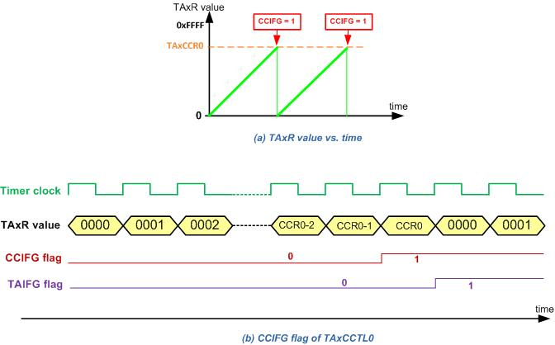
Counting in Up Mode

Slide 32
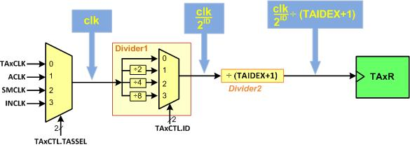
Clock in Timer_A

Slide 33
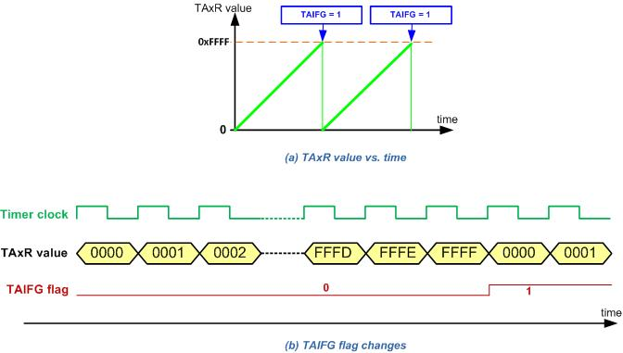
Continuous mode

Slide 34
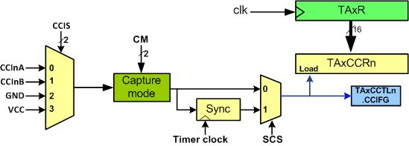
Input Edge Time Capturing

Slide 35
TAxCCTLn Register

Slide 36
TAxCCTLn Register (Table 17-6 of the chip manual)
bit | Name | Description
15-14 | CM | Capture mode 00: No capture 01: Capture on rising edge 10: Capture on falling edge 11: Capture on both rising and falling edges
13-12 | CCIS | Capture/compare input select. These its select the TAxCCR0 input signal: 00: CCIxA 01: CCIxB 10: GND 11: VCC
11 | SCS | Synchronize capture source. This bit is used to synchronize the capture input signal with the timer clock. 0: Asynchronous capture 1: Synchronous capture

Slide 37
TAxCCTLn Register (Table 17-6 of the chip manual) (Cont.)
bit | Name | Description
10 | SCCI | Synchronized capture/compare input. The selected CCI input signal is latched with the EQUx signal and can be read via this bit.
8 | CAP | Capture mode 0: Compare mode 1: Capture mode
7-5 | OUTMOD | Output mode. Modes 2, 3, 6, and 7 are not useful for TAxCCR0 because EQUx = EQU0 000: OUT bit value 001: Set 010: Toggle/reset 011: Set/reset 100: Toggle 101: Reset 110: Toggle/set 111: Reset/set

Slide 38
TAxCCTLn Register (Table 17-6 of the chip manual) (Cont.)
bit | Name | Description
4 | CCIE | Capture/compare interrupt enable. This bit enables the interrupt request of the corresponding CCIFG flag. 0: Interrupt disabled 1: Interrupt enabled
3 | CCI | Capture/compare input. The selected input signal can be read by this bit.
2 | OUT | Output. For output mode 0, this bit directly controls the state of the output. 0: Output low 1: Output high
1 | COV | Capture overflow. This bit indicates a capture overflow occurred. COV must be reset with software. 0: No capture overflow occurred 1: Capture overflow occurred
0 | CCIFG | Capture/compare interrupt flag 0: No interrupt pending 1: interrupt pending

Slide 39
Choosing the Capture Edge
CM | Capture mode
00 | No capture
01 | Capture on rising edge
10 | Capture on falling edge
11 | Capture on both edges

Slide 40
Port pin assignement of Timer_A
Timer_A | Port Pin | Timer_A | Port Pin | Timer_A | Port Pin | Timer_A | Port Pin
TA0.0 | P7.3 | TA1.0 | P8.0 | TA2.0 | P8.1 | TA3.0 | P10.4
TA0.1 | P2.4 | TA1.1 | P7.7 | TA2.1 | P5.6 | TA3.1 | P10.5
TA0.2 | P2.5 | TA1.2 | P7.6 | TA2.2 | P5.7 | TA3.2 | P8.2
TA0.3 | P2.6 | TA1.3 | P7.5 | TA2.3 | P6.6 | TA3.3 | P9.2
TA0.4 | P2.7 | TA1.4 | P7.4 | TA2.4 | P6.7 | TA3.4 | P9.3

Slide 41
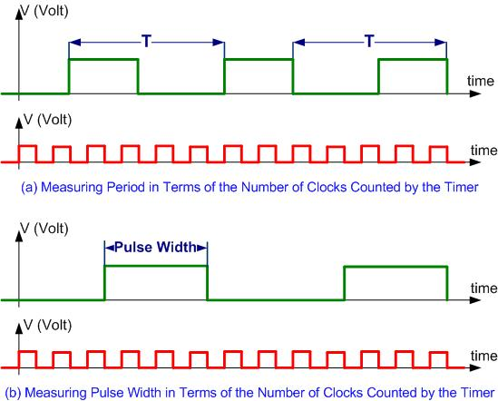
Measuring Period and Pulse Width

