Slide 1
Chapter 4
UART Serial Port Programming

Slide 2
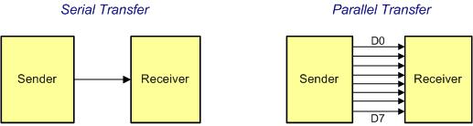
Serial vs. Parallel Data Transfer

Slide 3
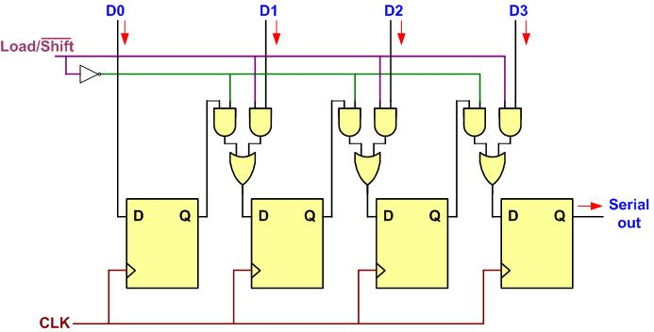
Parallel In Serial Out

Slide 4
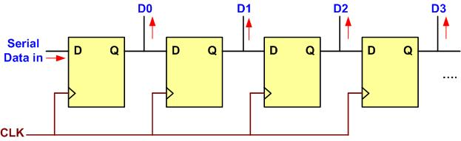
Serial In Parallel Out

Slide 5
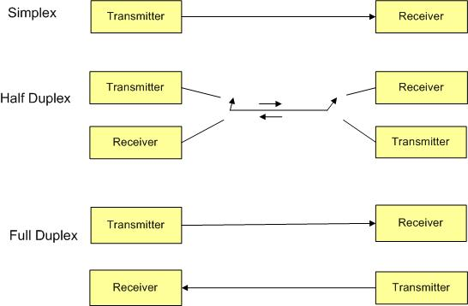
Simplex, Half-, and Full-Duplex Transfers

Slide 6
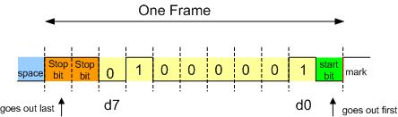
Framing ASCII "A" (0x41)

Slide 7
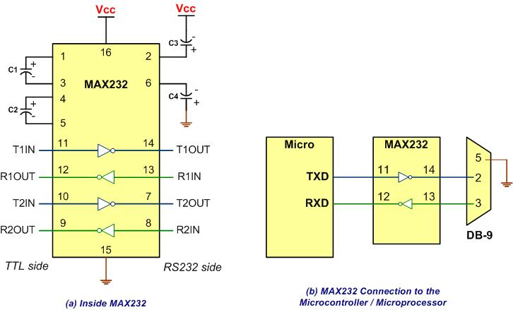
MAX232

Slide 8
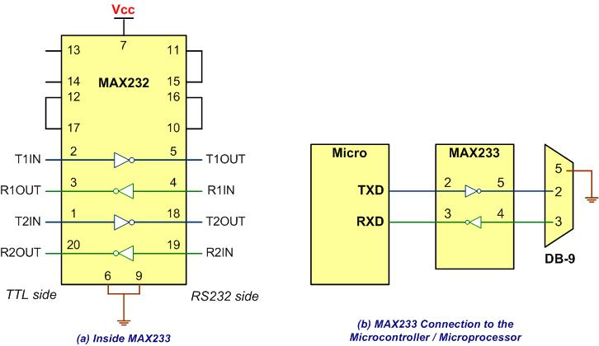
MAX233

Slide 9
RS232 Pins
Pin | Description
1 | Data carrier detect (DCD)
2 | Received data (RxD)
3 | Transmitted data (TxD)
4 | Data terminal ready (DTR)
5 | Signal ground (GND)
6 | Data set ready (DSR)
7 | Request to send (RTS)
8 | Clear to send (CTS)
9 | Ring indicator (RI)

Slide 10
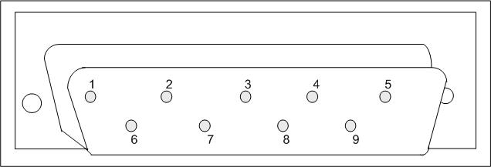
9-Pin Male Connector

Slide 11
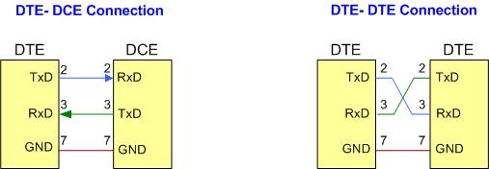
DTE-DCE and DTE-DTE Connections

Slide 12
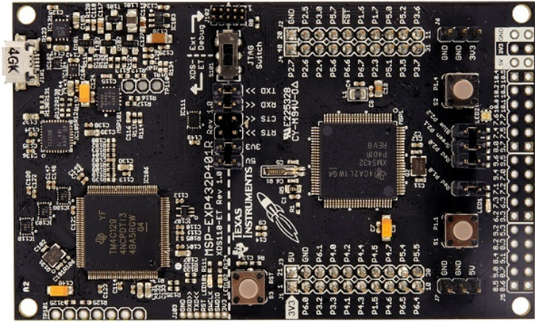
MSP432 LaunchPad board

Slide 13
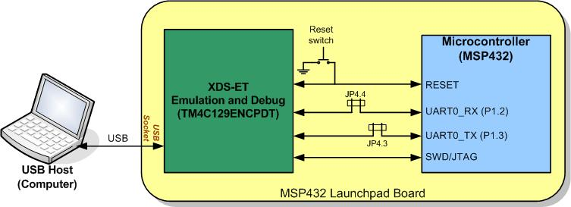
XDS110-ET emulator USB Port

Slide 14
Partial list of UART0 Registers and their addresses
Register Name | Register Function | Register Address
UCA0CTLW0 | Control Word 0 | 4000_1000
UCA0BRW | Baud Rate Control Word | 4000_1006
UCA0STATW | Status | 4000_100A
UCA0RXBUF | Receive Buffer | 4000_100C
UCA0TXBUF | Transfer Buffer | 4000_100E
UCA0IFG | Interrupt Flag | 4000_101C

Slide 15
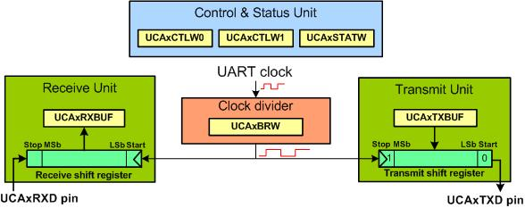
A Simplified Block Diagram of UART

Slide 16
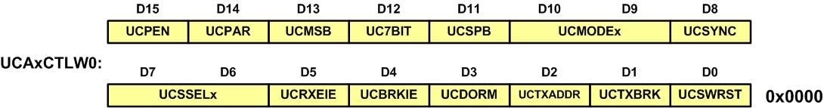
UART ControlWord0 (UCAxCTLW0) register

Slide 17
UART Control 0 Word (UCAxCTLW0) register
Field | Bit | Description
UCPEN | D15 | 0b = Parity disabled 1b = Parity enabled. Parity bit is generated (UCAxTXD) and expected (UCAxRXD).
UCPAR | D14 | 0b = Odd parity 1b = Even parity
UCMSB | D13 | 0b = LSB first 1b = MSB first
UC7BIT | D12 | 0b = 8-bit data 1b = 7-bit data
UCSPB | D11 | 0b = One stop bit 1b = Two stop bits
UCMODEx | D10:9 | 00b = UART mode 01b = Idle-line multiprocessor mode 10b = Address-bit multiprocessor mode 11b = UART mode with automatic baud-rate detection
UCSYNC | D8 | 0b = Asynchronous mode 1b = Synchronous mode

Slide 18
UART Control 0 Word (UCAxCTLW0) register (Cont.)
Field | Bit | Description
UCSSELx | D7:6 | 00b = UCLK 01b = ACLK 10b = SMCLK 11b = SMCLK
UCRXEIE | D5 | 0b = Erroneous characters rejected and UCRXIFG is not set. 1b = Erroneous characters received set UCRXIFG.
UCBRKIE | D4 | 0b = Received break characters do not set UCRXIFG. 1b = Received break characters set UCRXIFG.
UCDORM | D3 | 0b = Not dormant. All received characters set UCRXIFG. 1b = Dormant. Only characters that are preceded by an idle-line or with address bit set UCRXIFG. In UART mode with automatic baud-rate detection, only the combination of a break and synch field sets UCRXIFG.
UCTXADDR | D2 | 0b = Next frame transmitted is data. 1b = Next frame transmitted is an address.
UCTXBRK | D1 | 0b = Next frame transmitted is not a break. 1b = Next frame transmitted is a break or a break/synch.
UCSWRST | D0 | 0b = Disabled. eUSCI_A reset released for operation. 1b = Enabled. eUSCI_A logic held in reset state.

Slide 19
UART Control Word 1(UCAxCTLW1) register

Slide 20
UART Control Word 1(UCAxCTLW1) register
Field | Bit | Description
Reserved | D15:1 | Reserved
UCGLITx | D0 | Deglitch time 00b = Approximately 2 ns 01b = Approximately 50 ns 10b = Approximately 100 ns 11b = Approximately 200 ns

Slide 21
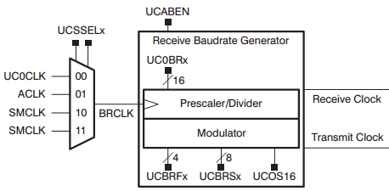
Clock Circuit of UART0

Slide 22
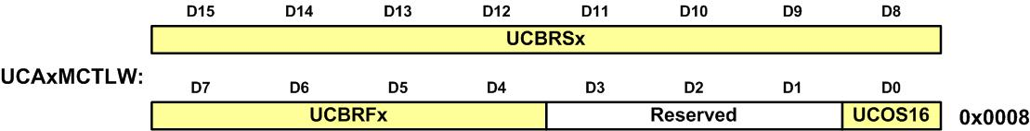
UCAxMCTLW (UCOS16=0 for non-oversampling)

Slide 23
UCAxBRW

Slide 24
UART0 BRW Values for Some Standard Baud Rates using default OSCO16=0 and Clock of 3 MHz
Baud rate | BRW (in decimal) | BRW (in hex)
4,800 | 625 | 0x271
9,600 | 312 | 0x138
19,200 | 156 | 0x9C
38,400 | 78 | 0x4E
115,200 | 26 | 0x1A

Slide 25
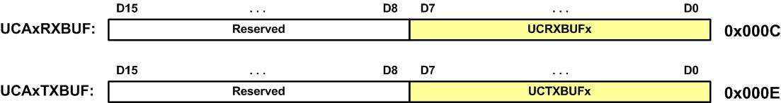
UART TX and RX Buffer registers

Slide 26
UART Status Register (UCAxSTATW)

Slide 27
UART Status Register (UCAxSTATW)
Field | Bit | Description
Reserved | D15:8 | Reserved
UCFE | D6 | Framing error flag. UCFE is cleared when UCAxRXBUF is read. 0b = No error 1b = Character received with low stop bit
UCOE | D5 | Overrun error flag. This bit is set when a character is transferred into UCAxRXBUF before the previous character was read. UCOE is cleared automatically when UCxRXBUF is read. 0b = No error 1b = Overrun error occurred
UCPE | D4 | Parity error flag. When UCPEN = 0, UCPE is read as 0. UCPE is cleared when UCAxRXBUF is read. 0b = No error 1b = Character received with parity error
UCRXERR | D2 | Receive error flag. This bit indicates a character was received with one or more errors. When UCRXERR = 1, on or more error flags, UCFE, UCPE, or UCOE is also set. UCRXERR is cleared when UCAxRXBUF is read. 0b = No receive errors detected 1b = Receive error detected
UCBUSY | D0 | eUSCI_A busy. This bit indicates if a transmit or receive operation is in progress. 0b = eUSCI_A inactive 1b = eUSCI_A transmitting or receiving

Slide 28
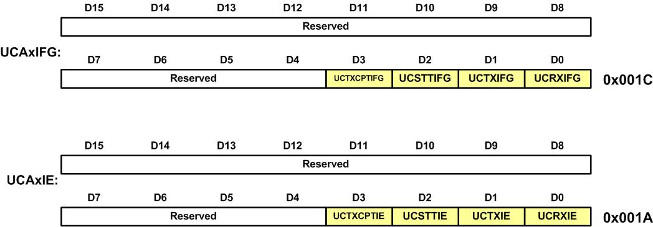
UART Interrupt Flag (UCAxIFG) and Interrupt Enable (UCAxIE) Registers

Slide 29
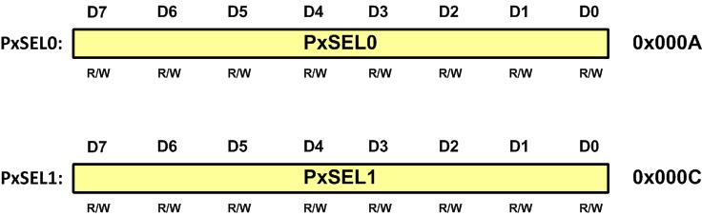
PxSEL1 and PxSEL0 Alternate Function Selection registers

Slide 30
Pins available for UARTs
I/O pin | Function | PxSEL1=0 | PxSEL0=1
P1.2 | UCA0RXD | P1SEL1=00000000 | P1SEL0=00000100
P1.3 | UCA0TXD | P1SEL1=00000000 | P1SEL0=00001000
FOR UART0: |  | P1SEL1=0x00 | P1SEL0=00001100=0x0C
P2.2 | UCA1RXD | P2SEL1=00000000 | P2SEL0=00000100
P2.3 | UCA1TXD | P2SEL1=00000000 | P2SEL0=00001000
For UART1 |  | P2SEL1=0x00 | P2SEL0=00001100=0x0C
P3.2 | UCA2RXD | P3SEL1=00000000 | P3SEL0=00000100
P3.3 | UCA2TXD | P3SEL1=00000000 | P3SEL0=00001000
For UART2 |  | P3SEL1=0x00 | P3SEL0=00001100=0x0C
P9.6 | UCA3RXD | P9SEL1=00000000 | P9SEL0=01000000
P9.7 | UCA3TXD | P9SEL1=00000000 | P9SEL0=10000000
For UART3 |  | P9SEL1=0x00 | P9SEL0=11000000=0xC0

Slide 31
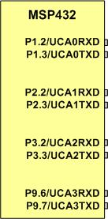
UART pins in MSP432

