Slide 1
Chapter 2
MSP432 ARM I/O Programming

Slide 2
Chapter Review
Section 2.1: MSP432 Microcontroller and LaunchPad
Section 2.2: GPIO (General Purpose I/O) Programming and Interfacing
Section 2.3: Seven-segment LED interfacing and programming
Section 2.4: I/O Port Programming in Assembly
Section 2.5:16-BIT I/O ports in MSP432
Section 2.6: Port Mapping Controller

Slide 3
MSP432P401R Main Features
ARM® Cortex™-M4 processor
100-pin microcontroller chip
256K bytes (256KB) of on-chip Flash memory for code
64KB of on-chip SRAM for data
large number of on-chip peripherals

Slide 4
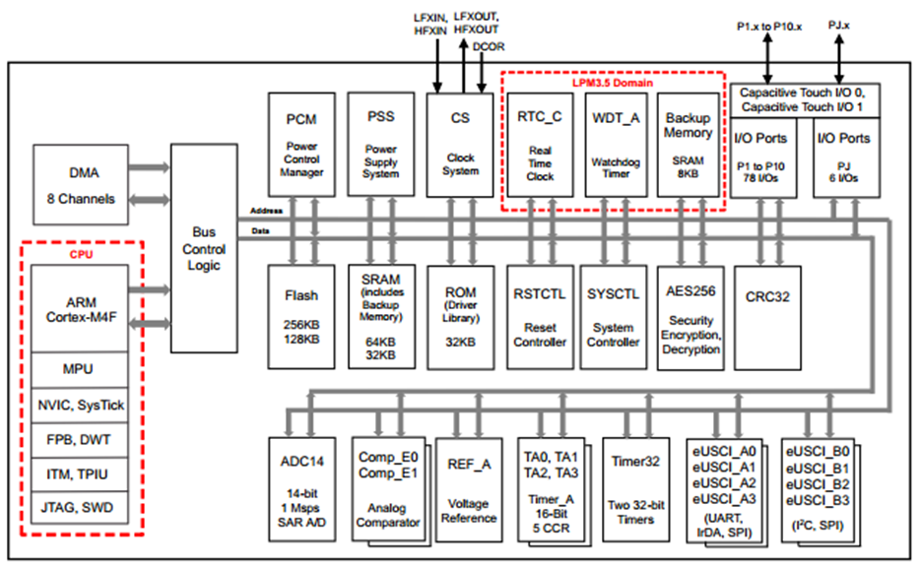
TI MSP432P401R Microcontroller High-Level Block Diagram

Slide 5
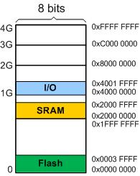
Memory Map in MSP432401P401R
 | Allocated size | Allocated address
Flash | 256KB | 0x0000 0000 to 0x0003 FFFF
SRAM | 64KB | 0x2000 0000 to 0x2000 FFFF
I/O | All the peripherals | 0x4000 0000 to 0x4001 FFFF

Slide 6
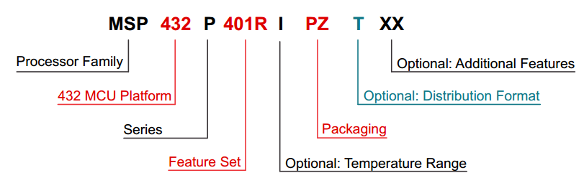
TI's naming convention for MSP432

Slide 7
TI's naming convention for MSP432 (Cont.)
Processor Family | MSP = Mixed Signal Processor XMS = Experimental Silicon
432 MCU Platform | TI’s 32-bit Low-Power Microcontroller Platform
Series | P = Performance and Low-Power Series
Feature Set | First Digit 4 = Flash based devices up to 48 MHz | Second Digit 0 = General Purpose | Third Digit 1 = ADC14 | Fourth Digit R = 256KB of Flash 64KB of SRAM M = 128KB of Flash 32KB of SRAM
Optional: Temperature Range | S = 0°C to 50 °C I = 40 °C to 85 °C T = –40 °C to 105 °C
Packaging | PZ = LQFP

Slide 8
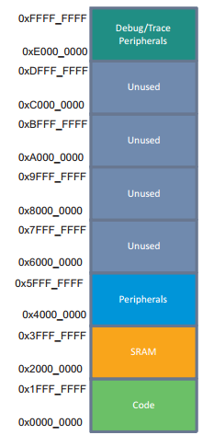
Memory zones in MS432

Slide 9
History and Features of MSP432
TI used the venerable 8051 microcontroller for their mixed signal processors
TI came up with MSP430 chip Due to the need for low power chip and 8051 limitations
MSP stands for Mixed Signal Processor
The MSP430 is a 16-bit RISC CPU designed and marketed exclusively by TI
In 2015, TI introduced an ARM-based device to the MSP430 Family and called it MSP432

Slide 10
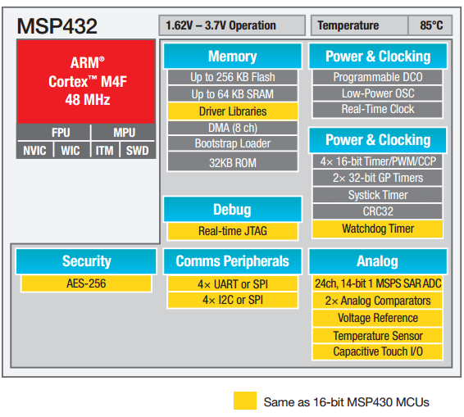
History and Features of MSP432 (Cont.)

Slide 11
Section 2.2: GPIO (General Purpose I/O) Programming and Interfacing
In the microcontroller, we have two types of I/O:
General Purpose I/O (GPIO): The GPIO ports are used for interfacing devices such as LEDs, switches, LCD, keypad, and so on.
Special purpose I/O: These I/O ports have designated function such as ADC (Analog-to-Digital), Timer, UART (universal asynchronous receiver transmitter), and so on.

Slide 12
GPIO
The GPIO ports in MSP432 are designated as port P1 to P10 + PJ
P1 to P10 are also referred as the Simple I/O or Digital I/O ports
port J has special function such as external crystal oscillator and JTAG connections
The base address of I/O port is 0x4000 4C00

Slide 13
GPIO Offset Addresses
GPIO P1 : 0x4000 4C00 + 0 (even addresses)
GPIO P2 : 0x4000 4C00 + 1 (odd addresses)
GPIO P3 : 0x4000 4C00 + 20 (even addresses)
GPIO P4 : 0x4000 4C00 + 21 (odd addresses)
GPIO P5 : 0x4000 4C00 + 40 (even addresses)
GPIO P6 : 0x4000 4C00 + 41 (odd addresses)
GPIO P7 : 0x4000 4C00 + 60 (even addresses)
GPIO P8 : 0x4000 4C00 + 61 (odd addresses)
GPIO P9 : 0x4000 4C00 + 80 (even addresses)
GPIO P10 : 0x4000 4C00 + 81 (odd addresses)

Slide 14
I/O Pins in MSP432 LaunchPad board
I/O ports are named with numbers P1, P2, P3, and so on
The pins are designated as P1.0-P1.7, P2.0-P2.7, P3.0-P3.7, and so on
The MSP432P401R has Ports P0, P1, P2, P3, P4, P5, P6, P7, P8, P9, P10 and PJ
P10 and PJ have only 6 pins while all other ports have 8 pins
we can combine two 8-bit ports to come up with 16-bit port

Slide 15
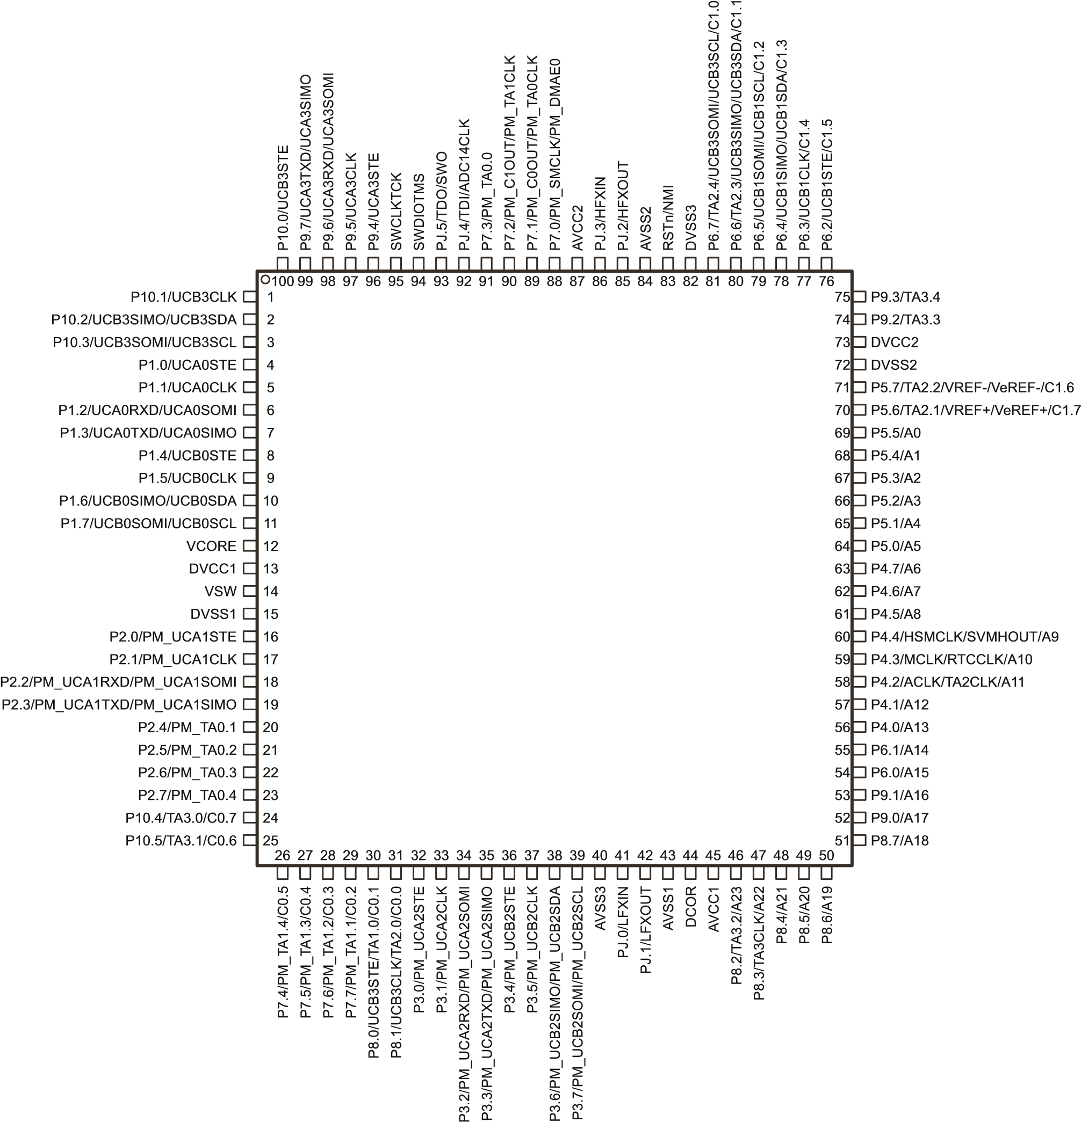
MSP432P401R 100-pin package pin-out

Slide 16
Direction and Data Registers
Generally every microcontroller has minimum of three registers associated with each of GPIO port
Data IN, Data Out, and Direction
The Direction register is used to make the pin either input or output
we use the Data register to actually write to the pin (PxOUT) or read data from the pin (PxIN)

Slide 17
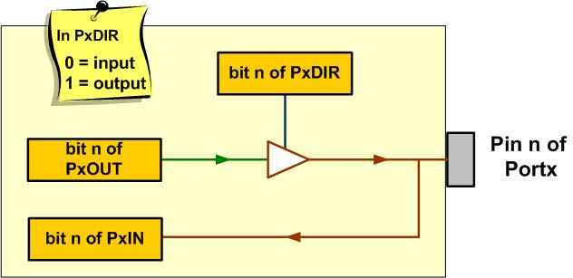
The Data and Direction Registers and a Simplified View of an I/O pin

Slide 18

Direction Register in MSP432 ARM
each of the Direction register bit needs to be a 0 to configure the port pin as input and a 1 as output
For example, by writing 0x03 (0b00000011 in binary) into the P1DIR register, pins 0 and 1 of P1 become outputs while the other pins become inputs.

Slide 19
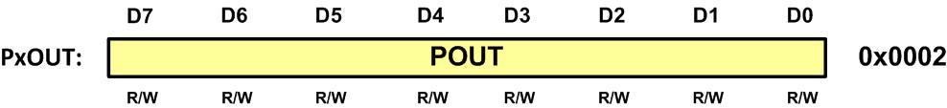
Port Data Output Register (PxOUT) in MSP432 ARM
To send data to pins, we write it to PxOUT register after the pin is configured as an output in the PxDIR register
For example, by writing 0x03 into the P1DIR register and 0x02 in P1OUT register, pin 0 of P1 become 0 while pin 1 of P1 become 1.

Slide 20
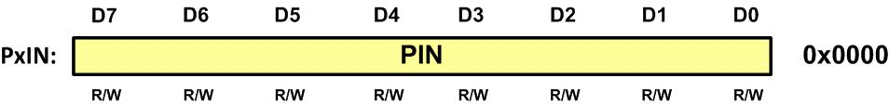
Port Data Input Register (PxIN) in MSP432 ARM
To bring into CPU data from a pin, we read it from PxIN register after the pin is configured as an input in the PxDIR register

Slide 21
Some commonly Used Registers of PORT1
Address | Name | Description | Type | Reset Value
0x4000 4C00 | P1IN | Port1 Input Register | R | 0b00000000
0x4000 4C02 | P1OUT | Port1 Output Register | R/W | 0b00000000
0x4000 4C04 | P1DIR | Port1Direction Register | R/W | 0b00000000
0x4000 4C06 | P1REN | Port1 Resistor Enable Register | R/W | 0b00000000
0x4000 4C08 | P1DS | Port1 Drive Strength Register | R/W | 0b00000000
0x4000 4C0A | P1SEL0 | Port1Select 0 Register | R/W | 0b00000000
0x4000 4C0C | P1SEL1 | Port1Select 1 Register | R/W | 0b00000000

Slide 22
Some commonly Used Registers of PORT2
Address | Name | Description | Type | Reset Value
0x4000 4C01 | P2IN | Port2 Input Register | R | 0b00000000
0x4000 4C03 | P2OUT | Port2 Output Register | R/W | 0b00000000
0x4000 4C05 | P2DIR | Port2 Direction Register | R/W | 0b00000000
0x4000 4C07 | P2REN | Port2 Resistor Enable Register | R/W | 0b00000000
0x4000 4C09 | P2DS | Port2 Drive Strength Register | R/W | 0b00000000
0x4000 4C0B | P2SEL0 | Port2 Select 0 Register | R/W | 0b00000000
0x4000 4C0D | P2SEL1 | Port2 Select 1 Register | R/W | 0b00000000

Slide 23
Some commonly Used Registers for PORT3
Address | Name | Description | Type | Reset Value
0x4000 4C20 | P3IN | Port3 Input Register | R | 0b00000000
0x4000 4C22 | P3OUT | Port3 Output Register | R/W | 0b00000000
0x4000 4C24 | P3DIR | Port3 Direction Register | R/W | 0b00000000
0x4000 4C26 | P3REN | Port3 Resistor Enable Register | R/W | 0b00000000
0x4000 4C28 | P3DS | Port3 Drive Strength Register | R/W | 0b00000000
0x4000 4C2A | P3SEL0 | Port3 Select 0 Register | R/W | 0b00000000
0x4000 4C2C | P3SEL1 | Port3 Select 1 Register | R/W | 0b00000000

Slide 24
Some commonly Used Registers of PORT4
Address | Name | Description | Type | Reset Value
0x4000 4C21 | P4IN | Port4 Input Register | R | 0b00000000
0x4000 4C23 | P4OUT | Port4 Output Register | R/W | 0b00000000
0x4000 4C25 | P4DIR | Port4 Direction Register | R/W | 0b00000000
0x4000 4C27 | P4REN | Port4 Resistor Enable Register | R/W | 0b00000000
0x4000 4C29 | P4DS | Port4 Drive Strength Register | R/W | 0b00000000
0x4000 4C2B | P4SEL0 | Port4 Select 0 Register | R/W | 0b00000000
0x4000 4C2D | P4SEL1 | Port4 Select 1 Register | R/W | 0b00000000

Slide 25

Port Pull-up or Pull-down Resistor Enable Register (PxREN) in MSP432 ARM
When a pin is configured as an input pin, you may enable the built-in pull-up or pull-down resistor attached to that pin
To enable the pull resistor, you need to set the corresponding bit in the PxREN register of that port
Pull-up or pull-down resistor is only used when the pin is configured as an input pin

Slide 26
Example
Find the value for P2DIR, P2OUT, and P2REN to configure the P2 pins as inputs. Pull down P2.0 and pull up P2.1.
Solution:
P2DIR = 0b00000000 = 0x00
P2REN = 0b00000011 = 0x03
P2OUT = 0b00000010 = 0x02

Slide 27
Alternate pin functions and the simple GPIO
Each pin of the MSP432 ARM chip can be used for one of several functions
The function associated with a pin is chosen by programming PxSEL1 and PxSEL0 function selection registers
For example, a given pin can be used as simple digital I/O (GPIO), analog input, or I2C pin
Using a single pin for multiple functions is called pin multiplexing
In the absence of pin multiplexing, a microcontroller will need many more pins to support all of its on-chip features.

Slide 28
Alternate pin functions and the simple GPIO (Cont.)
The PxSEL1 and PxSEL0 (Portx Selection 1 and 0 function selection) registers allow us to program a pin to be used for a given alternate function
Upon reset, ports 1 to 10 are configured for simple I/O. At any given situation
To use a pin as simple digital I/O, we must choose PxSEL1:PxSEL0=00 option

Slide 29
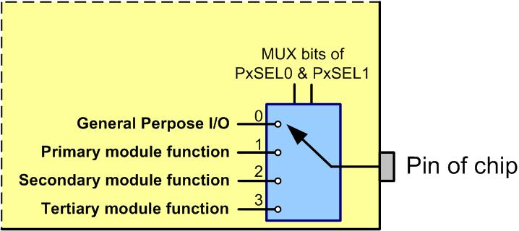
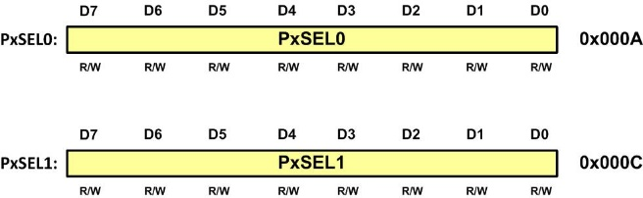
Alternate pin functions and the simple GPIO (Cont.)

Slide 30
Alternate pin functions and the simple GPIO (Cont.)
Upon power-on reset, the default selection is Simple I/O (PxSEL1:PXSEL0 = 00) for all pins
For option PxSEL1:PXSEL0 = 01, the pins may have alternate functions of UART, SPI, and I2C, timers, and so on
For option 2, some of the alternate functions are associated with timers
The analog functions ADC and comparators use alternate function 3

Slide 31
Alternate pin functions and the simple GPIO (Cont.)
PxSEL1.y | PxSEL0.y | Meaning
0 | 0 | Alternative 0 (Default) Simple I/O
0 | 1 | Alternative 1 (UART, SPI, I2C, …)
1 | 0 | Alternative 2 (Timers, …)
1 | 1 | Alternative 3 (ADC, Comparator, …)

Slide 32
MSP432 Port1 Alternative Pin Functions
Pin Name | SEL = 00 | SEL = 01 | SEL = 10 | SEL = 11
P1.0 | Simple I/O | UCA0STE | - | -
P1.1 | Simple I/O | UCA0CLK | - | -
P1.2 | Simple I/O | UCA0RXD/UCA0SOMI | - | -
P1.3 | Simple I/O | UCA0TXD/UCA0SIMO | - | -
P1.4 | Simple I/O | UCB0STE | - | -
P1.5 | Simple I/O | UCB0CLK | - | -
P1.6 | Simple I/O | UCB0SIMO/UCB0SDA | - | -
P1.7 | Simple I/O | UCB0SOMI/UCB0SCL | - | -

Slide 33
MSP432 Port2 Alternative Pin Functions
Pin Name | SEL = 00 | SEL = 01 | SEL = 10 | SEL = 11
P2.0 | Simple I/O | PM_UCA1STE | - | -
P2.1 | Simple I/O | PM_UCA1CLK | - | -
P2.2 | Simple I/O | PM_UCA1RXD/ PM_UCA1SOMI | - | -
P2.3 | Simple I/O | PM_UCA1TXD/ PM_UCA1SIMO | - | -
P2.4 | Simple I/O | PM_TA0.1 | - | -
P2.5 | Simple I/O | PM_TA0.2 | - | -
P2.6 | Simple I/O | PM_TA0.3 | - | -
P2.7 | Simple I/O | PM_TA0.4 | - | -

Slide 34
MSP432 Port3 Alternative Pin Functions
Pin Name | SEL = 00 | SEL = 01 | SEL = 10 | SEL = 11
P3.0 | Simple I/O | PM_UCA2STE | - | -
P3.1 | Simple I/O | PM_UCA2CLK | - | -
P3.2 | Simple I/O | PM_UCA2RXD/ PM_UCA2SOMI | - | -
P3.3 | Simple I/O | PM_UCA2TXD/ PM_UCA2SIMO | - | -
P3.4 | Simple I/O | PM_UCB2STE | - | -
P3.5 | Simple I/O | PM_UCB2CLK | - | -
P3.6 | Simple I/O | PM_UCB2SIMO/ PM_UCB2SDA | - | -
P3.7 | Simple I/O | PM_UCB2SOMI/ PM_UCB2SCL | - | -

Slide 35
MSP432 Port4 Alternative Pin Functions
Pin Name | SEL = 00 | SEL = 01 | SEL = 10 | SEL = 11
P4.0 | Simple I/O | - | - | A13
P4.1 | Simple I/O | - | - | A12
P4.2 | Simple I/O | ACLK | TA2CLK | A11
P4.3 | Simple I/O | MCLK | RTCCLK | A10
P4.4 | Simple I/O | HSMCLK | SVMHOUT | A9
P4.5 | Simple I/O | - | - | A8
P4.6 | Simple I/O | - | - | A7
P4.7 | Simple I/O | - | - | A6

Slide 36
MSP432 Port5 Alternative Pin Functions
Pin Name | SEL = 00 | SEL = 01 | SEL = 10 | SEL = 11
P5.0 | Simple I/O | - | - | A5
P5.1 | Simple I/O | - | - | A4
P5.2 | Simple I/O | - | - | A3
P5.3 | Simple I/O | - | - | A2
P5.4 | Simple I/O | - | - | A1
P5.5 | Simple I/O | - | - | A0
P5.6 | Simple I/O | TA2.1 | - | VREF+/VeREF+/C1.7
P5.7 | Simple I/O | TA2.2 | - | VREF-/VeREF-/C1.6

Slide 37
MSP432 Port6 Alternative Pin Functions
Pin Name | SEL = 00 | SEL = 01 | SEL = 10 | SEL = 11
P6.0 | Simple I/O | - | - | A15
P6.1 | Simple I/O | - | - | A14
P6.2 | Simple I/O | UCB1STE | - | C1.5
P6.3 | Simple I/O | UCB1CLK | - | C1.4
P6.4 | Simple I/O | UCB1SIMO/ UCB1SDA | - | C1.3
P6.5 | Simple I/O | UCB1SOMI/ UCB1SCL | - | C1.2
P6.6 | Simple I/O | TA2.3 | UCB3SIMO/ UCB3SDA | C1.1
P6.7 | Simple I/O | TA2.4 | UCB3SOMI/ UCB3SCL | C1.0

Slide 38
MSP432 Port7 Alternative Pin Functions
Pin Name | SEL = 00 | SEL = 01 | SEL = 10 | SEL = 11
P7.0 | Simple I/O | PM_SMCLK/ PM_DMAE0 | - | -
P7.1 | Simple I/O | PM_C0OUT/ PM_TA0CLK | - | -
P7.2 | Simple I/O | PM_C1OUT/ PM_TA1CLK | - | -
P7.3 | Simple I/O | PM_TA0.0 | - | -
P7.4 | Simple I/O | PM_TA1.4 | - | C0.5
P7.5 | Simple I/O | PM_TA1.3 | - | C0.4
P7.6 | Simple I/O | PM_TA1.2 | - | C0.3
P7.7 | Simple I/O | PM_TA1.1 | - | C0.2

Slide 39
MSP432 Port8 Alternative Pin Functions
Pin Name | SEL = 00 | SEL = 01 | SEL = 10 | SEL = 11
P8.0 |  | UCB3STE | TA1.0 | C0.1
P8.1 |  | UCB3CLK | TA2.0 | C0.0
P8.2 |  | TA3.2 |  | C0.0
P8.3 |  | TA3CLK |  | A22
P8.4 |  |  |  | A21
P8.5 |  |  |  | A20
P8.6 |  |  |  | A19
P8.7 |  |  |  | A18

Slide 40
MSP432 Port9 Alternative Pin Functions
Pin Name | SEL = 00 | SEL = 01 | SEL = 10 | SEL = 11
P9.0 |  |  |  | A17
P9.1 |  |  |  | A16
P9.2 |  | TA3.3
P9.3 |  | TA3.4
P9.4 |  | UCA3STE
P9.5 |  | UCA3CLK
P9.6 |  | UCA3RXD/ UCA3SOMI
P9.7 |  | UCA3TXD/ UCA3SIMO

Slide 41
MSP432 Port10 Alternative Pin Functions
Pin Name | SEL = 00 | SEL = 01 | SEL = 10 | SEL = 11
P10.0 |  | UCB3STE
P10.1 |  | UCB3CLK
P10.2 |  | UCB3SIMO/ UCB3SDA
P10.3 |  | UCB3SOMI/ UCB3SCL
P10.4 |  | TA3.0 |  | C0.7
P10.5 |  | TA3.1 |  | C0.6

Slide 42
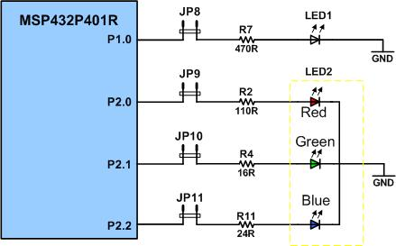
LED connection in MSP432 LaunchPad board
In the MSP432 LaunchPad board, we have a tri-color RGB LED connected to P2.0 (red), P2.1 (green), and P2.2 (blue)

Slide 43
Toggling LEDs in MSP432 LaunchPad board in C
Configure P2.1 (P2SEL1:P2SEL0 Register) to select simple GPIO function for P2.1,
set the Direction register bit 1of P2DIR as output,
write HIGH to bit 1 of P2OUT register to turn on the green LED,
call a delay function,
write LOW to bit 1 of P2OUT register to turn off the green LED,
call a delay function,
Repeat steps 3 to 7.

Slide 44
Toggling green LED on MSP432 LaunchPad in C (C Code)
int main(void) {
P2->SEL1 &= ~2; /* configure P2.1 as simple I/O */
P2->SEL0 &= ~2;
P2->DIR |= 2; /* P2.1 set as output pin */
while (1) {
P2->OUT |= 2; /* turn on P2.1 green LED */
delayMs(500);
P2->OUT &= ~2; /* turn off P2.1 green LED */
delayMs(500);
}
}

Slide 45
Toggling all three LEDs on MSP432 LaunchPad board (C Code)
int main(void) {
P2->SEL1 &= ~7; /* configure P2.2-P2.0 as simple I/O */
P2->SEL0 &= ~7;
P2->DIR |= 7; /* P2.2-2.0 set as output */
P2->OUT |= 7; /* turn all three LEDs on */
while (1) {
P2->OUT ^= 7; /* toggle P2.2-P2.0 all three LEDs */
delayMs(500);
}
}

Slide 46
CPU clock frequency and time delay
Usually microcontrollers have at least two types of clock source: the on-chip oscillator and the oscillator connected to external crystal
The advantage of the external crystal oscillator is the higher precision
The advantage of the on-chip oscillator is that it is always there
The clock from the source may be modified by a divider to reduce the clock rate or use a phase lock loop (PLL) circuit to produce a wider range of clock rates

Slide 47
CPU clock frequency and time delay in MSP432
The MSP432 has two oscillators connected to external crystal, LFXT and HFXT for low frequency crystal and high frequency crystal
The LFXT is designed to use a 32.768 KHz watch crystal
The HFXT can be used with crystals or resonators ranging from 1 MHz to 48 MHz
The MSP432 has five internal oscillators, among them the Digitally Controlled Oscillator (DCO) is the most flexible clock source that provides a wide range of clock frequencies

Slide 48
Measuring time delay in a C program loop
One simple way of creating a time delay is using a for-loop in C language
The length of time delay loop for a given system is function of two factors: a) the CPU frequency and b) the compiler
Regardless of clock source to CPU and the C compiler used, always use oscilloscope to measure the length of time delay loop for a given system with a given compiler and compiler option setting

Slide 49
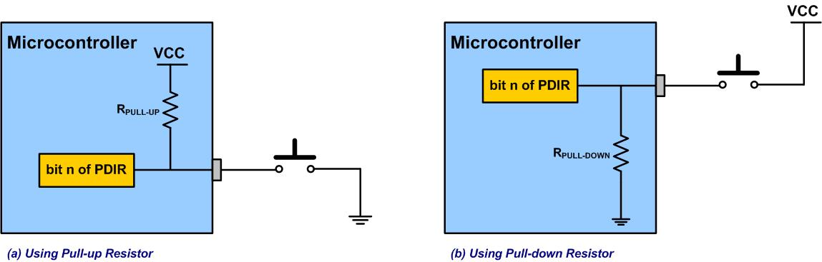
Connecting switches to MSP432

Slide 50
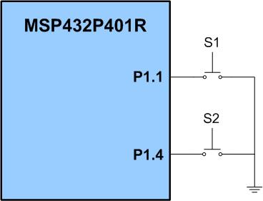
Reading a switch in MSP432 LaunchPad board

Slide 51
Reading a switch in MSP432
configure P1.1 as simple I/O in P1SEL1:P1SEL0 registers,
make P1.1 input pin in P1DIR register for push-button switch S1,
configure P1REN register to enable the pull resistor,
configure P1OUT register to select the pull-up resistor,
configure P2.0 as simple I/O in P2SEL1:P2SEL0 registers,
make P2.0 output pin in P2DIR register for red LED,
read switch from P1.1,
if P1.1(switch) is high, set P2.0 (red LED)
else clear P2.0 (red LED)
Repeat steps 7 to 9.

Slide 52
Reading a switch and displaying it on LED
int main(void) {
P1->SEL1 &= ~2; /* configure P1.1 as simple I/O */
P1->SEL0 &= ~2;
P1->DIR &= ~2; /* P1.1 set as input */
P1->REN |= 2; /* P1.1 pull resistor enabled */
P1->OUT |= 2; /* Pull up/down is selected by P1->OUT */
P2->SEL1 &= ~1; /* configure P2.0 as simple I/O */
P2->SEL0 &= ~1;
P2->DIR |= 1; /* P2.0 set as output pin */
while (1) {
if (P1->IN & 2) /* use switch 1 to control red LED */
P2->OUT &= ~1; /* turn off P2.0 red LED when SW is not pressed */
else
P2->OUT |= 1; /* turn on P2.0 red LED when SW is pressed */
}
}

Slide 53
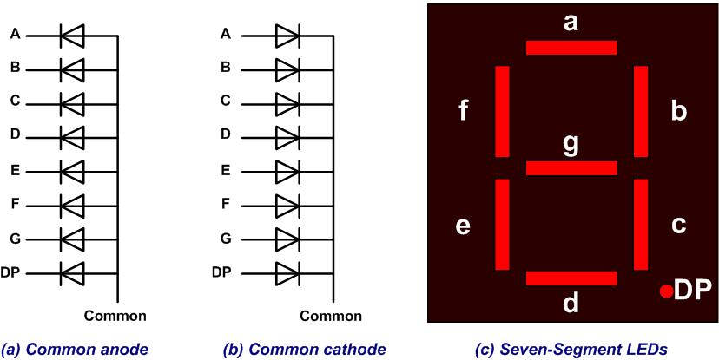
Seven-Segment LED

Slide 54
Assignments of port pins to each segments of a 7-seg LED
D7 | D6 | D5 | D4 | D3 | D2 | D1 | D0
. | g | f | e | d | c | b | a

Slide 55
Segment patterns for the 10 decimal digits for a common cathode 7-seg LED
Num | D7 | D6 | D5 | D4 | D3 | D2 | D1 | D0 | Hex value
 | . | g | f | e | d | c | b | a
0 | 0 | 0 | 1 | 1 | 1 | 1 | 1 | 1 | 0x3F
1 | 0 | 0 | 0 | 0 | 0 | 1 | 1 | 0 | 0x06
2 | 0 | 1 | 0 | 1 | 1 | 0 | 1 | 1 | 0x5B
3 | 0 | 1 | 0 | 0 | 1 | 1 | 1 | 1 | 0x4F
4 | 0 | 1 | 1 | 0 | 0 | 1 | 1 | 0 | 0x66
5 | 0 | 1 | 1 | 0 | 1 | 1 | 0 | 1 | 0x6D
6 | 0 | 1 | 1 | 1 | 1 | 1 | 0 | 1 | 0x7D
7 | 0 | 0 | 0 | 0 | 0 | 1 | 1 | 1 | 0x07
8 | 0 | 1 | 1 | 1 | 1 | 1 | 1 | 1 | 0x7F
9 | 0 | 1 | 1 | 0 | 1 | 1 | 1 | 1 | 0x6F

Slide 56
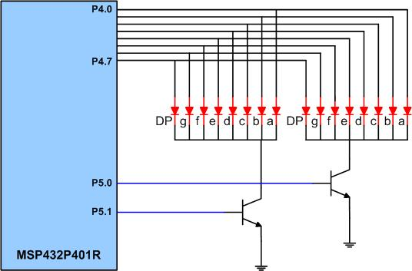
Microcontroller Connection to 7-segment LED

Slide 57
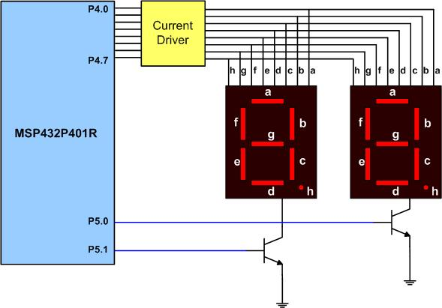
Microcontroller Connection to 7-segment LED with Buffer Driver

Slide 58
Seven-segment LED interfacing and programming
if we want to display number 75 on the 7-seg LED, the following steps should be used:
1) Configure Port 4 as output port to drive the segments,
2) Configure Port 5 as output port to select the digits,
3) Write the pattern of numeral 7 from Table 2 10 to Port 4,
4) Clear the P5.0 pin to turn off the ones digit,
5) Set the P5.1 pin HIGH to activate the tens digit,
6) Delay for some time,
7) Write the pattern of numeral 5 from Table 2 10 to Port 4,
8) Clear the P5.1 pin to turn off the tens digit,
9) Set the P5.0 pin HIGH to activate the ones digit,
10) Delay for some time,
11) Repeat from step 3 to 11.

Slide 59
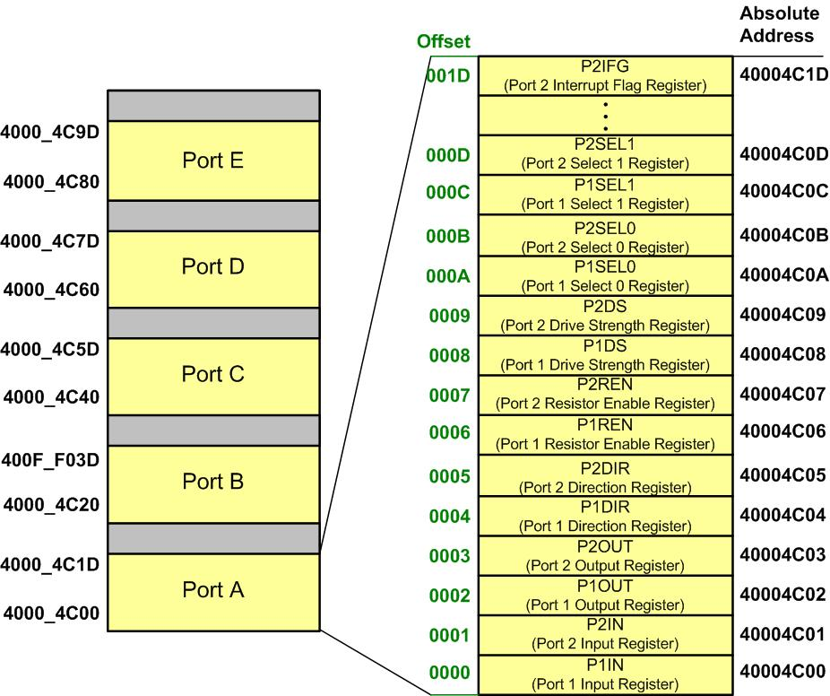
16-bit I/O Memory Map

