Slide 1
Chapter 11
PWM and DC Motor Control

Slide 2
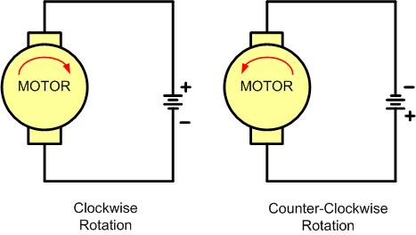
DC Motor Rotation (Permanent Magnet Field)

Slide 3
Selected DC Motor Characteristics
(http://www.Jameco.com)
Part No. | Nominal Volts | Volt Range | Current | RPM | Torque
154915CP | 3 V | 1.5–3 V | 0.070 A | 5,200 | 4.0 g-cm
154923CP | 3 V | 1.5–3 V | 0.240 A | 16,000 | 8.3 g-cm
177498CP | 4.5 V | 3–14 V | 0.150 A | 10,300 | 33.3 g-cm
181411CP | 5 V | 3–14 V | 0.470 A | 10,000 | 18.8 g-cm

Slide 4
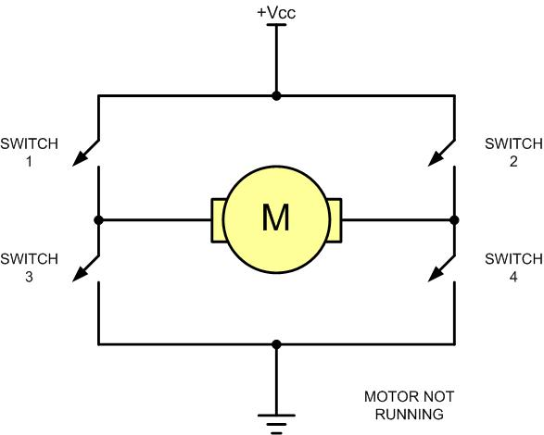
H-Bridge Motor Configuration

Slide 5
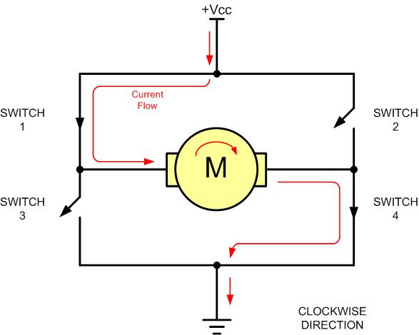
H-Bridge Motor Clockwise Configuration

Slide 6
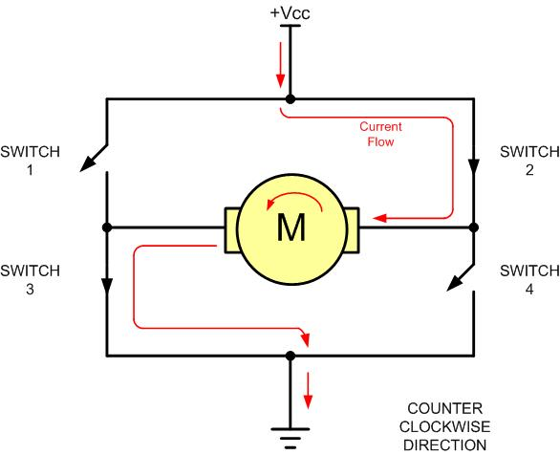
H-Bridge Motor Counterclockwise Configuration

Slide 7
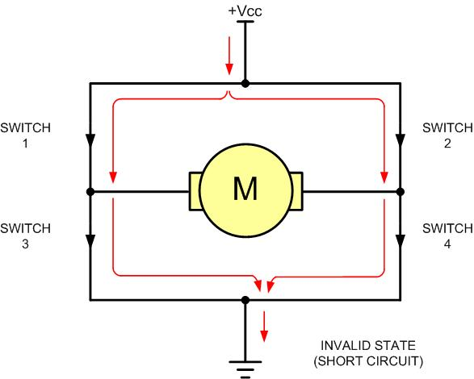
H-Bridge in an Invalid Configuration

Slide 8
Some H-Bridge Logic Configurations
Motor Operation | SW1 | SW2 | SW3 | SW4
Off | Open | Open | Open | Open
Clockwise | Closed | Open | Open | Closed
Counterclockwise | Open | Closed | Closed | Open
Invalid | Closed | Closed | Closed | Closed

Slide 9
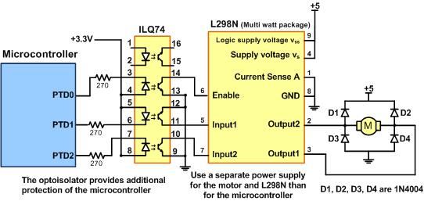
Bidirectional Motor Control Using an L298 Chip

Slide 10
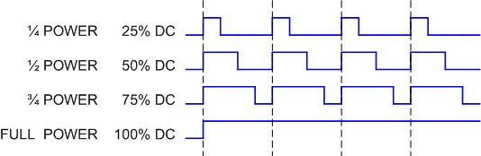
Pulse Width Modulation Comparison

Slide 11
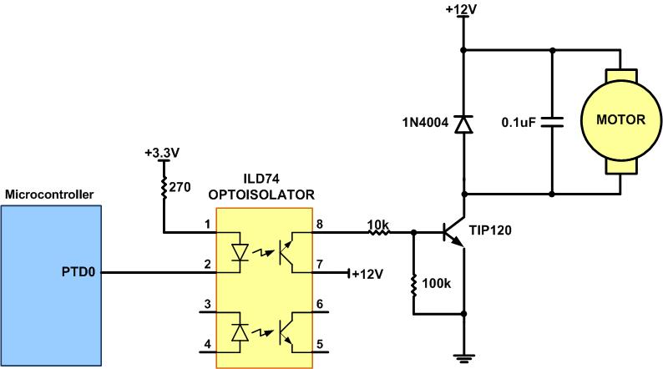
DC Motor Connection Using a Darlington Transistor

Slide 12
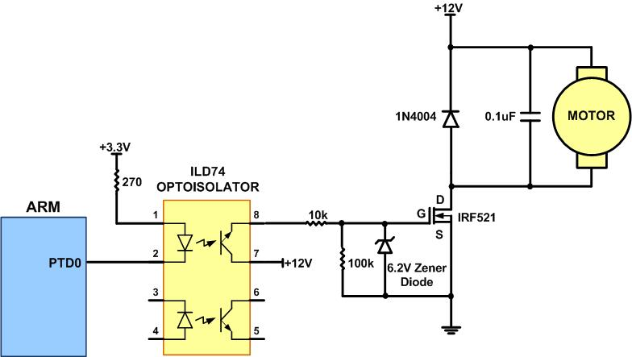
DC Motor Connection Using a MOSFET Transistor

Slide 13
TAxCTL (Timer_A Control Register)

Slide 14
TAxCTL (Timer_A Control Register)
bit | Name | Description
0 | TAIFG | Timer-A Interrupt Flag 0: Timer did not overflow 1: Timer overflowed
1 | TAIE | Timer_A Interrupt Enable (0: Disabled, 1: Enabled)
2 | TACLR | Timer_A Clear
4-5 | MC | Mode Control: 00: Stop mode: timer is halted 01: Up mode: Timer counts up to TAxCCR0 10: Continuous mode: Timer counts up to 0xFFFF 11: Up/down mode: Timer counts up to TAxCCR0 then down to 0.

Slide 15
TAxCTL (Timer_A Control Register) (Cont.)
bit | Name | Description
6-7 | ID | Input divider: These bits select the divider for the input clock: 00: divide by 1 01: divide by 2 10: divide by 4 11: divide by 8
8-9 | TASSEL | Timer_A clock Source Select: These bits select the Timer_A clock source: 00: TAxCLK (external clock): The timer uses external clock which is fed to the PM_TAxCLK pin. 01: ACLK (internal clock) 10: SMCLK (internal clock) 11: INCLK

Slide 16
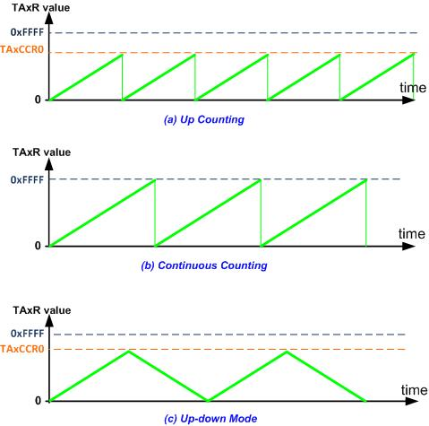
Up/Down-Counter and Up-Counter

Slide 17
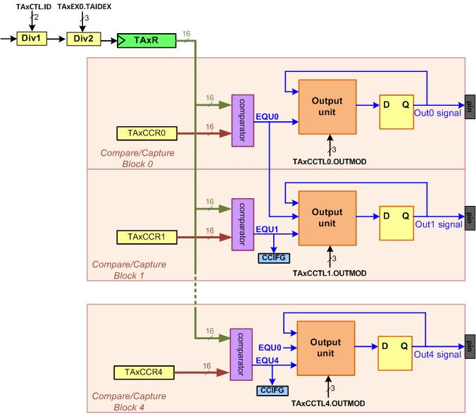
The Wave Generators of a Timer_A

Slide 18

TAxCCTLn Register

Slide 19
TAxCCTLn Register
bit | Name | Description
15-14 | CM | Capture mode 00: No capture 01: Capture on rising edge 10: Capture on falling edge 11: Capture on both rising and falling edges
13-12 | CCIS | Capture/compare input select. These bits select the TAxCCR0 input signal: 00: CCIxA 01: CCIxB 10: GND 11: VCC
11 | SCS | Synchronize capture source. This bit is used to synchronize the capture input signal with the timer clock. 0: Asynchronous capture 1: Synchronous capture

Slide 20
TAxCCTLn Register (Cont.)
bit | Name | Description
10 | SCCI | Synchronized capture/compare input. The selected CCI input signal is latched with the EQUx signal and can be read via this bit.
8 | CAP | Capture mode 0: Compare mode 1: Capture mode
7-5 | OUTMOD | Output mode. Modes 2, 3, 6, and 7 are not useful for TAxCCR0 because EQUx = EQU0 000: OUT bit value 001: Set 010: Toggle/reset 011: Set/reset 100: Toggle 101: Reset 110: Toggle/set 111: Reset/set

Slide 21
TAxCCTLn Register (Cont.)
bit | Name | Description
4 | CCIE | Capture/compare interrupt enable. This bit enables the interrupt request of the corresponding CCIFG flag. 0: Interrupt disabled 1: Interrupt enabled
3 | CCI | Capture/compare input. The selected input signal can be read by this bit.
2 | OUT | Output. For output mode 0, this bit directly controls the state of the output. 0: Output low 1: Output high
1 | COV | Capture overflow. This bit indicates a capture overflow occurred. COV must be reset with software. 0: No capture overflow occurred 1: Capture overflow occurred
0 | CCIFG | Capture/compare interrupt flag 0: No interrupt pending 1: interrupt pending

Slide 22
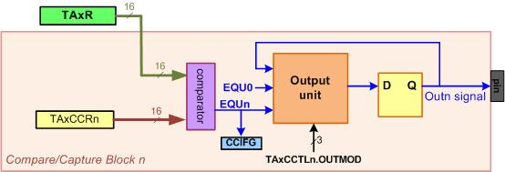
A Compare Block

Slide 23
Output Changes in Up and Continuous Modes
OUTMODE | output mode | when EQUn rises (TAxR = TAxCCRn) | when EQU0 rises (TAxR = TAxCCR0)
001 | Set | sets the output | does nothing
010 | Toggle/Reset | toggles the output | resets the output
011 | Set/Reset | sets the output | clears the output
100 | Toggle | toggles the output | does nothing
101 | Reset | clears the output | does nothing
110 | Toggle/Set | toggles the output | sets the output
111 | Reset/Set | clears the output | sets the output

Slide 24
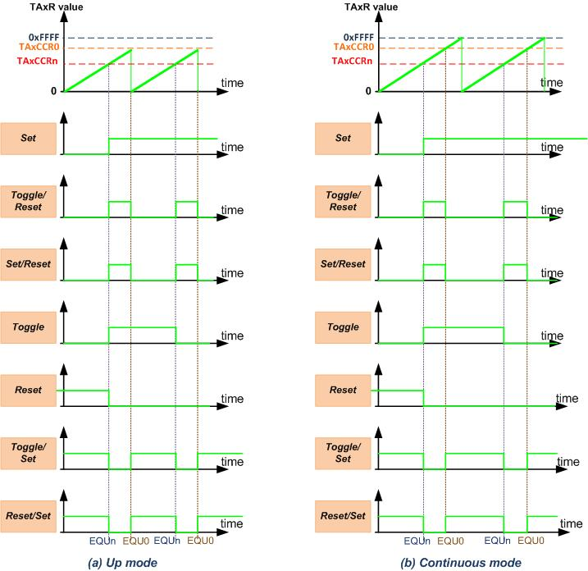
Output Modes in Up-Counting and Continuous-Counting

Slide 25
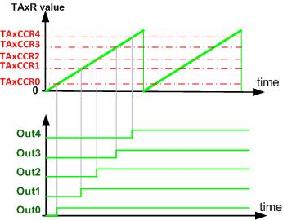
Setting 5 Outputs using 5 Comparators

Slide 26
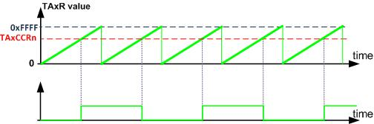
Generating Square Waves using Toggle Mode

Slide 27
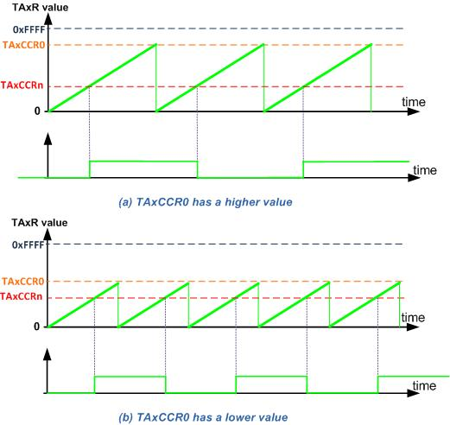
Changing the Frequency using TAxCCR0

Slide 28
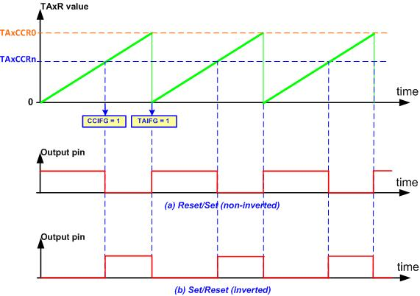
Edge-Aligned PWM

Slide 29
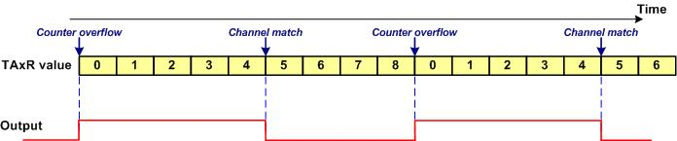
The PWM output for TAxCCR0 = 8, TAxCCRn = 5, Output Mode = Set/Reset (non-inverted)

Slide 30
Output Changes in Up-Down Mode
OUTMODE | mode | when TAxR = TAxCCRn | when TAxR = TAxCCR0
001 | Set | sets the output | does nothing
010 | Toggle/Reset | clears the output if the timer is increasing; otherwise, toggles. | does nothing
011 | Set/Reset | sets the output if the timer is decreasing | clears the output
100 | Toggle | toggles the output in all matches | does nothing
101 | Reset | clears the output | does nothing
110 | Toggle/Set | sets the output if the timer is increasing; otherwise, toggles. | does nothing
111 | Reset/Set | clears the output if the timer is decreasing | sets the output

Slide 31
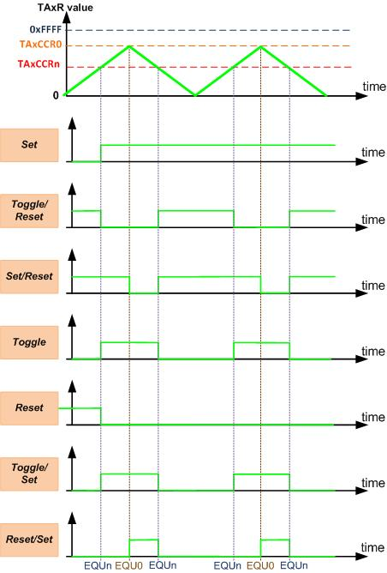
Generated Waves in Different Output Modes in Up-Down Counting

Slide 32
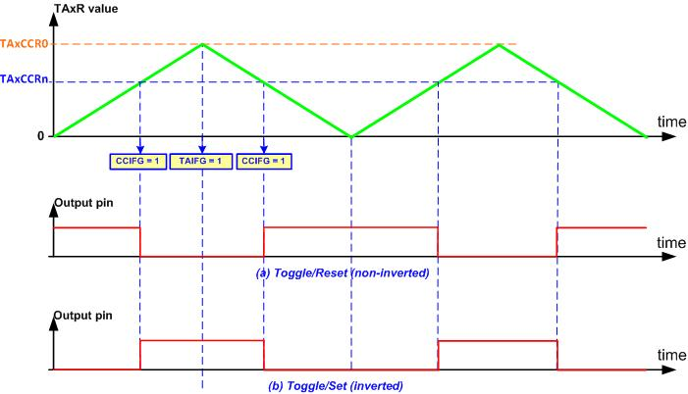
Center-Aligned PWM using Up-Down Mode

Slide 33
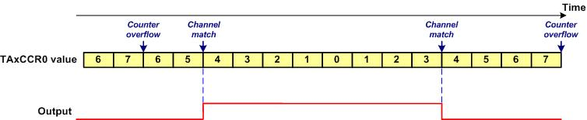
The PWM output for TAxCCR0 = 7, TAxCCRn = 4, Toggle/Reset (non-inverted)

Slide 34
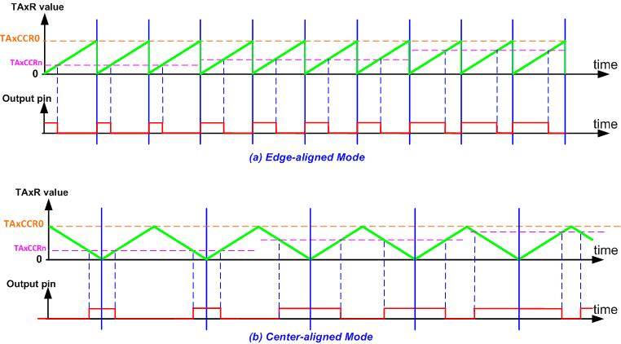
Edge-aligned vs. Center-aligned Mode

Slide 35
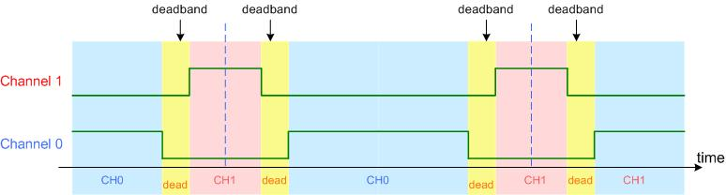
Dead band

