Slide 1
Chapter9
I2C Protocol and RTC Interfacing

Slide 2
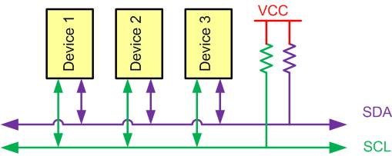
I2C Bus Characteristics

Slide 3
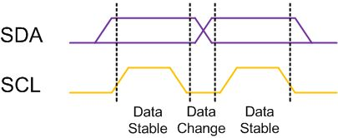
I2C Bit Format

Slide 4
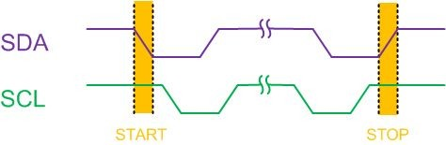
START and STOP Conditions

Slide 5
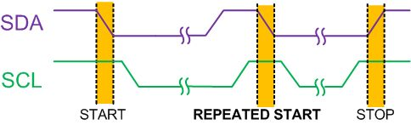
REPEATED START Condition

Slide 6
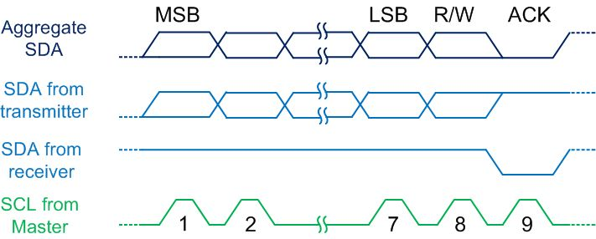
Byte Format in I2C

Slide 7
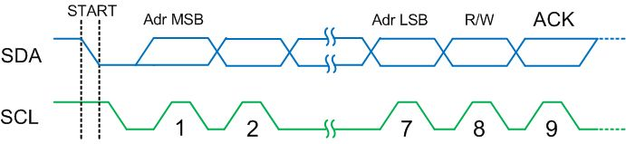
Address Byte Format in I2C

Slide 8
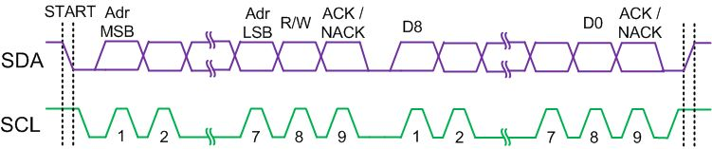
Typical Data Transmission

Slide 9
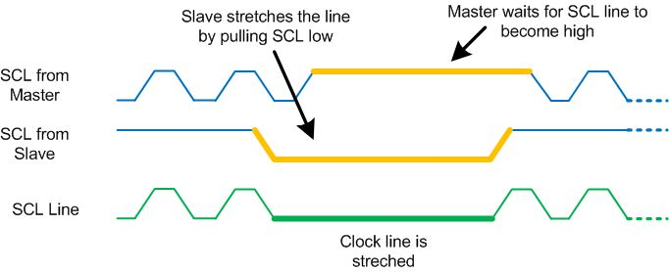
Clock Stretching

Slide 10
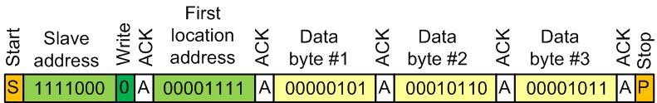
Multi-byte Burst Write

Slide 11
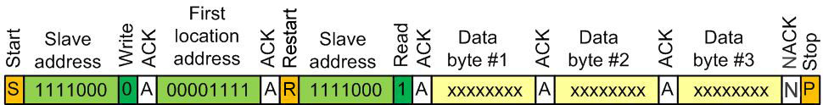
Multi-byte Burst Read

Slide 12
I2C Module Base Address for KL25Z
SSI Module | Base Address
I2C0 | 0x4006 6000
I2C1 | 0x4006 7000

Slide 13

SIM_SCGC4 register bits for enabling I2C clock

Slide 14
SIM_SCGC4 Description
Bits | Name | Function | Description
6 | I2C0 | I2C 0 Clock Gating Control | 1 to enable and 0 to disable
7 | I2C1 | I2C 1 Clock Gating Control | 1 to enable and 0 to disable

Slide 15
I2C_F Register to Set I2C Baud Rate

Slide 16
I2C_F Register
Bits | Field | Descriptions
6-7 | MULT | This field defines the multiply factor to the SCL divider.
0-5 | ICR | I2C Clock Rate: this field defines the prescaler value.

Slide 17
ICR and SCL Divider (From KL25Z Reference Manual)
ICR (Hex) | SCL divider | ICR (Hex) | SCL divider | ICR (Hex) | SCL divider | ICR (Hex) | SCL divider
00 | 20 | 10 | 48 | 20 | 160 | 30 | 640
01 | 22 | 11 | 56 | 21 | 192 | 31 | 768
02 | 24 | 12 | 64 | 22 | 224 | 32 | 896
03 | 26 | 13 | 72 | 23 | 256 | 33 | 1024
04 | 28 | 14 | 80 | 24 | 288 | 34 | 1152
05 | 30 | 15 | 88 | 25 | 320 | 35 | 1280
06 | 34 | 16 | 104 | 26 | 384 | 36 | 1536
07 | 40 | 17 | 128 | 27 | 480 | 37 | 1920
08 | 28 | 18 | 80 | 28 | 320 | 38 | 1280
09 | 32 | 19 | 96 | 29 | 384 | 39 | 1536
0A | 36 | 1A | 112 | 2A | 448 | 3A | 1792
0B | 40 | 1B | 128 | 2B | 512 | 3B | 2048
0C | 44 | 1C | 144 | 2C | 576 | 3C | 2304
0D | 48 | 1D | 160 | 2D | 640 | 3D | 2560
0E | 56 | 1E | 192 | 2E | 768 | 3E | 3072
0F | 68 | 1F | 240 | 2F | 960 | 3F | 3840

Slide 18
I2Cx_C1 Control register

Slide 19
I2Cx_C1 register bit Description
Bits | Name | Function | Description
7 | I2CEN | I2C Enable | 0: Disable, 1: Enable
5 | MST | I2C Master Mode Select | 1: Enable Master mode, 0: Slave mode
4 | TX | I2C Transmit Mode Select | 1: Transmit, 0: Receive
3 | TXAK | Transmit Acknowledge Enable | 1: Enable ACK, 0: Disable ACK

Slide 20
I2C_A1 slave address register

Slide 21
I2Cx_D Data register

Slide 22
I2Cx_S Register

Slide 23
I2Cx_R Register
Bit | Field | Description
7 | TCF | Transfer Complete Flag (0: Transfer in progress, 1: Transfer complete) Note: The flag is cleared by reading the I2C_D register in receive mode and writing to the I2C_D register in transmit mode.
6 | IAAS | Addressed As A Slave: The flag is set if the microcontroller is addressed by another device on the I2C bus. (0: Not addressed, 1: Addressed as a slave)
5 | BUSY | Bus Busy (0: Bus is idle, 1: Bus is busy)
4 | ARBL | Arbitration Lost (0: Standard bus operation, 1: Loss of arbitration) Note: The bit must by be cleared by software, by writing a 1 to it.
3 | RAM | Range Address Match: The flag is set if the received calling address matches the address range of the microcontroller. (0: Not addressed, 1: Addressed as a slave)
2 | SRW | Slave Read/Write: When the microcontroller is called on the bus, the bit indicates the R/W bit. (0: the microcontroller must receive, 1: microcontroller must transmit.)
1 | IICIF | I2C Interrupt Flag (0: No interrupt pending, 1: interrupt pending)
0 | RXAK | Receive Acknowledge (0: acknowledge signal was received, 1: No acknowledge signal was received)

Slide 24
Addresses of some I2C Registers
Address | Register
4006 6000 | I2C Address Register 1 (I2C0_A1)
4006 6001 | I2C Frequency Divider register (I2C0_F)
4006 6002 | I2C Control Register 1 (I2C0_C1)
4006 6003 | I2C Status register (I2C0_S)
4006 6004 | I2C Data I/O register (I2C0_D)
4006 6005 | I2C Control Register 2 (I2C0_C2)
4006 7000 | I2C Address Register 1 (I2C1_A1)
4006 7001 | I2C Frequency Divider register (I2C1_F)
4006 7002 | I2C Control Register 1 (I2C1_C1)
4006 7003 | I2C Status register (I2C1_S)
4006 7004 | I2C Data I/O register (I2C1_D)
4006 7005 | I2C Control Register 2 (I2C1_C2)

Slide 25
I2C Pin Assignment
I2C Module | I/O Pin(ALTx) | I/O pin(ALTx) | I/O pin(ALTx) Pin
I2C0SCL | PTE24(ALT4) | PTA3(ALT2) | PTC8(ALT2)
I2C0SDA | PTE25(ALT4) | PTA4(ALT2) | PTC9(ALT2)
I2C1SCL | PTE1(ALT6) | PTC1(ALT2) | PTC10(ALT2)
I2C1SDA | PTE0(ALT6) | PTC2(ALT2) | PTC11(ALT2)

Slide 26
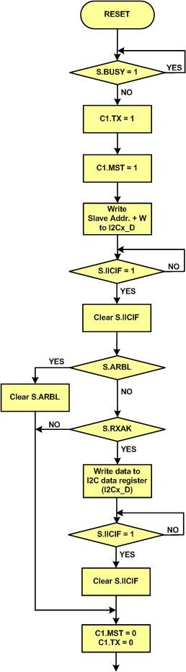
Master Single Transmit

Slide 27
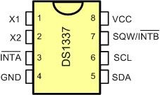
DS1337 Pins

Slide 28
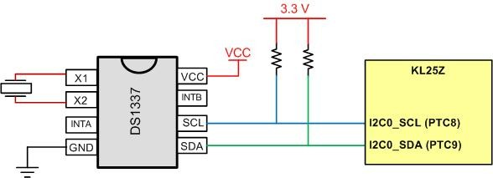
DS1337 Connections

Slide 29
DS1337 Address Map
Address | Bit7 | Bit6 | Bit5 | Bit4 | Bit3 | Bit2 | Bit1 |  | Bit0 |  | Function | Range
00H | 0 | 10 Seconds |  |  | Seconds |  |  |  |  |  | Seconds | 00-59
01H | 0 | 10 Minutes |  |  | Minutes |  |  |  |  |  | Minutes | 00-59
02H | 0 | 12/24 | 10 hour PM/AM | 10hour | Hours |  |  |  |  |  | Hours | 1-12 0-23
03H | 0 | 0 | 0 | 0 | 0 | Day |  |  |  |  | Day | 0-7
04H | 0 | 0 | 10 Date |  | Date |  |  |  |  |  | Date | 01-31
05H | Century | 0 | 0 | 10Mnt | Month |  |  |  |  |  | Month Century | 1-12+ Century
06H | 10 Year |  |  |  | Year |  |  |  |  |  | Year | 00-99
07H | A1M1 | 10 Seconds |  |  | Seconds |  |  |  |  |  | Alarm 1 Seconds | 00-59
08H | A1M2 | 10 Minutes |  |  | Minutes |  |  |  |  |  | Alarm 1 Minutes | 00-59
09H | A1M3 | 12/24 | AM/PM | 10 Hour | Hour |  |  |  |  |  | Alarm 1 Hours | 1-12 00-23
 |  |  | 10 Hour
0AH | A1M4 | DY/DT | 10 Date |  | Day |  |  |  |  |  | Alarm 1 Day | 1-7
 |  |  |  |  | Date |  |  |  |  |  | Alarm 1 Date | 01-31
0BH | A2M2 | 10 Minutes |  |  | Minutes |  |  |  |  |  | Alarm 2 Minutes | 00-59
0CH | A2M3 | 12/24 | AM/PM | 10 Hour | Hour |  |  |  |  |  | Alarm 2 Hours | 1-12 00-23
 |  |  | 10 Hour
0DH | A2M4 | DY/DT | 10 Date |  | Day |  |  |  |  |  | Alarm 2 Day | 1-7
 |  |  |  |  | Date |  |  |  |  |  | Alarm 2 Date | 01-31
0EH | EOSC | 0 | 0 | RS2 | RS1 | INTCN |  | A2IE |  | A1IE | Control | -
0FH | OSF | 0 | 0 | 0 | 0 | 0 |  | A2F |  | A1F | Status | -

Slide 30
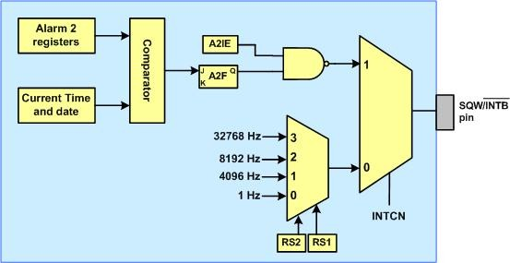
Simplified Structure of SQW/INTB Pin

Slide 31
RS bits
RS2 | RS1 | Output Frequency
0 | 0 | 1 Hz
0 | 1 | 4.096 kHz
1 | 0 | 8.192 kHz
1 | 1 | 32.768 kHz

Slide 32
Alarm 2 Register Mask Bits
DY/DT | A2M4 | A2M3 | A2M2 | Alarm Rate
X | 1 | 1 | 1 | Alarm once per minute
X | 1 | 1 | 0 | Alarm when minutes match
X | 1 | 0 | 0 | Alarm when hours and minutes match
0 | 0 | 0 | 0 | Alarm when date, hours, and minutes match
1 | 0 | 0 | 0 | Alarm when day, hours, and minutes match

