Slide 1
Chapter 5
Freescale ARM Timer Programming

Slide 2
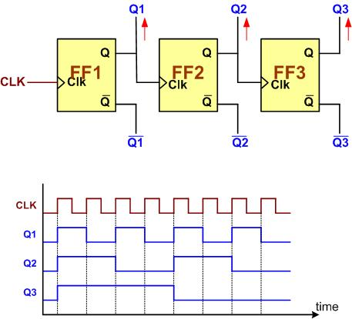
A 3-bit Counter

Slide 3

An 8-bit up-counter stages

Slide 4

An 8-bit down-counter stages

Slide 5

Counting Events Using a Counter

Slide 6
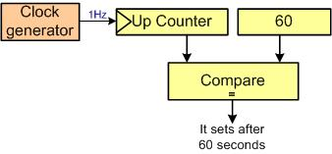
Using Counter as a Timer

Slide 7

Capturing

Slide 8
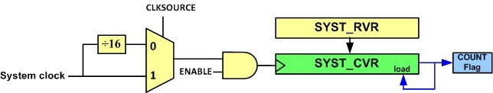
System Tick Timer Internal Structure

Slide 9
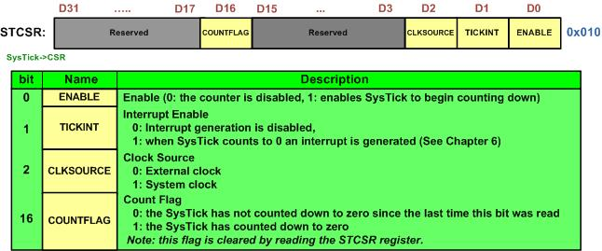
SYST_CSR (System Tick Control Status Register)

Slide 10
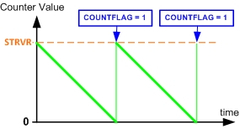
System Tick Counting

Slide 11
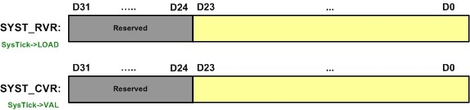
SYST_RVR vs. SYST_CVR

Slide 12
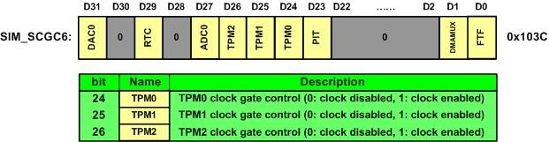
SIM_SCGC6 (SIM Clock Gating Control Register 6)

Slide 13
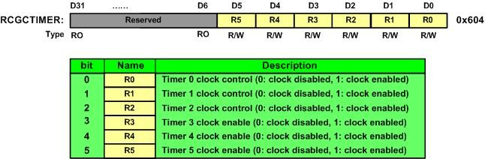
RCGCTimer (Timer Run Mode Clock Gating Control)

Slide 14
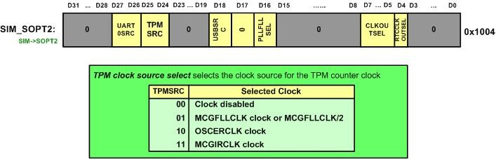
SIM_SOPT2 (System Options 2)

Slide 15
Clock Sources in FRDM-MKL25Z
MCG Mode | MCGFLLCLK | MCGPLLCLK/2 | OSCERCLK | MCGIRCLK
0 | 41.94 MHz | N.A. | N.A. | 32.768 kHz
1 | N.A. | 48.0 MHz | 8.0 MHz | N.A.
2 | N.A. |  | 8.0 MHz | N.A.
Note: N.A.: Not Applicable

Slide 16
TPMx_CNT Register

Slide 17
TPMx_CNT and TPMX_MOD registers

Slide 18

The TPM_CNT and TPM_MOD register and TOF flag

Slide 19
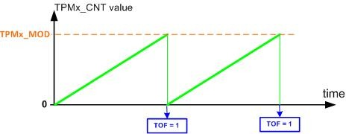
The role of TPMx_MOD

Slide 20
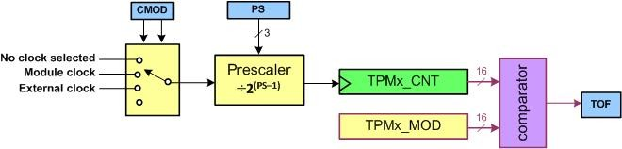
CMOD and PS (Prescaler) bits

Slide 21
Timer Status and Control (TPMx_SC) Register

Slide 22
Timer Status and Control (TPMx_SC) Register
Field | Bits | Description
PS | 0–2 | In the prescaler, the clock is divided by 2PS.
CMOD | 3–4 | Clock Mode Selection
CPWMS | 5 | Center-aligned PWM select (0: Up counter mode, 1: up-down counter mode). For generating delays use the Up counter mode.
TOIE | 6 | Time Overflow Interrupt Enable (0: Disabled, 1: Enabled). It is discussed in Chapter 6.
TOF | 7 | Timer Overflow Flag
DMA | 8 | DMA Enable (0: Disabled, 1: Enabled)

Slide 23
TPM Registers and their addresses
Absolute address | Register Name
4003 8000 | Status and Control (TPM0_SC)
4003 8004 | Counter (TPM0_CNT)
4003 8008 | Modulo (TPM0_MOD)
4003 800C | Channel 0 Status and Control (TPM0_C0SC)
4003 8010 | Channel 0 Value (TPM0_C0V)
4003 8014 | Channel 1 Status and Control (TPM0_C1SC)
4003 8018 | Channel 1 Value (TPM0_C1V)
4003 801C | Channel 2 Status and Control (TPM0_C2SC)
4003 8020 | Channel 2 Value (TPM0_C2V)
4003 8024 | Channel 3 Status and Control (TPM0_C3SC)
4003 8028 | Channel 3 Value (TPM0_C3V)
4003 802C | Channel 4 Status and Control (TPM0_C4SC)
4003 8030 | Channel 4 Value (TPM0_C4V)
4003 8034 | Channel 5 Status and Control (TPM0_C5SC)
4003 8038 | Channel 5 Value (TPM0_C5V)
4003 8050 | Capture and Compare Status (TPM0_STATUS)
4003 9000 | Status and Control (TPM1_SC)
4003 9004 | Counter (TPM1_CNT)
4003 9008 | Modulo (TPM1_MOD)

Slide 24
TPM Registers and their addresses (continuation)
Absolute address | Register Name
4003 900C | Channel 0 Status and Control (TPM1_C0SC)
4003 9010 | Channel 0 Value (TPM10_C0V)
4003 9014 | Channel 1 Status and Control (TPM1_C1SC)
4003 9018 | Channel 1 Value (TPM1_C1V)
4003 901C | Channel 2 Status and Control (TPM1_C2SC)
4003 9020 | Channel 2 Value (TPM1_C2V)
4003 9024 | Channel 3 Status and Control (TPM1_C3SC)
4003 9028 | Channel 3 Value (TPM1_C3V)
4003 902C | Channel 4 Status and Control (TPM1_C4SC)
4003 9030 | Channel 4 Value (TPM1_C4V)
4003 9034 | Channel 5 Status and Control (TPM1_C5SC)
4003 9038 | Channel 5 Value (TPM1_C5V)
4003 9050 | Capture and Compare Status (TPM1_STATUS)
4003 A000 | Status and Control (TPM2_SC)
4003 A004 | Counter (TPM2_CNT)
4003 A008 | Modulo (TPM2_MOD)
4003 A00C | Channel 0 Status and Control (TPM2_C0SC)
4003 A010 | Channel 0 Value (TPM2_C0V)
4003 A014 | Channel 1 Status and Control (TPM2_C1SC)

Slide 25
TPM Registers and their addresses (continuation)
Absolute address | Register Name
4003 A018 | Channel 1 Value (TPM2_C1V)
4003 A01C | Channel 2 Status and Control (TPM2_C2SC)
4003 A020 | Channel 2 Value (TPM2_C2V)
4003 A024 | Channel 3 Status and Control (TPM2_C3SC)
4003 A028 | Channel 3 Value (TPM2_C3V)
4003 A02C | Channel 4 Status and Control (TPM2_C4SC)
4003 A030 | Channel 4 Value (TPM2_C4V)
4003 A034 | Channel 5 Status and Control (TPM2_C5SC)
4003 A038 | Channel 5 Value (TPM2_C5V)
4003 A050 | Capture and Compare Status (TPM2_STATUS)

Slide 26
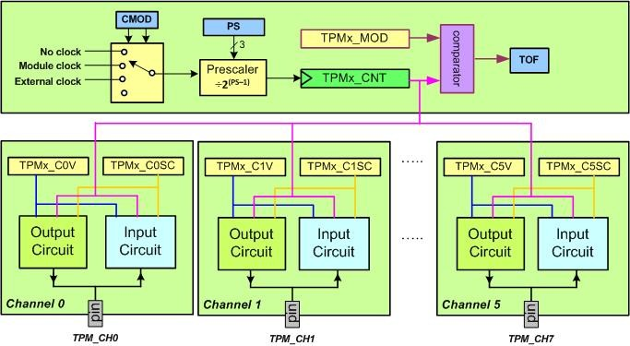
The Channels of TPMx

Slide 27
TPMx_CnV (TPMx Channel Value) Register

Slide 28
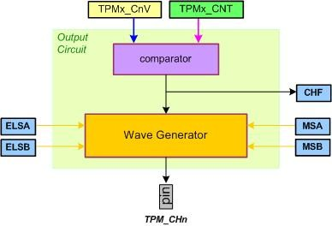
Output Circuit

Slide 29
TPMxCnSC (TPMx Channel Status and Control)

Slide 30
TPMxCnSC Register
Field | Bit | Description
CHF | 7 | Channel Flag
CHIE | 6 | Channel interrupt enable
MSB and MSA | 5-4 | Channel mode select
ELSB and ELSA | 3-2 | Edge or Level Select
DMA | 0 | DMA enable (0: Disabled, 1: Enabled)

Slide 31
Mode Selection for Output Compare
D5:D4 (MSB:MSA) | D3 (ELSB) | D2 (ELSA) | Output Action
01 | 0 | 1 | Toggle Output on Match
01 | 1 | 0 | Clear Output on Match (make it Low)
01 | 1 | 1 | Set Output on Match (make output High)
11 | 1 | 0 | Pulse Output Low on Match
11 | X | 1 | Pulse Output High on Match

Slide 32
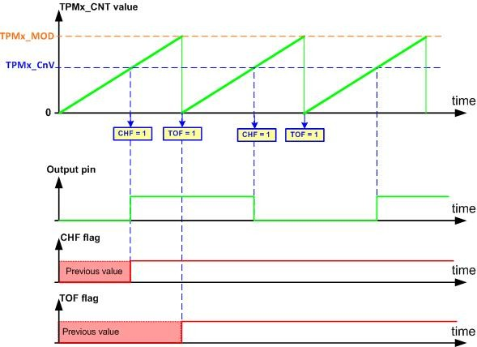
In Toggle Mode

Slide 33
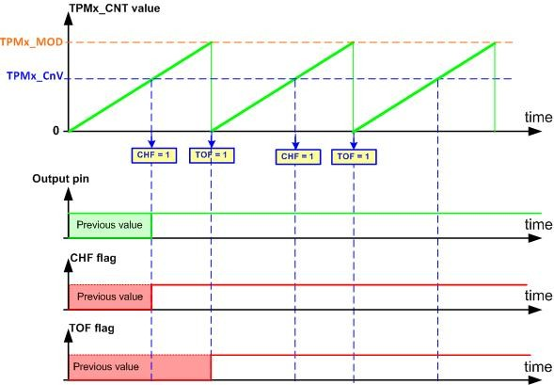
In Set Mode

Slide 34
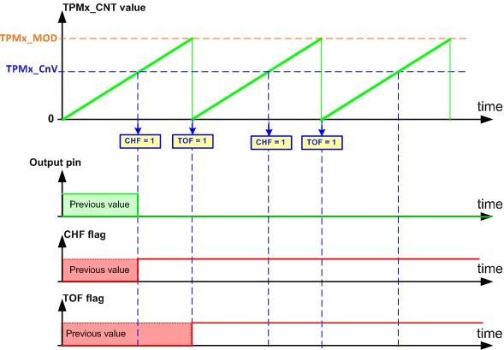
Clear Mode

Slide 35
Timers Channel Output alternate pin assignment
Using ALT3 pin options for TPM0 Channel Output
TPM0 Channels | Pins | Pin Control Register
TPM0 CH0 Output Pins | PTA3 | PORTA_PCR3=0x0300
 | PTE24 | PORTE_PCR24=0x0300
TPM0 CH1 Output Pins | PTA4 | PORTA_PCR4=0x0300
 | PTE25 | PORTE_PCR25=0x0300
TPM0 CH2 Output Pins | PTA5 | PORTA_PCR5=0x0300
 | PTE29 | PORTE_PCR29=0x0300
TPM0 CH3 Output Pins | PTE30 | PORTE_PCR30=0x0300
TPM0 CH4 Output Pins | PTC8 | PORTC_PCR8=0x0300
 | PTE31 | PORTE_PCR31=0x0300
TPM0 CH5 Output Pins | PTA0 | PORTA_PCR0=0x0300
 | PTC9 | PORTC_PCR9=0x0300

Slide 36
Timers Channel Output alternate pin assignment
Using ALT4 pin options for TPM0 Channel Output
TPM0 CH0 Output Pins | PTC1 | PORTC_PCR1=0x0400
 | PTD0 | PORTD_PCR0=0x0400
TPM0 CH1 Output Pins | PTC2 | PORTC_PCR2=0x0400
 | PTD1 | PORTD_PCR1=0x0400
TPM0 CH2 Output Pins | PTC3 | PORTC_PCR3=0x0400
 | PTD2 | PORTD_PCR2=0x0400
TPM0 CH3 Output Pins | PTC4 | PORTC_PCR4=0x0400
 | PTD3 | PORTD_PCR3=0x0400
TPM0 CH4 Output Pins | PTD4 | PORTD_PCR4=0x0400
TPM0 CH5 Output Pins | PTD5 | PORTD_PCR5=0x0400

Slide 37
Timers Channel Output alternate pin assignment
Using ALT3 pin options for TPM1 Channel Output
TPM1 Channels | Pins | Pin Control Register
TPM1 CH0 Output Pins | PTA12 | PORTA_PCR12=0x0300
 | PTB0 | PORTB_PCR0=0x0300
 | PTE20 | PORTE_PCR20=0x0300
TPM1 CH1 Output Pins | PTA13 | PORTA_PCR13=0x0300
 | PTB1 | PORTB_PCR1=0x0300
 | PTE21 | PORTE_PCR21=0x0300

Slide 38
Timers Channel Output alternate pin assignment
Using ALT3 pin options for TPM2 Channel Output
TPM2 Channels | Pins | Pin Control Register
TPM2 CH0 Output Pins | PTA1 | PORTA_PCR1=0x0300
 | PTB18 | PORTB_PCR18=0x0300
 | PTE22 | PORTE_PCR22=0x0300
TPM2 CH1 Output Pins | PTA2 | PORTA_PCR2=0x0300
 | PTB3 | PORTB_PCR3=0x0300
 | PTB19 | PORTB_PCR19=0x0300
 | PTE23 | PORTE_PCR23=0x0300

Slide 39
TPMx_STATUS Register

Slide 40
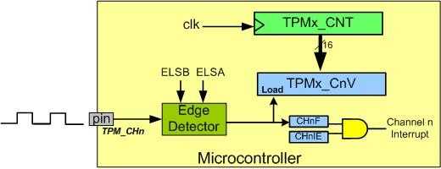
Input Edge Time Capturing

Slide 41
Choosing the Capture Edge
ELSB | ELSA | Capture mode
0 | 0 | Channel disabled
0 | 1 | Capture on rising edge
1 | 0 | Capture on falling edge
1 | 1 | Capture on both edges

Slide 42
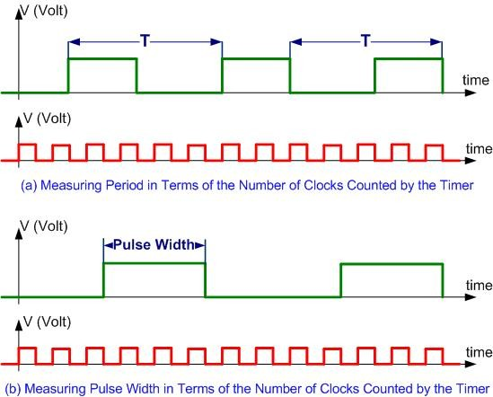
Measuring Period and Pulse Width

Slide 43
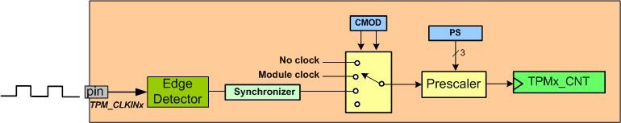
Counter Diagram

Slide 44
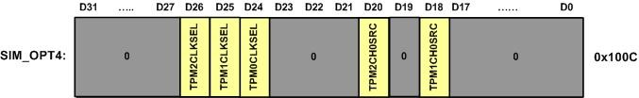
SIM_OPT4

Slide 45
Input Clock Pins
 | Pins | Pin Control Register
TPM_CLKIN0 Pins | PTA18 | PORTA_PCR18=0x0400
 | PTB16 | PORTB_PCR16=0x0400
 | PTC12 | PORTC_PCR12=0x0400
 | PTE29 | PORTE_PCR29=0x0400
TPM_CLKIN1 Pins | PTA19 | PORTA_PCR19=0x0400
 | PTB17 | PORTB_PCR17=0x0400
 | PTC13 | PORTC_PCR13=0x0400
 | PTE30 | PORTE_PCR30=0x0400

