Slide 1
Chapter 10
Relay, Optoisolator, and Stepper Motor Interfacing

Slide 2
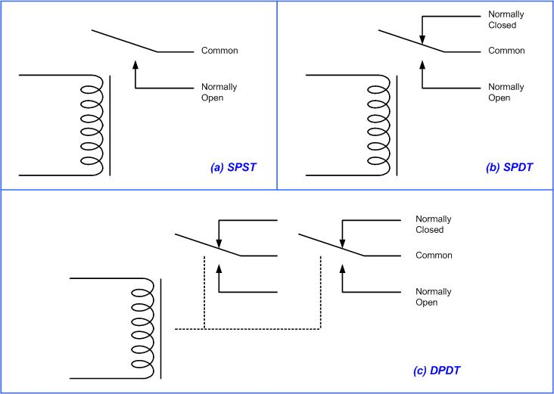
Relay Diagrams

Slide 3
Selected DIP Relay Characteristics
(www.Jameco.com)
Part No. | Contact Form | Coil Volts | Coil Ohms | Contact Volts | Current
106462CP | SPST-NO | 5 VDC | 500 | 100 VDC | 0.5 A
138430CP | SPST-NO | 5 VDC | 500 | 100 VDC | 0.5 A
106471CP | SPST-NO | 12 VDC | 1000 | 100 VDC | 0.5 A
138448CP | SPST-NO | 12 VDC | 1000 | 100 VDC | 0.5 A
129875CP | DPDT | 5 VDC | 62.5 | 30 VDC | 1 A

Slide 4
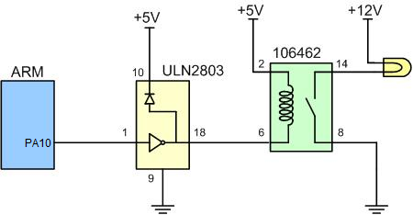
ARM Connection to Relay

Slide 5
Selected Solid-State Relay Characteristics (www.Jameco.com)
Part No. | Contact Style | Control Volts | Contact Volts | Contact Current
143058CP | SPST | 4-32 VDC | 240 VAC | 3 A
139053CP | SPST | 3-32 VDC | 240 VAC | 25 A
162341CP | SPST | 3-32 VDC | 240 VAC | 10 A
172591CP | SPST | 3-32 VDC | 60 VAC | 2 A
175222CP | SPST | 3-32 VDC | 60 VAC | 4 A
176647CP | SPST | 3-32 VDC | 120 VAC | 5 A

Slide 6
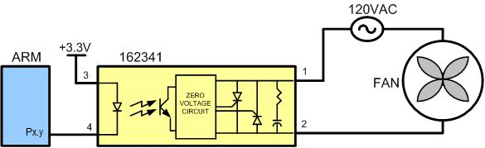
ARM Connection to a Solid-State Relay

Slide 7
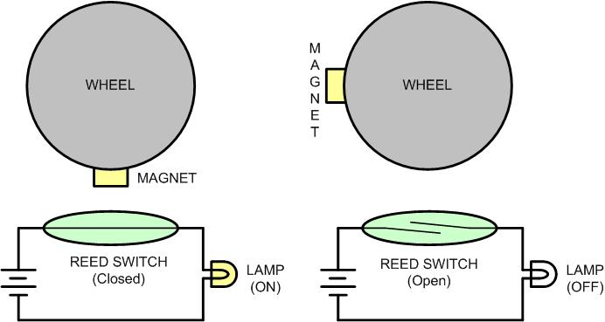
Reed Switch and Magnet Combination

Slide 8
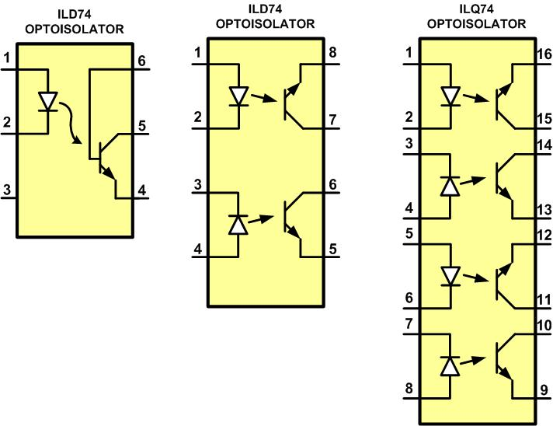
Optoisolator Package Examples

Slide 9
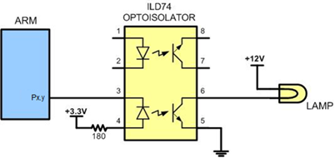
Controlling a Lamp via an Optoisolator

Slide 10
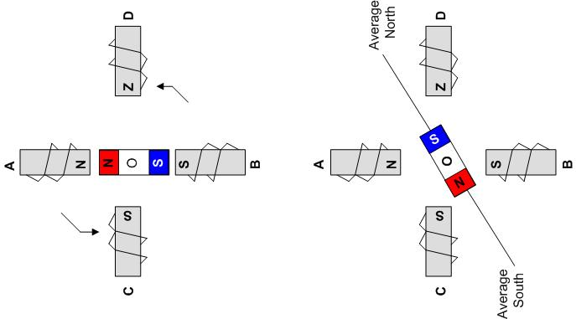
Rotor Alignment

Slide 11
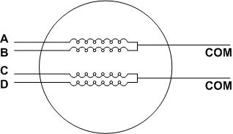
Stator Winding Configuration

Slide 12


Normal Four-Step Sequence
Clockwise | Step # | Winding A | Winding B | Winding C | Winding D | Counter Clockwise
 | 1 | 1 | 0 | 0 | 1
 | 2 | 1 | 1 | 0 | 0
 | 3 | 0 | 1 | 1 | 0
 | 4 | 0 | 0 | 1 | 1

Slide 13
Stepper Motor Step Angles
Step Angle | Step per Revolution
0.72 | 500
1.8 | 200
2.0 | 180
2.5 | 144
5.0 | 72
7.5 | 48
15 | 24

Slide 14
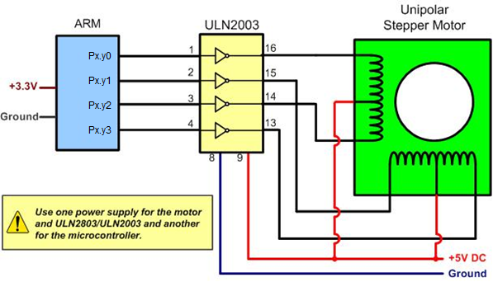
ARM Connection to Stepper Motor

Slide 15
Half-Step 8-Step Sequence
Clockwise | Step # | Winding A | Winding B | Winding C | Winding D | Counter Clockwise
 | 1 | 1 | 0 | 0 | 1
 | 2 | 1 | 0 | 0 | 0
 | 3 | 1 | 1 | 0 | 0
 | 4 | 0 | 1 | 0 | 0
 | 5 | 0 | 1 | 1 | 0
 | 6 | 0 | 0 | 1 | 0
 | 7 | 0 | 0 | 1 | 1
 | 8 | 0 | 0 | 0 | 1

Slide 16
Wave Drive 4-Step Sequence
Clockwise | Step # | Winding A | Winding B | Winding C | Winding D | Counter Clockwise
 | 1 | 1 | 0 | 0 | 0
 | 2 | 0 | 1 | 0 | 0
 | 3 | 0 | 0 | 1 | 0
 | 4 | 0 | 0 | 0 | 1

Slide 17
Selected Stepper Motor Characteristics (www.Jameco.com)
Part No. | Step Angle | Drive System | Volts | Phase Resistance | Current
151861CP | 7.5 | unipolar | 5 V | 9 ohms | 550 mA
171601CP | 3.6 | unipolar | 7 V | 20 ohms | 350 mA
164056CP | 7.5 | bipolar | 5 V | 6 ohms | 800 mA

Slide 18
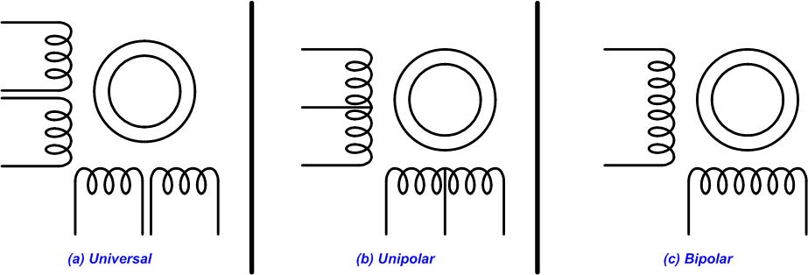
Common Stepper Motor Types

Slide 19
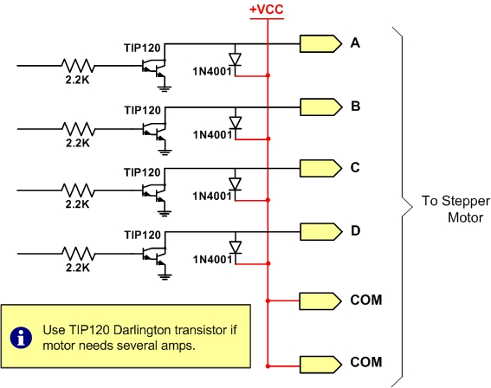
Using Transistors for Stepper Motor Driver

Slide 20
Darlington Transistor Listing
NPN | PNP | V_{CEO} (volts) | I_{C} (amps) | hfe (common)
TIP110 | TIP115 | 60 | 2 | 1000
TIP111 | TIP116 | 80 | 2 | 1000
TIP112 | TIP117 | 100 | 2 | 1000
TIP120 | TIP125 | 60 | 5 | 1000
TIP121 | TIP126 | 80 | 5 | 1000
TIP122 | TIP127 | 100 | 5 | 1000
TIP140 | TIP145 | 60 | 10 | 1000
TIP141 | TIP146 | 80 | 10 | 1000
TIP142 | TIP147 | 100 | 10 | 1000

Slide 21
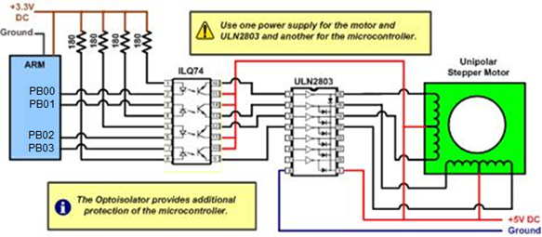
Controlling Stepper Motor via Optoisolator

