Slide 1
Figure 9-1: IEEE 754 Single-precision Floating-point Numbers
ARM Assembly Language Programming & Architecture by Mazidi, et al.

Slide 2
Figure 9-2: IEEE 754 Double-precision Floating-point Numbers
ARM Assembly Language Programming & Architecture by Mazidi, et al.

Slide 3
Figure 9-3: IEEE 754 Half-precision Floating-point Numbers
ARM Assembly Language Programming & Architecture by Mazidi, et al.

Slide 4
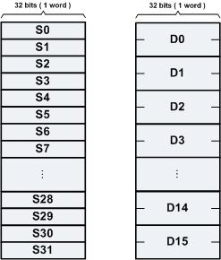
Figure 9-4: ARM Floating-point data Register Bank
ARM Assembly Language Programming & Architecture by Mazidi, et al.

Slide 5

Figure 9-5: ARM Floating-point status and control register (FPSCR)
ARM Assembly Language Programming & Architecture by Mazidi, et al.

Slide 6
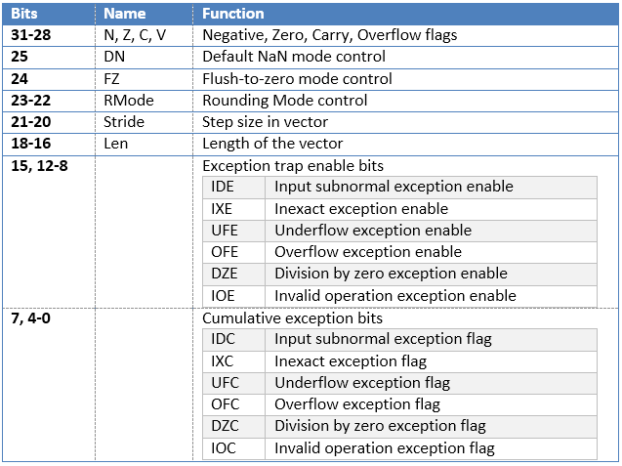
Table 9-1: ARM Floating-point status and control register bit assignments
ARM Assembly Language Programming & Architecture by Mazidi, et al.

Slide 7
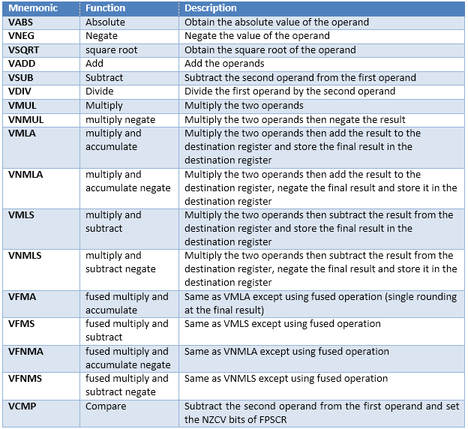
Table 9-2: Floating-point data processing instructions
ARM Assembly Language Programming & Architecture by Mazidi, et al.

