Slide 1
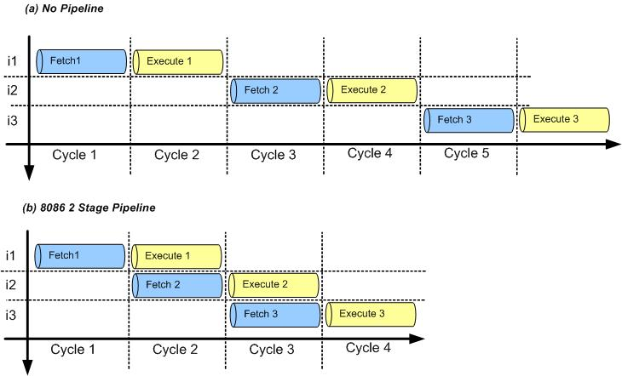
Figure 7-1: Non-Pipelined Instruction Execution vs. 2-stage Pipeline
ARM Assembly Language Programming & Architecture by Mazidi, et al.

Slide 2
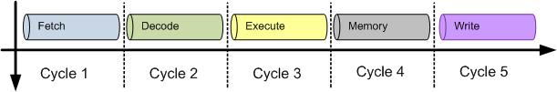
Figure 7- 2: 5-Stage Pipeline in ARM9
ARM Assembly Language Programming & Architecture by Mazidi, et al.

Slide 3
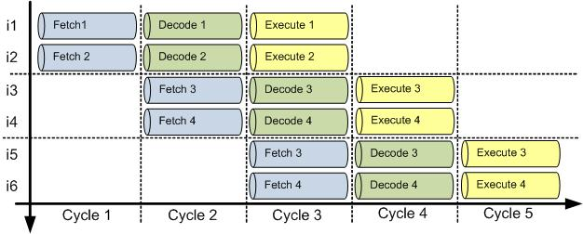
Figure 7- 3: Superscalar CPUs
ARM Assembly Language Programming & Architecture by Mazidi, et al.

Slide 4
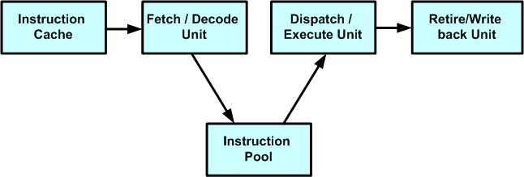
Figure 7- 4: CPU Instruction Execution
ARM Assembly Language Programming & Architecture by Mazidi, et al.

Slide 5
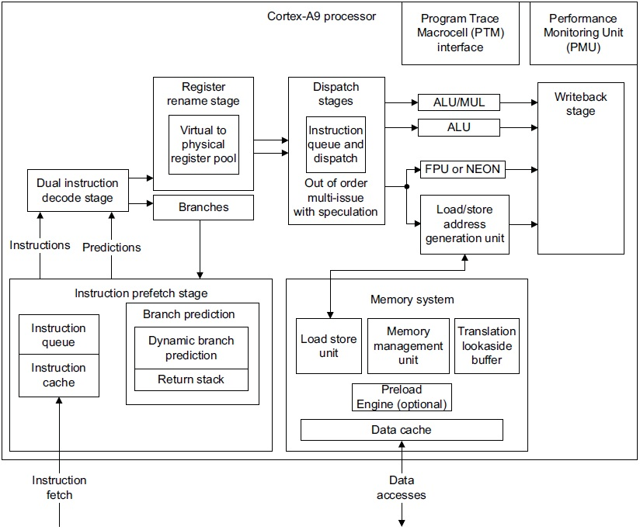
Figure 7- 5: Top-level diagram of the ARM Cortex A9 processor
ARM Assembly Language Programming & Architecture by Mazidi, et al.

