Slide 1
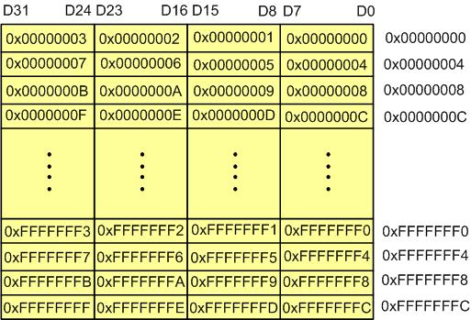
Figure 6-1: Memory Byte Addressing in ARM
ARM Assembly Language Programming & Architecture by Mazidi, et al.

Slide 2
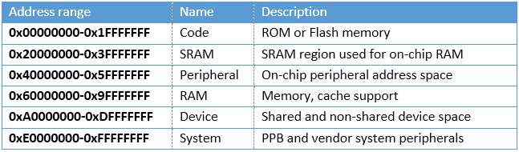
Table 6-1: Sample Memory Space Allocation in ARM
ARM Assembly Language Programming & Architecture by Mazidi, et al.

Slide 3
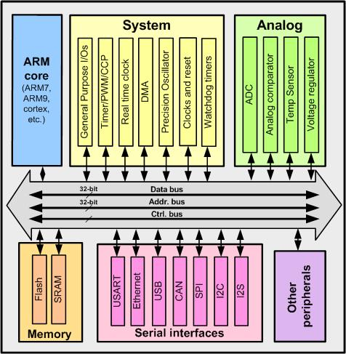
Figure 6-2: Memory Connection Block Diagram in ARM
ARM Assembly Language Programming & Architecture by Mazidi, et al.

Slide 4
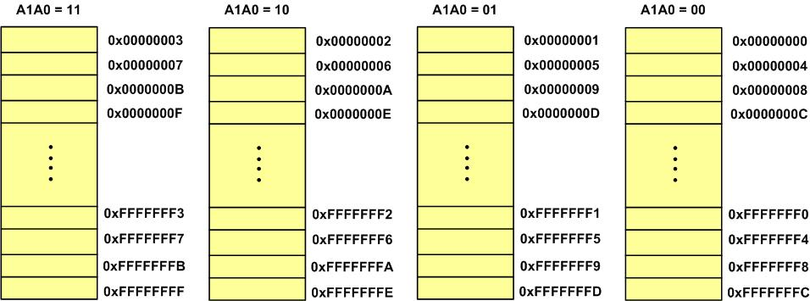
Figure 6-3: Memory Block Diagram in ARM
ARM Assembly Language Programming & Architecture by Mazidi, et al.

Slide 5
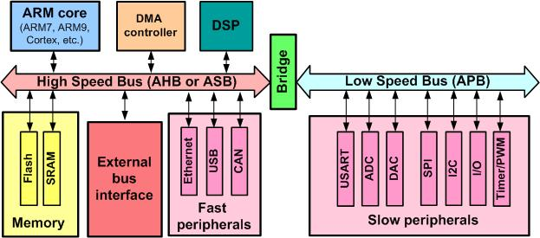
Figure 6-4: AHB and APB in ARM
ARM Assembly Language Programming & Architecture by Mazidi, et al.

Slide 6
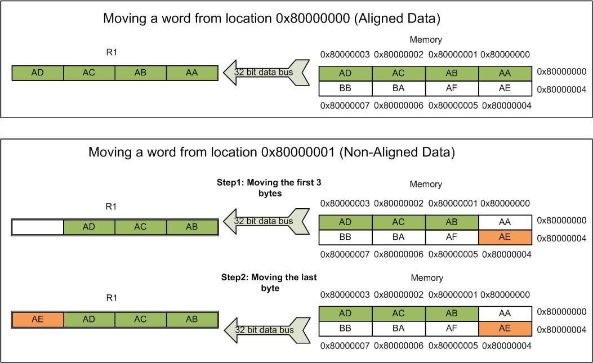
Figure 6-5: Memory Access for Aligned and Non-aligned Data
ARM Assembly Language Programming & Architecture by Mazidi, et al.

Slide 7
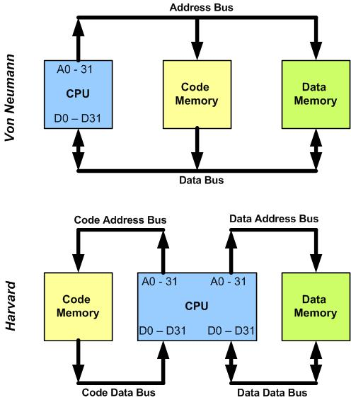
Figure 6-6: Von Neumann vs. Harvard Architecture
ARM Assembly Language Programming & Architecture by Mazidi, et al.

Slide 8
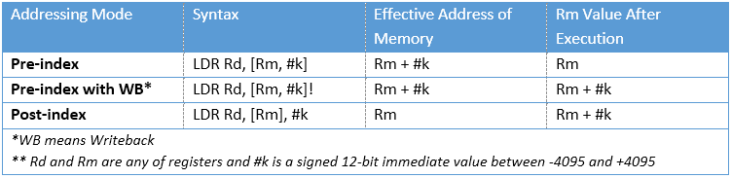
Table 6-2: Indexed Addressing in ARM
ARM Assembly Language Programming & Architecture by Mazidi, et al.

Slide 9
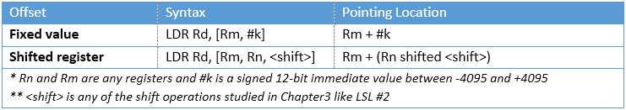
Table 6-3: Offset of Fixed Value vs. Offset of Shifted Register
ARM Assembly Language Programming & Architecture by Mazidi, et al.

Slide 10
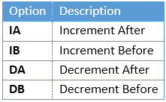
Table 6-4: Options for LDM and STM instructions
ARM Assembly Language Programming & Architecture by Mazidi, et al.

Slide 11
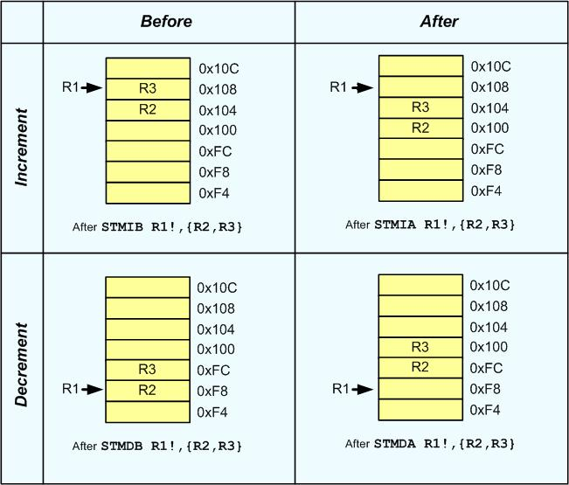
Figure 6-7: Four Options of STM and LDM in ARM
ARM Assembly Language Programming & Architecture by Mazidi, et al.

Slide 12
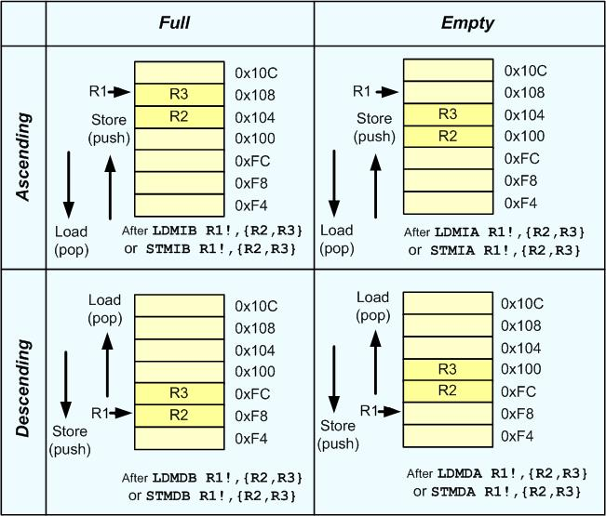
Figure 6-8: Four General Stack Structure
ARM Assembly Language Programming & Architecture by Mazidi, et al.

Slide 13
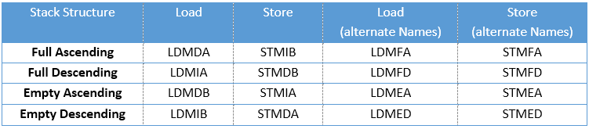
Table 6-5: The four stack structures and the options of LDM and STM instructions
ARM Assembly Language Programming & Architecture by Mazidi, et al.

Slide 14
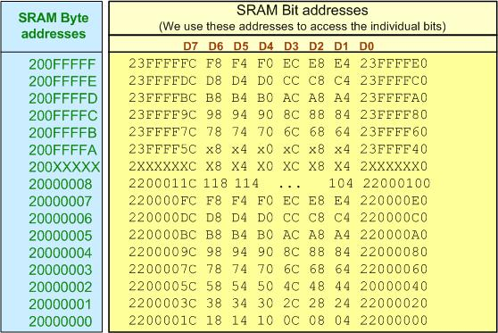
Figure 6-9: SRAM bit-addressable region and their alias addresses
ARM Assembly Language Programming & Architecture by Mazidi, et al.

Slide 15
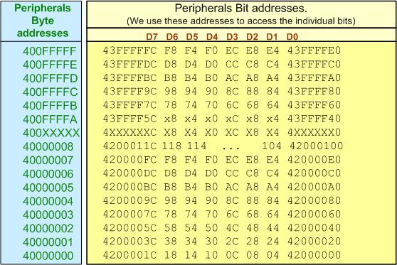
Figure 6-10: Peripherals bit-addressable region and their alias addresses.
ARM Assembly Language Programming & Architecture by Mazidi, et al.

Slide 16
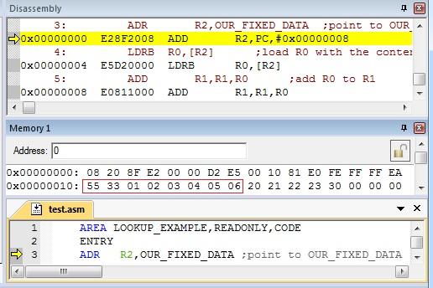
Figure 6-11: Memory Dump for ADR Instruction
ARM Assembly Language Programming & Architecture by Mazidi, et al.

Slide 17
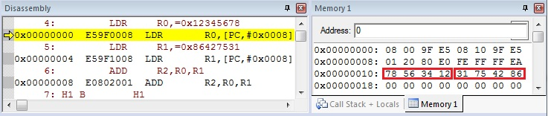
Figure 6- 12: Memory Dump for LDR Instruction
ARM Assembly Language Programming & Architecture by Mazidi, et al.

