Slide 1
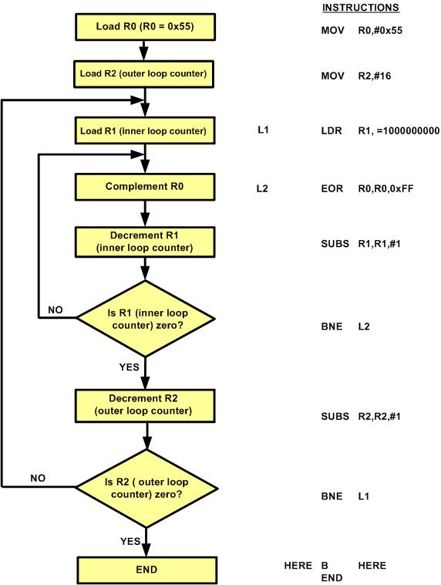
Figure 4- 1: Flowchart for Example 4-3
ARM Assembly Language Programming & Architecture by Mazidi, et al.

Slide 2
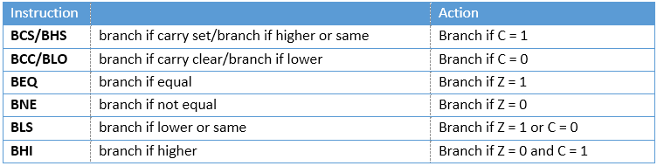
Table 4-1: ARM Conditional Branch Instructions for Unsigned Data
ARM Assembly Language Programming & Architecture by Mazidi, et al.

Slide 3
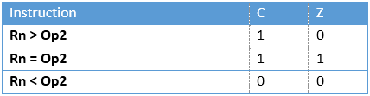
Table 4- 2: Flag Settings for Compare (CMP Rn, Op2) of Unsigned Data
ARM Assembly Language Programming & Architecture by Mazidi, et al.

Slide 4
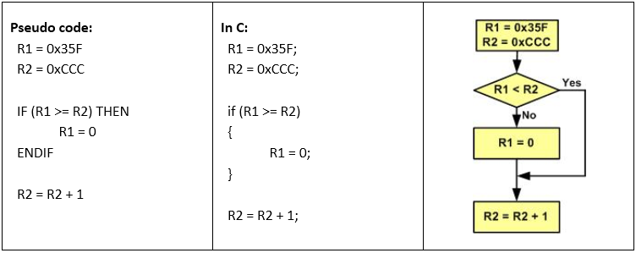
Figure 4- 2: Flowchart of if Instruction
ARM Assembly Language Programming & Architecture by Mazidi, et al.

Slide 5
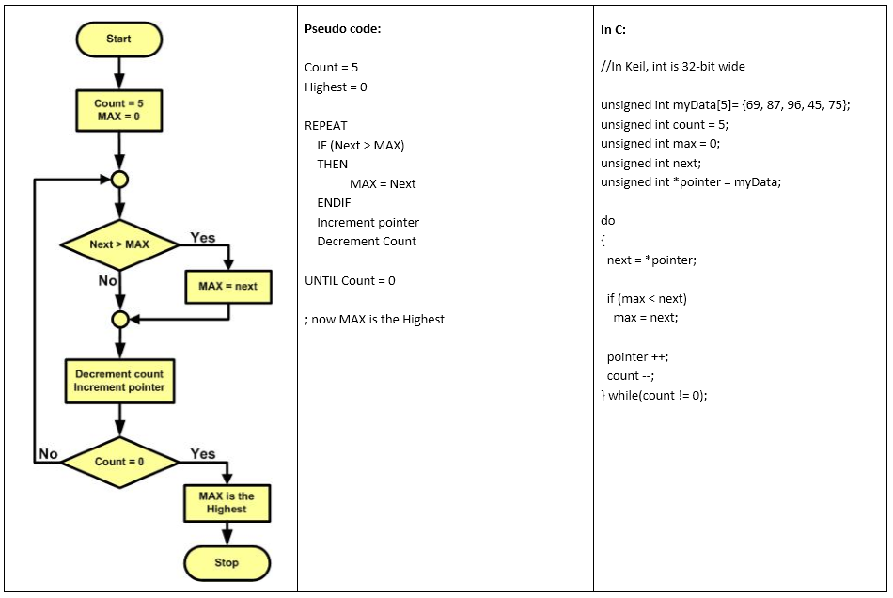
Figure 4- 3: Flowchart and Pseudocode for Program 4-1
ARM Assembly Language Programming & Architecture by Mazidi, et al.

Slide 6
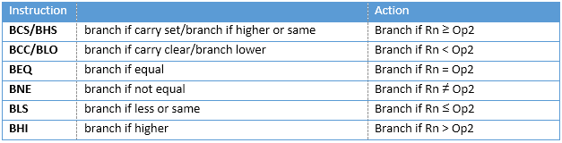
Table 4- 3: ARM Conditional Branch Instructions for Unsigned Data
ARM Assembly Language Programming & Architecture by Mazidi, et al.

Slide 7
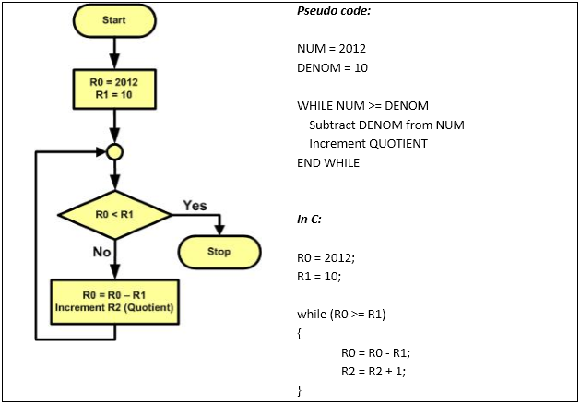
Figure 4- 4: Flowchart and Pseudo-code for Program 4-2
ARM Assembly Language Programming & Architecture by Mazidi, et al.

Slide 8
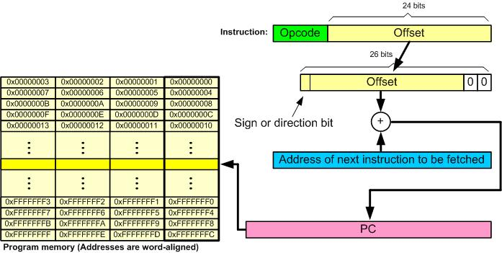
Figure 4- 5: B (Branch) Instruction
ARM Assembly Language Programming & Architecture by Mazidi, et al.

Slide 9
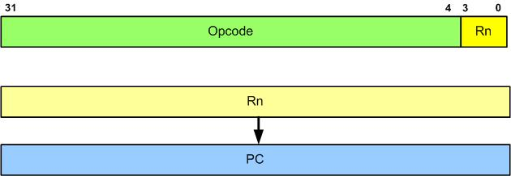
Figure 4- 6: BX (Branch and exchange) Instruction Target Address
ARM Assembly Language Programming & Architecture by Mazidi, et al.

Slide 10
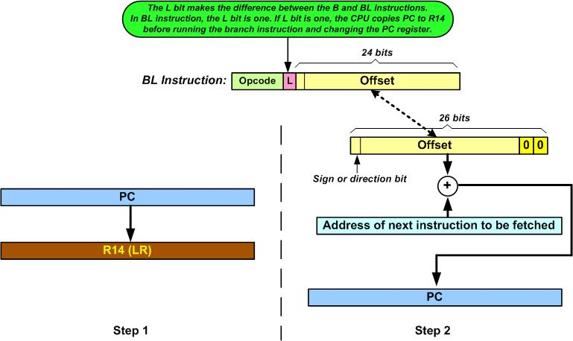
Figure 4- 7: BL (Branch and Link) Instruction
ARM Assembly Language Programming & Architecture by Mazidi, et al.

Slide 11
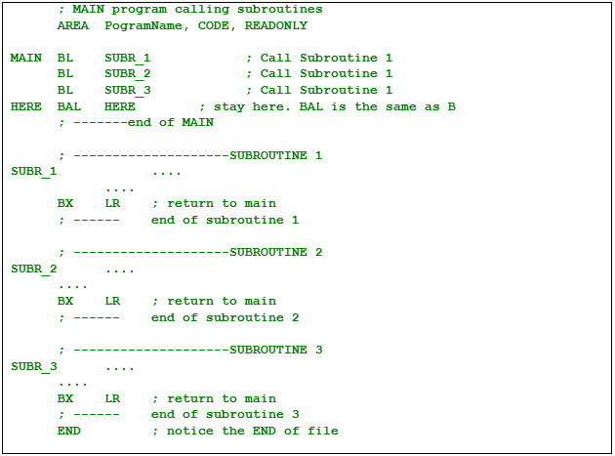
Figure 4- 8: ARM Assembly Main Program That Calls Subroutines
ARM Assembly Language Programming & Architecture by Mazidi, et al.

Slide 12
Figure 4- 9: Non-pipeline execution
ARM Assembly Language Programming & Architecture by Mazidi, et al.

Slide 13
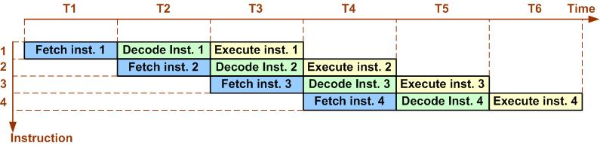
Figure 4- 10: Pipeline in ARM
ARM Assembly Language Programming & Architecture by Mazidi, et al.

Slide 14
Figure 4- 11: Condition Field in ARM Instructions
ARM Assembly Language Programming & Architecture by Mazidi, et al.

Slide 15
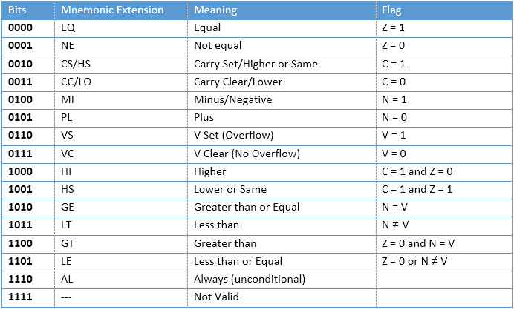
Table 4- 4: ARM Condition codes for the Opcode bits [31-28]
ARM Assembly Language Programming & Architecture by Mazidi, et al.

