Slide 1
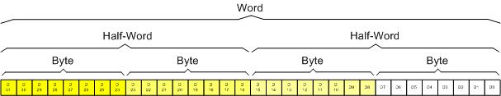
Figure 2- 1: ARM Registers Data Size
ARM Assembly Language Programming & Architecture by Mazidi, et al.

Slide 2
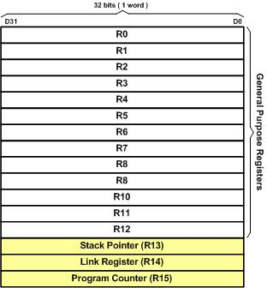
Figure 2- 2: ARM Registers
ARM Assembly Language Programming & Architecture by Mazidi, et al.

Slide 3
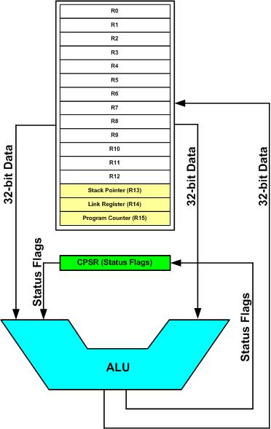
Figure 2- 3: ARM Registers and ALU
ARM Assembly Language Programming & Architecture by Mazidi, et al.

Slide 4
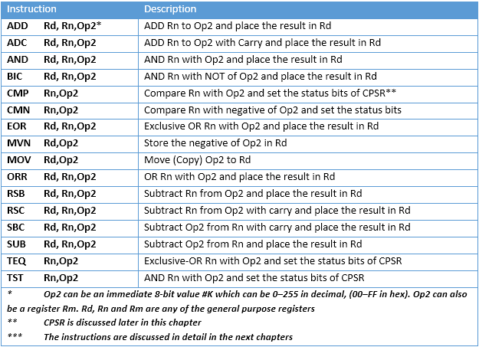
Table 2- 1: ALU Instructions Using GPRs
ARM Assembly Language Programming & Architecture by Mazidi, et al.

Slide 5
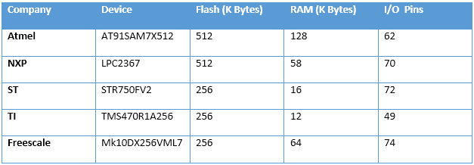
Table 2- 2: On-chip Memory Size for some ARM Chips
ARM Assembly Language Programming & Architecture by Mazidi, et al.

Slide 6
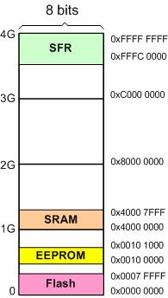
Figure 2- 4: An Example of ARM Memory Allocation
ARM Assembly Language Programming & Architecture by Mazidi, et al.

Slide 7
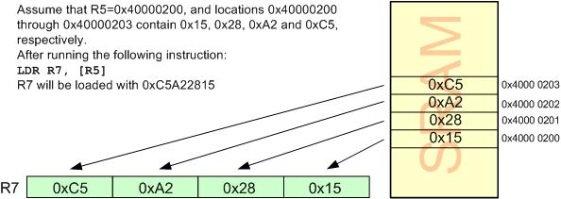
Figure 2-5: Executing the LDR Instruction
ARM Assembly Language Programming & Architecture by Mazidi, et al.

Slide 8
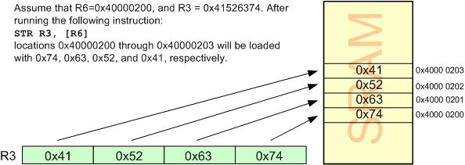
Figure 2-6: Executing the STR Instruction
ARM Assembly Language Programming & Architecture by Mazidi, et al.

Slide 9
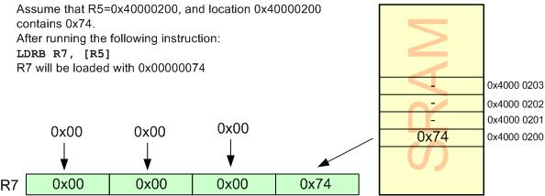
Figure 2- 7: Executing the LDRB Instruction
ARM Assembly Language Programming & Architecture by Mazidi, et al.

Slide 10
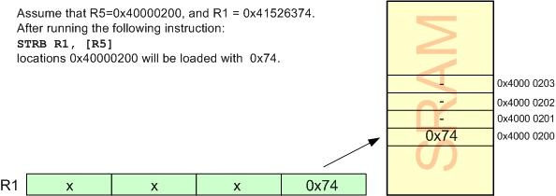
Figure 2- 8: Executing the STRB Instruction
ARM Assembly Language Programming & Architecture by Mazidi, et al.

Slide 11
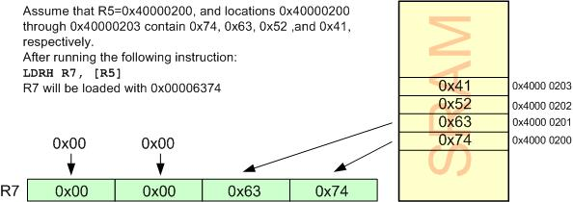
Figure 2- 9: Executing the LDRH Instruction
ARM Assembly Language Programming & Architecture by Mazidi, et al.

Slide 12
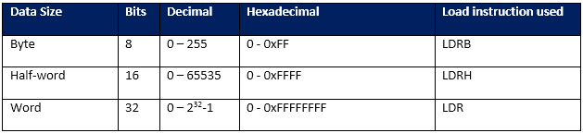
Table 2- 3: Unsigned Data Range in ARM and associated Load Instructions
ARM Assembly Language Programming & Architecture by Mazidi, et al.

Slide 13
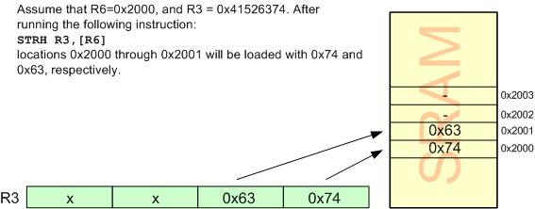
Figure 2- 10: Executing the STRH Instruction
ARM Assembly Language Programming & Architecture by Mazidi, et al.

Slide 14
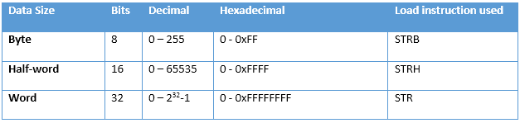
Table 2-4: Unsigned Data Range in ARM and associated Store Instructions
ARM Assembly Language Programming & Architecture by Mazidi, et al.

Slide 15
Figure 2- 11: CPSR (Current Program Status Register)
ARM Assembly Language Programming & Architecture by Mazidi, et al.

Slide 16
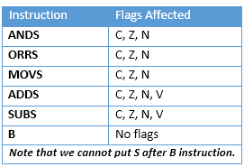
Table 2- 5: Flag Bits Affected by Different Instructions
ARM Assembly Language Programming & Architecture by Mazidi, et al.

Slide 17
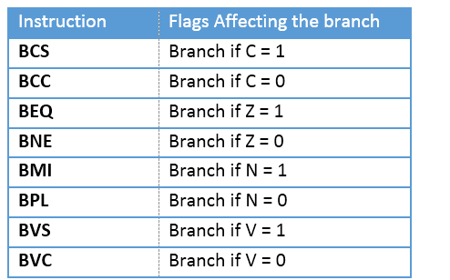
Table 2- 6: ARM Branch (Jump) Instructions Using Flag Bits
ARM Assembly Language Programming & Architecture by Mazidi, et al.

Slide 18
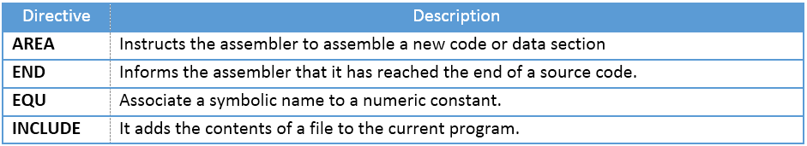
Table 2- 7: Some Widely Used ARM Directive
ARM Assembly Language Programming & Architecture by Mazidi, et al.

Slide 19
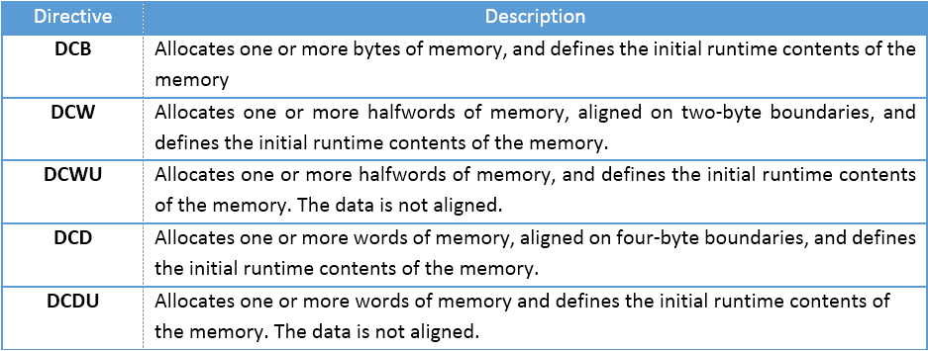
Table 2- 8: Some Widely Used ARM Memory Allocation Directives
ARM Assembly Language Programming & Architecture by Mazidi, et al.

Slide 20
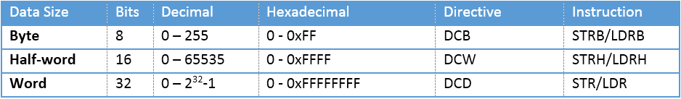
Table 2- 9: Unsigned Data Range in ARM and associated Instructions
ARM Assembly Language Programming & Architecture by Mazidi, et al.

Slide 21
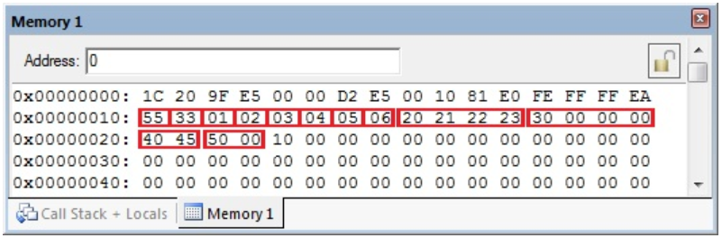
Figure 2- 12: Memory Dump for Program 2-3A
ARM Assembly Language Programming & Architecture by Mazidi, et al.

Slide 22
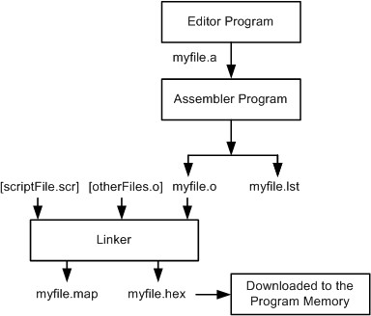
Figure 2- 13: Steps to Create a Program
ARM Assembly Language Programming & Architecture by Mazidi, et al.

Slide 23
Figure 2- 14: Sample of an Error Message
ARM Assembly Language Programming & Architecture by Mazidi, et al.

Slide 24
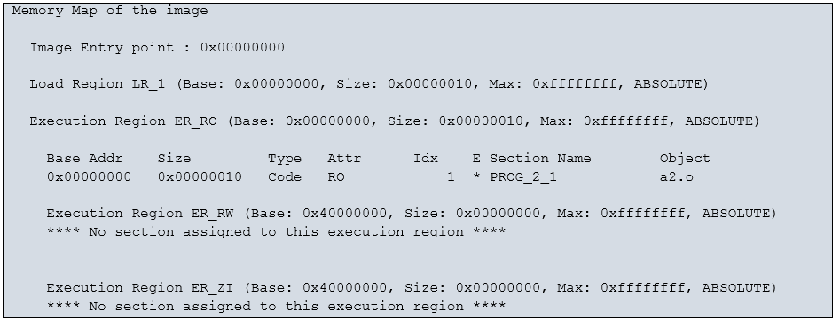
Figure 2- 15: Sample of a Map File
ARM Assembly Language Programming & Architecture by Mazidi, et al.

Slide 25
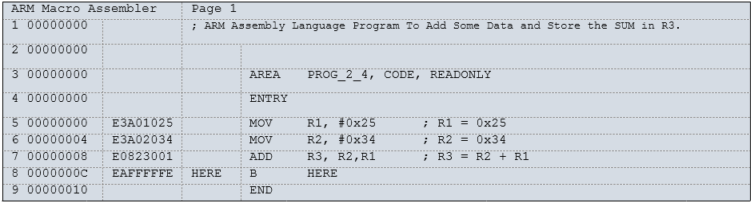
Figure 2- 16: Sample of a List File for ARM
ARM Assembly Language Programming & Architecture by Mazidi, et al.

Slide 26

Figure 2- 17: ADD Instruction Formation
ARM Assembly Language Programming & Architecture by Mazidi, et al.

Slide 27

Figure 2- 18: SUB Instruction Formation
ARM Assembly Language Programming & Architecture by Mazidi, et al.

Slide 28
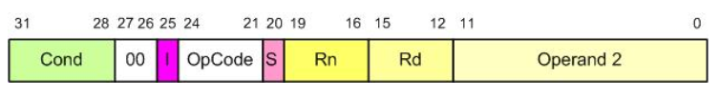
Figure 2- 19: General Formation of Data Processing Instructions
ARM Assembly Language Programming & Architecture by Mazidi, et al.

Slide 29

Figure 2- 20: Branch Instruction Formation
ARM Assembly Language Programming & Architecture by Mazidi, et al.

Slide 30
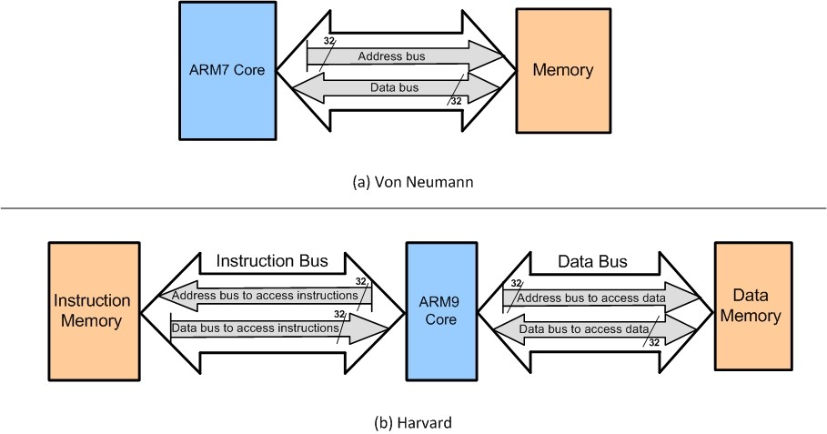
Figure 2- 21: Harvard vs. Von Neumann Architecture
ARM Assembly Language Programming & Architecture by Mazidi, et al.

Slide 31
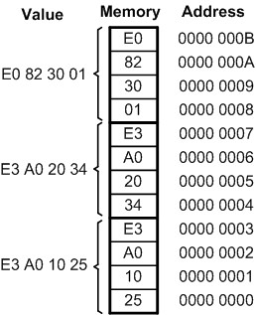
Figure 2- 22: ARM Program Memory Contents for Program 2-4 List File (Little Endian)
ARM Assembly Language Programming & Architecture by Mazidi, et al.

Slide 32
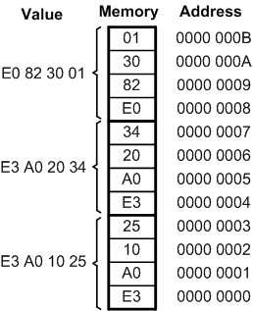
Figure 2- 23: Big Endian Convention
ARM Assembly Language Programming & Architecture by Mazidi, et al.

Slide 33
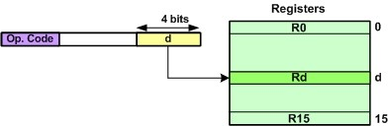
Figure 2- 24: Register Addressing Mode
ARM Assembly Language Programming & Architecture by Mazidi, et al.

Slide 34

Figure 2- 25: Immediate Addressing Mode
ARM Assembly Language Programming & Architecture by Mazidi, et al.

Slide 35
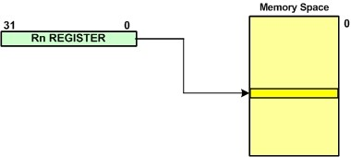
Figure 2- 26: Register Indirect Addressing Mode
ARM Assembly Language Programming & Architecture by Mazidi, et al.

Slide 36
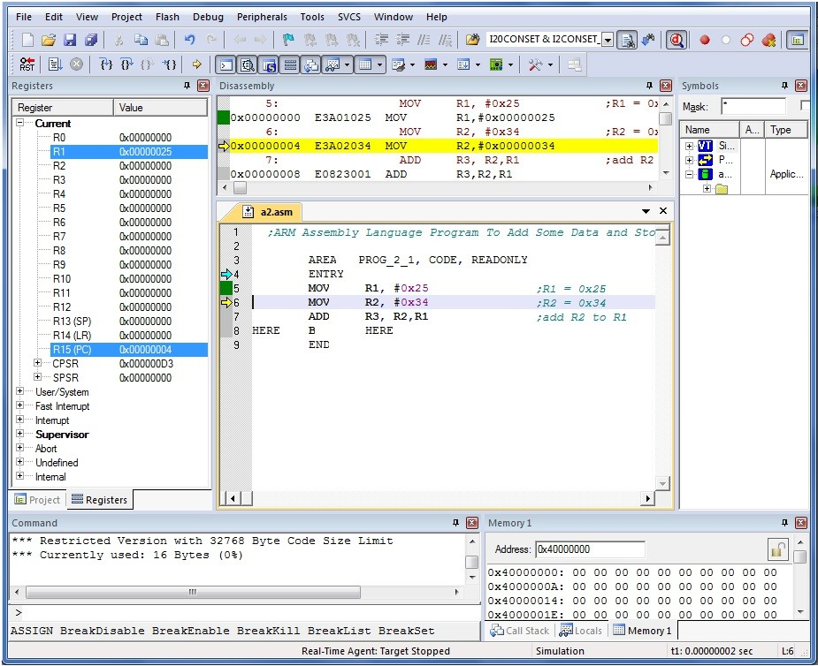
Figure 2- 27: Keil uVision Screenshot
ARM Assembly Language Programming & Architecture by Mazidi, et al.

Slide 37
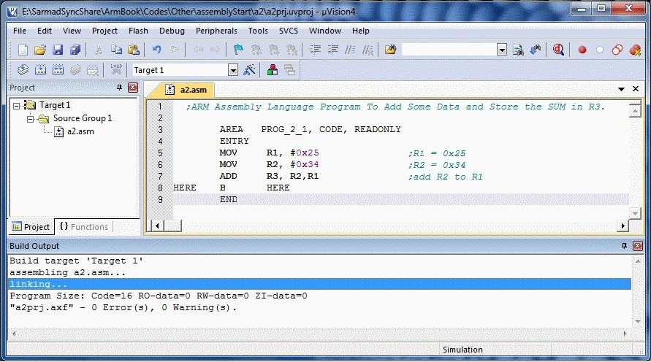
Figure 2- 28: Keil uVision Screenshot
ARM Assembly Language Programming & Architecture by Mazidi, et al.

