Slide 1
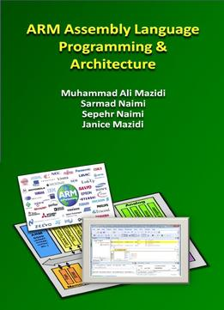
The History of ARM and Microcontrollers
Chapter 1
ARM Assembly Language Programming & Architecture
ARM Assembly Language Programming & Architecture by Mazidi, et al.

Slide 2
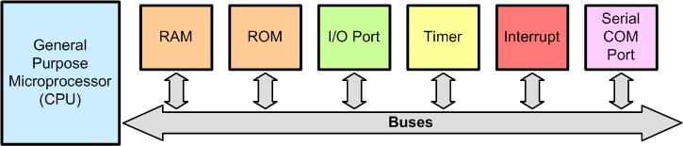
Figure 1- 1: A Computer Made by General Purpose Microprocessor
ARM Assembly Language Programming & Architecture by Mazidi, et al.

Slide 3
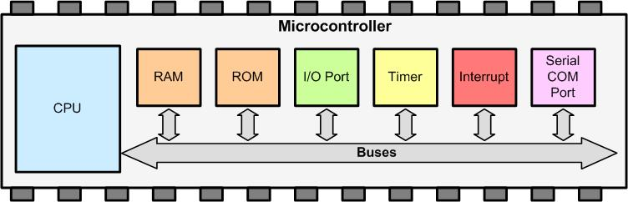
Figure 1- 2: Simplified View of the Internal Parts of Microcontrollers (SOC)
ARM Assembly Language Programming & Architecture by Mazidi, et al.

Slide 4
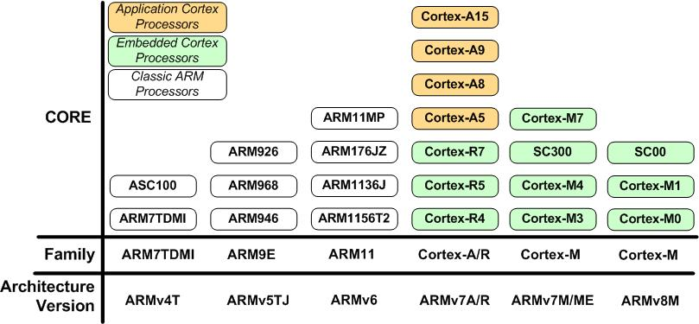
Figure 1- 3: ARM Family and Architecture
ARM Assembly Language Programming & Architecture by Mazidi, et al.

Slide 5
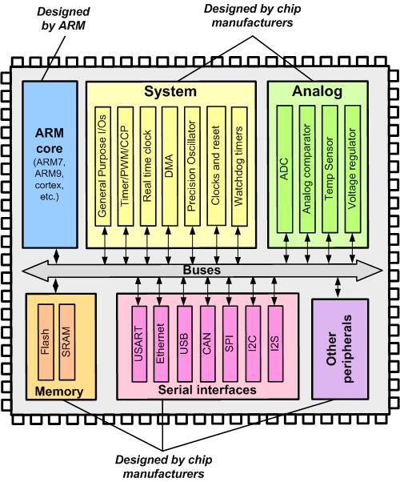
Figure 1- 4: ARM Simplified Block Diagram
ARM Assembly Language Programming & Architecture by Mazidi, et al.

