Slide 1

THE 8051
MICROCONTROLLER & Embedded Systems
Muhammad Ali Mazidi, Janice Mazidi
& Rolin McKinlay

Slide 2
8051 HARDWARE
CONNECTION AND INTEL HEX FILE
Chapter 8

Slide 3
Objectives
Upon completion of this chapter, you will be able to:
>> Explain the purpose of each pin of the 8051 microcontroller
>> Show the hardware connection of the 8051 chip
>> Explain how to design an 8051-based system
>> Show the design of the DS89C4x0 Trainer
>> Code the test program in Assembly and C for testing the DS89C4x0
>> Show how to delete programs from DS89C4x0 flash ROM using PC HyperTerminal
>> Show how to download programs into a DS89C4x0 system using PC HyperTerminal
>> Explain the Intel hex file

Slide 4
Objectives
Describing the process of physically connecting and testing 8051-based systems,
Section 8.1, the function of the pins of 8051 chip,
Section 8.2, the hardware connection for an 8051 Trainer using the DS89C4x0 (DS89C430/40/50) chip and how to download programs into a DS89C4x0-based system using PC HyperTerminal,
Section 8.3, he characteristics of the Intel hex file

Slide 5
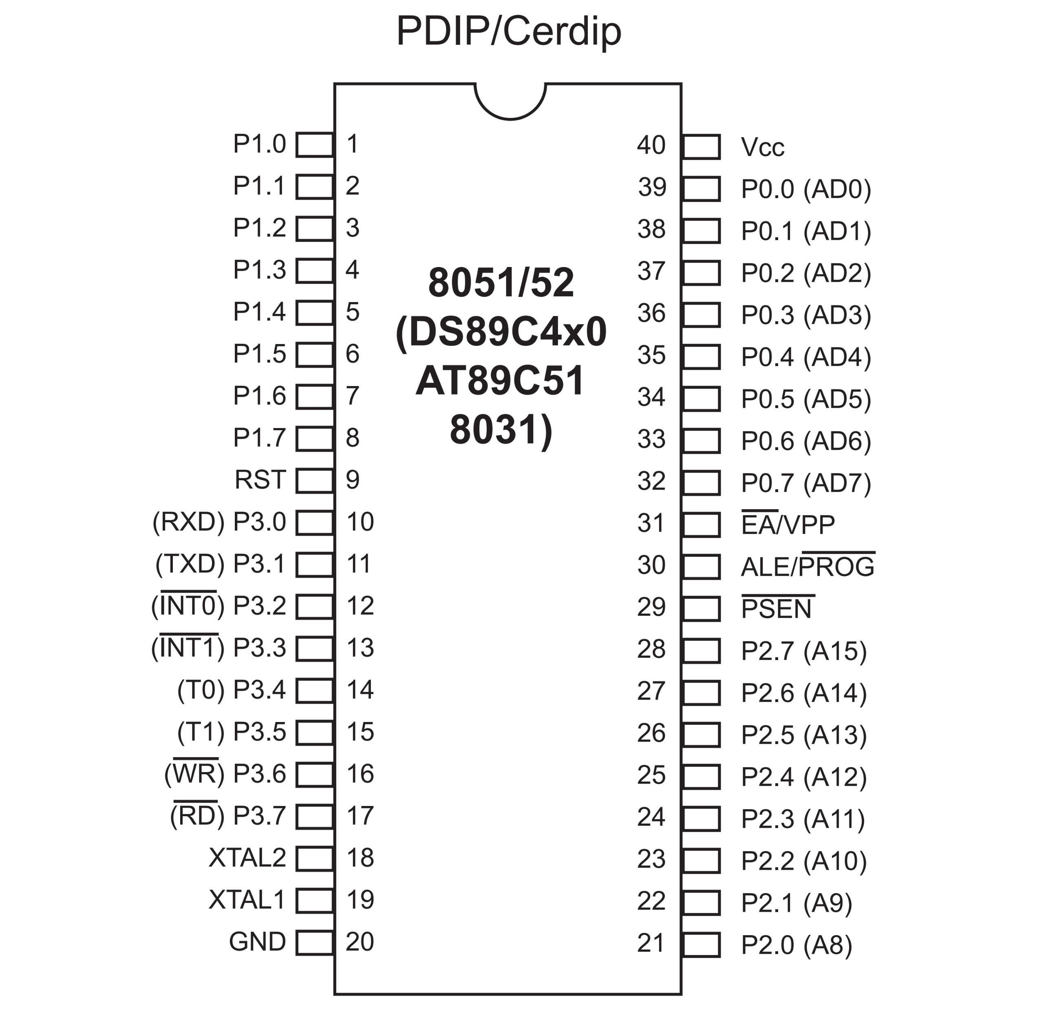
Figure 8-1. 8051 Pin Diagram

Slide 6
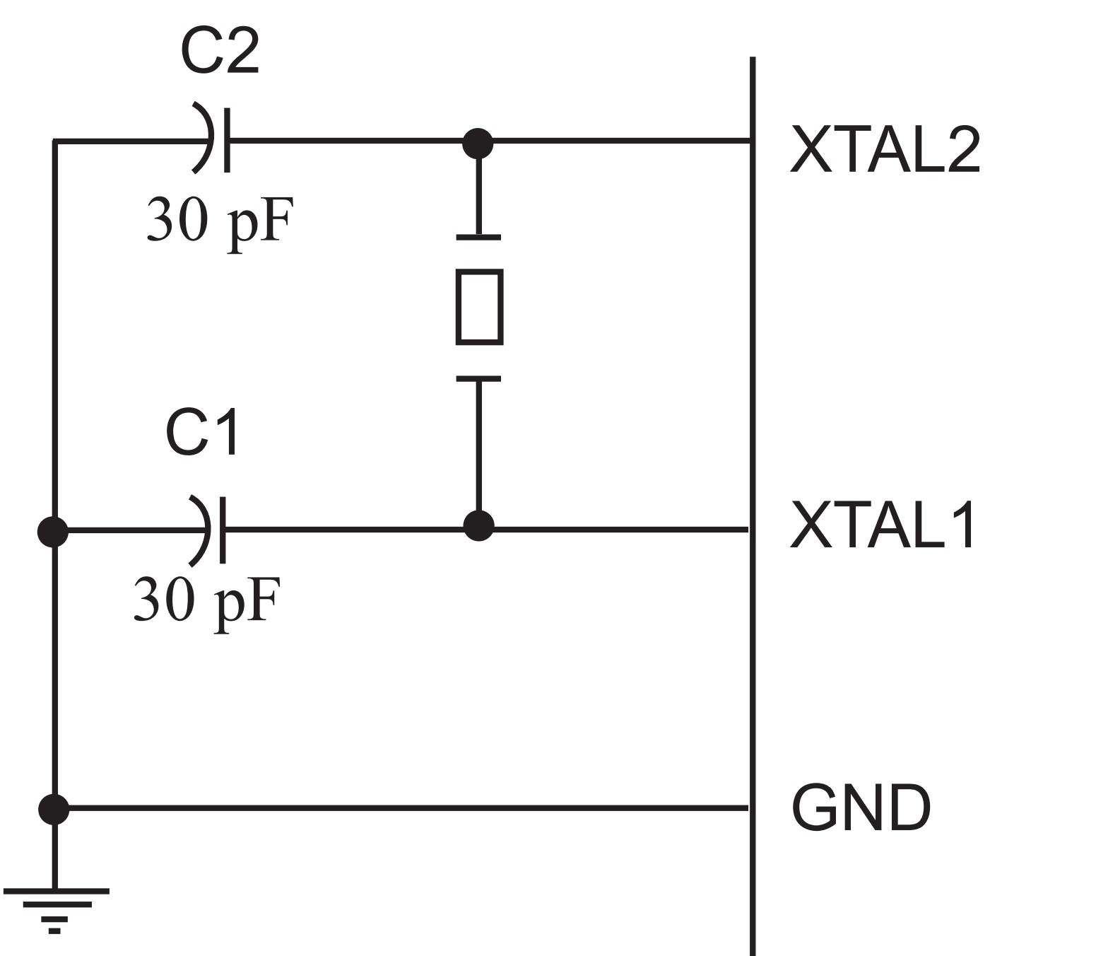
Figure 8-2 (a). XTAL Connection to 8051

Slide 7
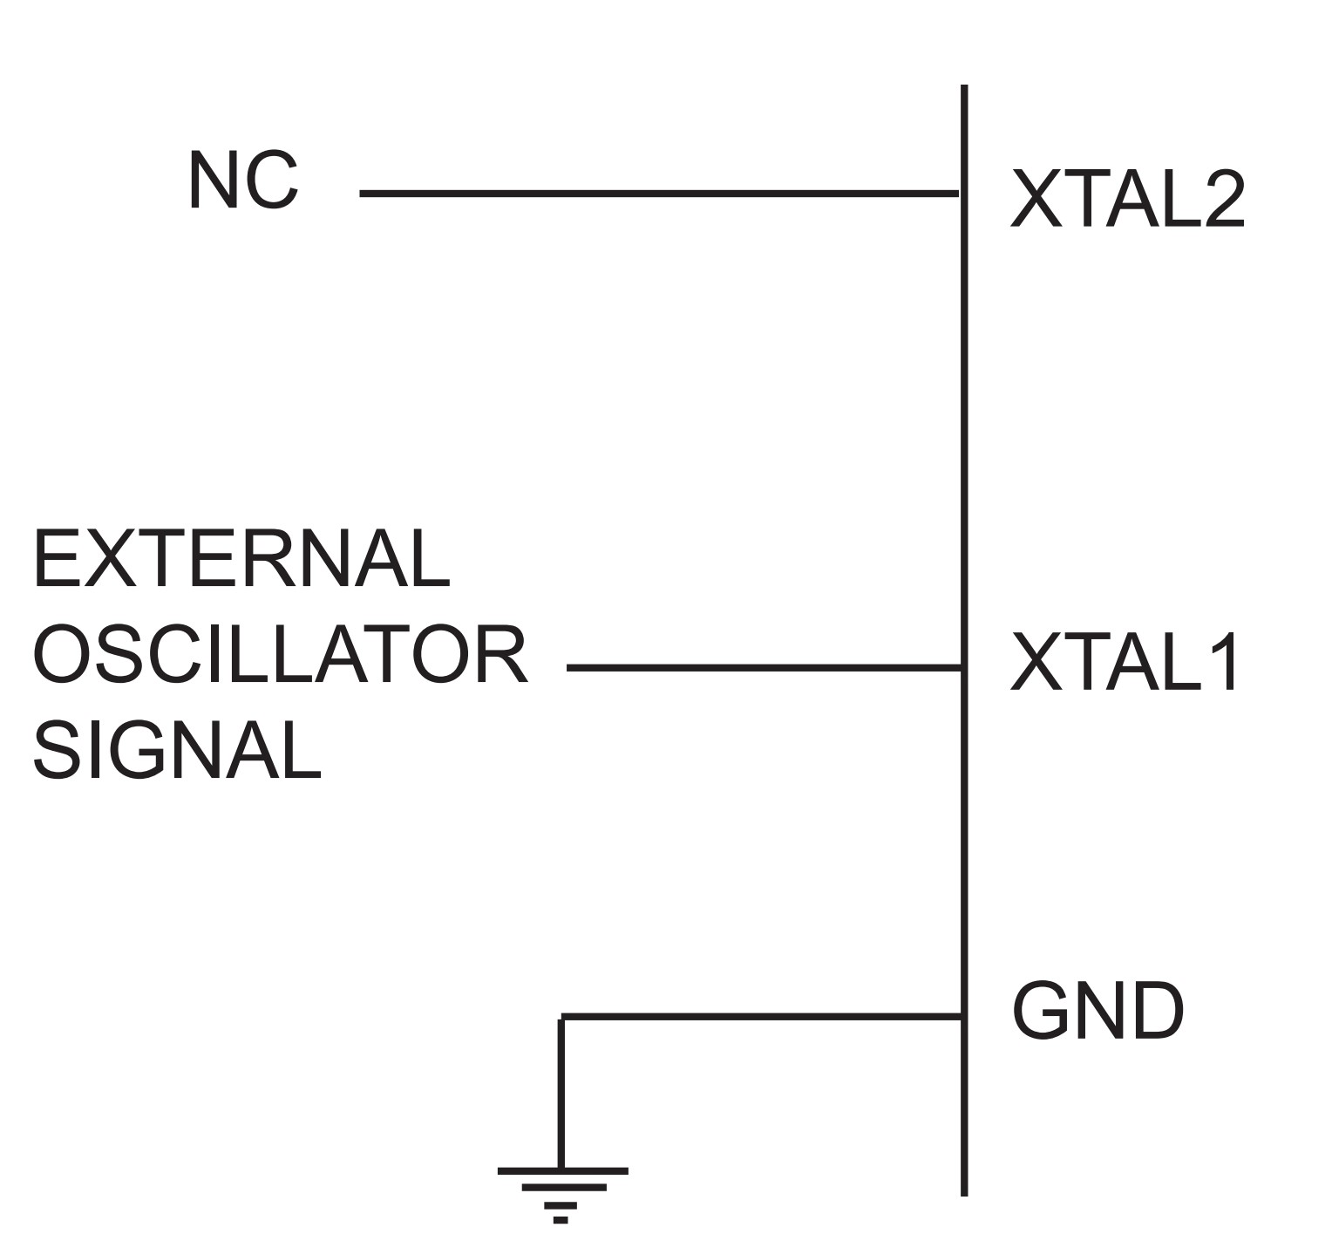
Figure 8-2 (b). XTAL Connection to an External Clock Source

Slide 8
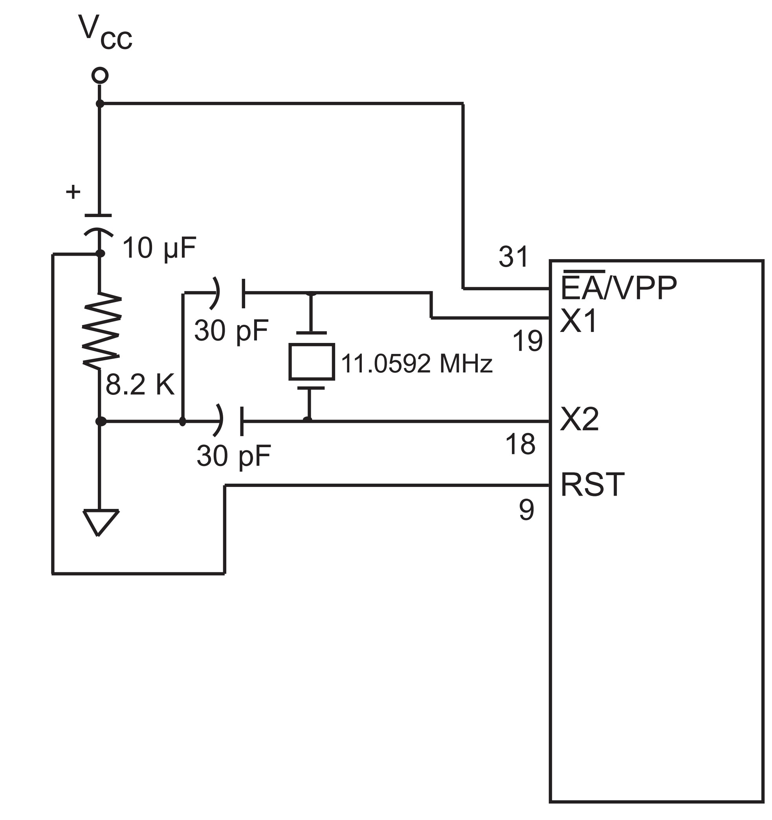
Figure 8-3 (a). Power-On RESET Circuit

Slide 9
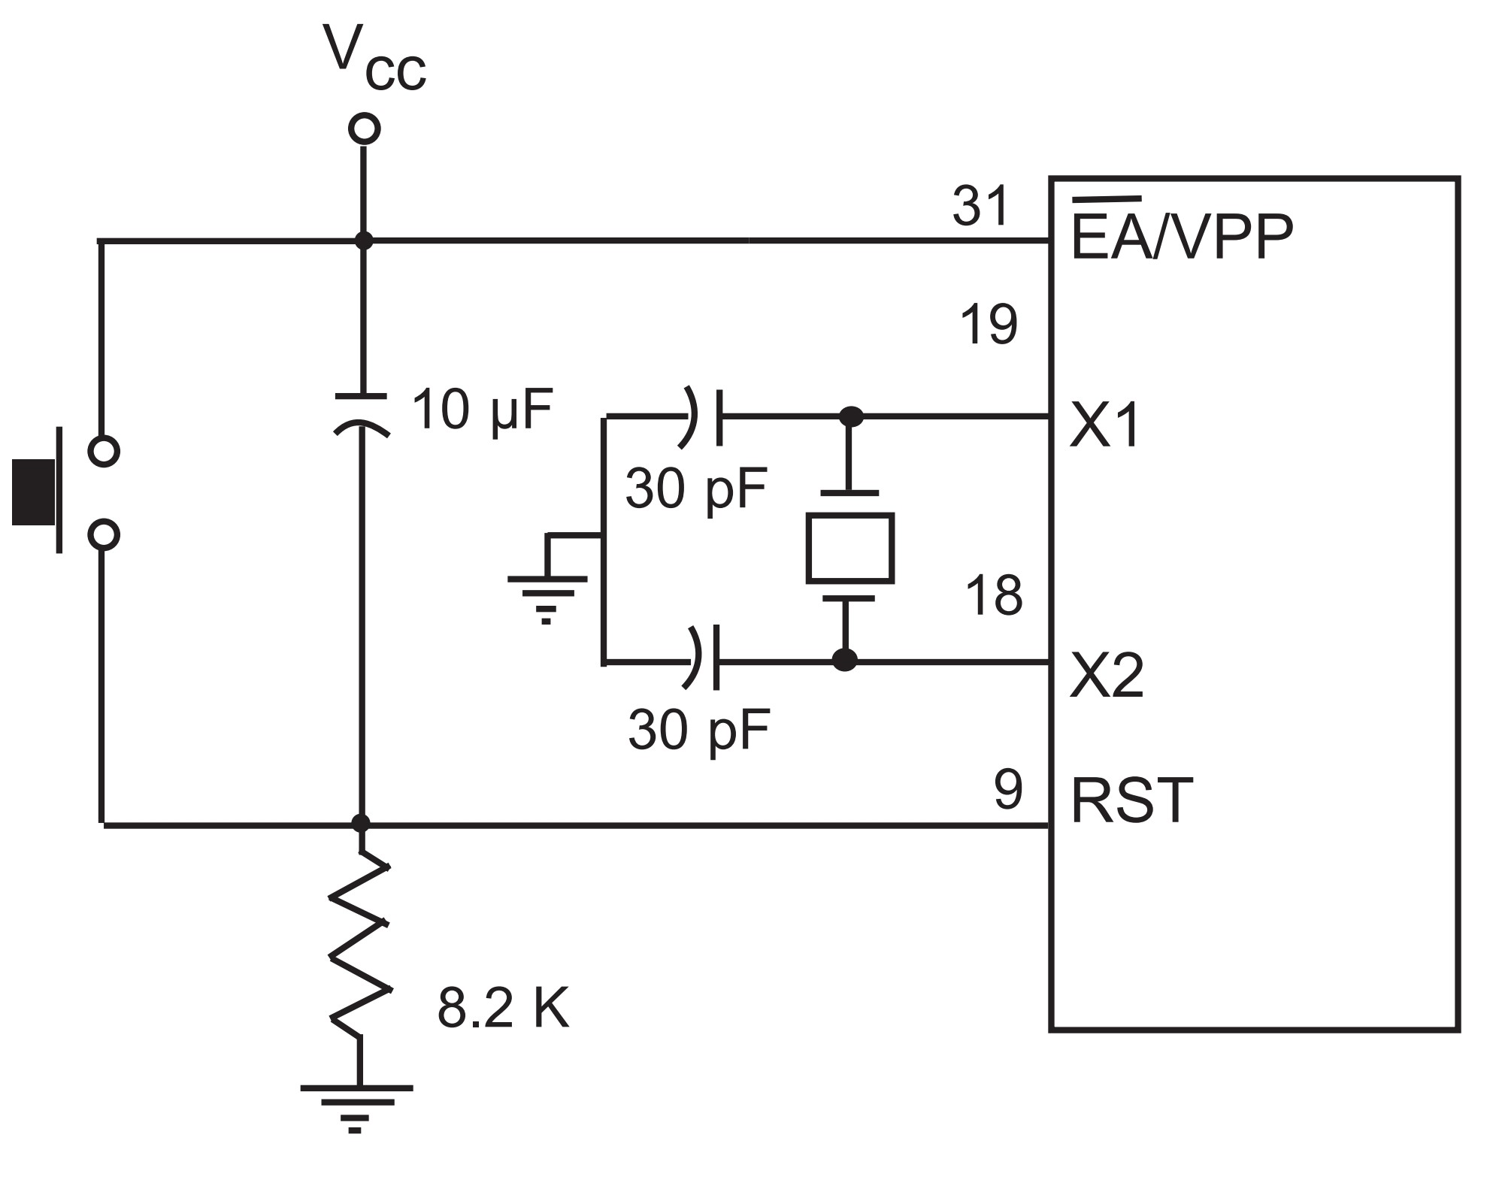
Figure 8-3 (b). Power-On RESET with Momentary Switch

Slide 10
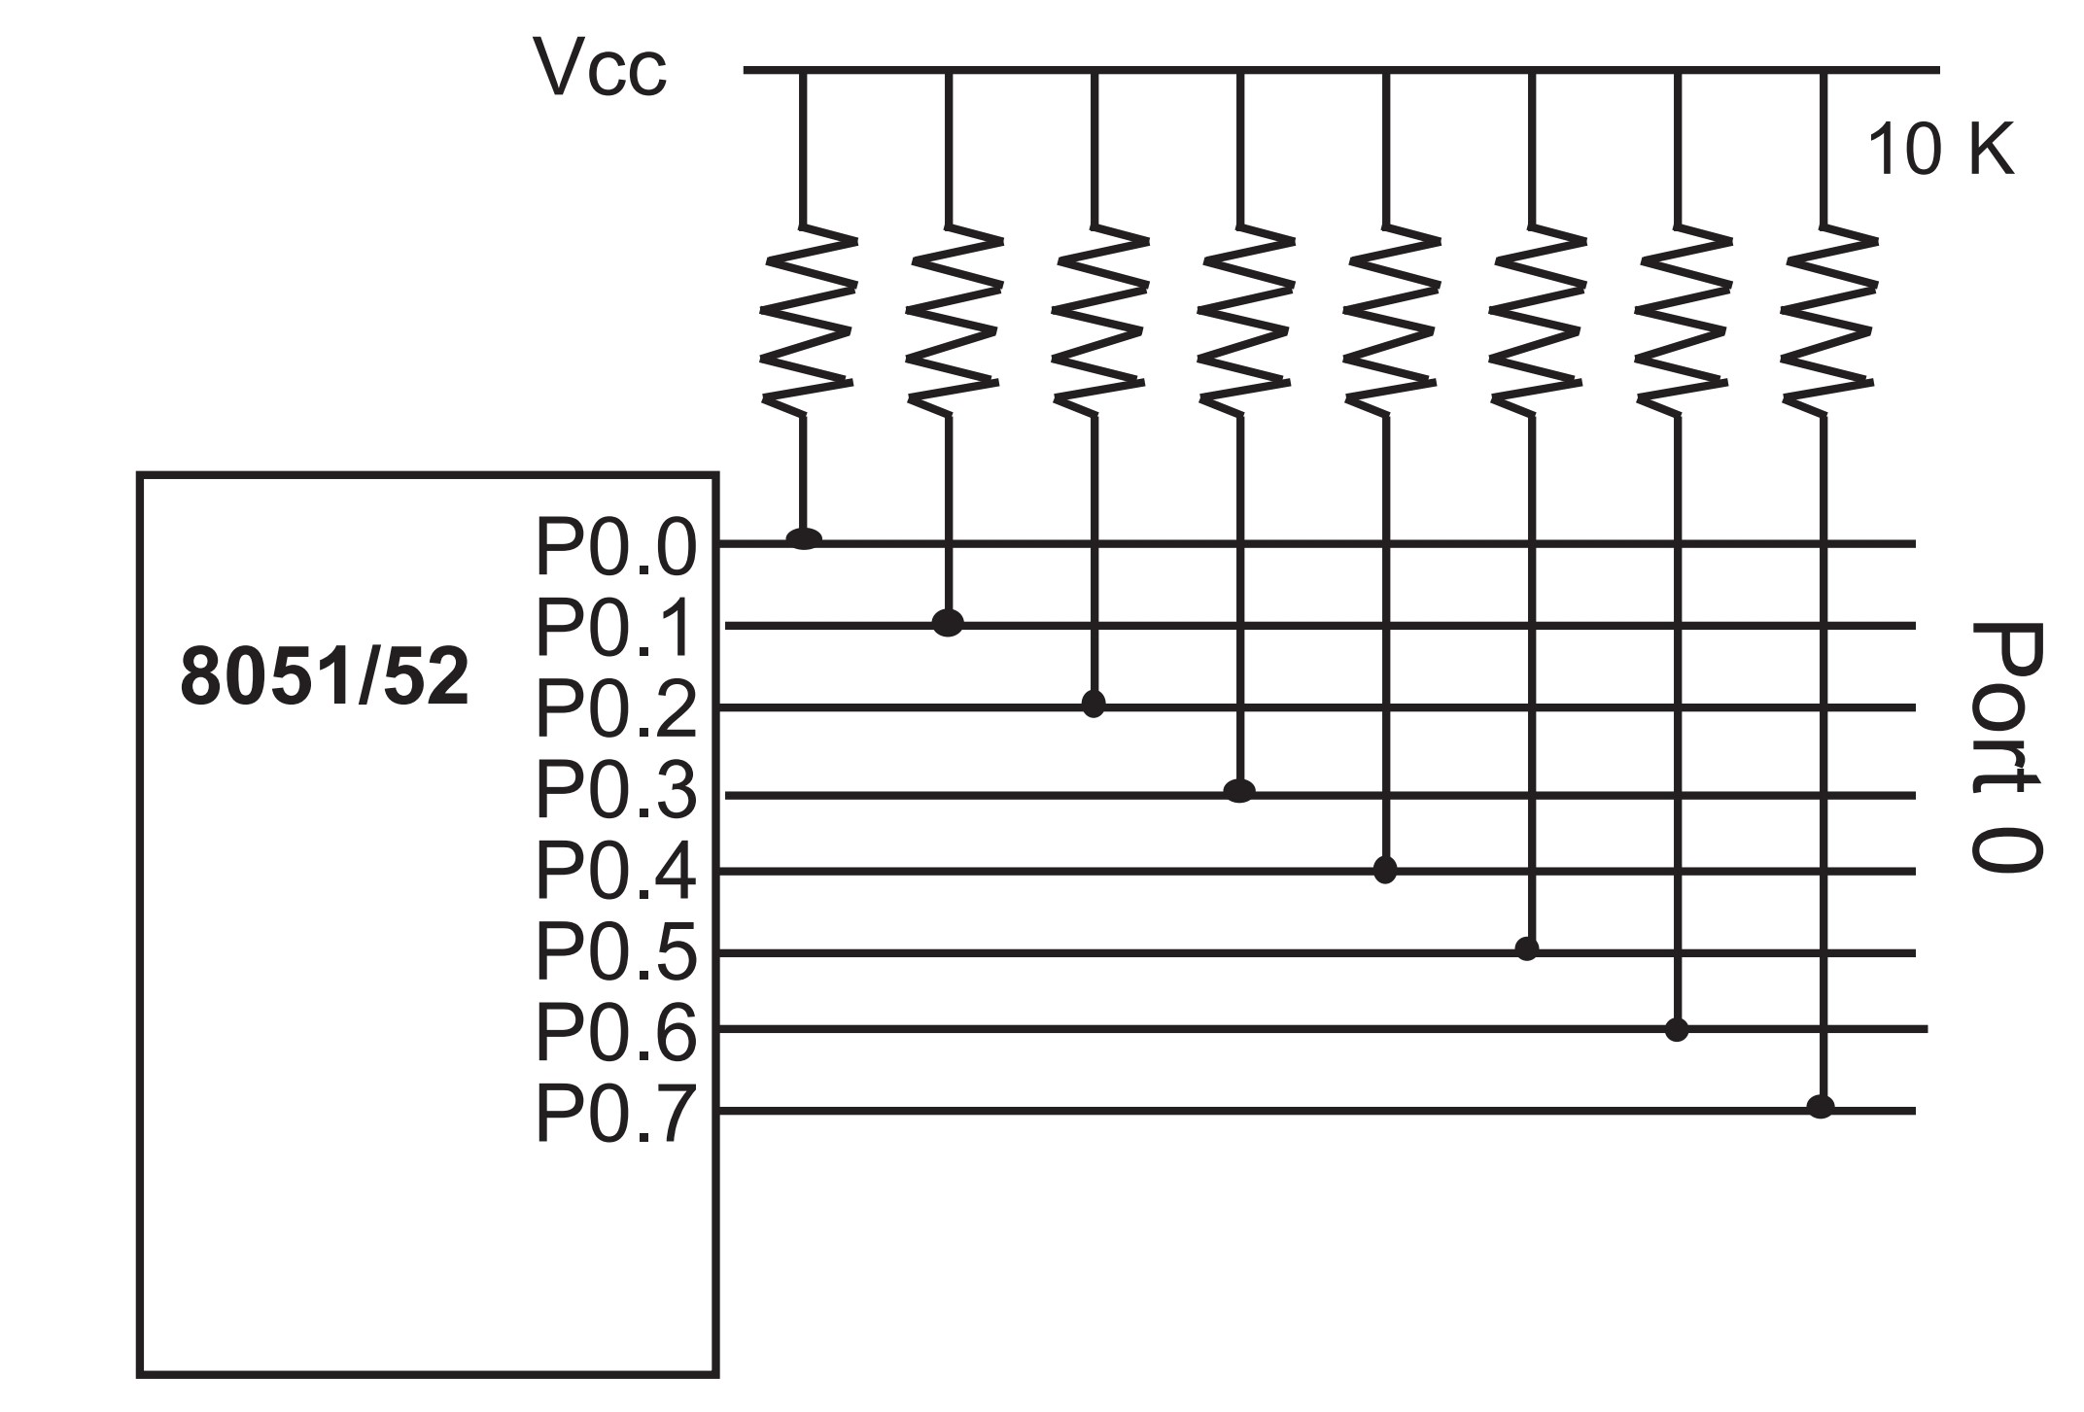
Figure 8-4. Port 0 with Pull-Up Resistors

Slide 11
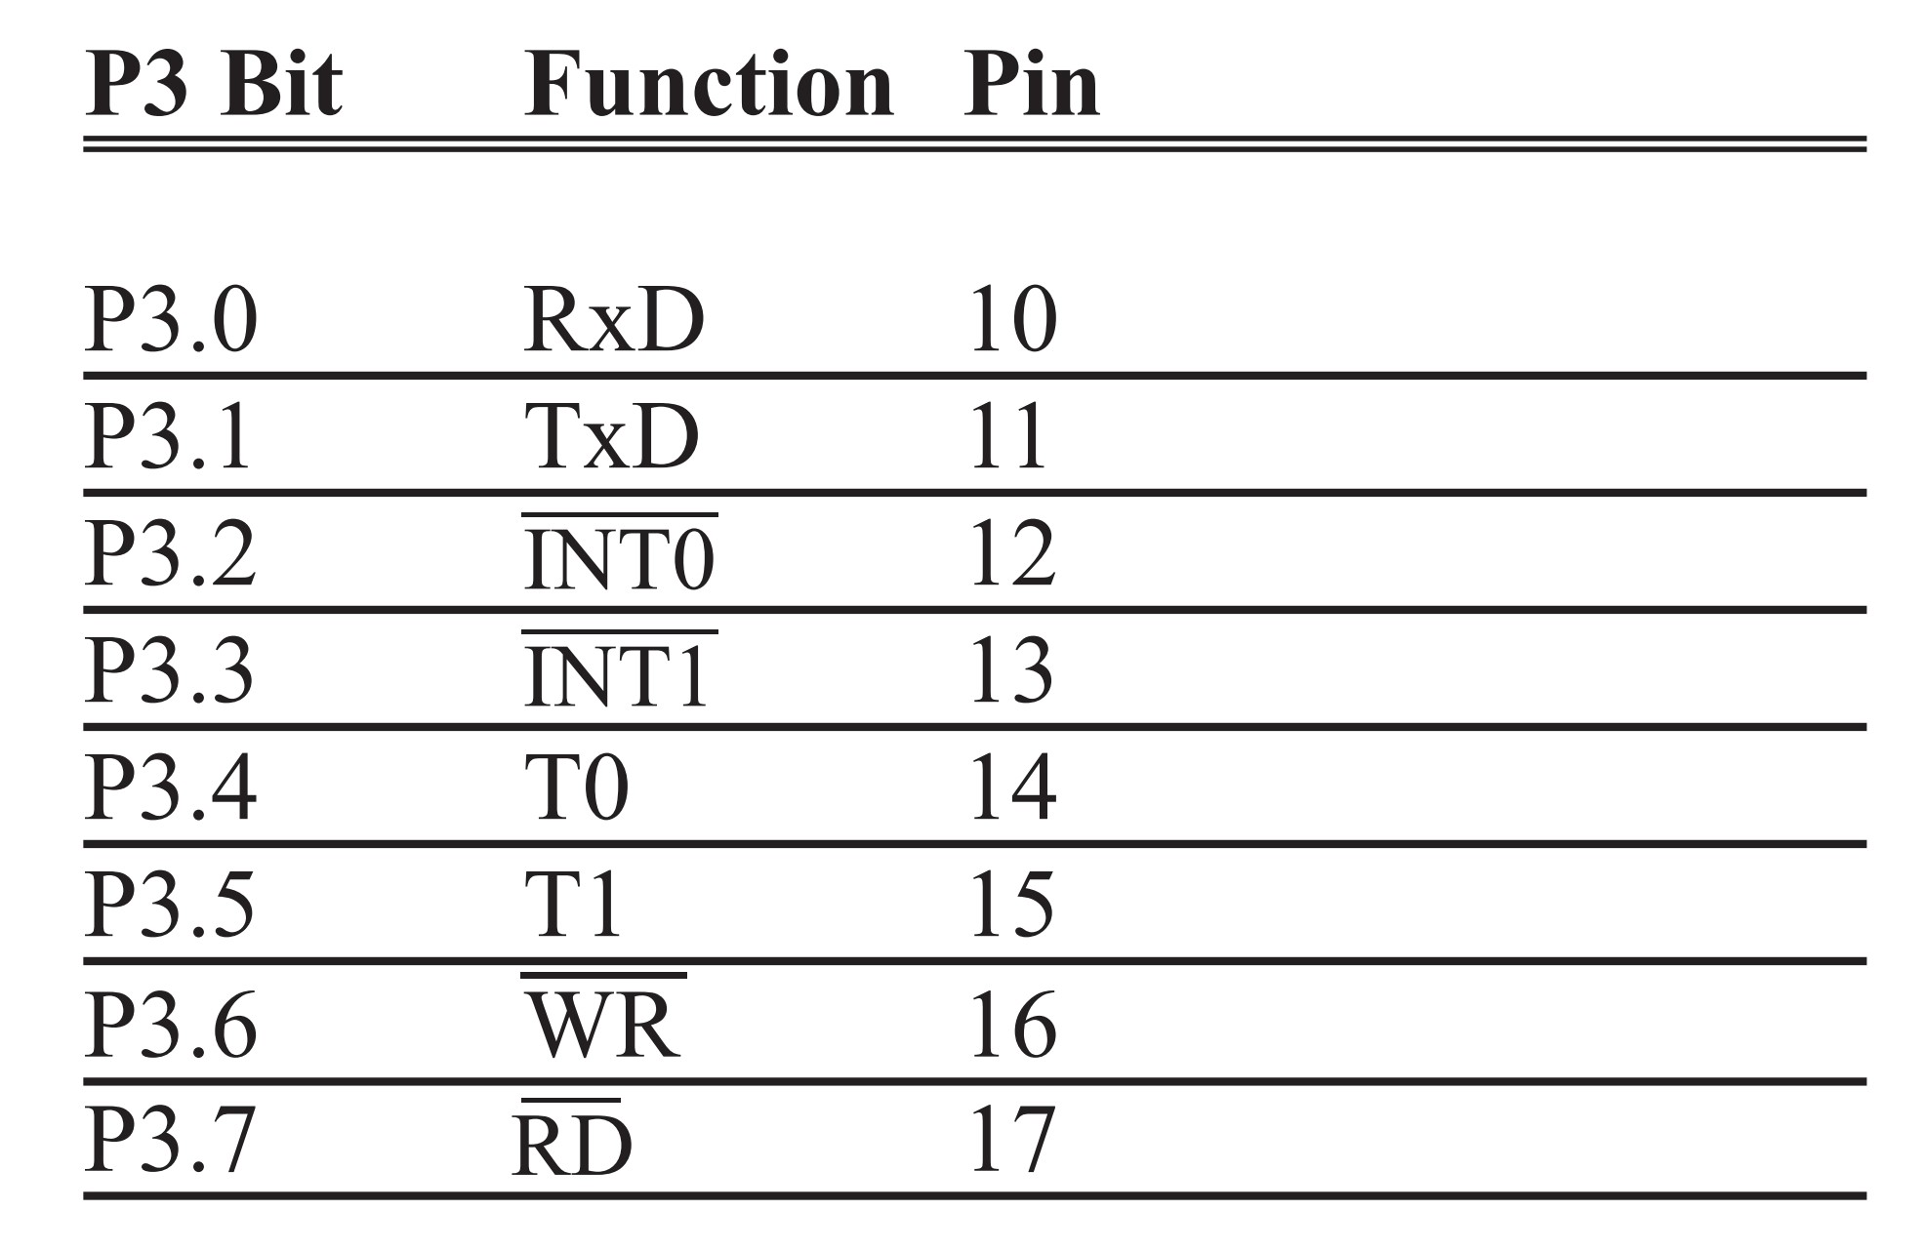
Table 8-1: Port 3 Alternate Functions

Slide 12
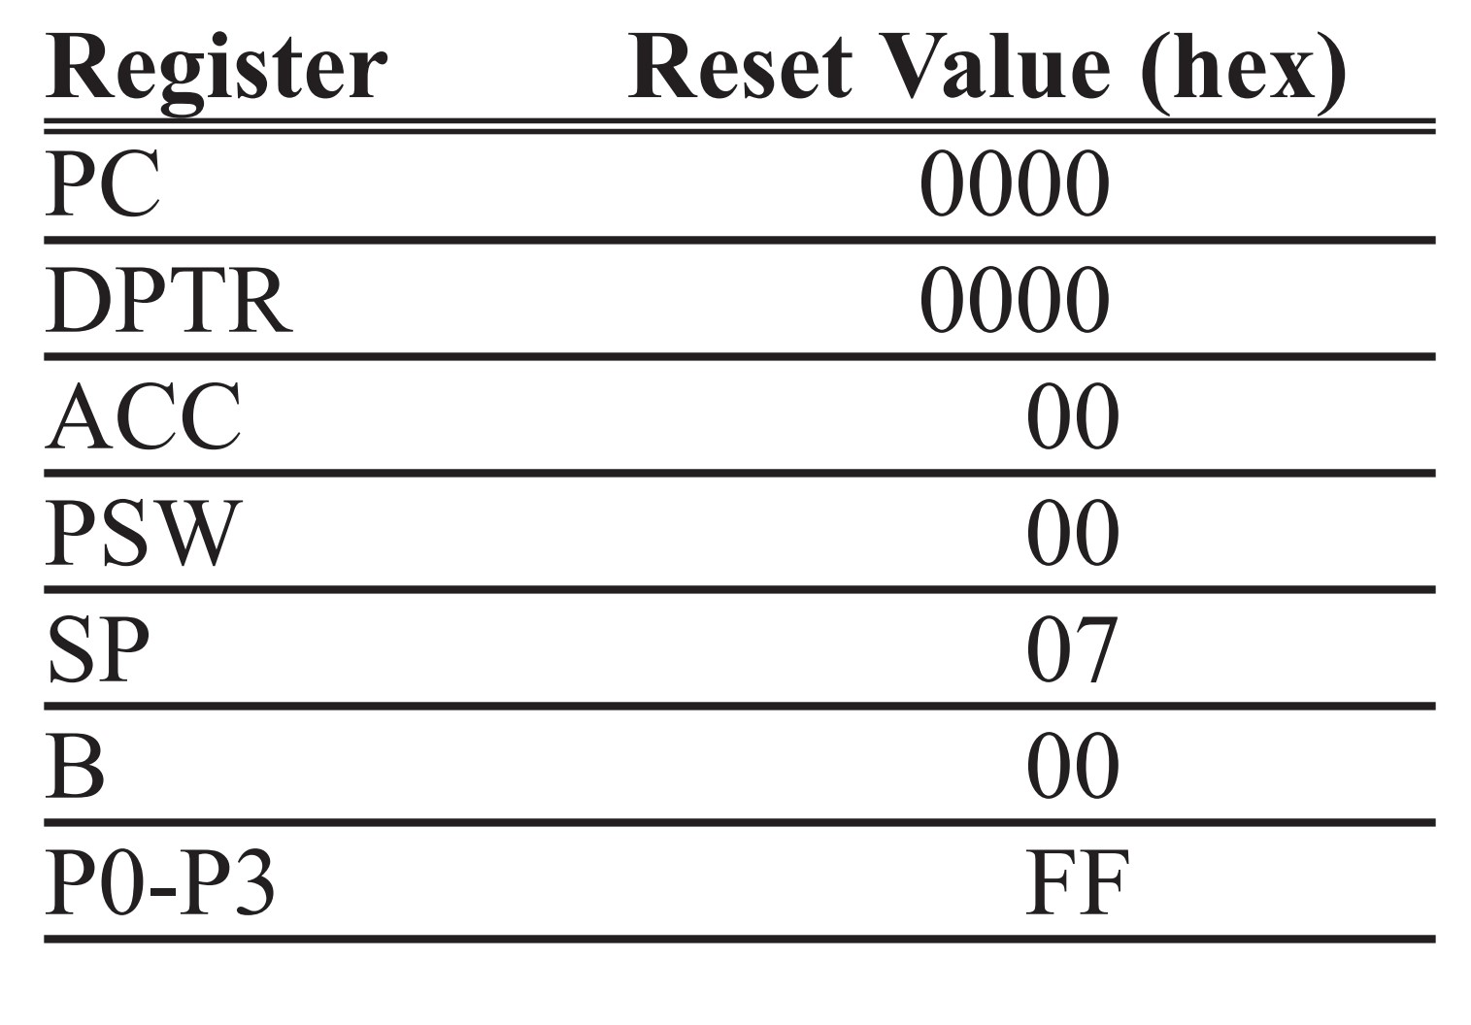
Table 8-2: RESET Value of Some 8051 Registers

Slide 13
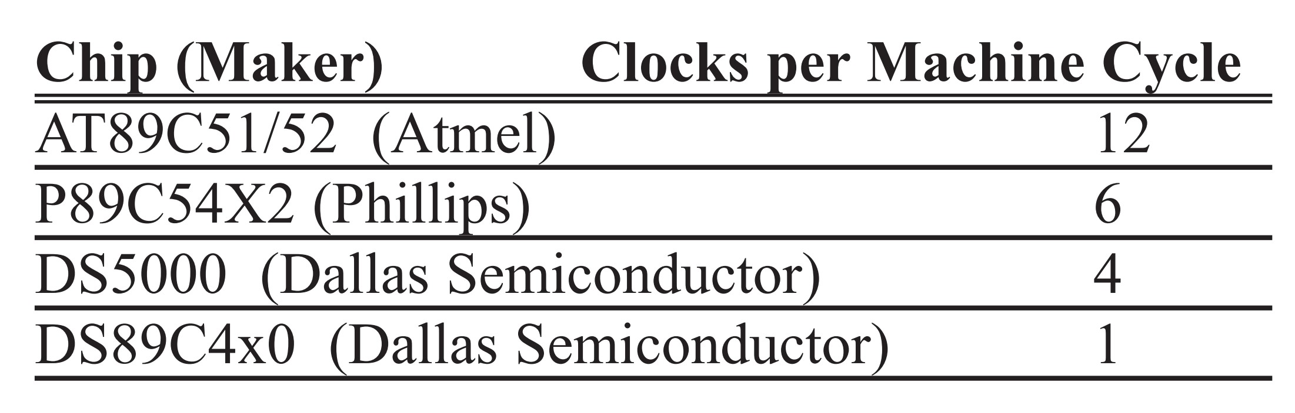
Table 8-3: Clocks per Machine Cycle (MC) for Various 8051 Versions

Slide 14
Example 8-1
Find the machine cycle (MC) for the following chips if XTAL = 11.0592 MHz.
(a) AT89C51 (b) DS89C4x0 (c) DS5000
Solution:
1/11.0592 MHz = 90.42 nanoseconds (ns)
(a) MC = 12 x 90.42 ns = 1.085 ms
(b) MC = 1 x 90.42 ns = 90.42 ns
(c) MC = 4 x 90.42 ns = 361.68 ns

Slide 15
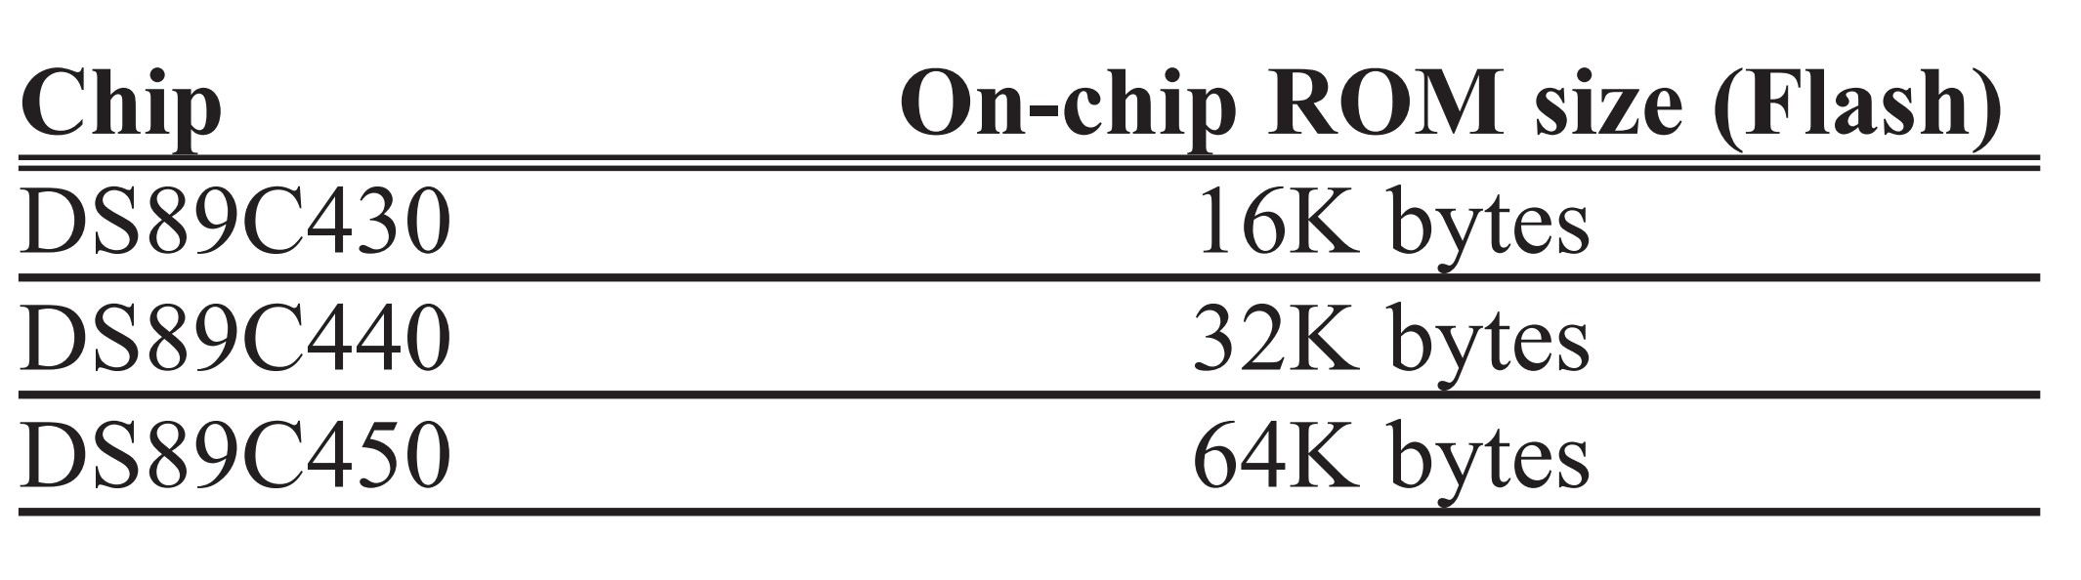
Table 8-4: On-Chip Flash ROM Size for the DS89C4x0 Family from Maxim-Dallas Semiconductor. See www.maxim-ic.com

Slide 16
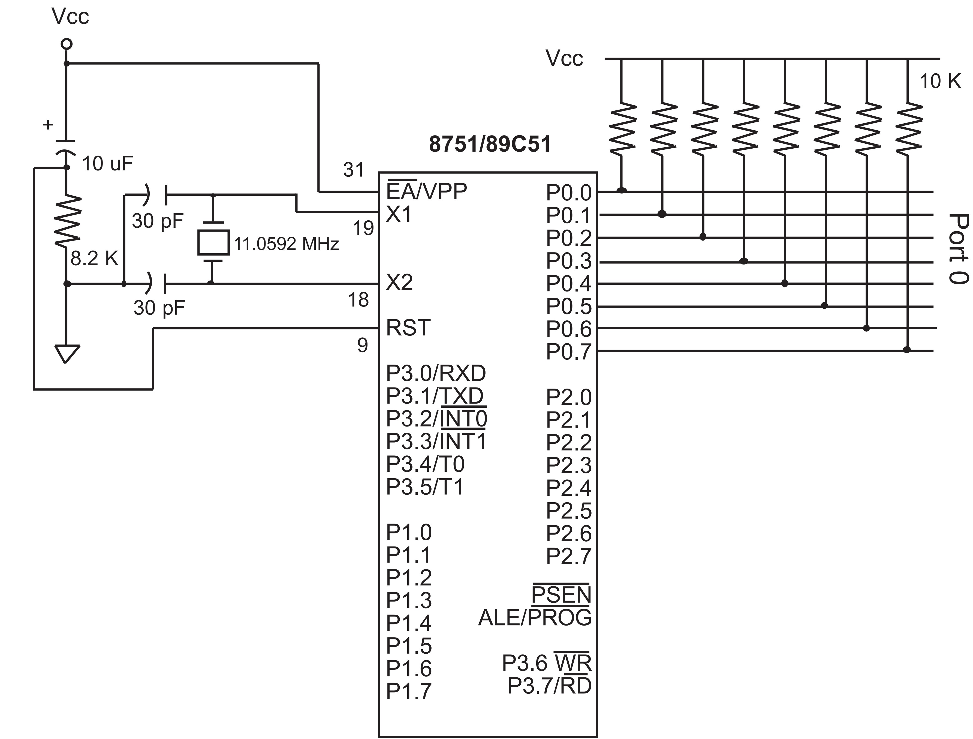
Figure 8-5. Minimum Connection for 89C51/52-Based Systems

Slide 17
Example 8-2
Find the address space for the on-chip ROM of the following chips.
(a) AT89C51, (b) AT89C52, and (c) DS89C430
Solution:
(a) AT89C51 has 4K bytes of on-chip ROM. That gives us 4 ´ 1024 = 4,096 bytes. Converting the 4096 to hex, we get 1000H. Therefore, the address space is 0000 - 0FFFH.
(b) AT89C52 has 8K bytes of on-chip ROM. That gives us 8 ´ 1024 = 8,192 bytes. Converting the 8,192 to hex, we get 2000H. Therefore, the address space is 0000 - 1FFFH.
(c) DS89C430 has 16K bytes of on-chip ROM. That gives us 16 ´ 1024 = 16,384 bytes. Converting the 16,384 to hex, we get 4000H. Therefore, the address space is 0000 - 3FFFH.

Slide 18
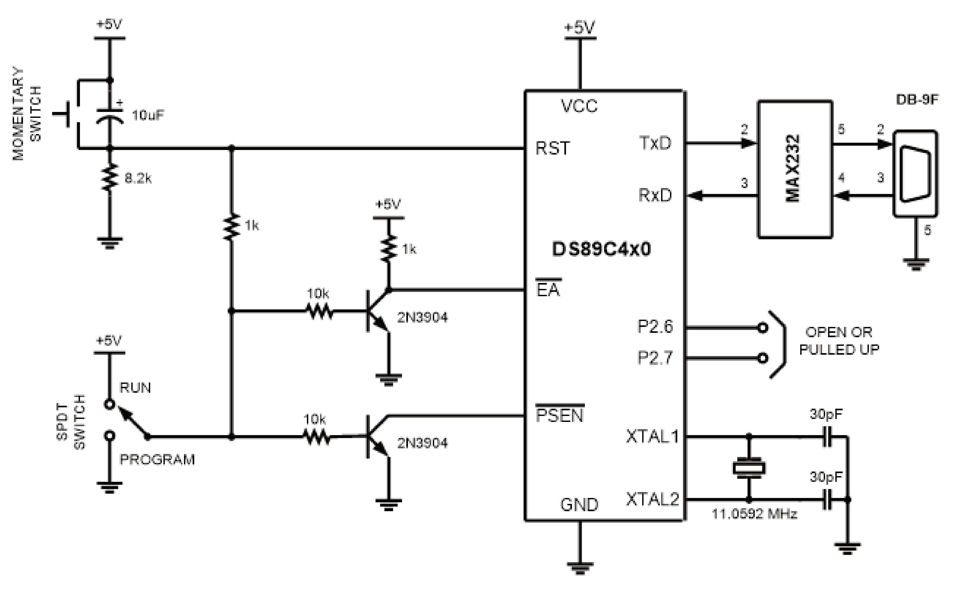
Figure 8-6. DS89C4x0 Trainer (for MAX232 connection, see Section 10.2)

Slide 19
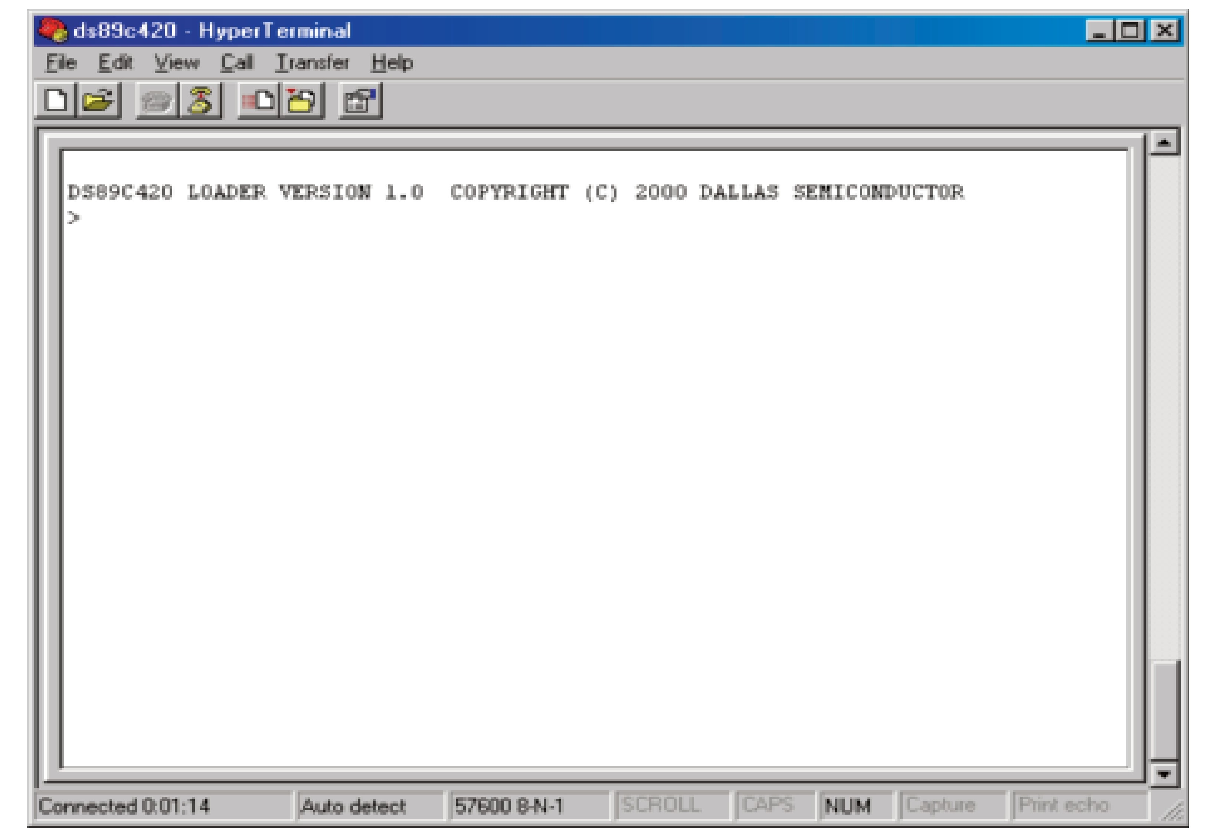
Figure 8-7. Screen Capture from HyperTerminal for DS89C4x0 Trainer

Slide 20
LOC OBJ LINE
0000 1 ORG 0H
0000 758055 2 MAIN: MOV P0, #55H
0003 759055 3 MOV P1, #55H
0006 75A055 4 MOV P2, #55H
0009 7DFA 5 MOV R5, #250
000B 111C 6 ACALL MSDELAY
000D 7580AA 7 MOV P0, #0AAH
0010 7590AA 8 MOV P1, #0AAH
0013 75A0AA 9 MOV P2, #0AAH
0016 7DFA 10 MOV R5, #250
0018 111C 11 ACALL MSDELAY
001A 80E4 12 SJMP MAIN 13 ;--- THE 250 MILLISECOND DELAY. 14 MSDELAY:
001C 7C23 15 HERE3: MOV R4, #35
001E 7B4F 16 HERE2: MOV R3,#79
0020 DBFE 17 HERE1: DJNZ R3, HERE1
0022 DCFA 18 DJNZ R4, HERE2
0024 DDF6 19 DJNZ R5, HERE3
0026 22 20 RET
21 END
Figure 8-8. List File For Test Program (Assembly)

Slide 21
Figure 8-9. Intel Hex File Test Program as Provided by the Assembler
:1000000075805575905575A0557DFA111C7580AA9F
:100010007590AA75A0AA7DFA111C80E47C237B4F01
:07002000DBFEDCFADDF62235
:00000001FF
Seperating the fields we get the following
:CC AAAA TT DDDDDDDDDDDDDDDDDDDDDDDDDDDDDDDD SS
:10 0000 00 75805575905575A0557DFA111C7580AA 9F
:10 0010 00 7590AA75A0AA7DFA111C80E47C237B4F 01
:07 0020 00 DBFEDCFADDF622 35
:00 0000 01 FF

Slide 22
Example 8-3
From Figure 8-9, analyze the six parts of line 3.
Solution:
After the colon (:) we have 07, which means that seven bytes of data are in this line.
0020H is the address at which the data starts. Next, 00 means that this is not the last line of the record. Then the data, which is seven bytes, is as follows: DB FE DC FA DD F6 22. Finally, the last byte, 35, is the checksum byte.

Slide 23
Example 8-4
Verify the checksum byte for line 3 of Figure 8-9. Verify also that the information is not corrupted.
Solution:
07 + 00 + 20 + 00 + DB + FE + DC + FA + DD + F6 + 22 = 5CBH. Dropping the carries (5) gives CBH, and its 2's complement is 35H, which is the last byte of line 3.
If we add all the information in line 3, including the checksum byte, and drop the carries we should get 00.
07 + 00 + 20 + 00 + DB + FE + DC + FA + DD + F6 + 22 + 35 = 600H

Slide 24
Example 8-5
Compare the data portion of the Intel hex file of Figure 8-9 with the opcodes in the list file of the test program given in Figure 8-8. Do they match?
Solution:
In the first line of Figure 8-9, the data portion starts with 75H, the opcode for the instruction “MOV”, as shown in the list file of Figure 8-8. The last byte of the data in line 3 of Figure 8-9 is 22, which is the opcode for the “RET” instruction in the list file of Figure 8-8.

