Slide 1

THE 8051
MICROCONTROLLER & Embedded Systems
Muhammad Ali Mazidi, Janice Mazidi
& Rolin McKinlay

Slide 2
8051 PROGRAMMING
IN C
Chapter 7

Slide 3
Objectives
Upon completion of this chapter, you will be able to:
>> Examine the C data type for the 8051
>> Code 8051 C programs for time delay and I/O operations
>> Code 8051 C programs for I/O bit manipulation
>> Code 8051 C programs for logic and arithmetic operations
>> Code 8051 C programs for ASCII and BCD data conversion
>> Code 8051 C programs for binary (hex) to decimal conversion
>> Code 8051 C programs to use the 8051 code space
>> Code 8051 C programs for data serialization

Slide 4
Objectives
The study of C programming for the 8051,
Section 7.1, data types and time delays,
Section 7.2, I/O programming,
Section 7.3, the logic operations AND, OR, XOR, inverter, and shift,
Section 7.4, ASCII and BCD conversions and checksums,
Section 7.5, how 8051 C compilers use the program (code) ROM space for data,
Section 7.6, data serialization for 8051

Slide 5
Example 7-1
Write an 8051 C program to send values 00 - FF to port P1.
Solution:
#include <reg51.h>
void main(void)
{
unsigned char z;
for(z=0;z<=255;z++)
P1=z;
}
Run the above program on your simulator to see how P1 displays values 00 - FFH in binary.

Slide 6
Example 7-2
Write an 8051 C program to send hex values for ASCII characters of 0, 1, 2, 3, 4, 5, A, B, C, and D to port P1.
Solution:
#include <reg51.h>
void main(void)
{
unsigned char mynum[]= "012345ABCD";
unsigned char z;
for(z=0;z<=10;z++)
P1=mynum[z];
}
Run the above program on your simulator to see how P1 displays values 30H, 31H, 32H, 33H, 34H, 35H, 41H, 42H, 43H, and 44H, the hex values for ASCII 0, 1, 2, and so on.

Slide 7
Example 7-3
Write an 8051 C program to toggle all the bits of P1 continuously.
Solution:
// Toggle P1 forever
#include <reg51.h>
void main(void)
{
for(;;) //repeat forever
{
P1=0x55; //0x indicates the data is in hex (binary)
P1=0xAA;
}
}
Run the above program on your simulator to see how P1 toggles continuously. Examine the asm code generated by the C compiler.

Slide 8
Example 7-4
Write an 8051 C program to send values of –4 to +4 to port P1.
Solution:
//sign numbers
#include <reg51.h>
void main(void)
{
char mynum[]= {+1,-1,+2,-2,+3,-3,+4,-4};
unsigned char z;
for(z=0;z<=8;z++)
P1=mynum [z];
}
Run the above program on your simulator to see how P1 displays values of 1, FFH, 2, FEH, 3, FDH, 4, and FCH, the hex values for +1, –1, +2, –2, and so on.

Slide 9
Example 7-5
Write an 8051 C program to toggle bit D0 of the port P1 (P1.0) 50,000 times.
Solution:
#include <reg51.h>
sbit MYBIT = P1^0; //notice that sbit is
//declared outside of main
void main(void)
{
unsigned int z;
for (z=0; z<=50000; z++)
{
MYBIT = 0;
MYBIT = 1;
}
}
Run the above program on your simulator to see how P1.0 toggles continuously.

Slide 10
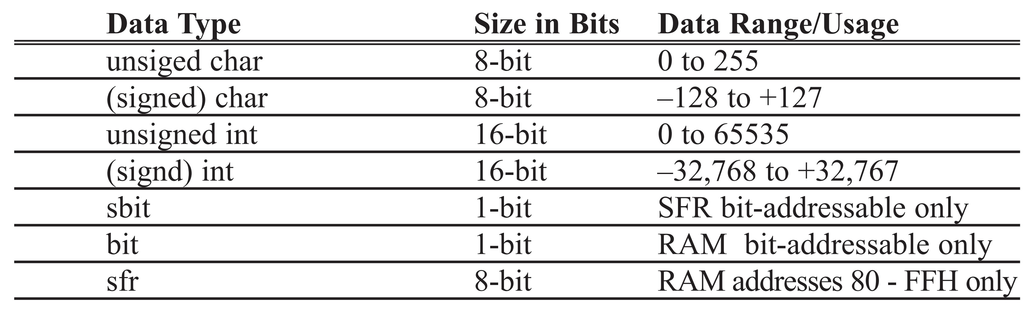
Table 7-1: Some Widely Used Data Types for 8051 C

Slide 11
Example 7-6
Write an 8051 C program to toggle bits of P1 continuously forever with some delay.
Solution:
// Toggle P1 forever with some delay in between "on" and "off".
#include <reg51.h>
void main(void)
{
unsigned int x;
for(;;) //repeat forever
{
P1=0x55;
for(x=0;x<40000;x++); //delay size unknown
P1=0xAA;
for(x=0;x<40000;x++);
}
}

Slide 12
Example 7-7
Write an 8051 C program to toggle the bits of P1 ports continuously with a 250 ms delay.
Solution:
#include <reg51.h>
void MSDelay(unsigned int);
void main(void)
{
while(1) //repeat forever
{
P1=0x55;
MSDelay(250);
P1=0xAA;
MSDelay(250);
}
}
void MSDelay(unsigned int itime)
{
unsigned int i, j;
for(i=0;i<itime;i++)
for(j=0;j<1275;j++);
}
The program below is tested for the DS89C4x0
with XTAL = 11.0592 MHz.
Run the above program on your Trainer and use the oscilloscope to measure the delay.

Slide 13
Example 7-8
Write a 8051 C program to toggle all the bits of P0 and P2 continuously with a 250 ms delay.
Solution:
#include <reg51.h>
void MSDelay(unsigned int);
void main(void)
{
while(1) //another way to do it forever
{
P0=0x55;
P2=0x55;
MSDelay(250);
P0=0xAA;
P2=0xAA;
MSDelay(250);
}
}
void MSDelay(unsigned int itime)
{
unsigned int i, j;
for(i=0;i<itime;i++)
for(j=0;j<1275;j++);
}
//This program is tested
for the DS89C4x0
with XTAL = 11.0592 MHz

Slide 14
Example 7-9
LEDs are connected to bits P1 and P2. Write an 8051 C program that shows the count from 0 to FFH (0000 0000 to 1111 1111 in binary) on the LEDs.
Solution:
#include <reg51.h>
#define LED P2 //notice how we can define P2
void main(void)
{
P1=00; //clear P1
LED=0; //clear P2
for(;;) //repeat forever
{
P1++; //increment P1
LED++; //increment P2
}
}

Slide 15
Example 7-10
Write an 8051 C program to get a byte of data from P1, wait 1/2 second, and then send it to P2.
Solution:
#include <reg51.h>
void MSDelay(unsigned int);
void main(void)
{
unsigned char mybyte;
P1=0xFF; //make P1 an input port
while(1)
{
mybyte=P1; //get a byte from P1
MSDelay(500);
P2=mybyte; //send it to P2
}
}
void MSDelay(unsigned int itime)
{
unsigned int i, j;
for(i=0;i<itime;i++)
for(j=0;j<1275;j++);
}

Slide 16
Example 7-11
Write an 8051 C program to get a byte of data from P0. If it is less than 100, send it to P1; otherwise, send it to P2.
Solution:
#include <reg51.h>
void main(void)
{
unsigned char mybyte;
P0=0xFF; //make P0 an input port
while(1)
{
mybyte=P0; //get a byte from P0
if(mybyte<100)
P1=mybyte; //send it to P1 if less than 100
else
P2=mybyte; //send it to P2 if more than 100
}
}

Slide 17
Example 7-12
Write an 8051 C program to toggle only bit P2.4 continuously without disturbing the rest of the bits of P2.
Solution:
//toggling an individal bit
#include <reg51.h>
sbit mybit = P2^4; //notice the way single bit is declared
void main(void)
{
while(1)
{
mybit=1; //turn on P2.4
mybit=0; //turn off P2.4
}
}

Slide 18
Example 7-13
Write an 8051 C program to monitor bit P1.5. If it is high, send 55H to P0; otherwise, send AAH to P2.
Solution:
#include <reg51.h>
sbit mybit = P1^5; //notice the way single bit is declared
void main(void)
{
mybit=1; //make mybit an input
while(1)
{
if(mybit==1)
P0=0x55;
else
P2=0xAA;
}
}

Slide 19
Solution:
#include <reg51.h>
void MSDelay(unsigned int);
sbit Dsensor = P1^1; //notice the way single bit is defined
sbit Buzzer = P1^7;
void main(void)
{
Dsensor=1; //make P1.1 an input
while(Dsensor==1)
{
buzzer=0;
MSDelay(200);
buzzer=1;
MSDelay(200);
}
}
void MSDelay(unsigned int itime)
{
unsigned int i, j;
for(i=0;i<itime;i++)
for(j=0;j<1275;j++);
}
Example 7-14
A door sensor is connected to the P1.1 pin, and a buzzer is connected to P1.7. Write an 8051 C program to monitor the door sensor, and when it opens, sound the buzzer. You can sound the buzzer by sending a square wave of a few hundred Hz.

Slide 20
Solution:
Example 7-15
#include <reg51.h>
#define LCDData P1 //LCDData declaration
sbit En=P2^0; //the enable pin
void main(void)
{
unsigned char message[ ]= "The Earth is but One Country";
unsigned char z;
for(z=0;z<28;z++) //send all the 28 characters
{
LCDData=message[z];
En=1; //a high-
En=0; //-to-low pulse to latch the LCD data
}
}
Run the above program on your simulator to see how P1 displays each character of the message. Meanwhile, monitor bit P2.0 after each character is issued.
The data pins of an LCD are connected to P1. The information is latched into the LCD whenever its Enable pin goes from high to low. Write an 8051 C program to send “The Earth is but One Country” to this LCD.

Slide 21
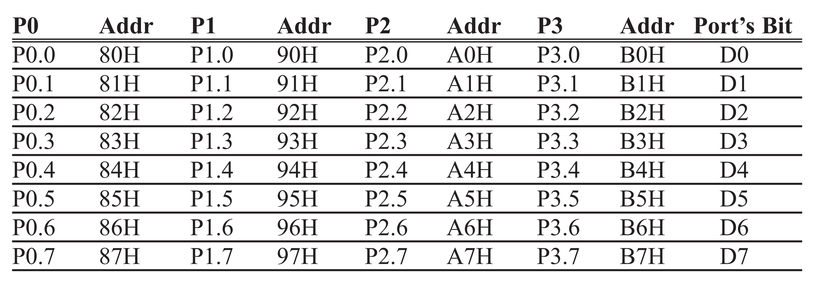
Table 7-2: Single Bit Addresses of Ports

Slide 22
Solution:
Example 7-16
sfr P0 = 0x80; //declaring P0 using sfr data type
sfr P1 = 0x90;
sfr P2 = 0xA0;
void MSDelay(unsigned int);
void main(void)
{
while(1) //do it forever
{
P0=0x55;
P1=0x55;
P2=0x55;
MSDelay(250); //250 ms delay
P0=0xAA;
P1=0xAA;
P2=0xAA;
MSDelay(250);
}
}
void MSDelay(unsigned int itime)
{
unsigned int i, j;
for(i=0;i<itime;i++)
for(j=0;j<1275;j++);
}
Write an 8051 C program to toggle all the bits of P0, P1, and P2 continuously with a 250 ms delay. Use the sfr keyword to declare the port addresses.
// Accessing Ports as SFRs using the sfr data type

Slide 23
Example 7-17
Write an 8051 C program to turn bit P1.5 on and off 50,000 times.
Solution:
sbit MYBIT = 0x95; //another way to declare bit P1^5
void main(void)
{
unsigned int z;
for(z=0;z<50000;z++)
{
MYBIT=1;
MYBIT=0;
}
}

Slide 24
Example 7-18
Write an 8051 C program to get the status of bit P1.0, save it, and send it to P2.7 continuously.
Solution:
#include <reg51.h>
sbit inbit = P1^0;
sbit outbit = P2^7; //sbit is used to declare SFR bits
bit membit; //notice we use bit to declare
//bit-addressable memory
void main(void)
{
while(1)
{
membit=inbit; //get a bit from P1.0
outbit=membit; //and send it to P2.7
}
}

Slide 25
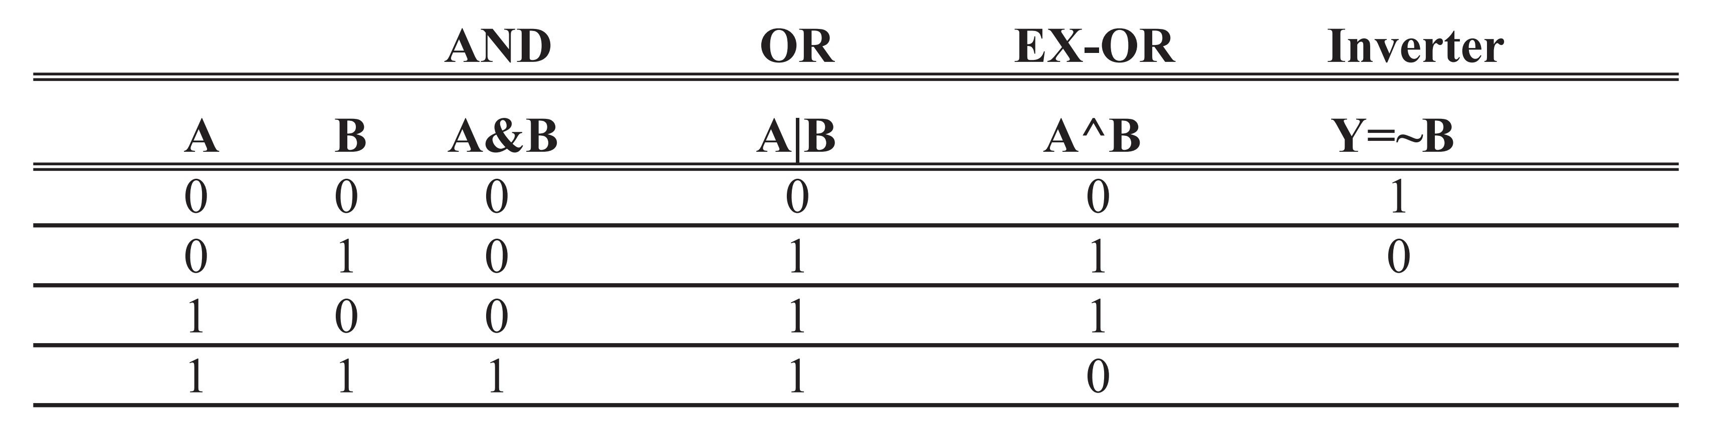
Table 7-3: Bit-wise Logic Operators for C
1. 0x35 & 0x0F = 0x05 /* ANDing */
2. 0x04 | 0x68 = 0x6C /* ORing: */
3. 0x54 ^ 0x78 = 0x2C /* XORing */
4. ~0x55 = 0xAA /* Inverting 55H */

Slide 26
Example 7-19
Run the following program on your simulator and examine the results.
Solution:
#include <reg51.h>
void main (void)
{
P0= 0x35 & 0x0F; //ANDing
P1= 0x04 | 0x68; //ORing
P2= 0x54 ^ 0x78; //XORing
P0= ~0x55; //inversing
P1= 0x9A >> 3; //shifting right 3 times
P2= 0x77 >> 4; //shifting right 4 times
P0= 0x6 << 4; //shifting left 4 times
}

Slide 27
Example 7-20
Write an 8051 C program to toggle all the bits of P0 and P2 continuously with a 250 ms delay. Use the inverting operator.
Solution:
#include <reg51.h>
void MSDelay(unsigned int);
void main(void)
{
P0=0x55;
P2=0x55;
while(1)
{
P0=~P0;
P2=~P2;
MSDelay(250);
}
}
void MSDelay(unsigned int itime)
{
unsigned int i, j;
for(i=0;i<itime;i++)
for(j=0;j<1275;j++);
}
The program below is tested for the DS89C4x0
with XTAL = 11.0592 MHz.

Slide 28
Example 7-21
Write an 8051 C program to toggle all the bits of P0, P1, and P2 continuously with a 250 ms delay. Use the Ex-OR operator.
Solution:
#include <reg51.h>
void MSDelay(unsigned int);
void main(void)
{
P0=0x55;
P1=0x55;
P2=0x55;
while(1)
{
P0=P0^0xFF;
P1=P1^0xFF;
P2=P2^0xFF;
MSDelay(250);
}
}
void MSDelay(unsigned int itime)
{
unsigned int i, j;
for(i=0;i<itime;i++)
for(j=0;j<1275;j++);
}
The program below is tested for the DS89C4x0
with XTAL = 11.0592 MHz.

Slide 29
Example 7-22
Write an 8051 C program to get bit P1.0 and send it to P2.7 after inverting it.
Solution:
#include <reg51.h>
sbit inbit=P1^0;
sbit outbit=P2^7; //sbit is used declare port (SFR) bits
bit membit; //notice this is bit-addressable memory
void main(void)
{
while(1)
{
membit=inbit; //get a bit from P1.0
outbit=~membit; //invert it and send it to P2.7
}
}

Slide 30
Solution:
Example 7-23
#include <reg51.h>
void main(void)
{
unsigned char z;
z=P1; //read P1
z=z&0x3; //mask the unused bits
switch(z) //make decision
{
case(0):
{
P0='0'; //issue ASCII 0
break;
}
case(1):
{
P0='1'; //issue ASCII 1
break;
}
case(2):
{
P0='2'; //issue ASCII 2
break;
}
case(3):
{
P0='3'; //issue ASCII 3
break;
}
}
}
Write an 8051 C program to read the P1.0 and P1.1 bits and issue an ASCII character to P0 according to the following table.
P1.1 P1.0
0 0 send ‘0’ to P0
0 1 send ‘1’ to P0
1 0 send ‘2’ to P0
1 1 send ‘3’ to P0

Slide 31
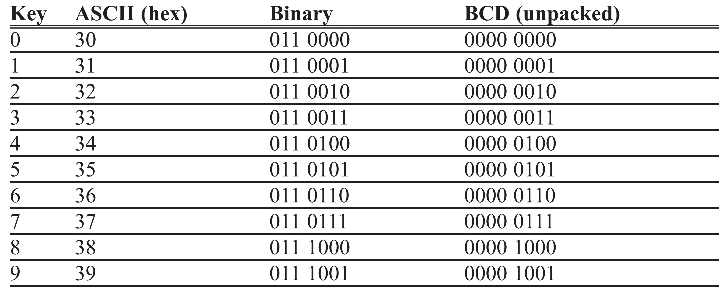
Table 7-4: ASCII Code for Digits 0 - 9

Slide 32
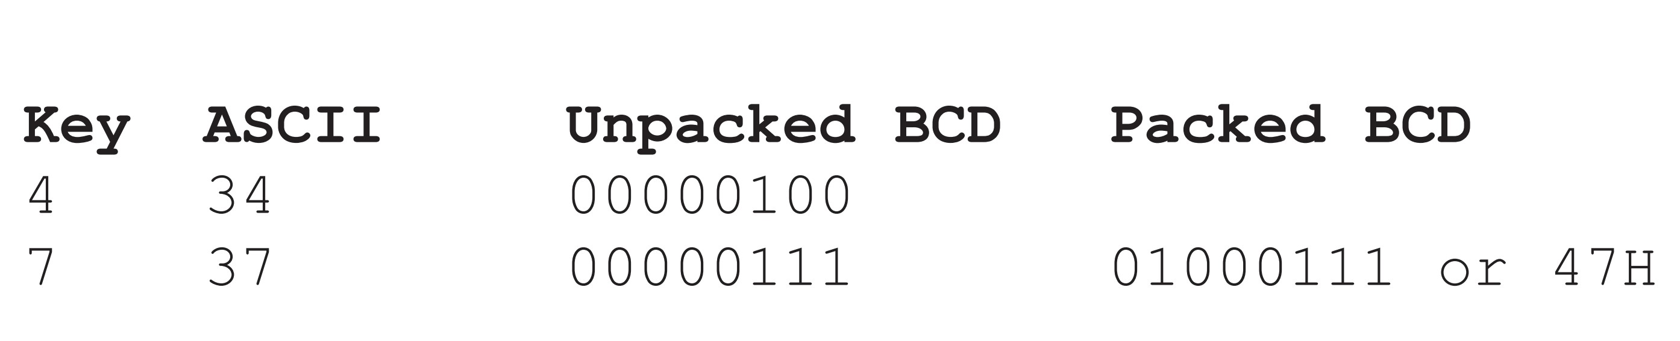
ASCII to Packed BCD Conversion

Slide 33
Example 7-24
Write an 8051 C program to convert packed BCD 0x29 to ASCII and display the bytes on P1 and P2.
Solution:
#include <reg51.h>
void main(void)
{
unsigned char x, y, z;
unsigned char mybyte = 0x29;
x = mybyte & 0x0F; //mask lower 4 bits
P1 = x | 0x30; //make it ASCII
y = mybyte & 0xF0; //mask upper 4 bits
y = y >> 4; //shift it to lower 4 bits
P2 = y | 0x30; //make it ASCII
}

Slide 34
Example 7-25
Write an 8051 C program to convert ASCII digits of ‘4’ and ‘7’ to packed BCD and display them on P1.
Solution:
#include <reg51.h>
void main(void)
{
unsigned char bcdbyte;
unsigned char w='4';
unsigned char z='7';
w = w & 0x0F; //mask 3
w = w << 4; //shift left to make upper BCD digit
z = z & 0x0F; //mask 3
bcdbyte = w | z; //combine to make packed BCD
P1 = bcdbyte;
}

Slide 35
Example 7-26
Assume that we have 4 bytes of hexadecimal data: 25H, 62H, 3FH, and 52H.
(a) Find the checksum byte, (b) perform the checksum operation to ensure data integrity, and (c) if the second byte 62H has been changed to 22H, show how checksum detects the error.
Solution:
(a) Find the checksum byte.
25H
+ 62H
+ 3FH
+ 52H
118H
(Dropping carry of 1 and taking the 2’s complement, we get E8H.)

Slide 36
Example 7-26
Assume that we have 4 bytes of hexadecimal data: 25H, 62H, 3FH, and 52H.
(a) Find the checksum byte, (b) perform the checksum operation to ensure data integrity, and (c) if the second byte 62H has been changed to 22H, show how checksum detects the error.
Solution:
(b) Perform the checksum operation to ensure data integrity.
25H
+ 62H
+ 3FH
+ 52H
+ E8H
200H
(Dropping the carries we get 00, which means data is not corrupted.)

Slide 37
Example 7-26
Assume that we have 4 bytes of hexadecimal data: 25H, 62H, 3FH, and 52H.
(a) Find the checksum byte, (b) perform the checksum operation to ensure data integrity, and (c) if the second byte 62H has been changed to 22H, show how checksum detects the error.
Solution:
(c) If the second byte 62H has been changed to 22H, show how checksum detects the error.
25H
+ 22H
+ 3FH
+ 52H
+ E8H
1C0H
(Dropping the carry, we get C0H, which means data is corrupted.)

Slide 38
Solution:
Example 7-27
#include <reg51.h>
void main(void)
{
unsigned char mydata[] = {0x25,0x62,0x3F,0x52};
unsigned char sum=0;
unsigned char x;
unsigned char chksumbyte;
for(x=0;x<4;x++)
{
P2=mydata[x]; //issue each byte to P2
sum=sum+mydata[x]; //add them together
P1=sum; //issue the sum to P1
}
chksumbyte=~sum+1; //make 2’s complement
P1=chksumbyte; //show the checksum byte
}
Single-step the above program on the 8051 simulator and examine the contents of P1 and P2. Notice that each byte is put on P1 as they are added together.
Write an 8051 C program to calculate the checksum byte for the data given in Example 7-26.

Slide 39
Example 7-28
Write an 8051 C program to perform step (b) of Example 7-26. If data is good, send ASCII character ‘G’ to P0. Otherwise send ‘B’ to P0.
Solution:
#include <reg51.h>
void main(void)
{
unsigned char mydata[]={0x25,0x62,0x3F,0x52,0xE8};
unsigned char chksum=0;
unsigned char x;
for(x=0;x<5;x++)
chksum=chksum+mydata[x]; //add them together
if(chksum==0)
P0='G';
else
P0='B';
}

Slide 40
Example 7-29
Write an 8051 C program to convert 11111101 (FD hex) to decimal and display the digits on P0, P1, and P2.
Solution:
#include <reg51.h>
void main(void)
{
unsigned char x, binbyte, d1, d2, d3;
binbyte = 0xFD; //binary(hex) byte
x = binbyte / 10; //divide by 10
d1 = binbyte % 10; //find remainder (LSD)
d2 = x % 10; //middle digit
d3 = x / 10; //most significant digit (MSD)
P0 = d1;
P1 = d2;
P2 = d3;
}

Slide 41
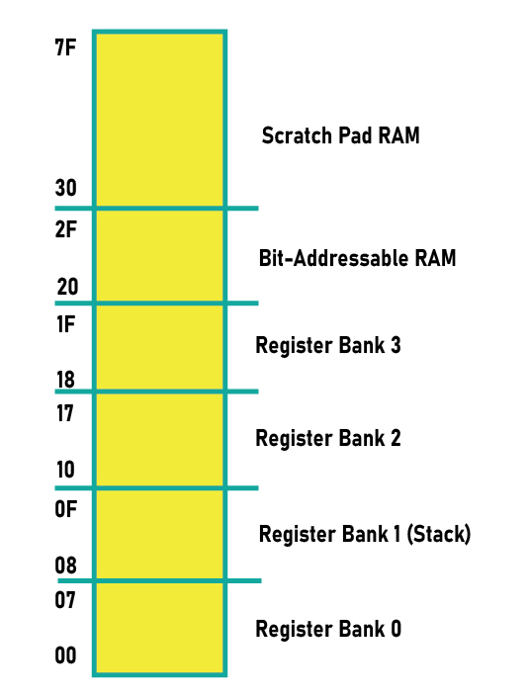
Figure 7-1. RAM Allocation in the 8051

Slide 42
Example 7-30
Compile and single-step the following program on your 8051 simulator. Examine the contents of the 128-byte RAM space to locate the ASCII values.
Solution:
#include <reg51.h>
void main(void)
{
unsigned char mynum[]= "ABCDEF"; //This uses RAM space
//to store data
unsigned char z;
for(z=0;z<=6;z++)
P1=mynum [z];
}
Run the above program on your 8051 simulator and examine the RAM space to locate values 41H, 42H, 43H, 44H, etc., the hex values for ASCII letters ‘A’, ‘B’, ‘C’, and so on.

Slide 43
Example 7-31
Write, compile, and single-step the following program on your 8051 simulator. Examine the contents of the code space to locate the values.
Solution:
#include <reg51.h>
void main(void)
{
unsigned char mydata[100]; //100 byte space in RAM
unsigned char x,z=0;
for(x=0;x<100;x++)
{
z--; //count down
mydata[x]=z; //save it in RAM
P1=z; //give a copy to P1 too
}
}
Run the above program on your 8051 simulator and examine the data RAM space to locate values FFH, FEH, FDH, and so on in RAM.

Slide 44
Example 7-32
Compile and single-step the following program on your 8051 simulator. Examine the contents of the code space to locate the ASCII values.
Solution:
#include <reg51.h>
void main(void)
{
code unsigned char mynum[]= "ABCDEF"; //uses code space
//for data
unsigned char z;
for(z=0;z<=6;z++)
P1=mynum[z];
}
Run the above program on your 8051 simulator and examine the code space to locate values 41H, 42H, 43H, 44H, etc., the hex values for ASCII characters of ‘A’, ‘B’, ‘C’, and so on.

Slide 45
Example 7-33
Compare and contrast the following programs and discuss the advantages and disadvantages of each one.
(a)
#include <reg51.h>
void main(void)
{
P1='H';
P1='E';
P1='L';
P1='L';
P1='O';
}
(b)
#include <reg51.h>
void main(void)
{
unsigned char mydata[]="HELLO";
unsigned char z;
for(z=0;z<=5;z++)
P1=mydata[z];
}
(c)
#include <reg51.h>
void main(void)
{
//Notice Keyword code
code unsigned char mydata[]="HELLO";
unsigned char z;
for(z=0;z<=5;z++)
P1=mydata[z];
}

Slide 46
Example 7-33
Solution:
All the programs send out “HELLO” to P1, one character at a time, but they do it in different ways. The first one is short and simple, but the individual characters are embedded into the program. If we change the characters, the whole program changes. It also mixes the code and data together. The second one uses the RAM data space to store array elements, therefore the size of the array is limited. The third one uses a separate area of the code space for data. This allows the size of the array to be as long as you want if you have the on-chip ROM. However, the more code space you use for data, the less space is left for your program code. Both programs (b) and (c) are easily upgradable if we want to change the string itself or make it longer. That is not the case for program (a).

Slide 47
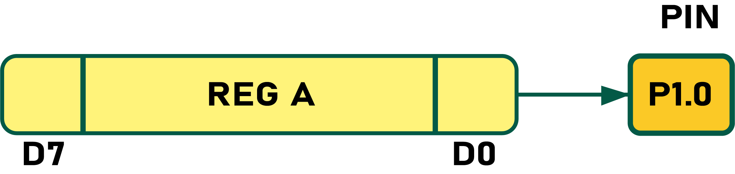
Example 7-34
Write a C program to send out the value 44H serially one bit at a time via P1.0. The LSB should go out first.
Solution:
#include <reg51.h>
sbit P1b0 = P1^0;
sbit regALSB = ACC^0;
void main(void)
{
unsigned char conbyte = 0x44;
unsigned char x;
ACC = conbyte;
for(x=0; x<8; x++)
{
P1b0 = regALSB;
ACC = ACC >> 1;
}
}
//SERIALIZING DATA VIA P1.0 (SHIFTING RIGHT)

Slide 48
Example 7-35
Write a C program to send out the value 44H serially one bit at a time via P1.0. The MSB should go out first.
Solution:
#include <reg51.h>
sbit P1b0 = P1^0;
sbit regAMSB = ACC^7;
void main(void)
{
unsigned char conbyte = 0x44;
unsigned char x;
ACC = conbyte;
for(x=0; x<8; x++)
{
P1b0 = regAMSB;
ACC = ACC << 1;
}
}
//SERIALIZING DATA VIA P1.0 (SHIFTING LEFT)

Slide 49
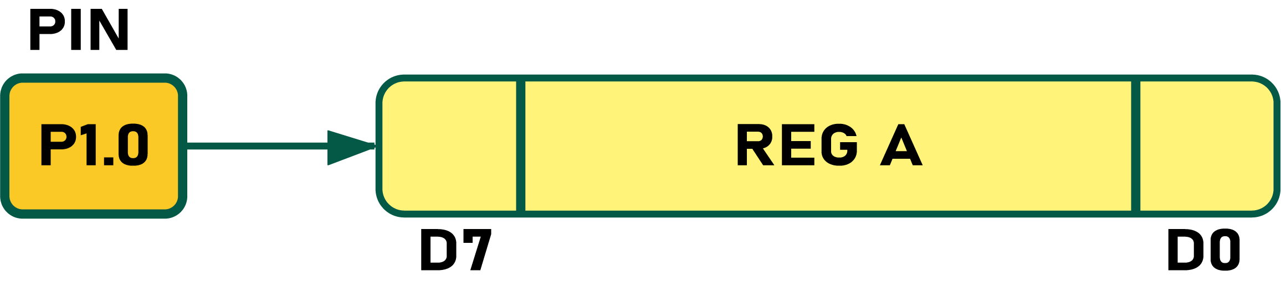
Example 7-36
Write a C program to bring in a byte of data serially one bit at a time via P1.0. The LSB should come in first.
Solution:
#include <reg51.h>
sbit P1b0 = P1^0;
sbit ACCMSB = ACC^7;
void main(void)
{
unsigned char conbyte = 0x44;
unsigned char x;
for(x=0; x<8; x++)
{
ACCMSB = P1b0;
ACC = ACC >> 1;
}
P2=ACC;
}
//BRINGING IN DATA VIA P1.0 (SHIFTING RIGHT)

Slide 50
Example 7-37
Write a C program to bring in a byte of data serially one bit at a time via P1.0. The MSB should come in first.
Solution:
#include <reg51.h>
sbit P1b0 = P1^0;
sbit regALSB = ACC^0;
void main(void)
{
unsigned char x;
for(x=0; x<8; x++)
{
regALSB = P1b0;
ACC = ACC << 1;
}
P2=ACC;
}
//BRINGING DATA IN VIA P1.0 (SHIFTING LEFT)

