Slide 1

THE 8051
MICROCONTROLLER & Embedded Systems
Muhammad Ali Mazidi, Janice Mazidi
& Rolin McKinlay

Slide 2
DC MOTOR CONTROL
AND PWM
Chapter 17

Slide 3
Objectives
Upon completion of this chapter, you will be able to:
>> Describe the basic operation of a DC motor
>> Interface the 8051 with a DC motor
>> Code 8051 programs to control and operate a DC motor
>> Describe how PWM is used to control motor speed

Slide 4
Objectives
DC motor control and shows 8051 interfacing with DC motor,
Section 17.1, the characteristics of DC motors and interfacing to the 8051,
The topic of PWM (pulse width modulation)
Both Assembly and C in the programming examples

Slide 5
Table 17-1: Selected DC Motor Characteristics (www.Jameco.com)
Part No. Nominal Volts Volt Range Current RPM Torque
154915CP 3V 1.5-3V 0.070 A 5200 4.0 g-cm
154923CP 3V 1.5-3V 0.240 A 16000 8.3 g-cm
177498CP 4.5V 3-14V 0.150 A 10300 33.3 g-cm
181411CP 5V 3-14V 0.470 A 10000 18.8 g-cm

Slide 6
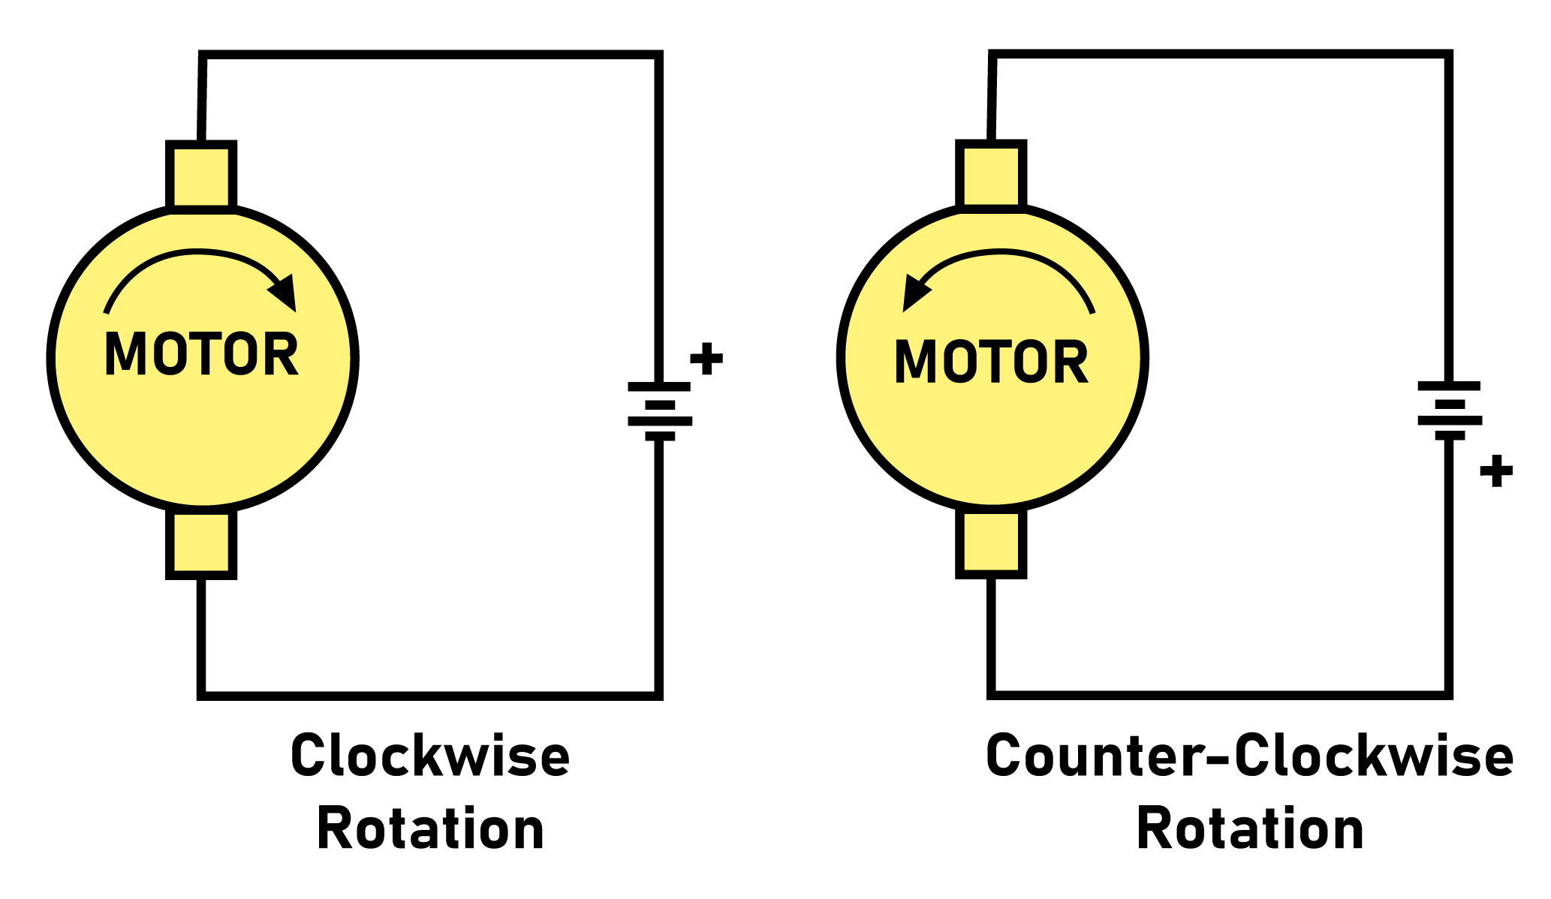
Figure 17-1. DC Motor Rotation (Permanent Magnet Field)

Slide 7
Table 17-2: Some H-Bridge Logic Configurations for Figure 17-2
Motor Operation SW1 SW2 SW3 SW4
Off Open Open Open Open
Clockwise Closed Open Open Closed
Counter Clockwise Open Closed Closed Open
Invalid Closed Closed Closed Closed

Slide 8
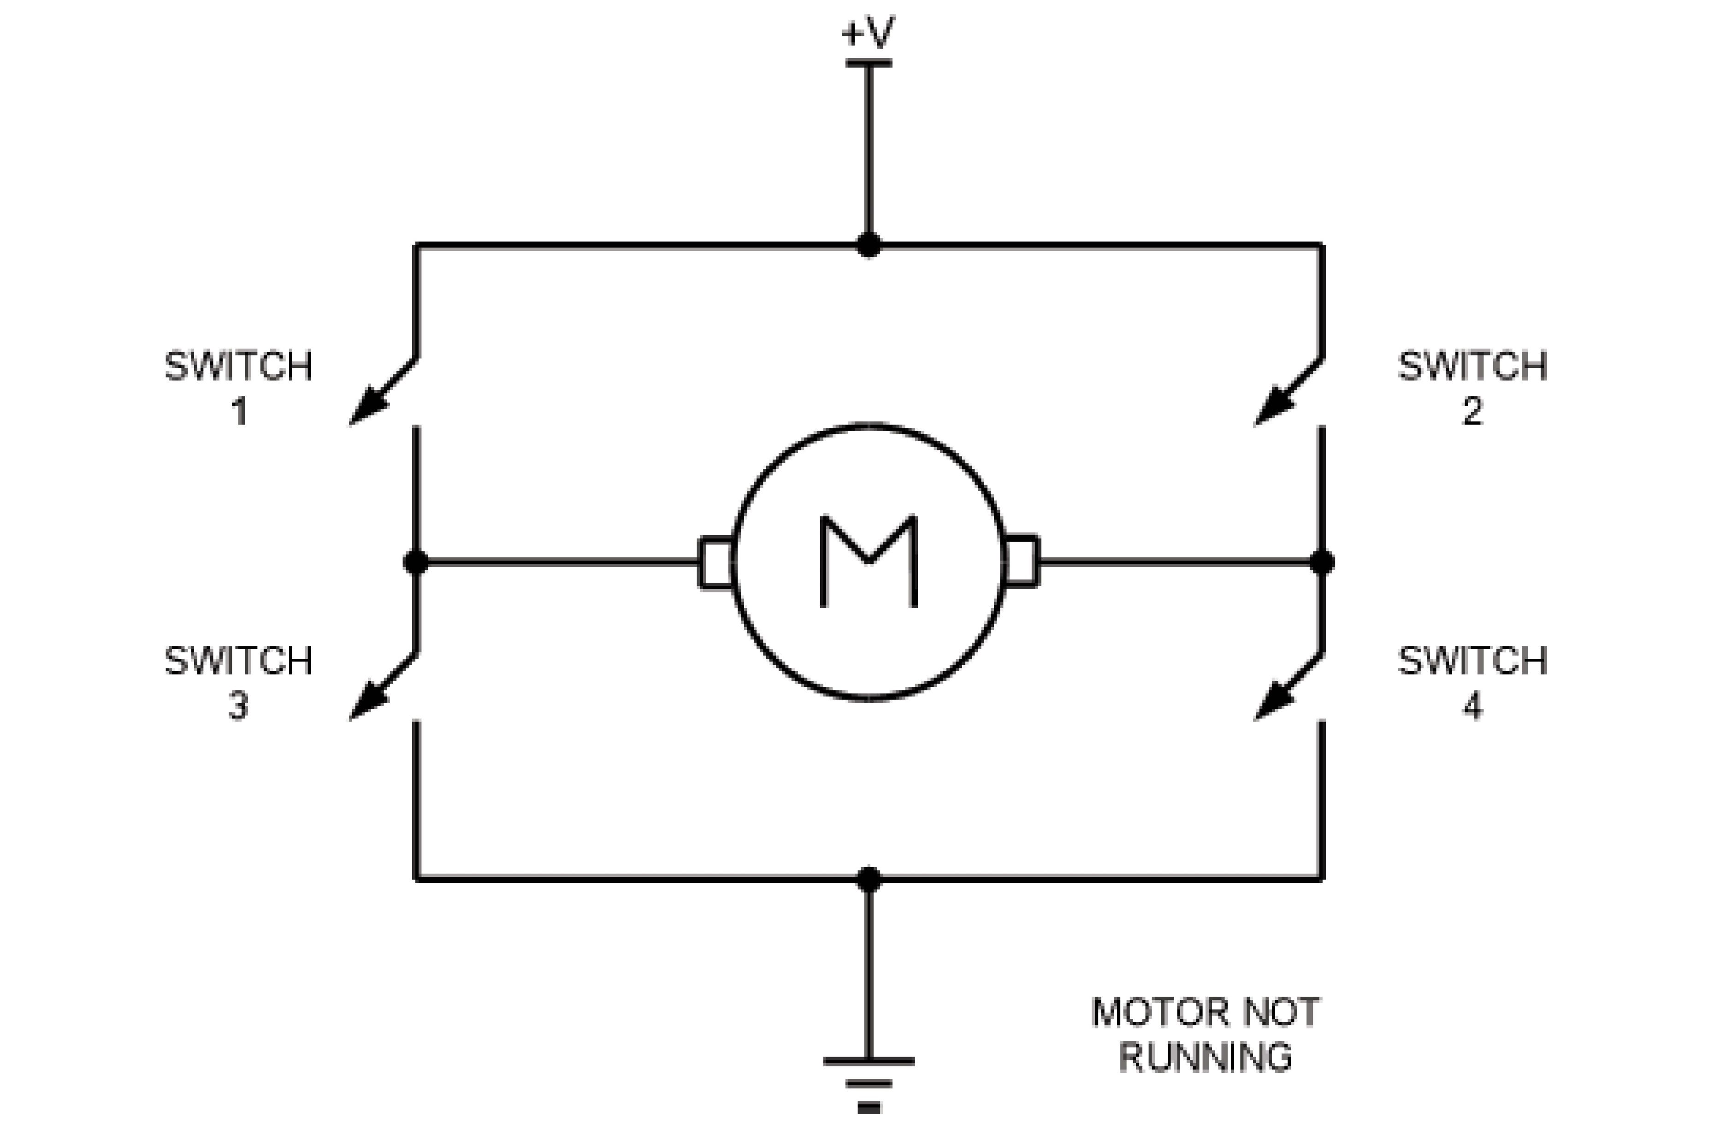
Figure 17-2. H-Bridge Motor Configuration

Slide 9
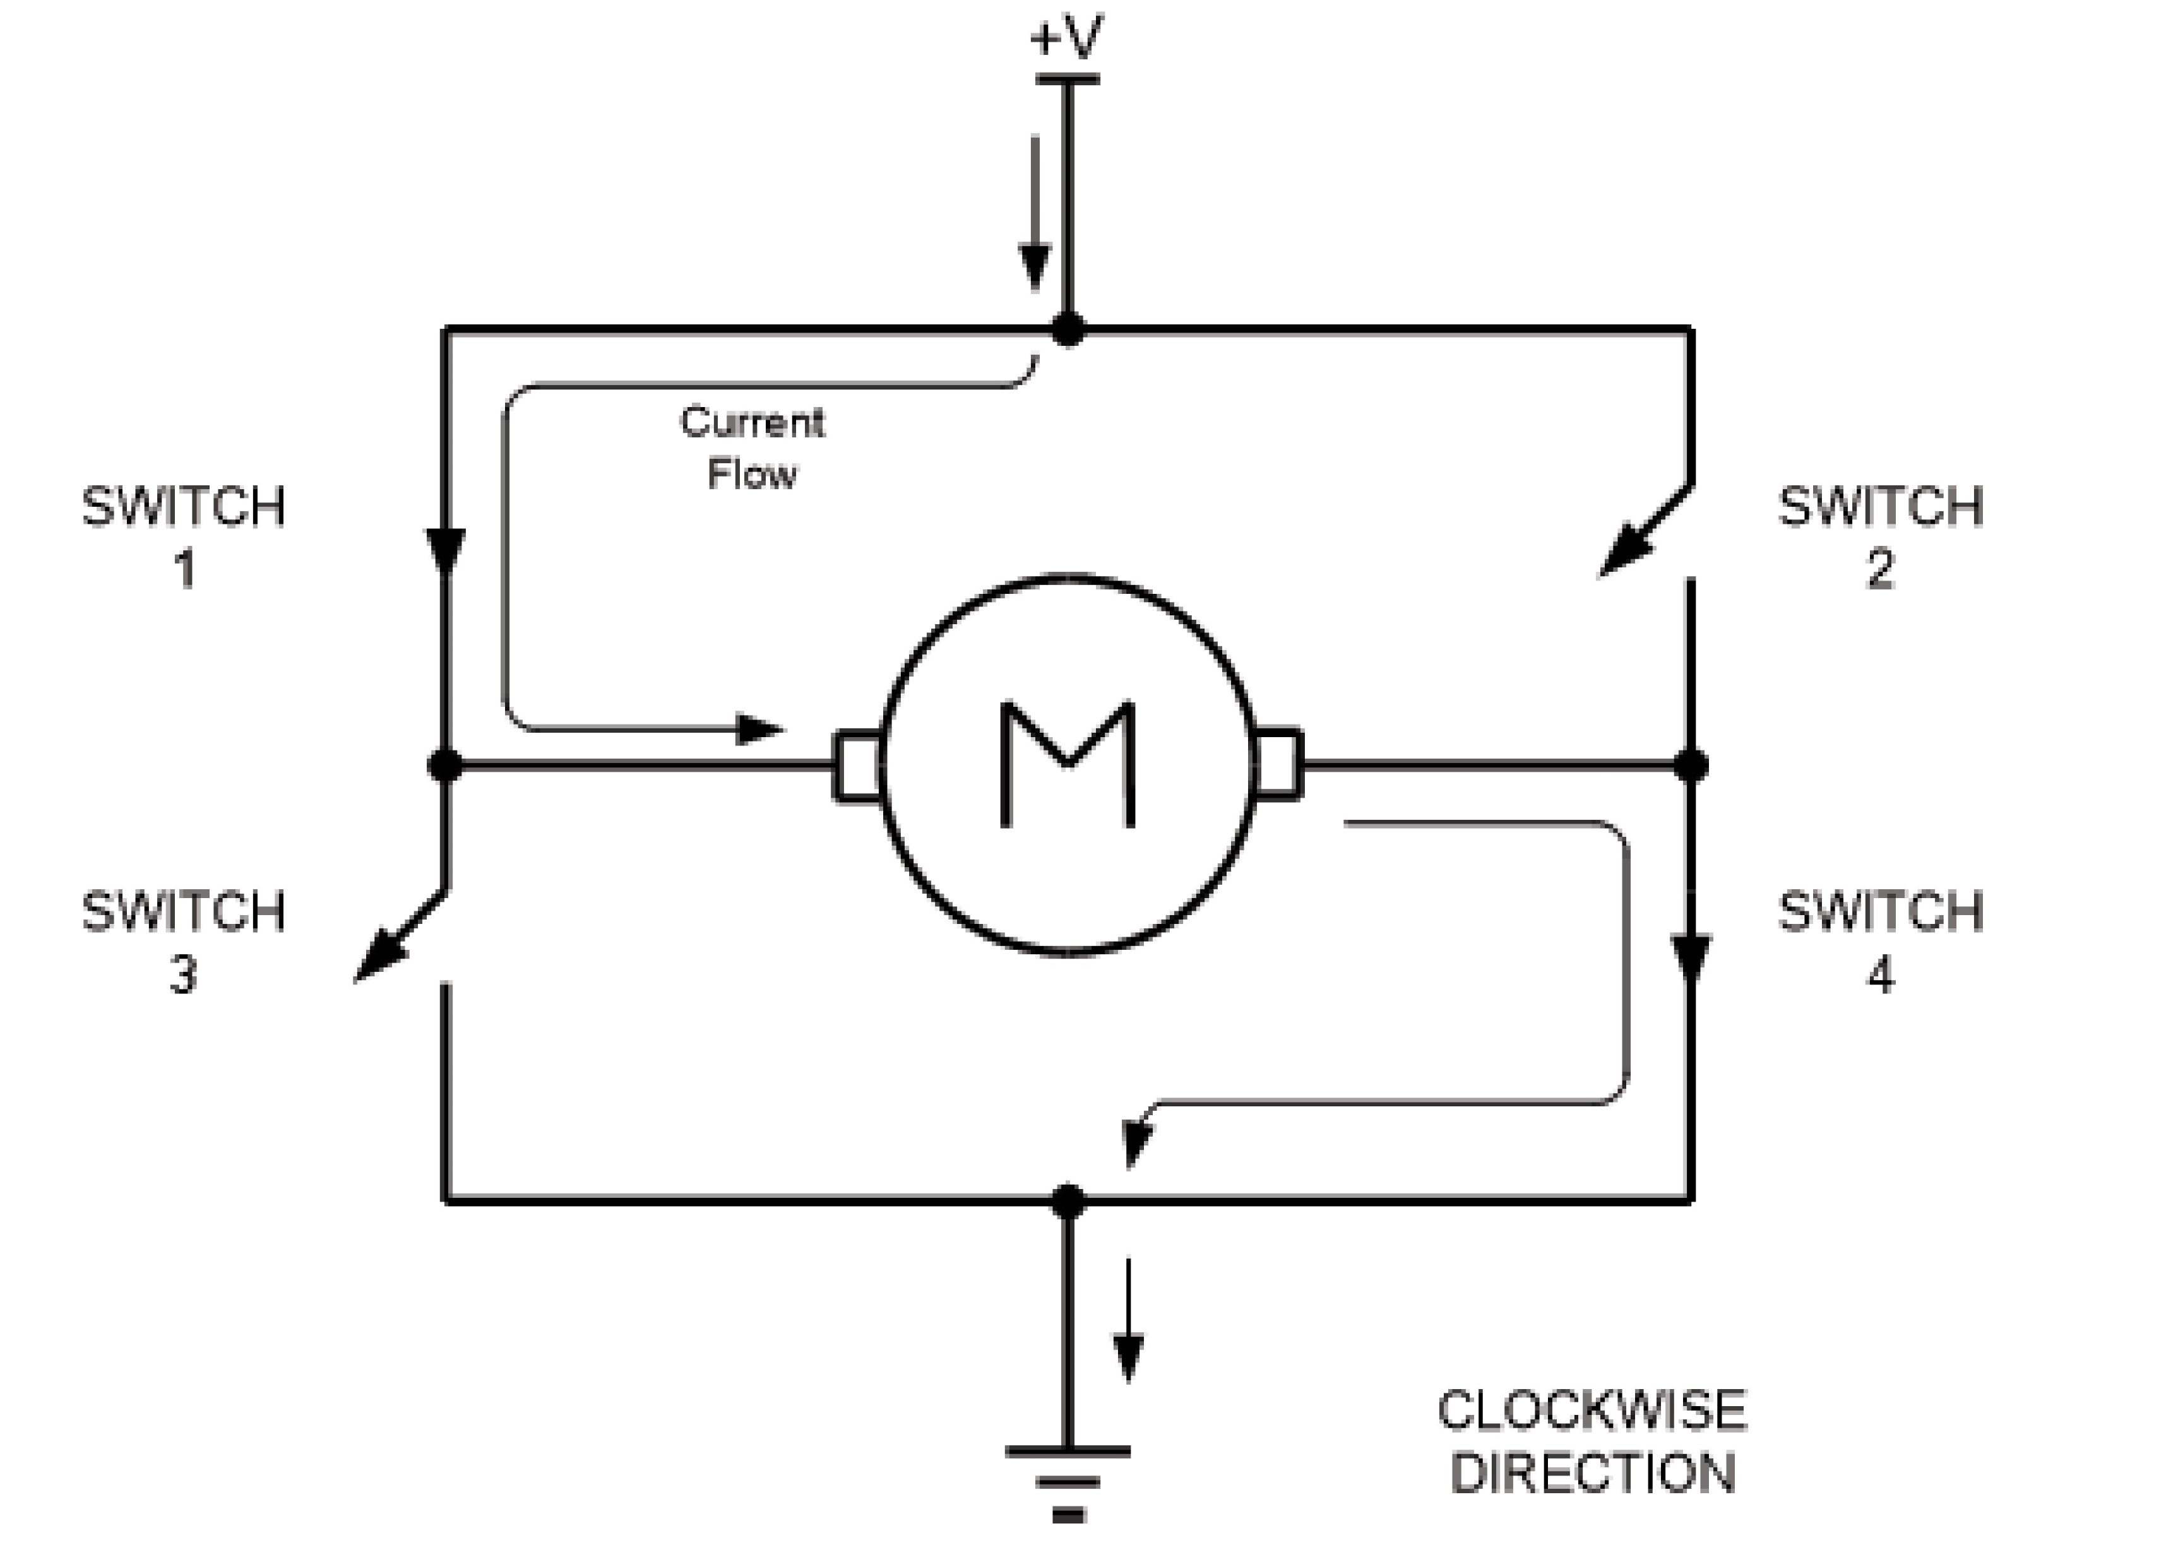
Figure 17-3. H-Bridge Motor Clockwise Configuration

Slide 10
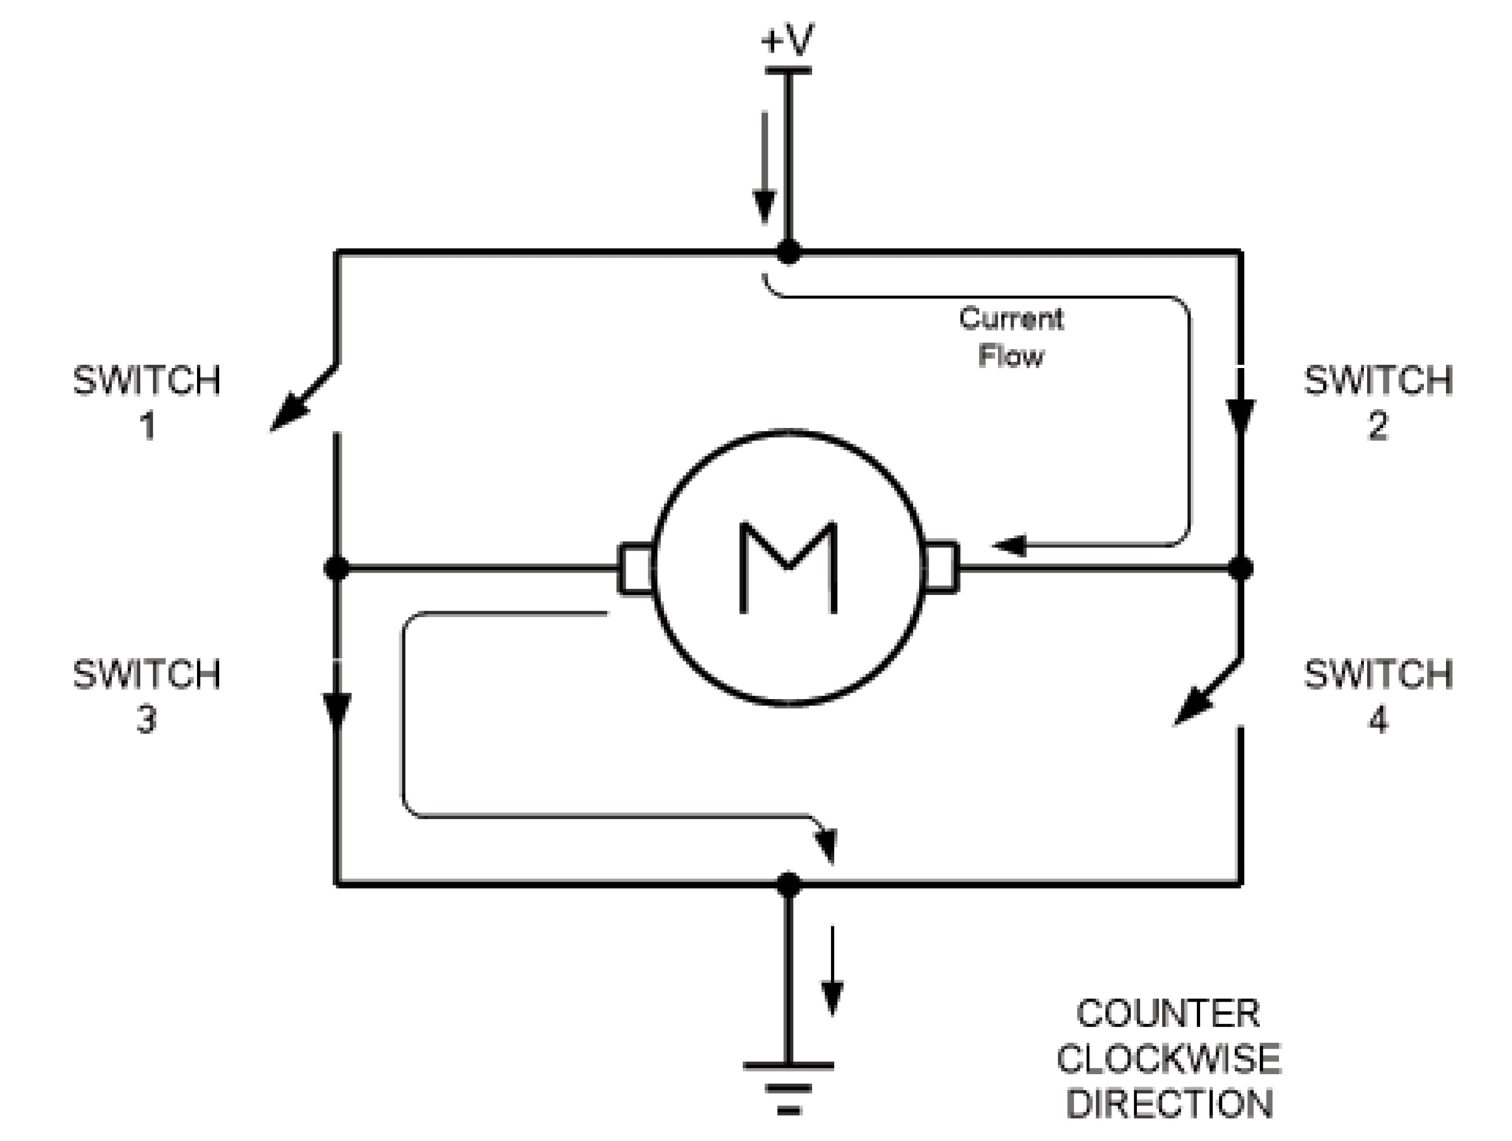
Figure 17-4. H-Bridge Motor Counterclockwise Configuration

Slide 11
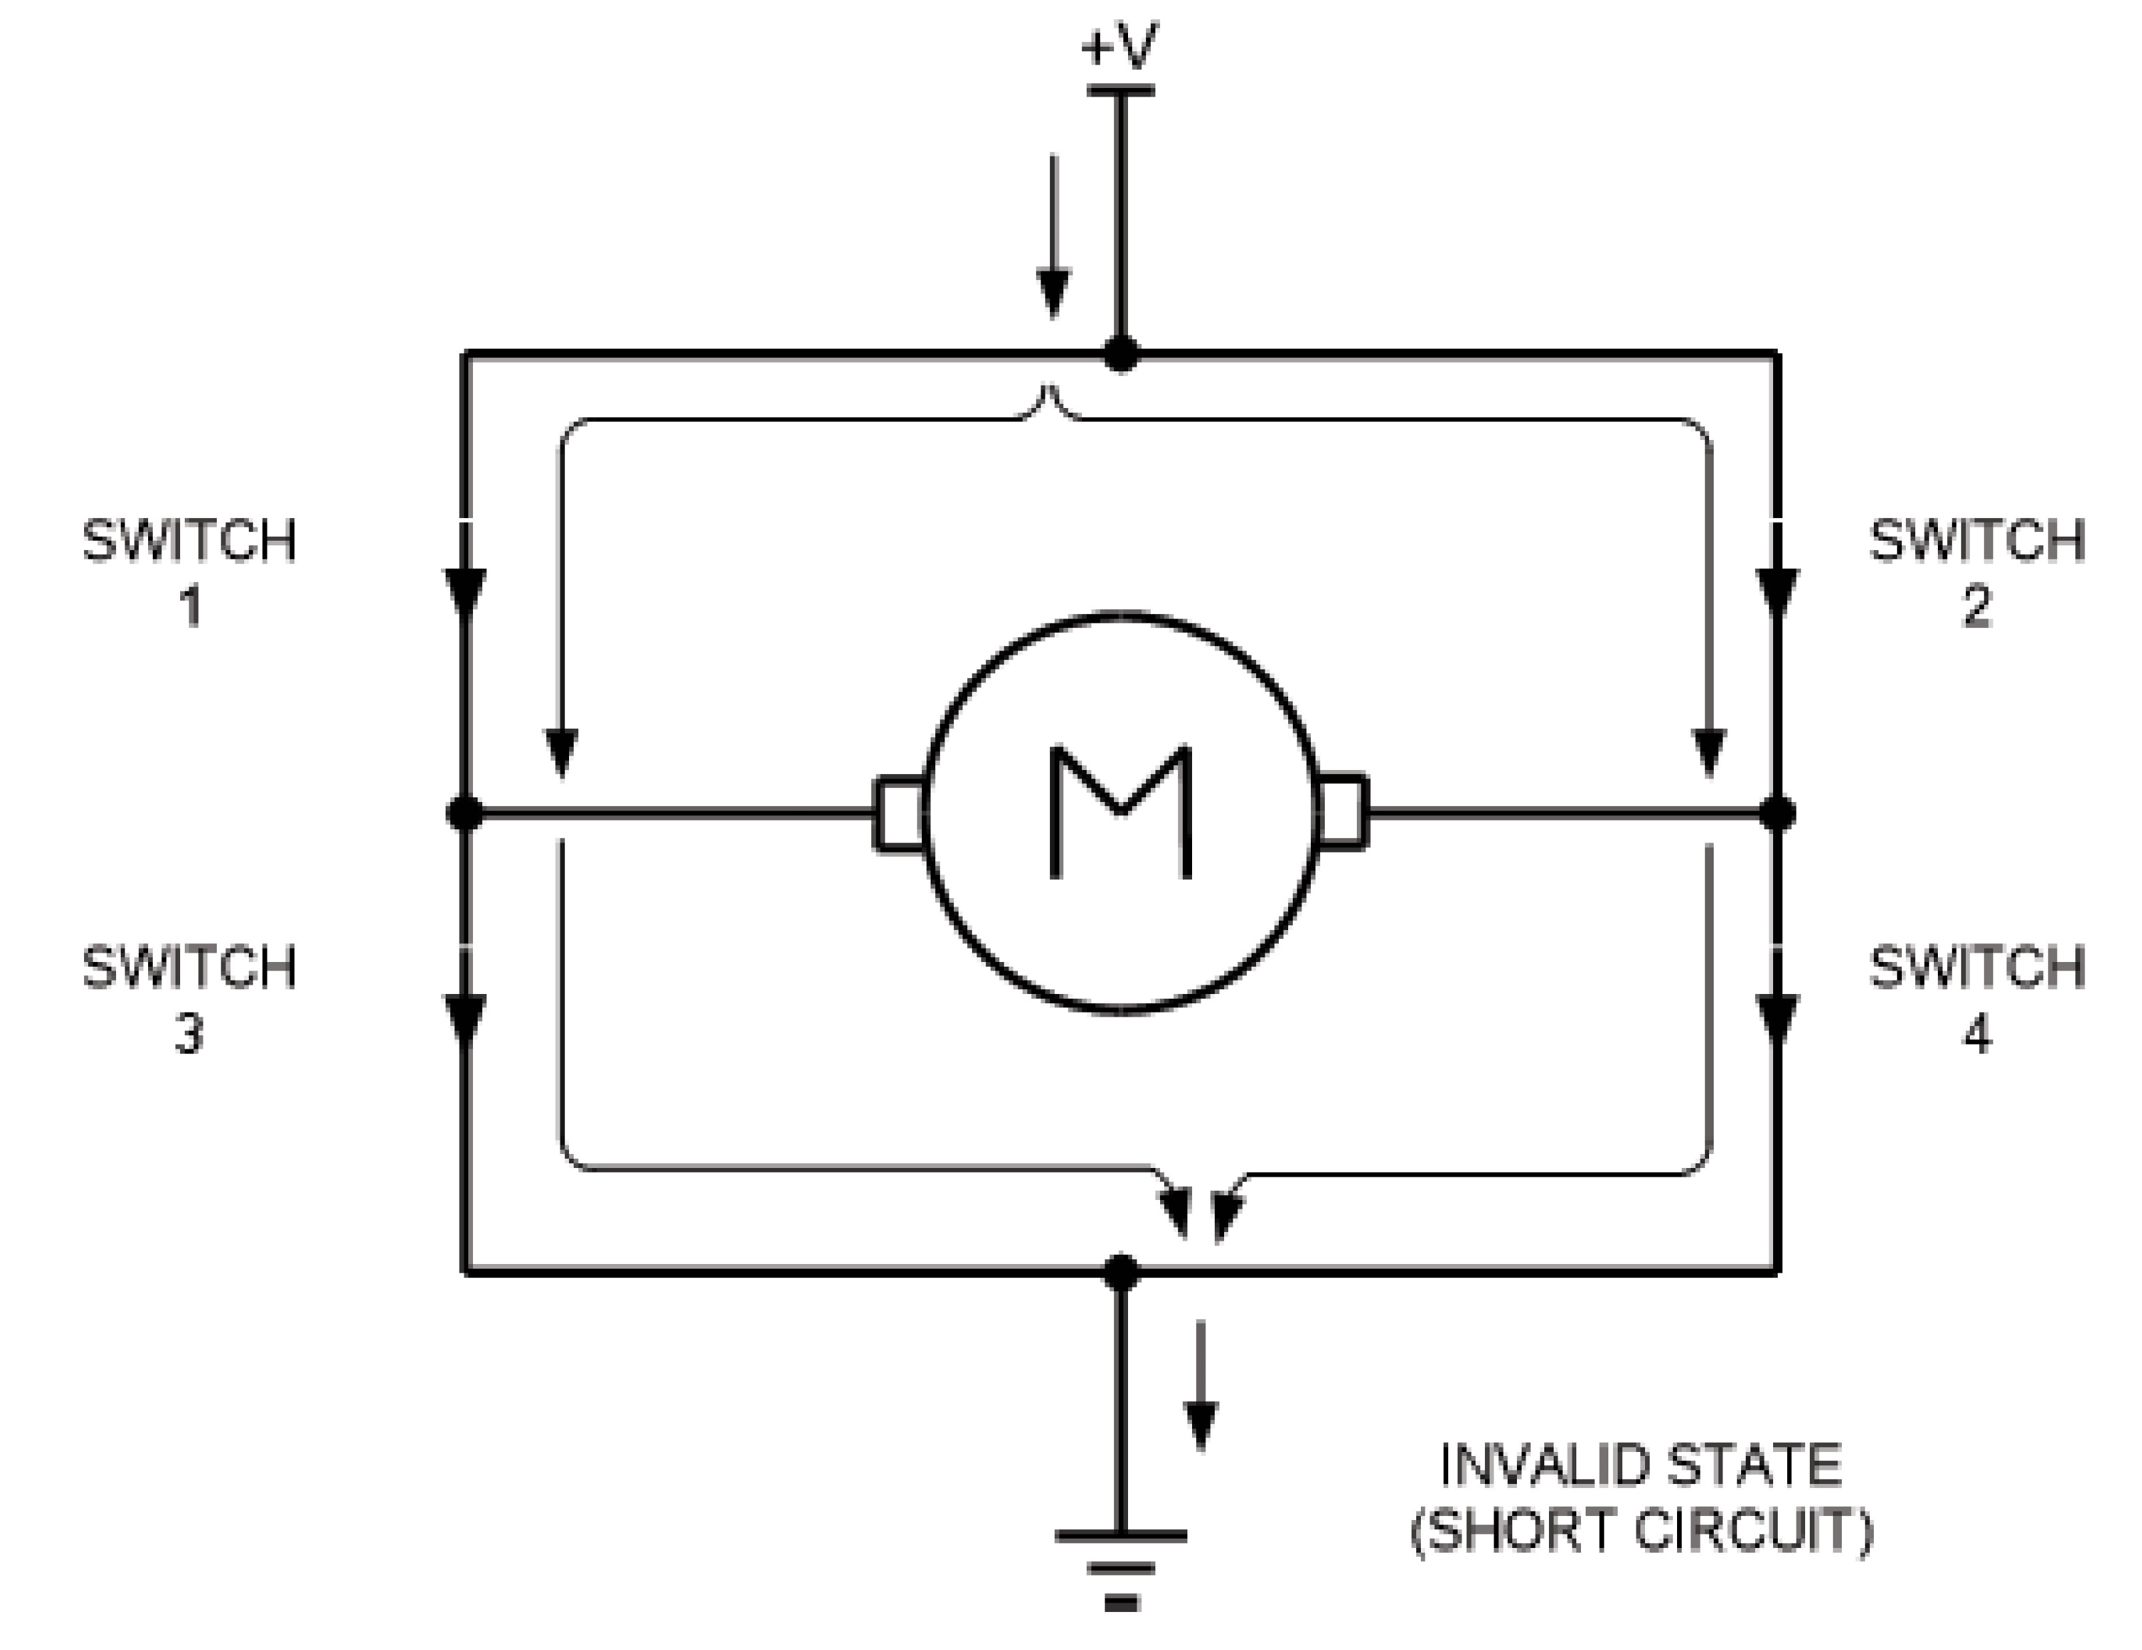
Figure 17-5. H-Bridge in an Invalid Configuration

Slide 12
Example 17-1
A switch is connected to pin P2.7. Using a simulator, write a program to monitor the status of SW and perform the following: (a) If SW = 0, the DC motor moves clockwise. (b) If SW = 1, the DC motor moves counterclockwise.
Solution:
ORG 0H
MAIN:
CLR P1.0 ;switch 1
CLR P1.1 ;switch 2
CLR P1.2 ;switch 3
CLR P1.3 ;switch 4
SETB P2.7
MONITOR:
JNB P2.7, CLOCKWISE
SETB P1.0 ;switch 1
CLR P1.1 ;switch 2
CLR P1.2 ;switch 3
SETB P1.3 ;switch 4
SJMP MONITOR
CLOCKWISE:
CLR P1.0 ;switch 1
SETB P1.1 ;switch 2
SETB P1.2 ;switch 3
CLR P1.3 ;switch 4
SJMP MONITOR
END
View the results on your simulator. This example is for simulation only and should not be used on a connected system.

Slide 13
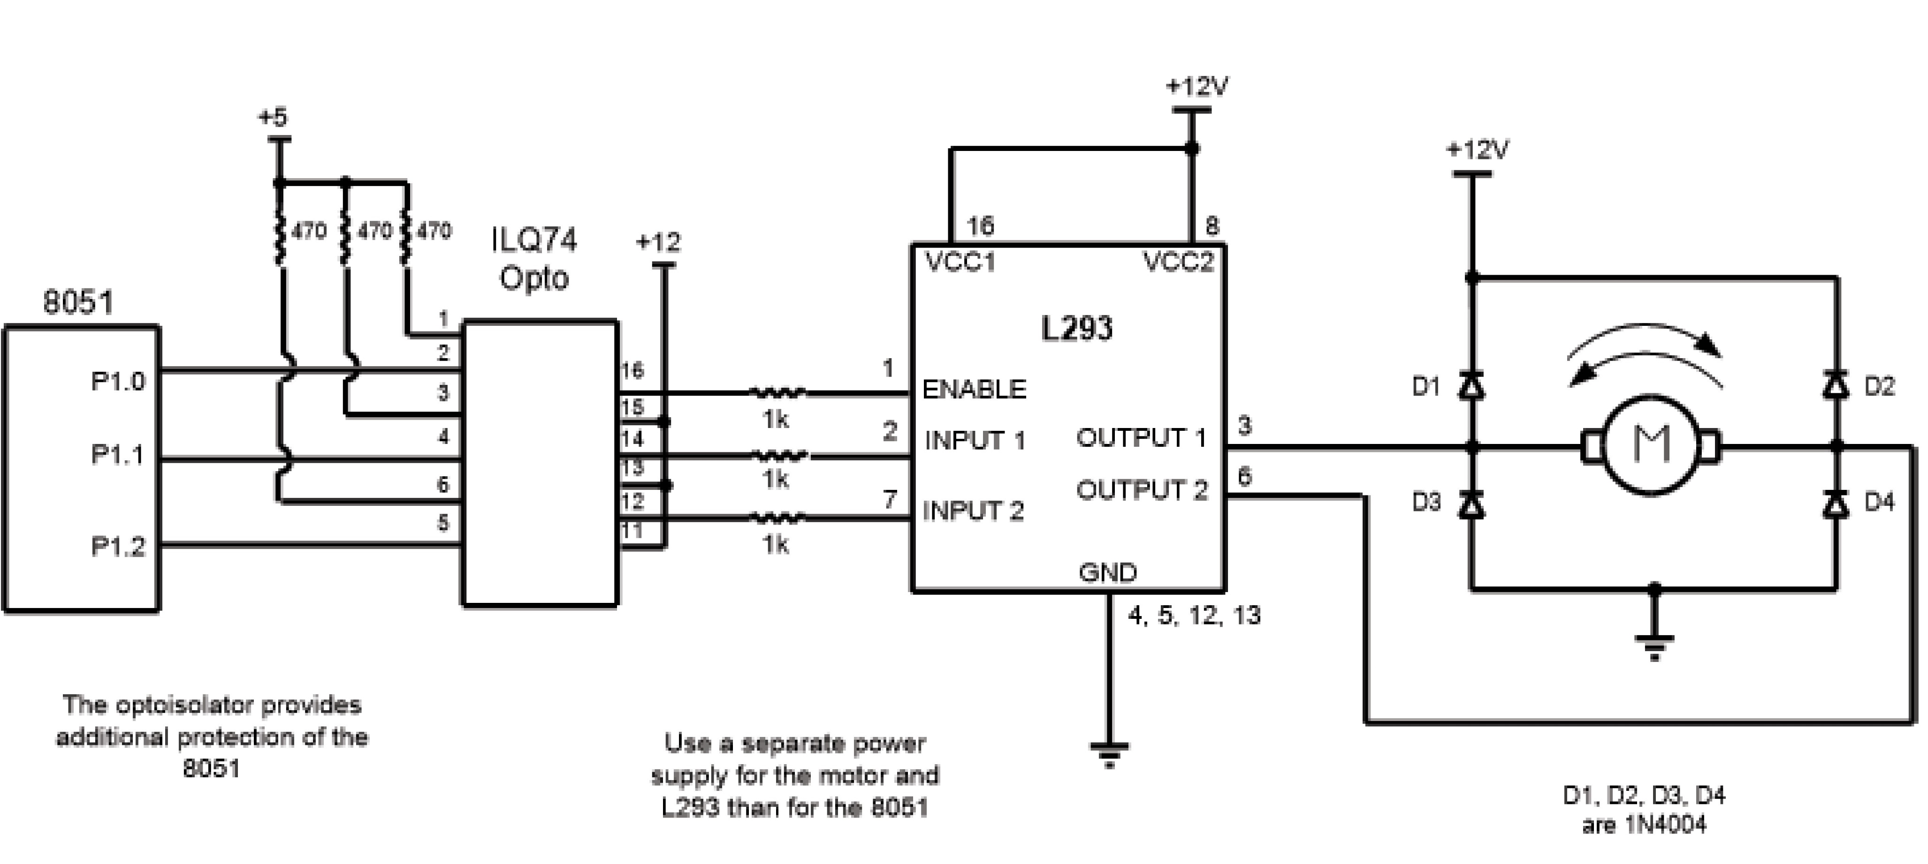
Figure 17-6. Bidirectional Motor Control Using an L293 Chip

Slide 14
Example 17-2
Figure 17-6 shows the connection of an L293. Add a switch to pin P2.7. Write a program to monitor the status of SW and perform the following: (a) If SW = 0, the DC motor moves clockwise. (b) If SW = 1, the DC motor moves counterclockwise.
Solution:
ORG 0H
MAIN:
CLR P1.0
CLR P1.1
CLR P1.2
SETB P2.7
MONITOR:
SETB P1.0 ;enable the chip
JNB P2.7, CLOCKWISE
CLR P1.1 ;turn the motor counterclockwise
SETB P1.2
SJMP MONITOR
CLOCKWISE:
SETB P1.1
CLR P1.2 ;turn motor clockwise
SJMP MONITOR
END

Slide 15
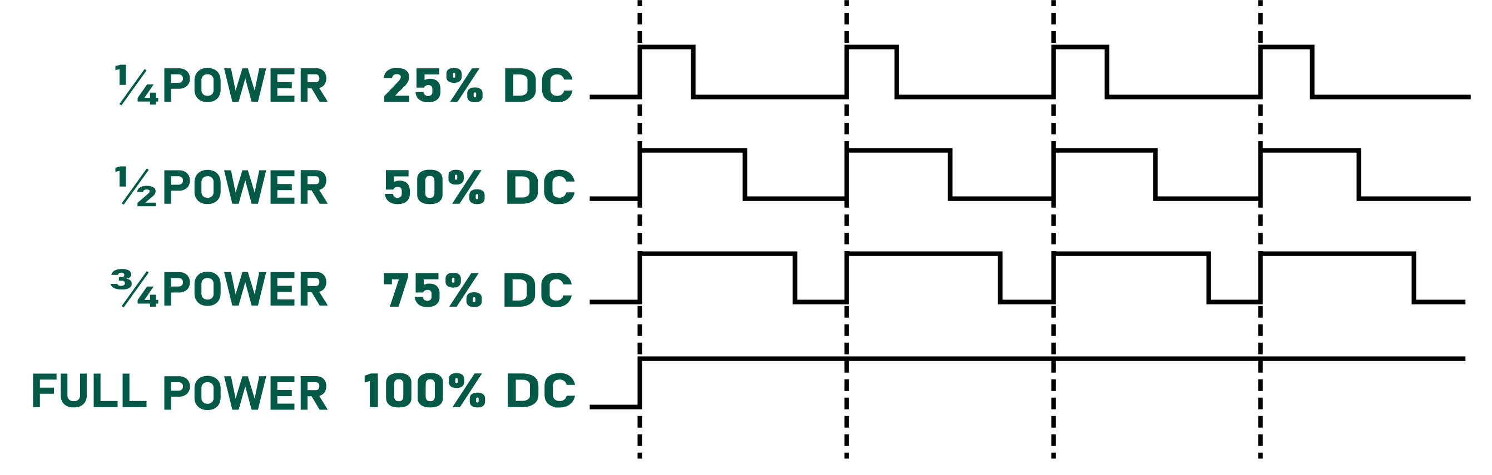
Figure 17-7. Pulse Width Modulation Comparison

Slide 16
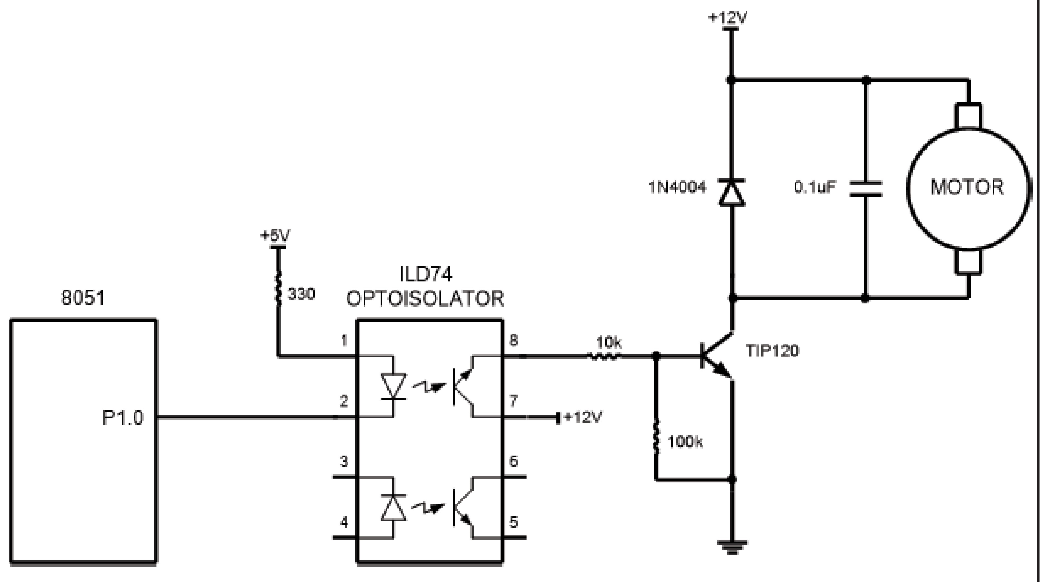
Figure 17-8. DC Motor Connection using a Darlington Transistor

Slide 17
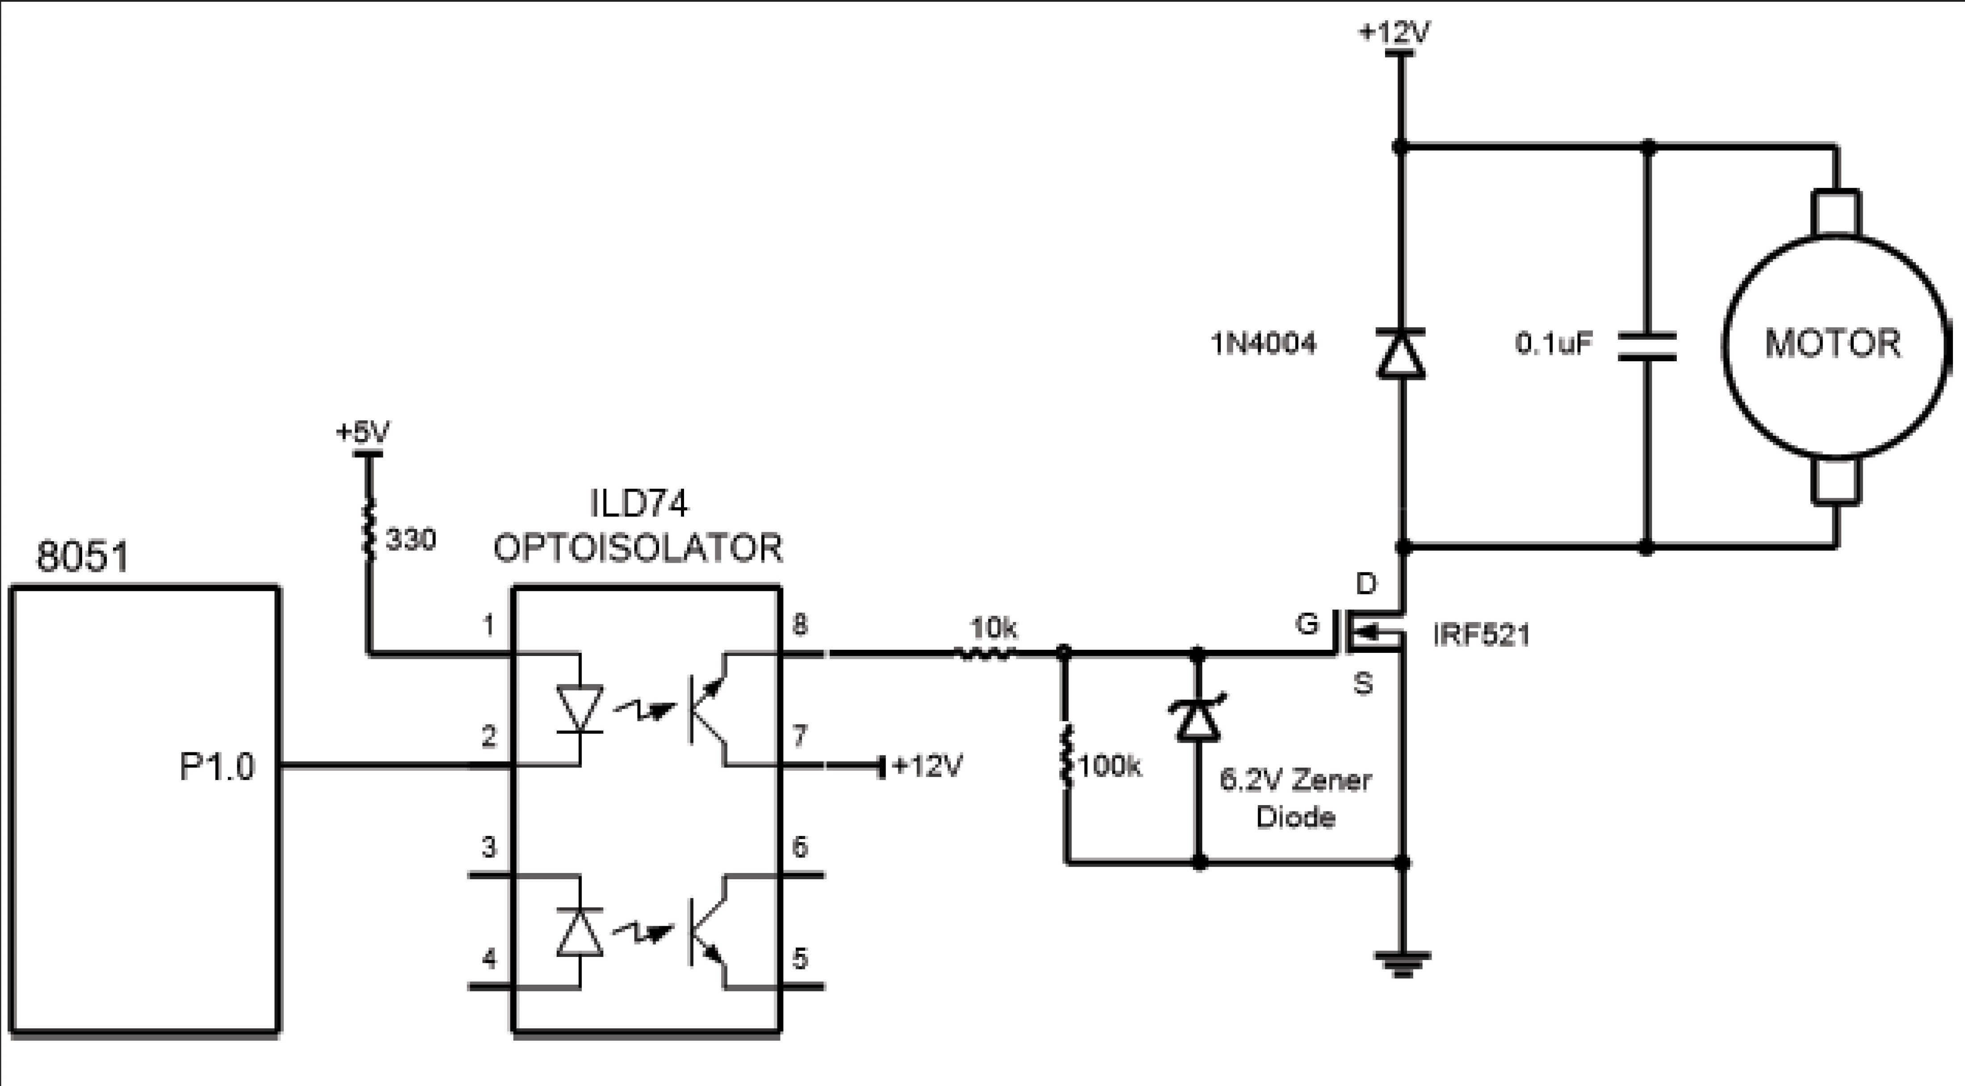
Figure 17-9. DC Motor Connection using a MOSFET Transistor

Slide 18
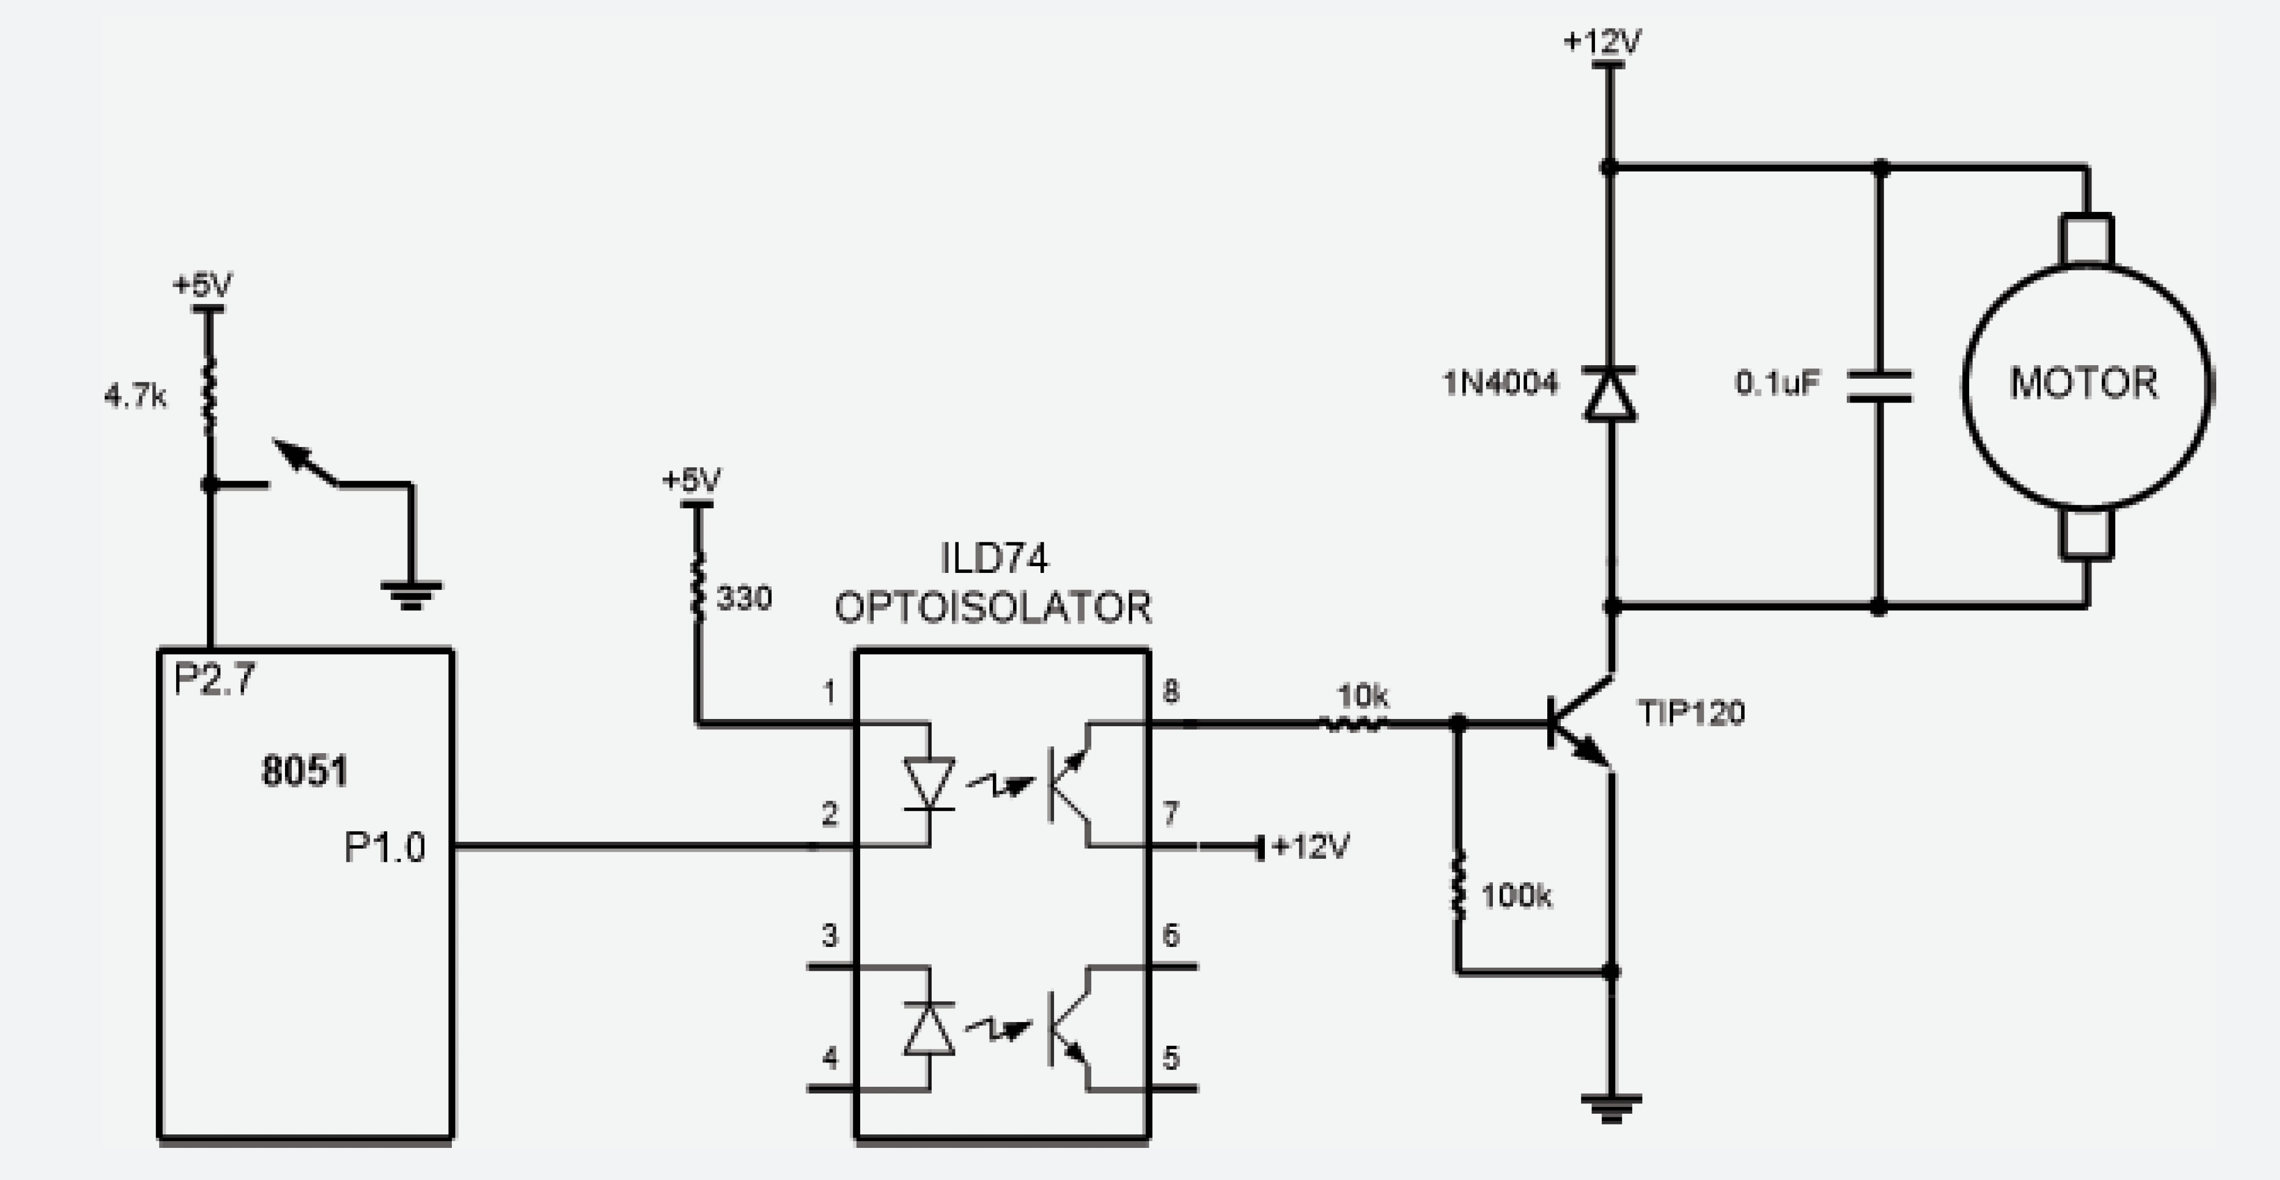
Refer to the figure in this example. Write a program to monitor the status of the switch and perform the following: (a) If P2.7 = 1, the DC motor moves with 25% duty cycle pulse.
(b) If P2.7 = 0, the DC motor moves with 50% duty cycle pulse.
Example 17-3
Solution:
ORG 0H
MAIN:
CLR P1.0 ;turn off motor
SETB P2.7
MONITOR:
JNB P2.7, FIFTYPERCENT
SETB P1.0 ;high portion of pulse
MOV R5, #25
ACALL DELAY
CLR P1.0 ;low portion of pulse
MOV R5, #75
ACALL DELAY
SJMP MONITOR
FIFTYPERCENT:
SETB P1.0 ;high portion of pulse
MOV R5, #50
ACALL DELAY
CLR P1.0 ;low portion of pulse
MOV R5, #50
ACALL DELAY
SJMP MONITOR
DELAY:
H1: MOV R2, #100
H2: MOV R3, #255
H3: DJNZ R3, H3
DJNZ R2, H2
DJNZ R5, H1
RET
END

Slide 19
Refer to Figure 17-6 for connection of the motor. A switch is connected to pin P2.7. Write a C program to monitor the status of SW and perform the following: (a) If SW = 0, the DC motor moves clockwise.
(b) If SW = 1, the DC motor moves counterclockwise.
Example 17-4
Solution:
#include <reg51.h>
sbit SW = P2^7;
sbit ENABLE = P1^0;
sbit MTR_1 = P1^1;
sbit MTR_2 = P1^2;
void main()
{
SW = 1;
ENABLE = 0;
MTR_1 = 0;
MTR_2 = 0;
while(1)
{
ENABLE = 1;
if(SW == 1)
{
MTR_0 = 1;
MTR_1 = 0;
}
else
{
MTR_0 = 0;
MTR_1 = 1;
}
}
}

Slide 20
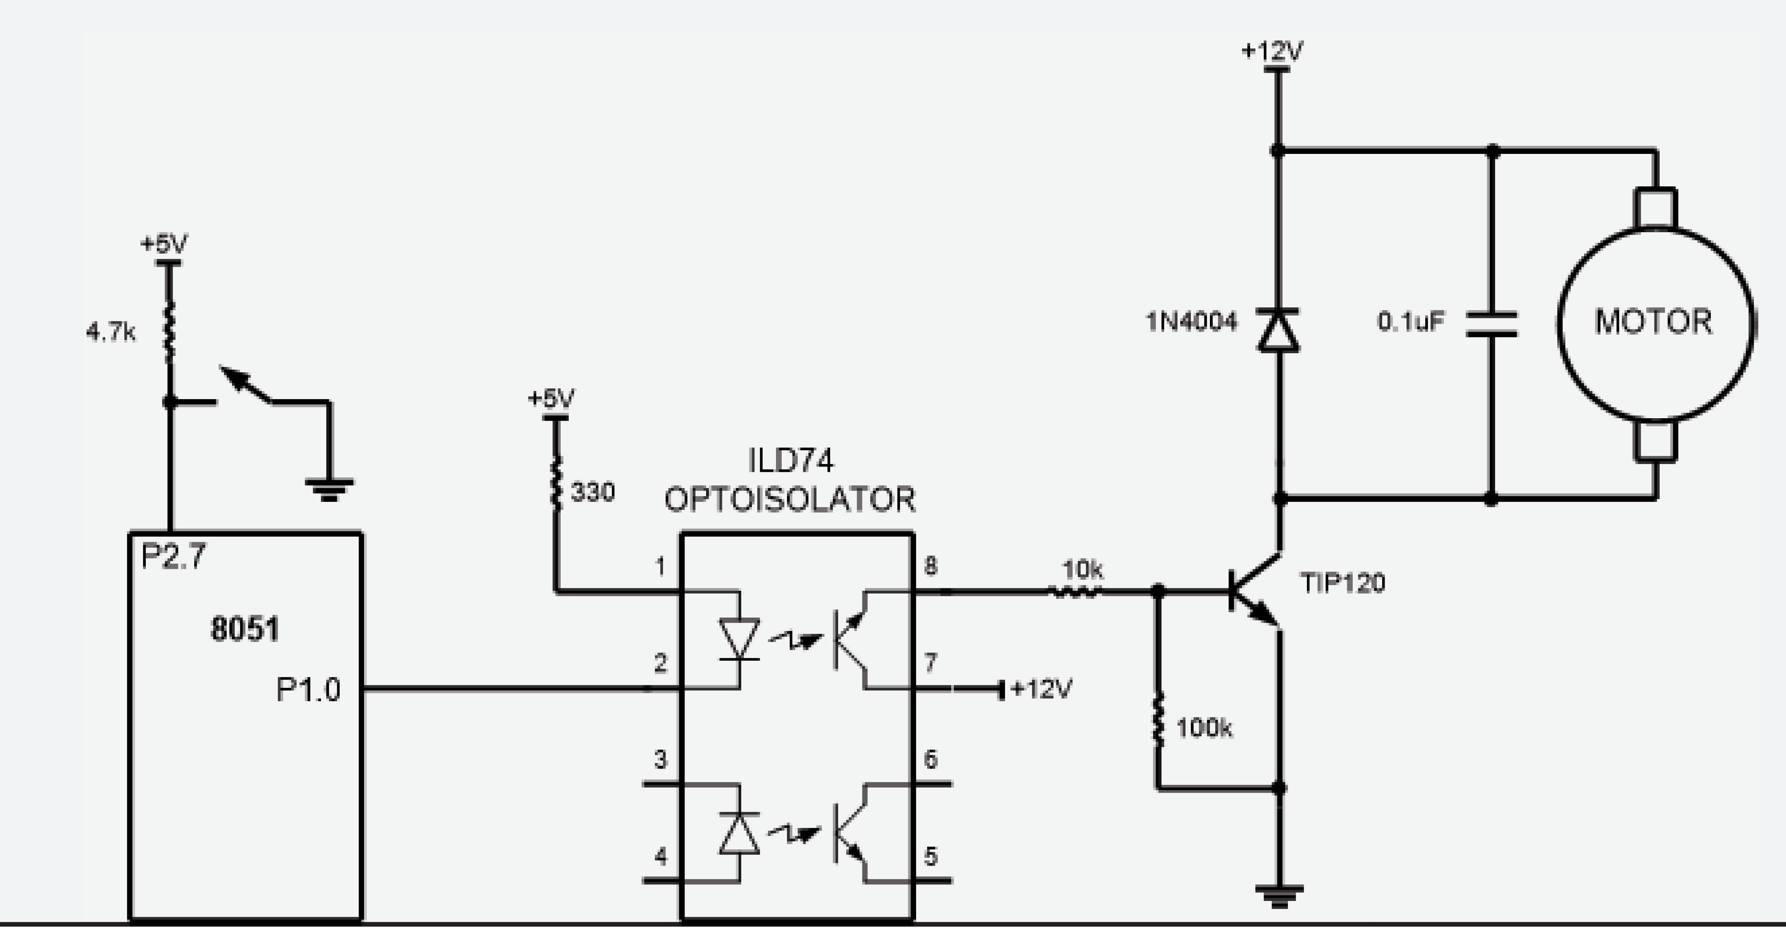
Refer to the figure in this example. Write a C program to monitor the status of SW and perform the following:
(a) If SW = 0, the DC motor moves with 50% duty cycle pulse.
(b) If SW = 1, the DC motor moves with 25% duty cycle pulse.
Example 17-5
Solution:
#include <reg51.h>
sbit SW = P2^7;
sbit MTR = P1^0;
void MSDelay(unsigned int value);
void main()
{
SW = 1;
MTR = 0;
while(1)
{
if(SW == 1)
{
MTR = 1;
MSDelay(25);
MTR = 0;
MSDelay(75);
}
else
{
MTR = 1;
MSDelay(50);
MTR = 0;
MSDelay(50);
}
}
}
void MSDelay(unsigned int value)
{
unsigned char x, y;
for(x=0; x<1275; x++)
for(y=0; y<value; y++);
}

Slide 21
Example 17-6
Refer to Figure 17-8 for connection to the motor. Two switches are connected to pins P2.0 and P2.1. Write a C program to monitor the status of both switches and perform the following:
SW2(P2.7) SW1(P2.6)
0 0 DC motor moves slowly (25% duty cycle).
0 1 DC motor moves moderately (50% duty cycle).
1 0 DC motor moves fast (75% duty cycle).
1 1 DC motor moves very fast (100% duty cycle).

Slide 22
Example 17-6
Solution:
#include <reg51.h>
sbit MTR = P1^0;
void MSDelay(unsigned int value);
void main()
{
unsigned char z;
P2 = 0xFF;
z = P2;
z = z & 0x03;
MTR = 0;
while(1)
{
switch(z)
{
case(0):
{
MTR = 1;
MSDelay(25);
MTR = 0;
MSDelay(75);
break;
}
case(1):
{
MTR = 1;
MSDelay(50);
MTR = 0;
MSDelay(50);
break;
}
case(2):
{
MTR = 1;
MSDelay(75);
MTR = 0;
MSDelay(25);
break;
}
default:
MTR = 1;
}
}

