Slide 1

THE 8051
MICROCONTROLLER & Embedded Systems
Muhammad Ali Mazidi, Janice Mazidi
& Rolin McKinlay

Slide 2
DS12887 RTC
INTERFACING AND
PROGRAMMING
Chapter 16

Slide 3
Objectives
Upon completion of this chapter, you will be able to:
>> Explain how the real-time clock (RTC) chip works
>> Explain the function of the DS12887 RTC pins
>> Explain the function of the DS12887 RTC registers
>> Understand the interfacing of the DS12887 RTC to the 8051
>> Code programs in Assembly and C to access the RTC registers
>> Code programs to display time and date in Assembly and C
>> Understand the interrupt and alarm features of the DS12887
>> Explore and program the alarm and interrupt features of the RTC

Slide 4
Objectives
The interfacing and programming of the DS12C887 real-time clock (RTC) chip, DS12887 RTC pin functions and its interfacing with the 8051,
Section 16.1, programing the DS12887 in Assembly language,
Section 16.2, the C programming of DS12887,
Section 16.3, the alarm and SQW features of the DS12287

Slide 5
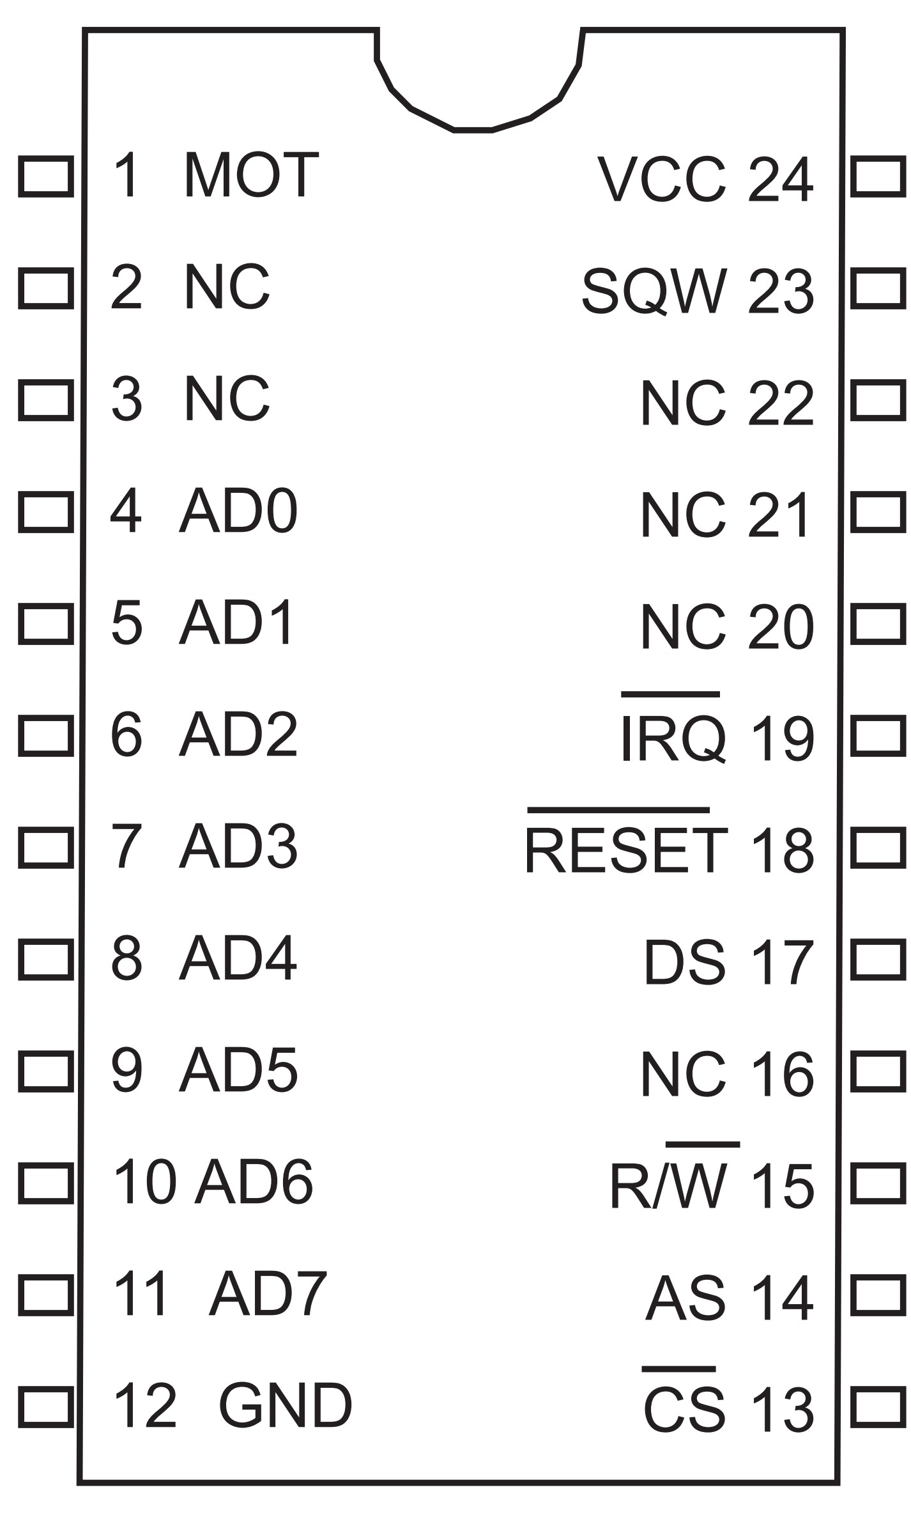
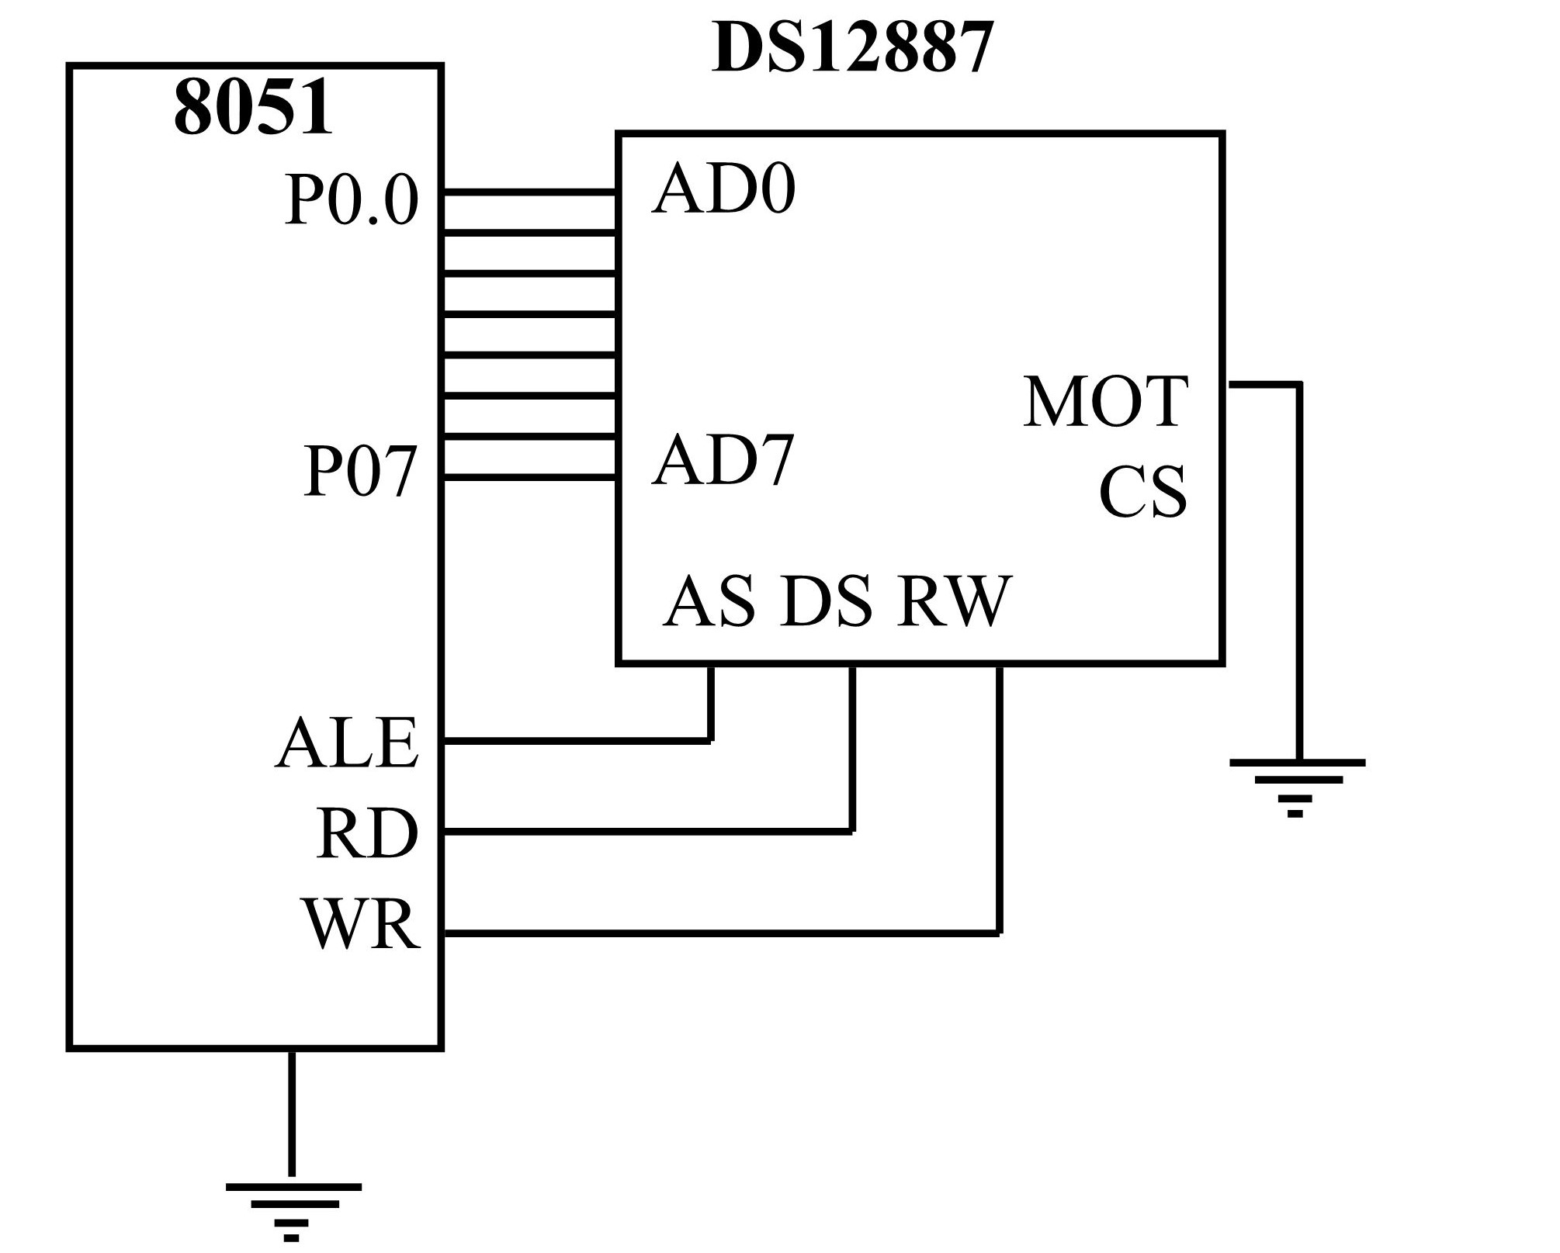
Figure 16-1. DS12887 RTC Chip
Figure 16-2. DS12887 Connection to 8051

Slide 6
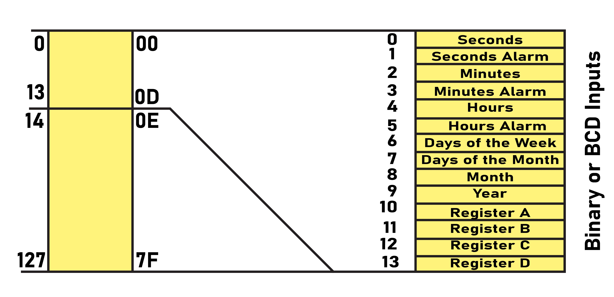
Figure 16-3. DS12887 Address Map

Slide 7
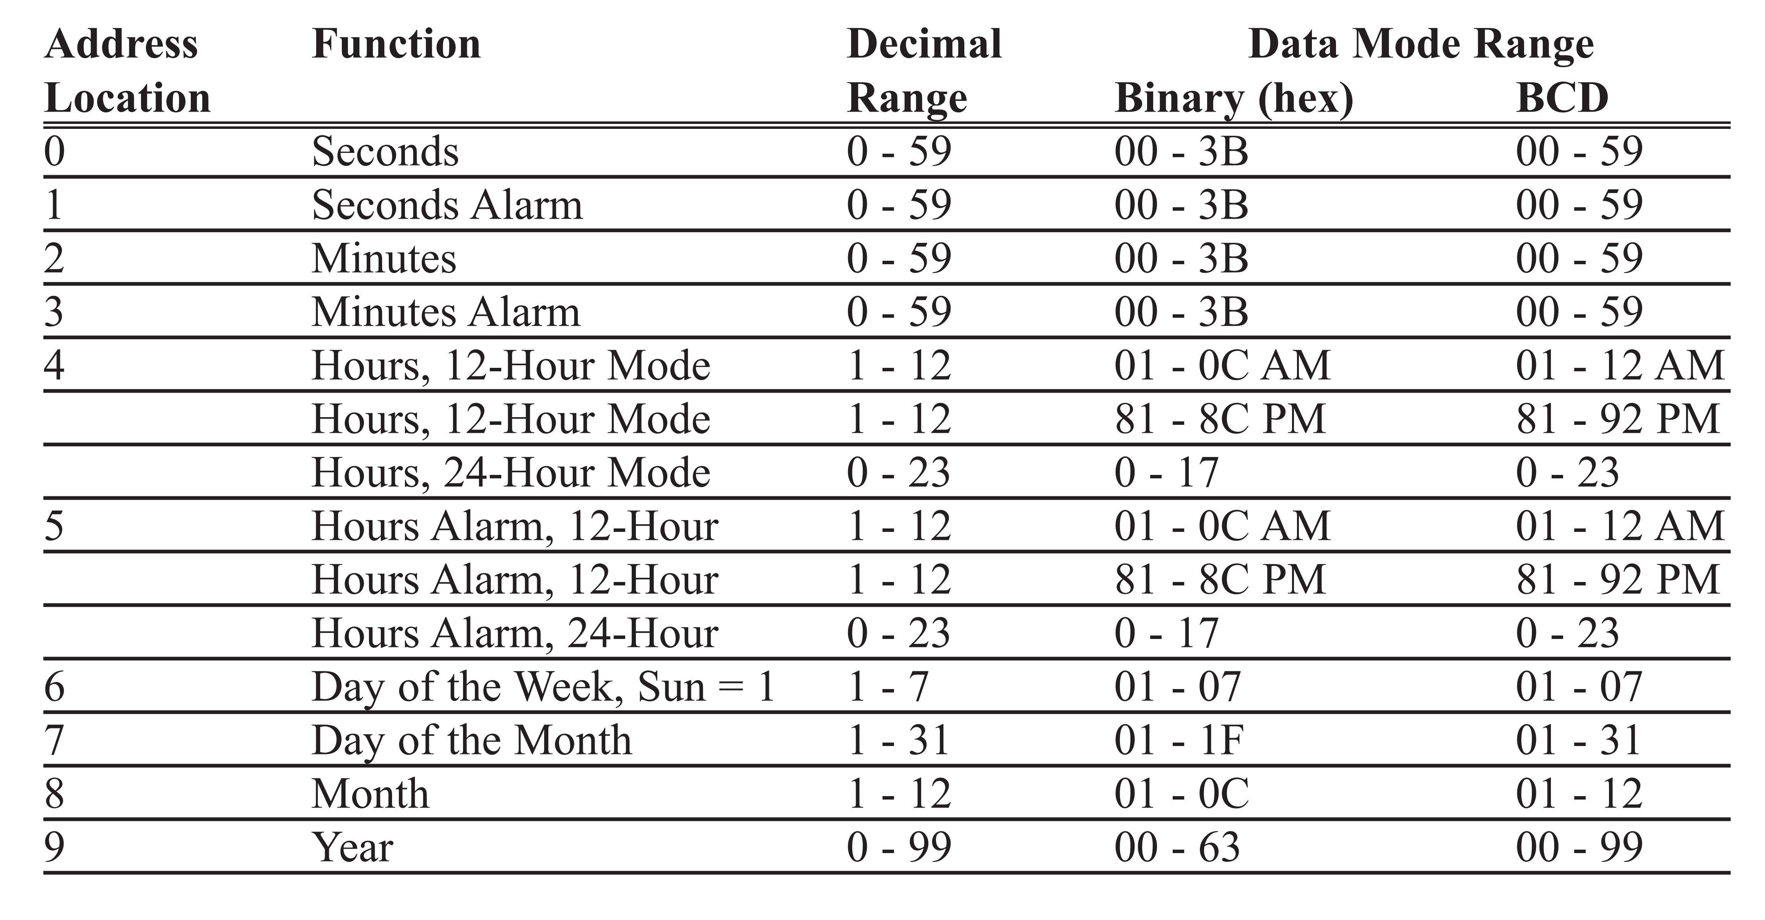
Table 16-1: DS12887 Address Location for Time, Calendar, and Alarm

Slide 8

Figure 16-4. Register A Bits for Turning on the DS12887’s Oscillator
UIP Update in progress. This is a read-only bit.
DV2 DV1 DV0
0 1 0 will turn the oscillator on
RS3 RS2 RS1 RS0
Provides 14 different frequencies at the SQW pin. See Section 16.3 and the DS12887 data sheet.

Slide 9

Figure 16-5. Some Major Bits of Register B
SET SET = 0: Clock is counting once per second and time and dates are updated
SET = 1: Update is inhibited (during the initialization we must make SET = 1)
PIE Periodic Interrupt Enable. See Section 16.3.
AIE Alarm Interrupt Enable. The AIE = 1 will allow the IRQ to be asserted, when
all three bytes of time (yy:mm:dd) are the same as the alarm bytes. See
Section 16.3.
UIE See the DS12887 data sheet
SQWE Square wave enable: See Section 16.3
DM Data mode. DM = 0: BCD data format and DM = 1: Binary (hex) data format
24/12 1 for 24-hour mode and 0 for 12-hour mode
DSE Daylight Saving Enable. If 1, enables the daylight saving. (The first Sunday in
April and the last Sunday of October)

Slide 10

UIP Update in progress. This is a read-only bit.
DV2 DV1 DV0
0 1 0 will turn the oscillator on
RS3 RS2 RS1 RS0 SQW Output Frequency
0 0 0 0 None
0 0 0 1 256 Hz
0 0 1 0 128 Hz
0 0 1 1 8.192 kHz
0 1 0 0 4.096 kHz
0 1 0 1 2.048 kHz
0 1 1 0 1.024 kHz
0 1 1 1 512 Hz
1 0 0 0 256 Hz (repeat)
1 0 0 1 128 Hz (repeat)
1 0 1 0 64 Hz
1 0 1 1 32 Hz
1 1 0 0 16 Hz
1 1 0 1 8 Hz
1 1 1 0 4 Hz
1 1 1 1 2 Hz
Figure 16-6. Register A bits for Frequencies Generated at the SQW Output Pin

Slide 11

SET SET = 0: Clock is counting once per second, and time and dates are updated.
SET = 1: Update is inhibited (during the initialization we must make SET = 1).
PIE Periodic interrupt enable. If PIE = 1, upon generation of the periodic-interrupt,
the IRQ pin of the DS12887 is asserted low. Therefore, IRQ becomes a hardware
version of the PI bit in register C if we do not want to poll the PI bit. The rate of the periodic-interrupt is dictated by RS0 - RS3 of register A. Remember that PIE allows the generation of a hardware interrupt version of bit PI in
register C and has no effect on the periodic-interrupt generation. In other words,
the PIE will simply direct the PI bit of register C into the IRQ output pin.
AIE Alarm interrupt enable. If AIE = 1, the IRQ pin will be asserted low when all three bytes of the real time (hh:mm:ss) are the same as the alarm bytes of hh:mm:ss. Also, if AIE = 1, the cases of once-per-second, once-per-minute, and once-per-hour will assert low the IRQ pin. Remember that AIE allows the generation of the hardware interrupt version of the AI bit in register C and has no effect on AI generation. In other words, the AIE will simply direct the AI bit of register C into the IRQ output pin.
UIE See the DS12887 data sheet.
SQWE Square wave enable: If SQWE = 1, the square-wave frequency generated by the RS0 - RS3 options of register A will show up on the SQW output pin of the DS12877 chip.
DM Data Mode. DM = 0: BCD data format and DM = 1:binary (hex) data format
24/12 1 for 24-hour mode and 0 for 12-hour mode
DSE Daylight saving enable
Figure 16-7. PIE, AIE, and SQWE bits of Register B

Slide 12
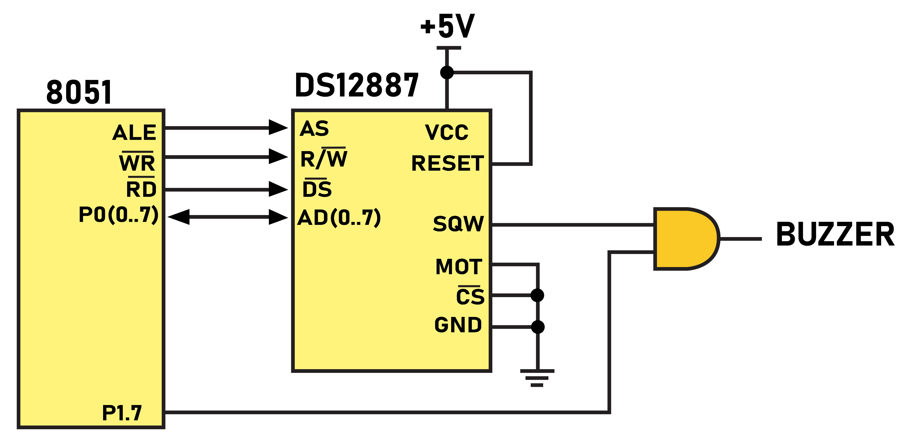
Figure 16-8. Using SQW to Sound a Buzzer

Slide 13
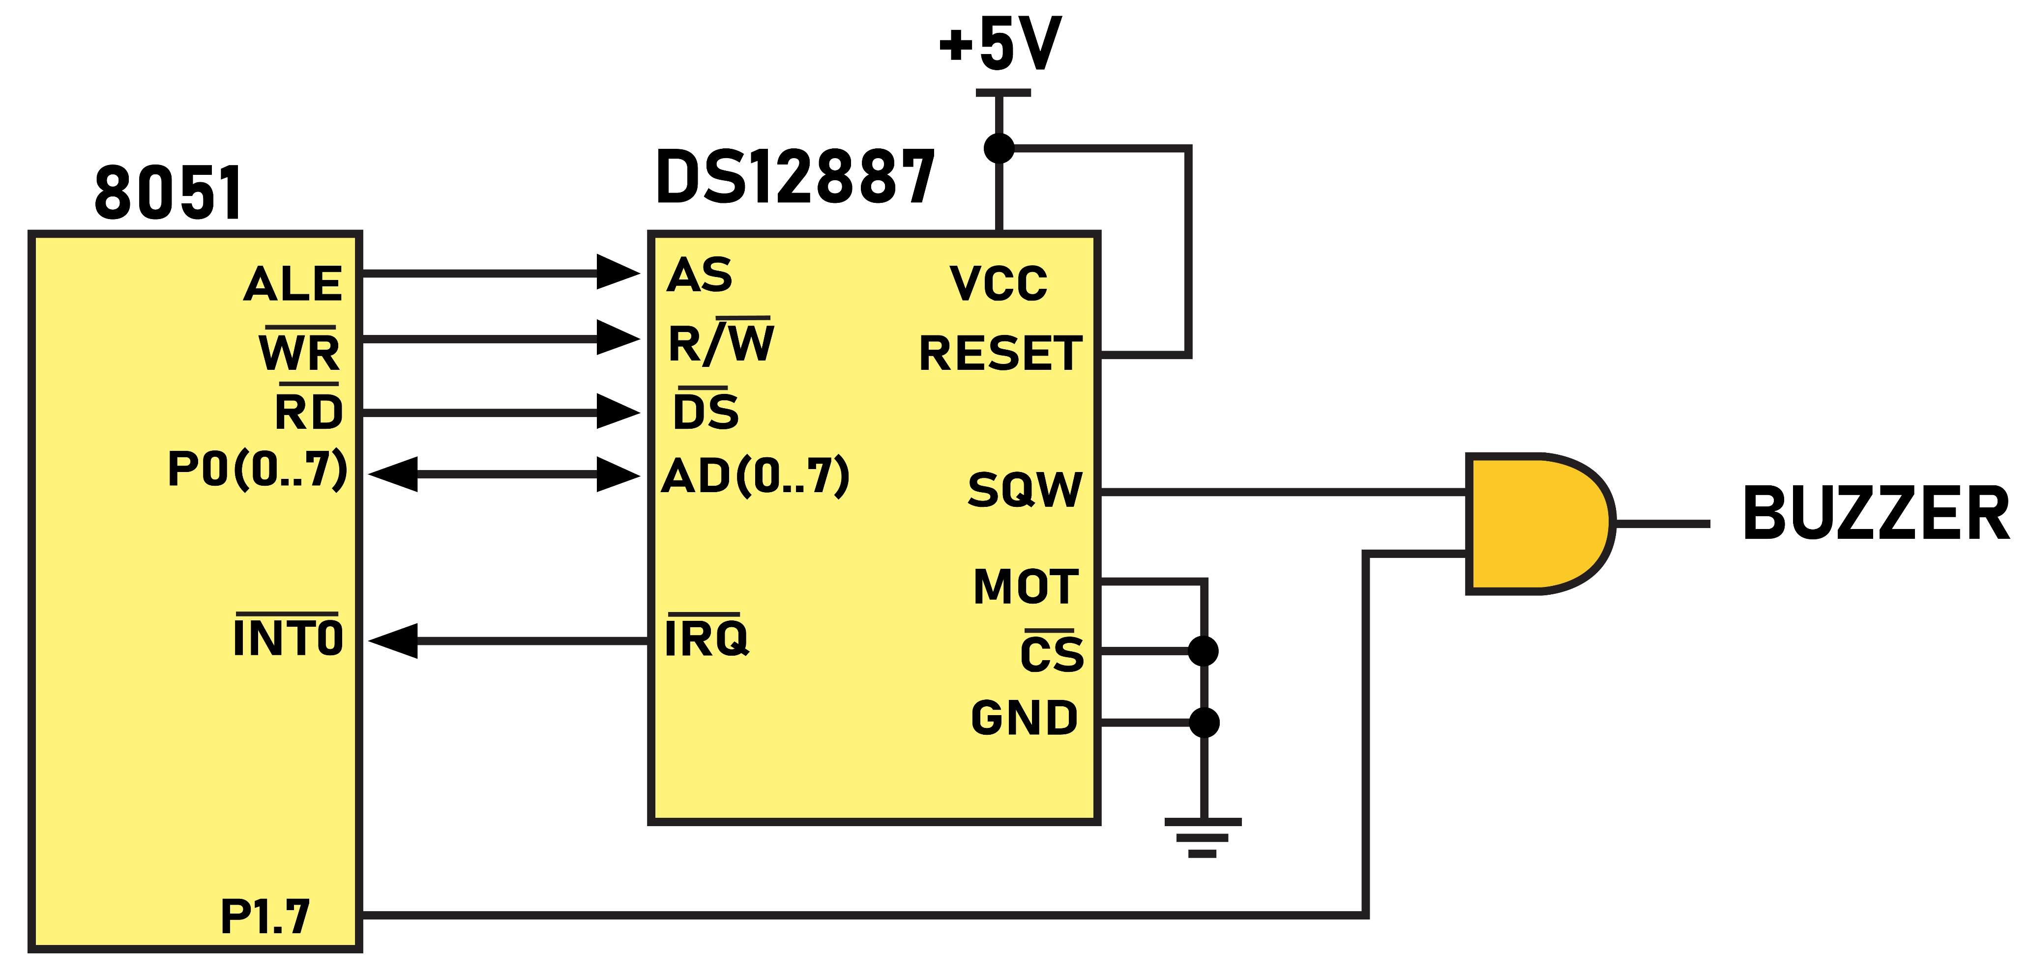
Figure 16-9. Using DS12887 IRQ to Activate an 8051 Interrupt

Slide 14

IRQF = 1: if PF = PIE = 1 or AF = AIE = 1 or UF = UIE = 1
(PIE, AIE, and UIE are the bits of Register B)
PF Periodic interrupt flag. Periodic interrupts can be generated at a rate of once every 500 ms to once every 122 µs. The rate is set by bits RS3 - RS0 of register A. The PF becomes 1 when an edge is detected for the period. We can poll this or, with the help of bit PIE of register B, the IRQ pin of DS12887 can be asserted low for the hardware interrupt version of this bit. This will be done if the PIF bit of Reg B is set to 1. That is, PF and PIE of register B together (if both are 1) will allow IRQ to be asserted low. Reading PF will clear it, and that is how we deassert the IRQ pin.
AF Alarm interrupt flag. The AF becomes 1 when the current real time matches the alarm time. AF and AIE of register B together (if both are 1) will allow the IRQ to be asserted low when all the three bytes of the real time (yy:mm:dd) are the same as the bytes in the alarm time. The AF also becomes 1 for cases of once per second, once per minute, and once per hour alarm. Reading AF will clear, it and that is how we deassert the IRQ pin.
UF See the DS12887 data sheet.
Figure 16-10. Register C bits for Interrupt Flag Sources

Slide 15

UIP Update in progress. This is a read-only bit.
DV2 DV1 DV0
0 1 0 will turn the oscillator on
RS3 RS2 RS1 RS0 T pi PERIODIC QW Output Freq.
INTERRUPT RATE
0 0 0 0 None None
0 0 0 1 3.9062 ms 256 Hz
0 0 1 0 7.812 ms 128 Hz
0 0 1 1 122.070 µs 8.192 kHz
0 1 0 0 244.141 µs 4.096 kHz
0 1 0 1 488.281 µs 2.048 kHz
0 1 1 0 976.5625 µs 1.024 kHz
0 1 1 1 1.953125 ms 512 Hz
1 0 0 0 3.90625 ms 256 Hz
1 0 0 1 7.8125 ms 128 Hz
1 0 1 0 15.625 ms 64 Hz
1 0 1 1 31.25 ms 32 Hz
1 1 0 0 62.5 ms 16 Hz
1 1 0 1 125 ms 8 Hz
1 1 1 0 250 ms 4 Hz
1 1 1 1 500 ms 2 Hz
Figure 16-11. Register A bits for Periodic Interrupt Rate

