Slide 1

THE 8051
MICROCONTROLLER & Embedded Systems
Muhammad Ali Mazidi, Janice Mazidi
& Rolin McKinlay

Slide 2
RELAY,
OPTOISOLATOR,
AND STEPPER MOTOR
Chapter 15

Slide 3
Objectives
Upon completion of this chapter, you will be able to:
>> Describe the basic operation of a relay
>> Interface the 8051 with a relay
>> Describe the basic operation of an optoisolator
>> Interface the 8051 with an optoisolator
>> Describe the basic operation of a stepper motor
>> Interface the 8051 with a stepper motor
>> Code 8051 programs to control and operate a stepper motor
>> Define stepper motor operation in terms of step angle, steps
per revolution, tooth pitch, rotation speed, and RPM

Slide 4
Objectives
Stepper motor control and 8051 interfacing with relays, optoisolators, and stepper motors,
Section 15.1, the basics of relays and optoisolators and their interfacing with the 8051,
Section 15.2, stepper motor interfacing with the 8051,
Both Assembly and C is used in the programming examples

Slide 5
Table 15-1: Selected DIP Relay Characteristics (www.Jameco.com)
Part No. Contact Form Coil Volts Coil Ohms Contact Volts-Current
106462CP SPST-NO 5VDC 500 100VDC-0.5A
138430CP SPST-NO 5VDC 500 100VDC-0.5A
106471CP SPST-NO 12VDC 1000 100VDC-0.5A
138448CP SPST-NO 12VDC 1000 100VDC-0.5A
129875CP DPDT 5VDC 62.5 30VDC-1A

Slide 6
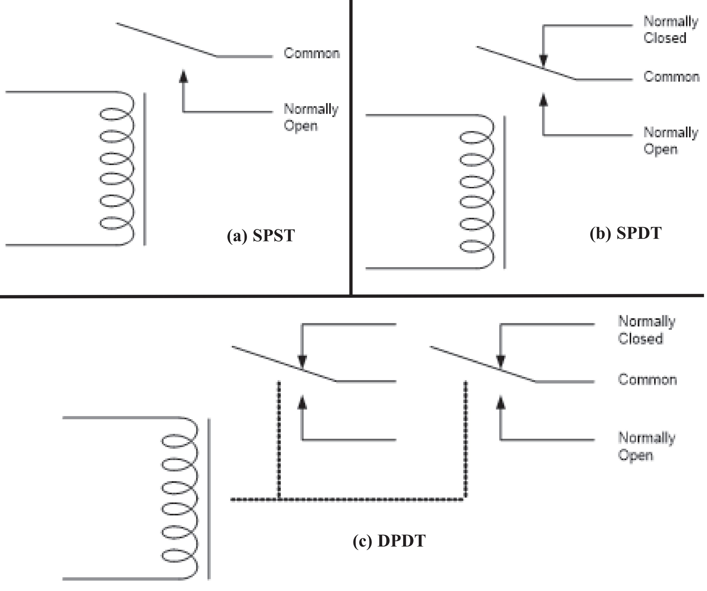
Figure 15-1. Relay Diagrams

Slide 7
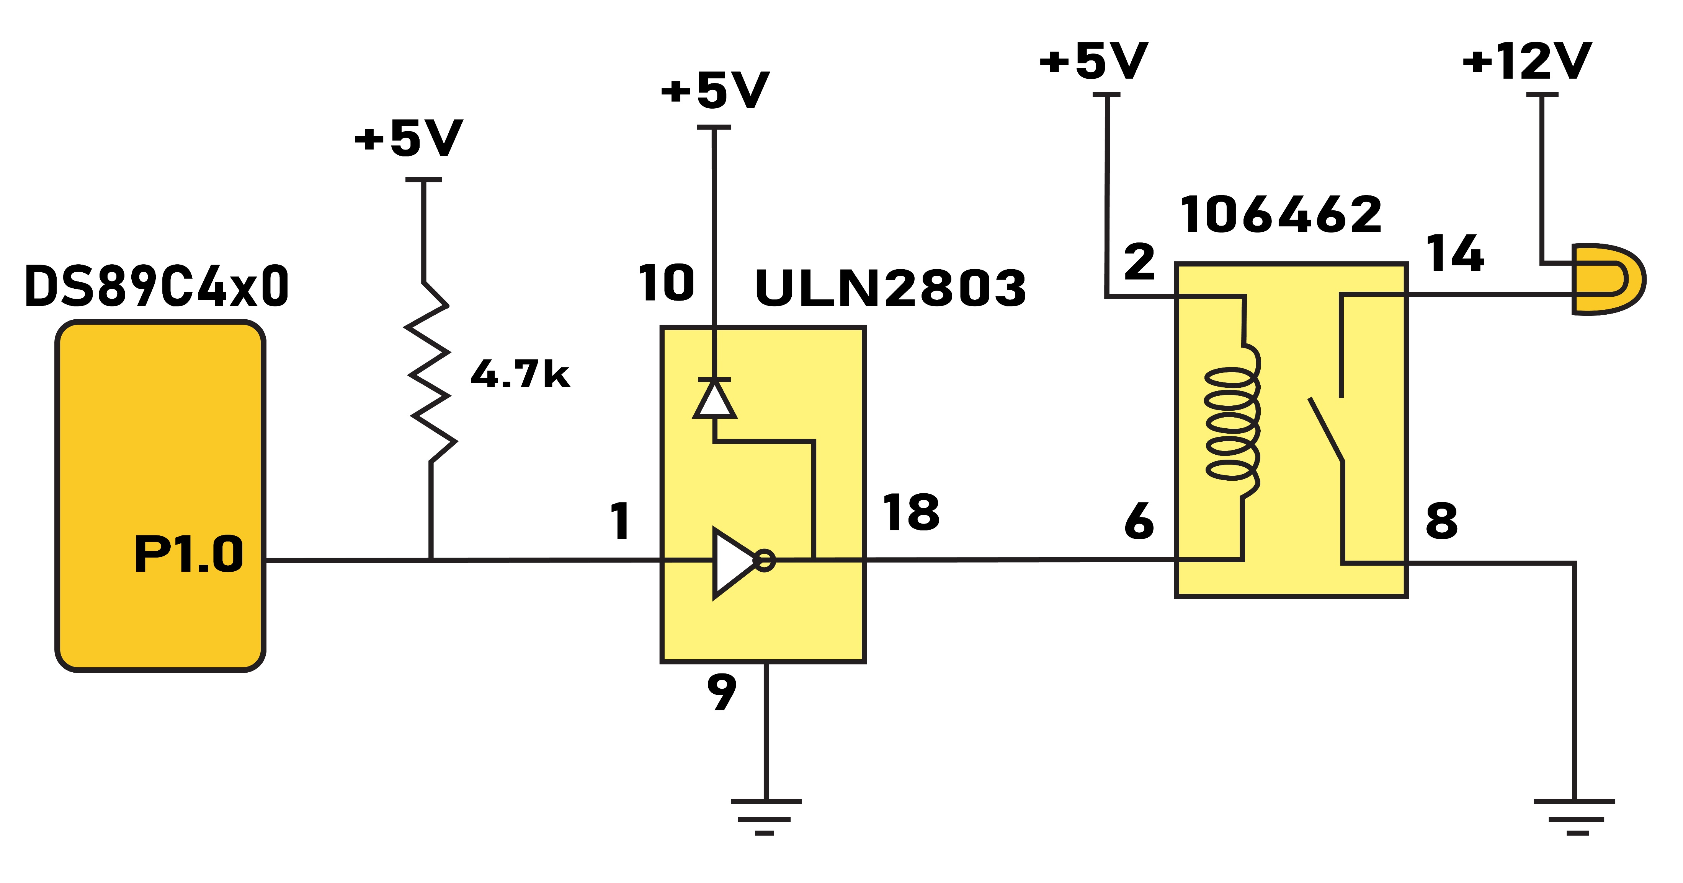
Figure 15-2. DS89C4x0 Connection to Relay

Slide 8
Table 15-2: Selected Solid-State Relay Characteristics (www.Jameco.com)
Part No. Contact Style Control Volts Contact Volts Contact Current
143058CP SPST 4-32VDC 240VAC 3A
139053CP SPST 3-32VDC 240VAC 25A
162341CP SPST 3-32VDC 240VAC 10A
172591CP SPST 3-32VDC 60VDC 2A
175222CP SPST 3-32VDC 60VDC 4A
176647CP SPST 3-32VDC 120VDC 5A

Slide 9
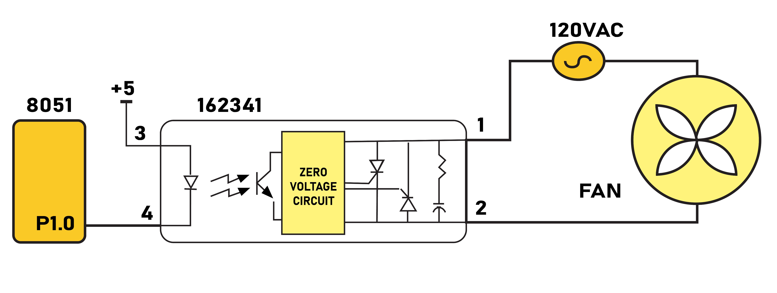
Figure 15-3. 8051 Connection to a Solid-State Relay

Slide 10
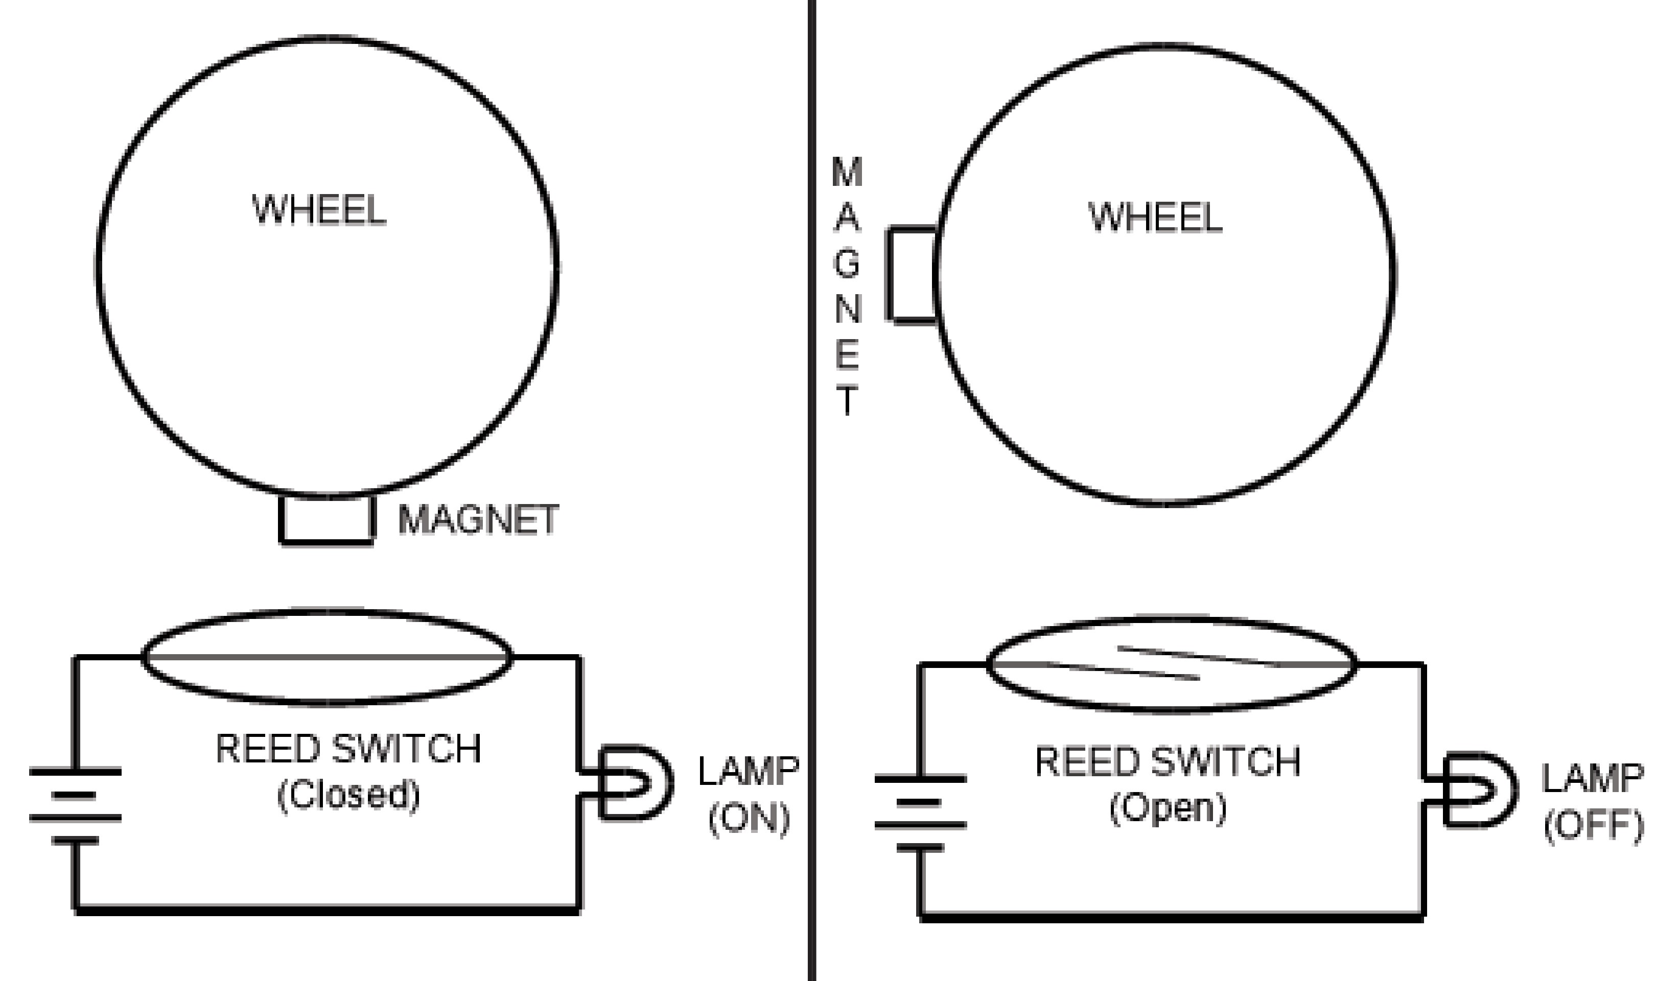
Figure 15-4. Reed Switch and Magnet Combination

Slide 11
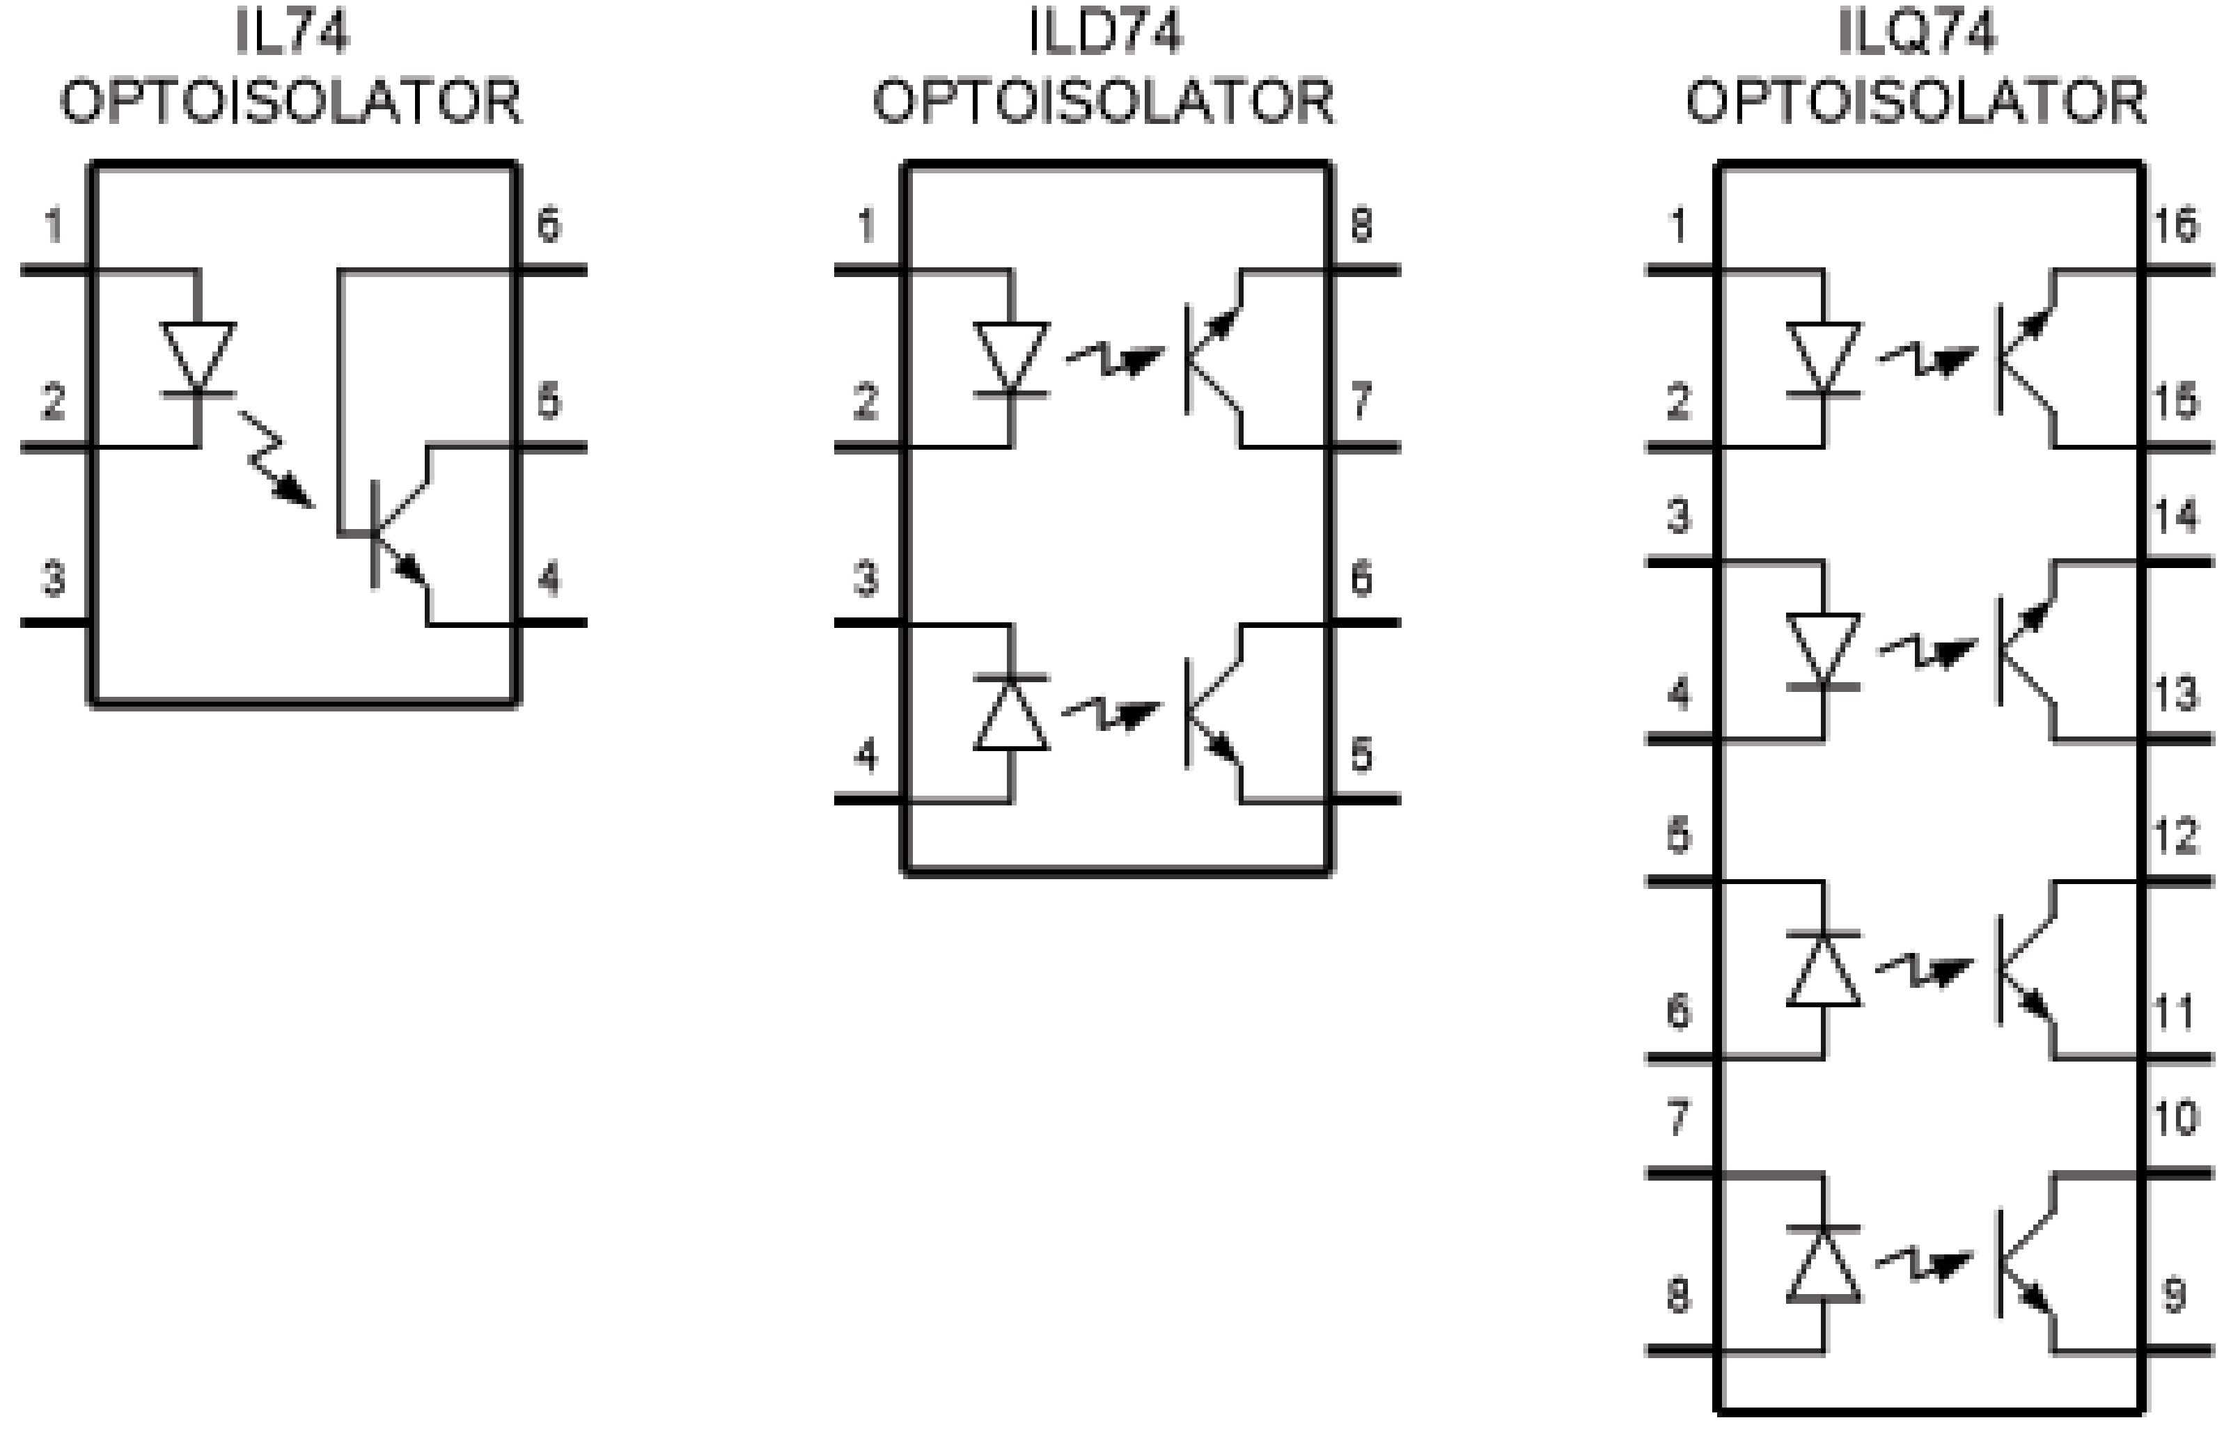
Figure 15-5. Optoisolator Package Examples

Slide 12
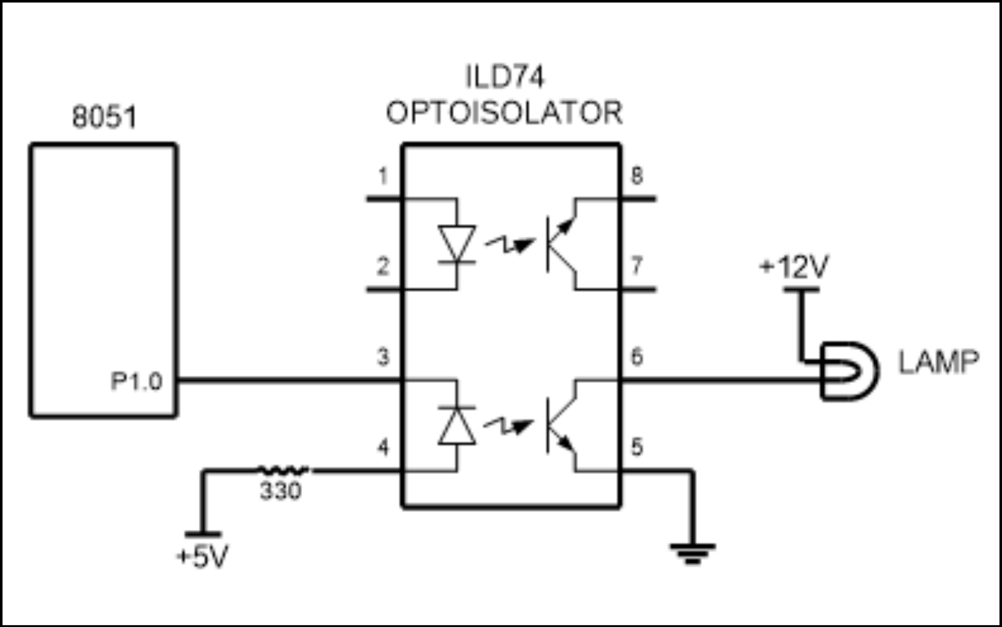
Figure 15-6. Controlling a Lamp via Optoisolator

Slide 13
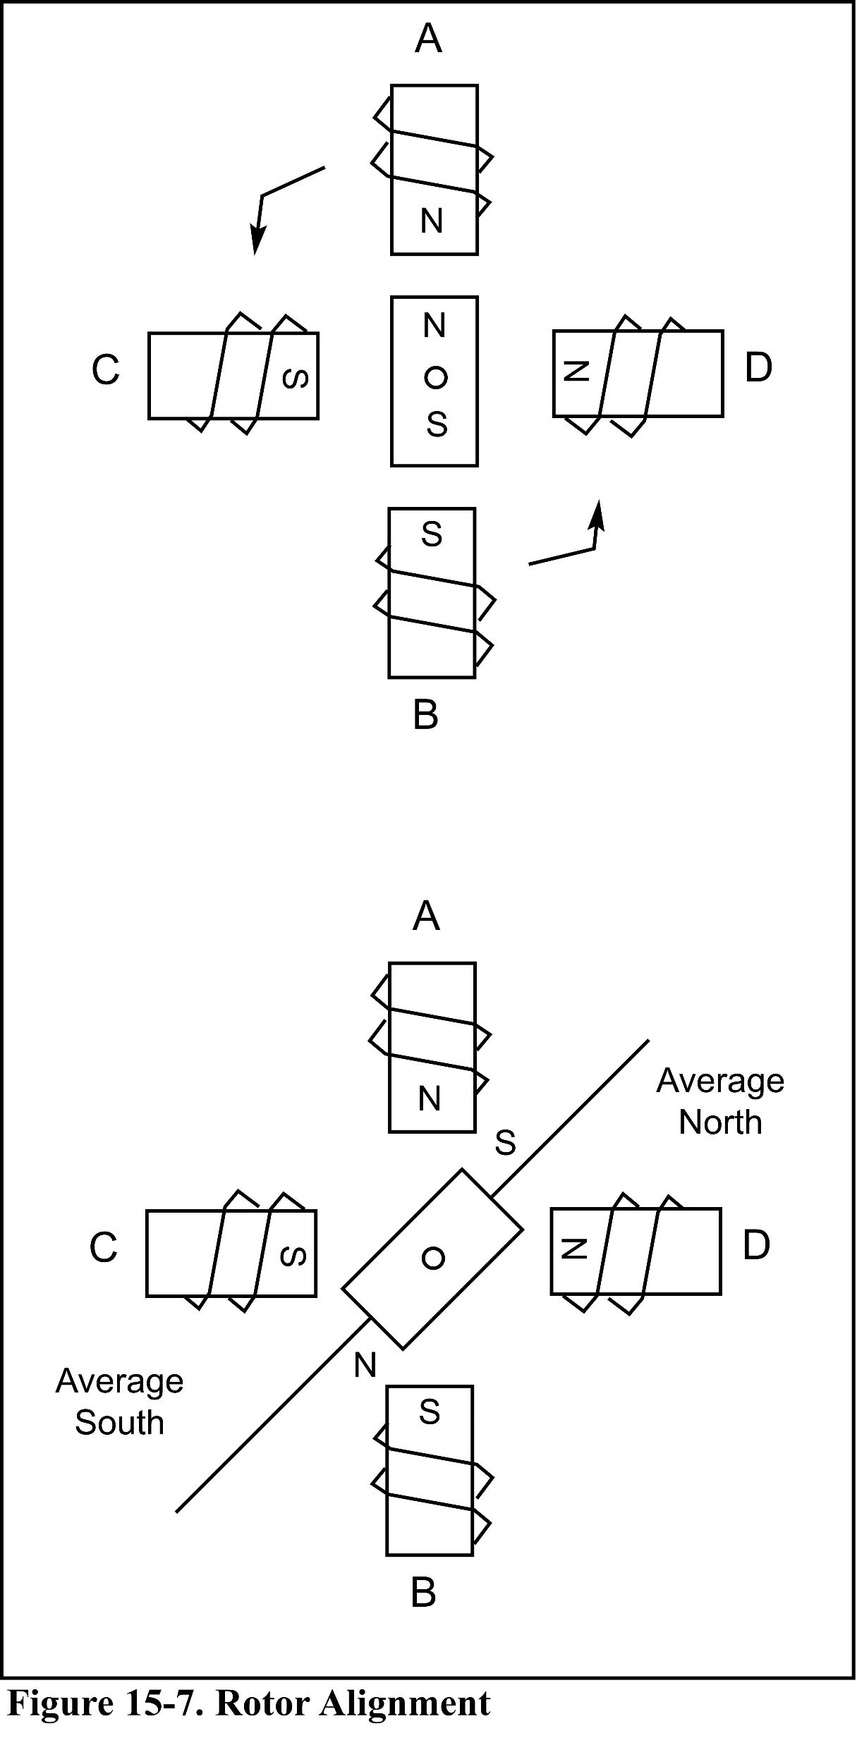
Figure 15-7. Rotor Alignment

Slide 14
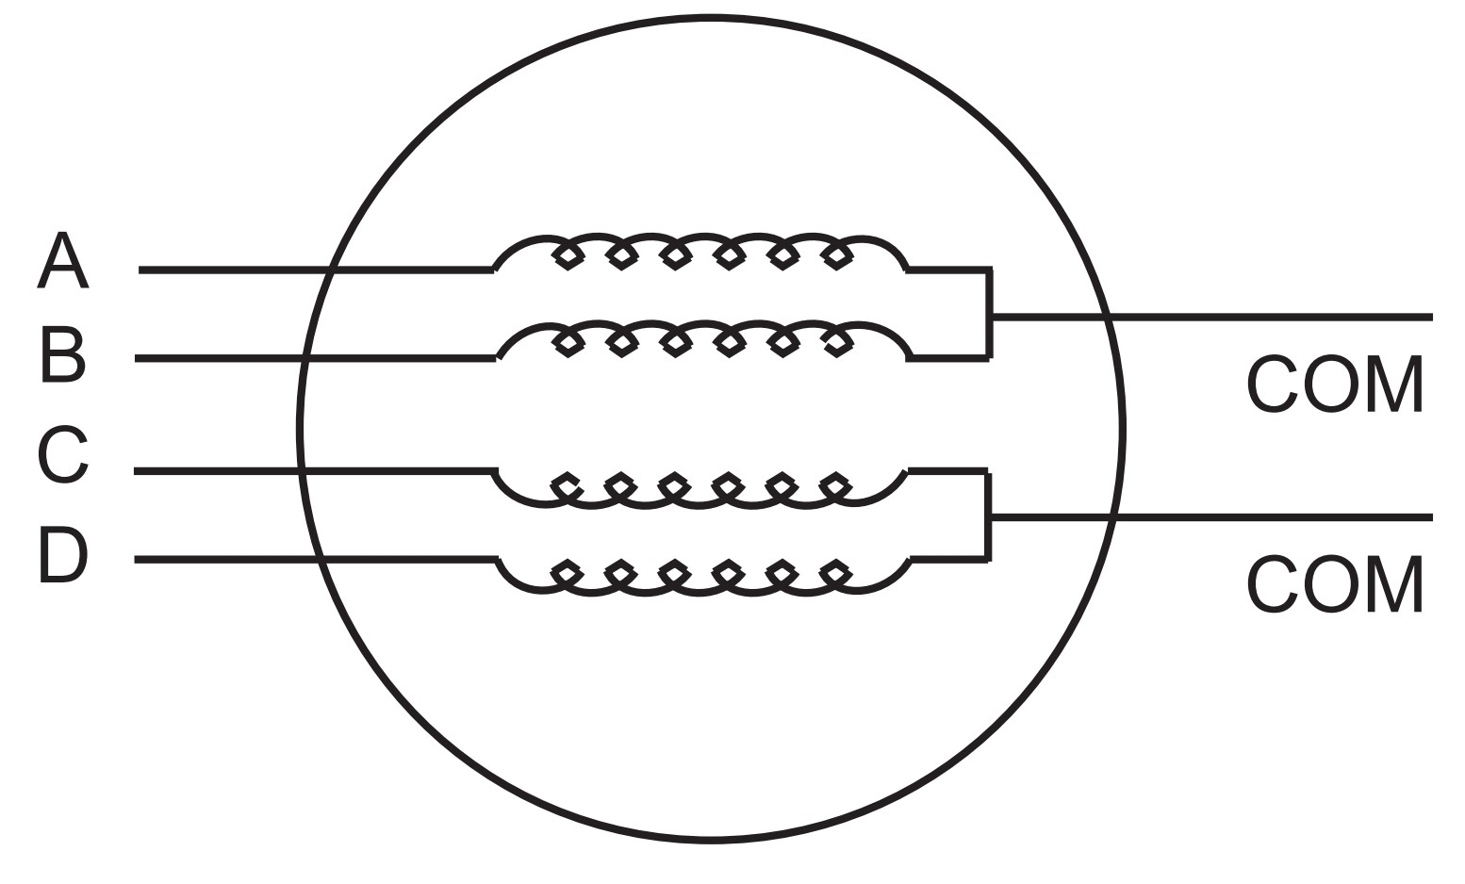
Figure 15-8. Stator Windings Configuration

Slide 15
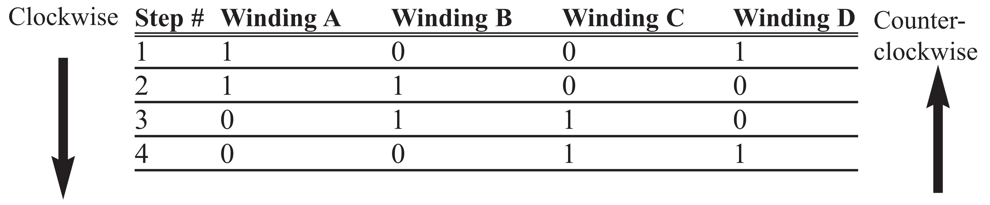
Table 15-3: Normal 4-Step Sequence

Slide 16
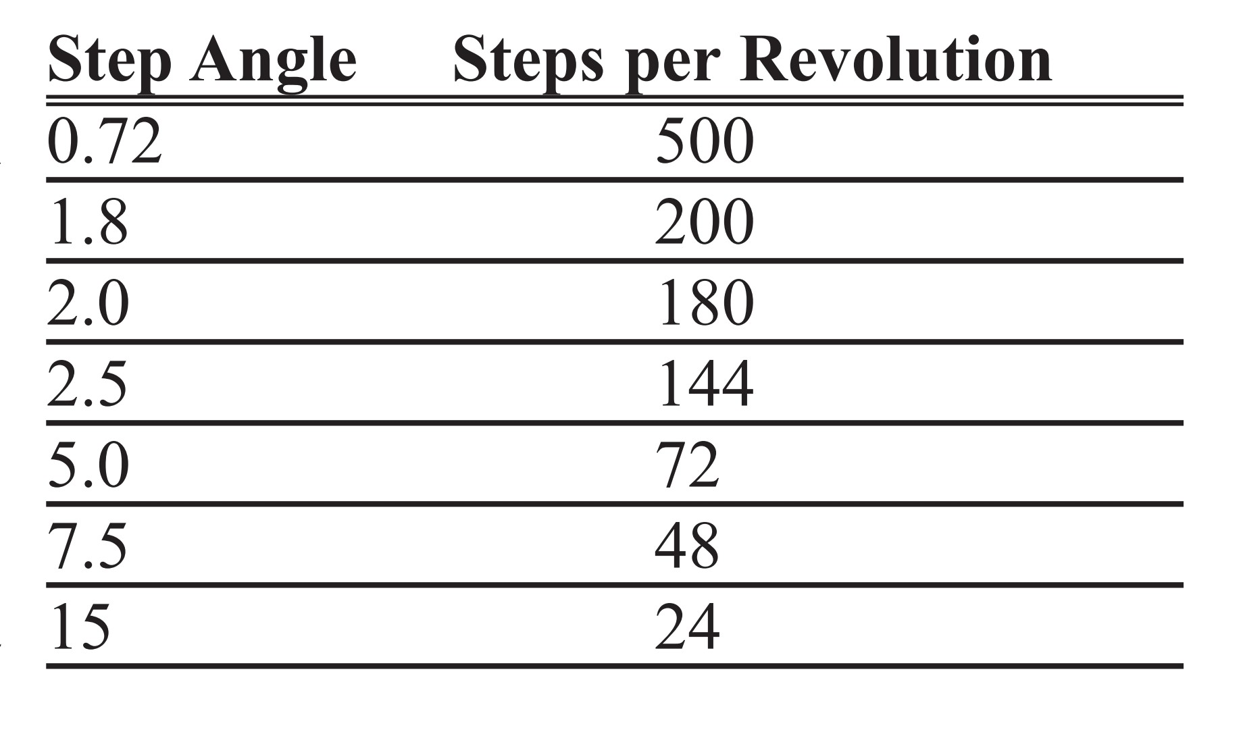
Table 15-4: Stepper Motor Step Angles

Slide 17
Describe the 8051 connection to the stepper motor of Figure 15-9 and code a program to rotate it continuously.
Example 15-1
Solution:
The following steps show the 8051 connection to the stepper motor and its programming.
1.Use an ohmmeter to measure the resistance of the leads. This should identify which COM leads are connected to which winding leads.
2. The common wire(s) are connected to the positive side of the motor's power supply. In many motors, +5 V is sufficient.
3. The four leads of the stator winding are controlled by four bits of the 8051 port (P1.0 - P1.3). However, since the 8051 lacks sufficient current to drive the stepper motor windings, we must use a driver such as the ULN2003 to energize the stator. Instead of the ULN2003, we could have used transistors as drivers, as shown in Figure 17-9. However, notice that if transistors are used as drivers, we must also use diodes to take care of inductive current generated when the coil is turned off. One reason that using the ULN2003 is preferable to the use of transistors as drivers is that the ULN2003 has an internal diode to take care of back EMF.
MOV A,#66H ;load step sequence
BACK: MOV P1,A ;issue sequence to motor
RR A ;rotate right clockwise
ACALL DELAY ;wait
SJMP BACK ;keep going
...
DELAY
MOV R2,#100
H1: MOV R3,#255
H2: DJNZ R3,H2
DJNZ R2,H1
RET
Change the value of DELAY to set the speed of rotation.
We can use the single-bit instructions SETB and CLR instead of RR A to create the sequences.

Slide 18
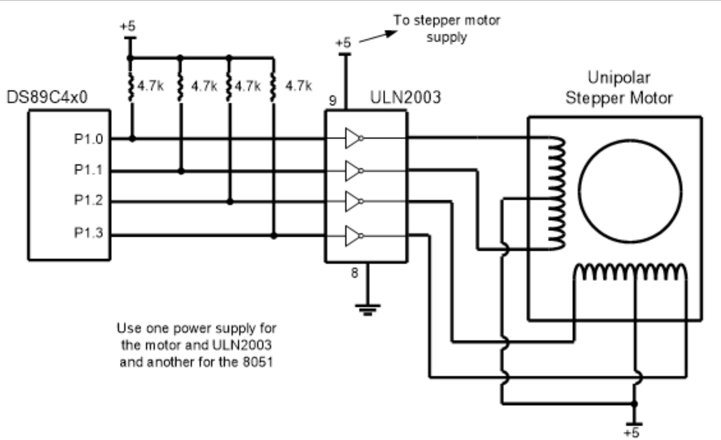
Figure 15-9. 8051 Connection to Stepper Motor

Slide 19
Example 15-2
Give the number of times the four-step sequence in Table 15-3 must be applied to a
stepper motor to make an 80-degree move if the motor has a 2-degree step angle.
Solution:
A motor with a 2-degree step angle has the following characteristics:
Step angle: 2 degrees Steps per revolution: 180
Number of rotor teeth: 45 Movement per 4-step sequence: 8 degrees
To move the rotor 80 degrees, we need to send 10 consecutive four-step sequences, since 10 x 4 steps x 2 degrees = 80 degrees.

Slide 20
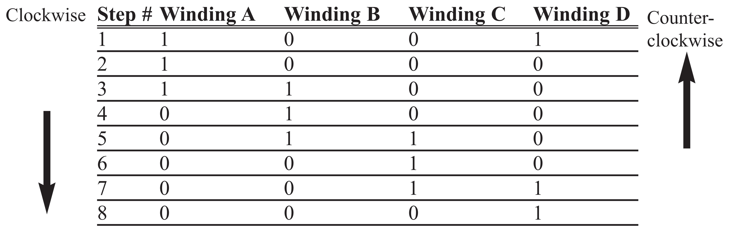
Table 15-5: Half-Step 8-Step Sequence

Slide 21
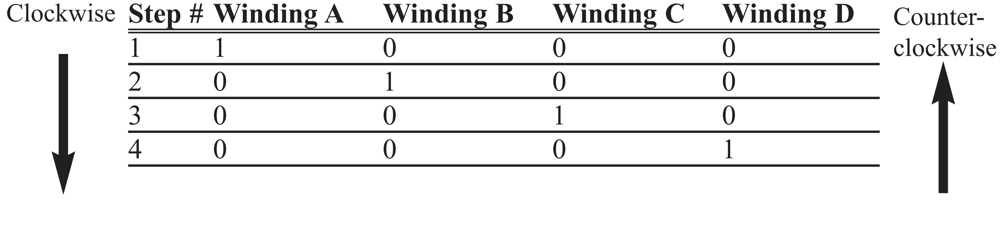
Table 15-6: Wave Drive 4-Step Sequence

Slide 22
Table 15-7: Selected Solid-State Relay Characteristics (www.Jameco.com)
Part No. Step Angle Drive System Volts Phase Resistance Current
151861CP 7.5 unipolar 5 V 9 ohms 550 mA
171601CP 3.6 unipolar 7 V 20 ohms 350 mA
164056CP 7.5 bipolar 5 V 6 mA 800 mA

Slide 23
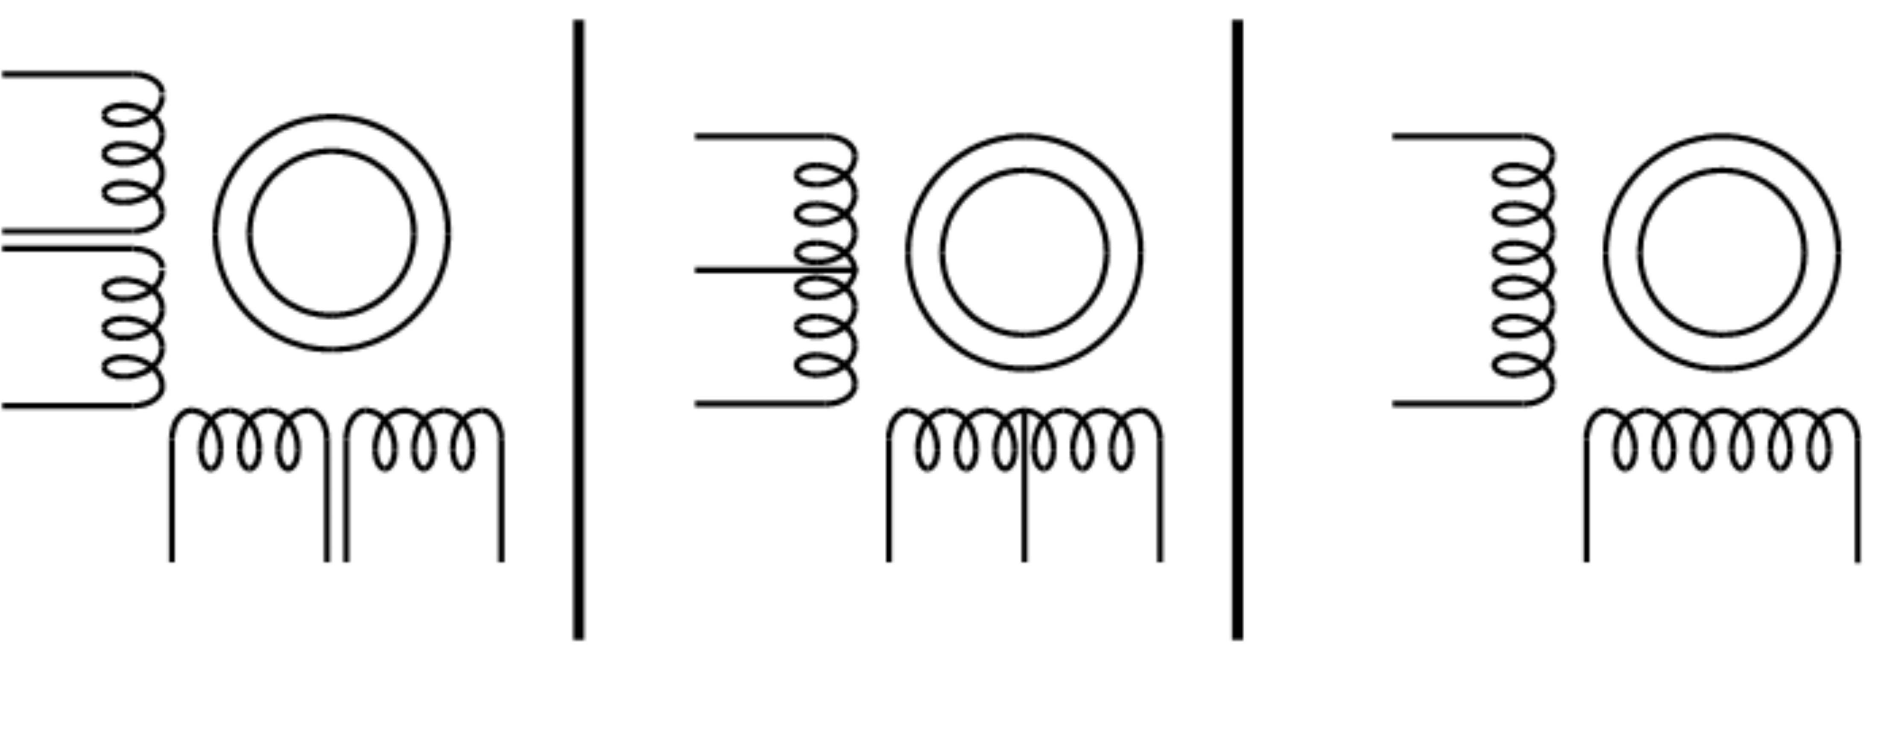

Figure 15-10. Common Stepper Motor Types

Slide 24
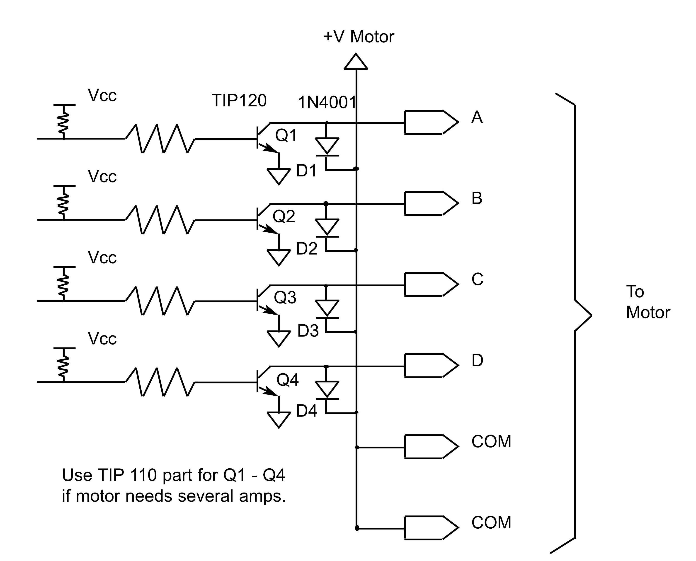
Figure 15-11. Using Transistors for Stepper Motor Driver

Slide 25
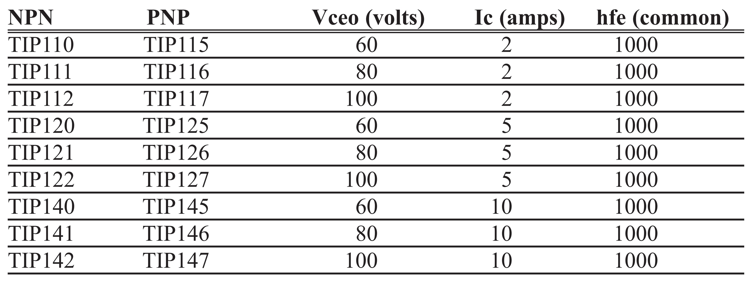
Table 15-8: Darlington Transistor Listing

Slide 26
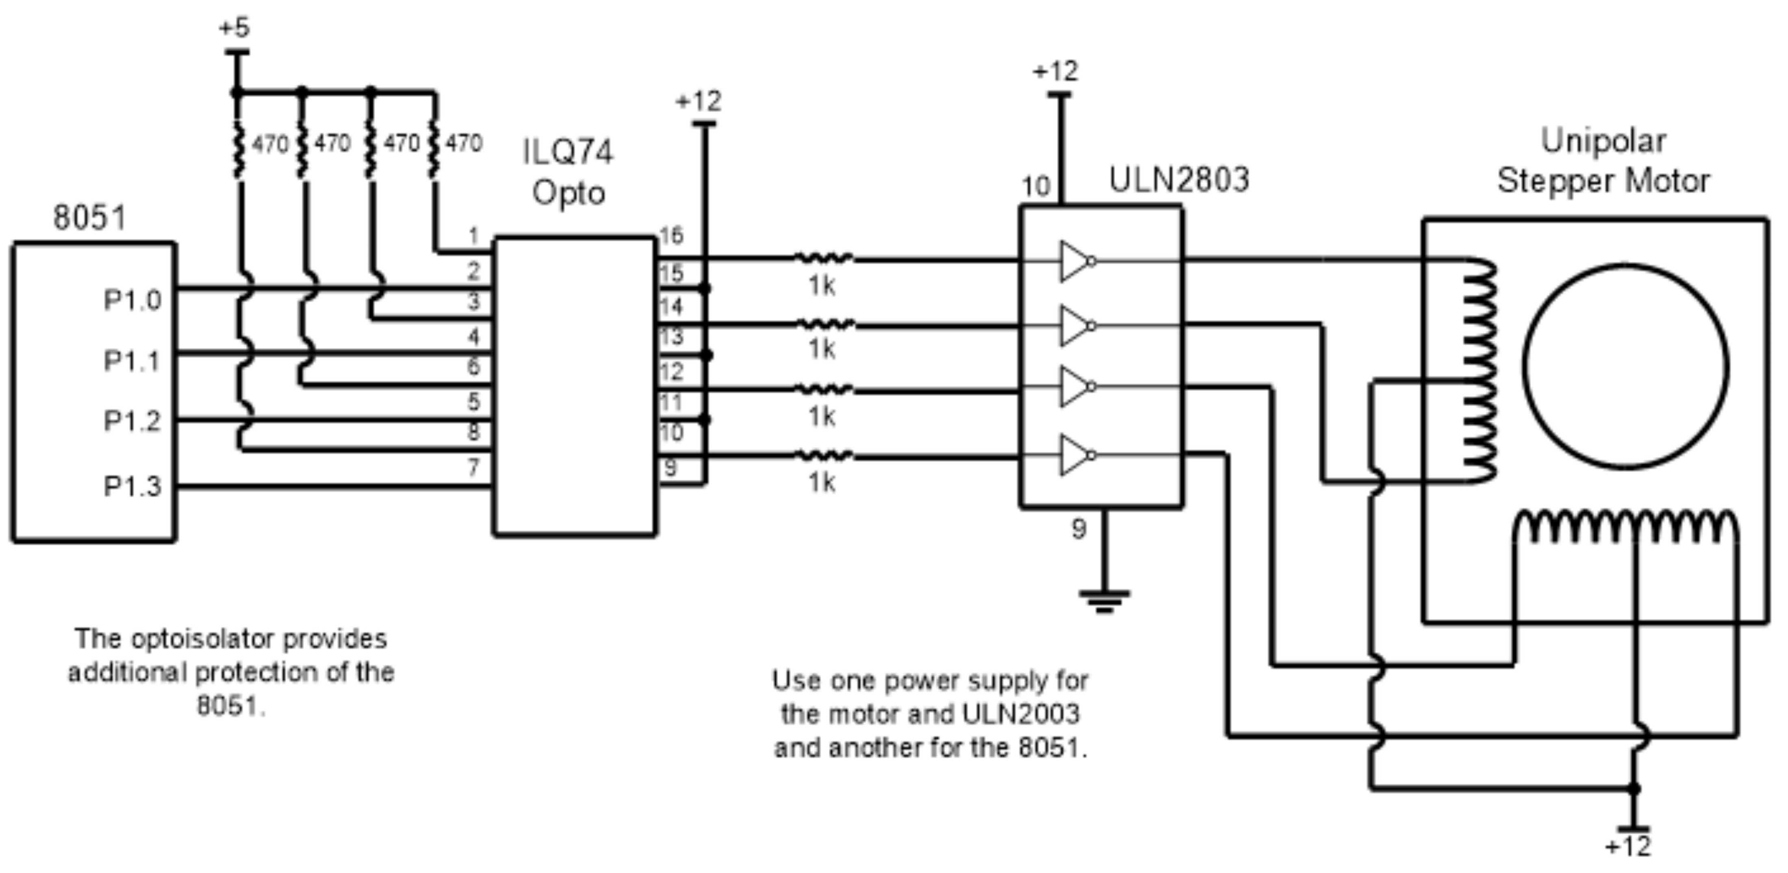
Figure 15-12. Controlling Stepper Motor via Optoisolator

Slide 27
Example 15-3
A switch is connected to pin P2.7. Write a program to monitor the status of SW and perform the following: (a) If SW = 0, the stepper motor moves clockwise. (b) If SW = 1, the stepper motor moves counterclockwise.
Solution:
ORG 0H ;starting address
MAIN: SETB P2.7 ;make an input
MOV A, #66H ;starting phase value
MOV P1, A ;send value to port
TURN:
JNB P2.7, CW ;check switch result
RR A ;rotate right
ACALL DELAY ;call delay
MOV P1,A ;write value to port
SJMP TURN ;repeat
CW: RL A ;rotate left
ACALL DELAY ;call delay
MOV P1,A ;write value to port
SJMP TURN ;repeat
DELAY:
MOV R2, #100
H1: MOV R3, #255
H2: DJNZ R3, H2
DJNZ R2,H1
RET
END

Slide 28
#include <reg.h>
sbit SW=P2^7;
void main()
{
SW = 1;
while(1)
{
if(SW == 0)
{
P1 = 0x66;
MSDelay(100);
P1 = 0xCC;
MSDelay(100);
P1 = 0x99;
MSDelay(100);
P1 = 0x33;
MSDelay(100);
}
else
{
P1 = 0x66;
MSDelay(100);
P1 = 0x33;
MSDelay(100);
P1 = 0x99;
MSDelay(100);
P1 = 0xCC;
MSDelay(100);
}
}
}
void MSDelay(unsigned int value)
{
unsigned int x, y;
for(x=0;x<1275;x++)
for(y=0;y<value;y++);
}
Solution:
Example 15-4
A switch is connected to pin P2.7. Write a C program to monitor the status of SW and perform the following:
(a) If SW = 0, the stepper motor moves clockwise.
(b) If SW = 1, the stepper motor moves counterclockwise.

